Slide 1
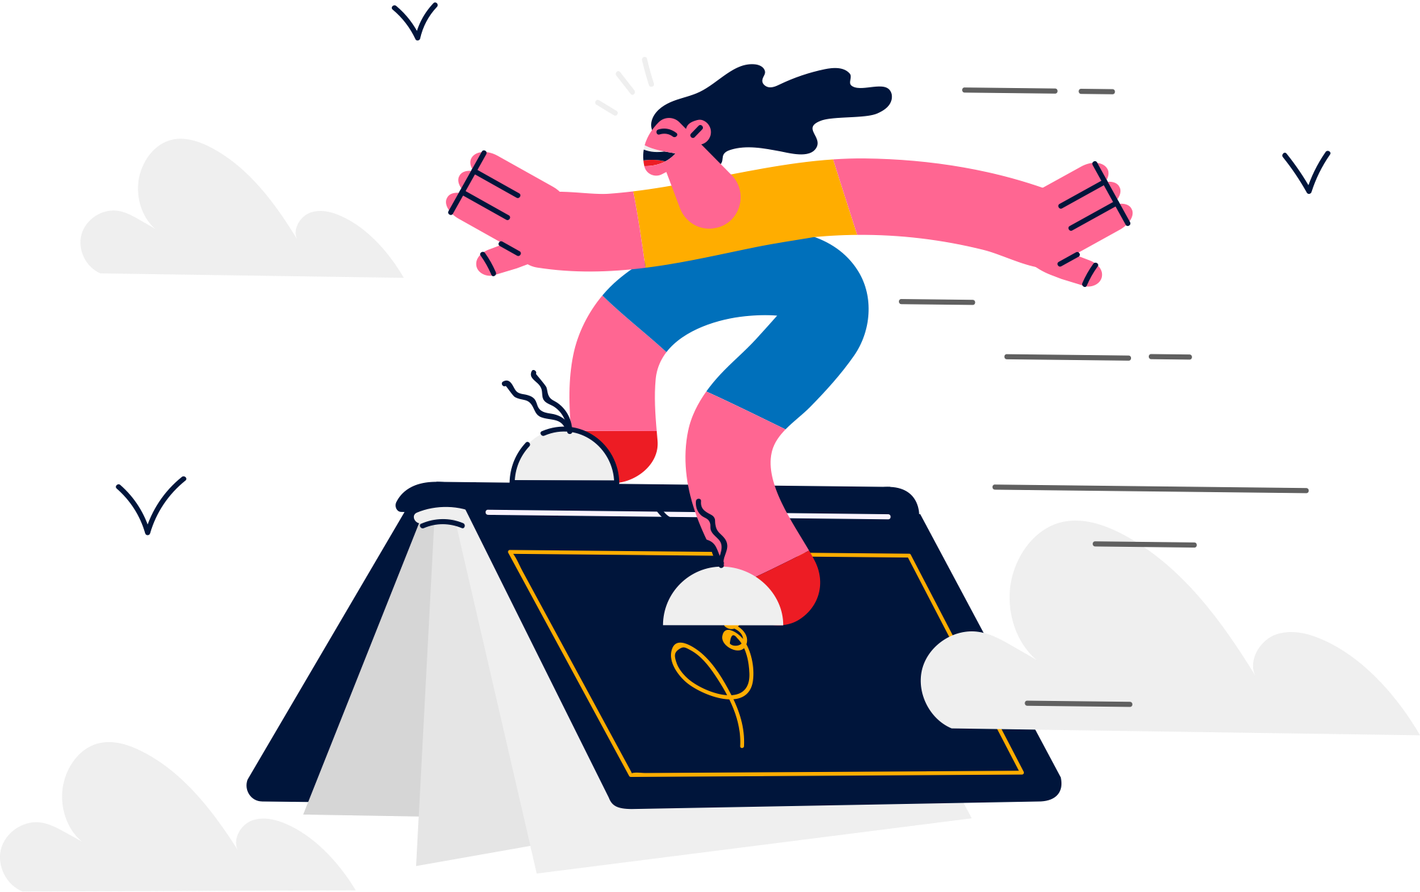
LESSON 1.3
DIGITAL MEDIA LITERACY
The Great Digital Library
What can we learn on the internet?

Slide 2
What types of information can be found online
What are we learning today?
Sorting information into facts, opinions, and stories

Slide 3
WARM UP QUESTION
What types of things can we learn about on the internet?

Slide 4
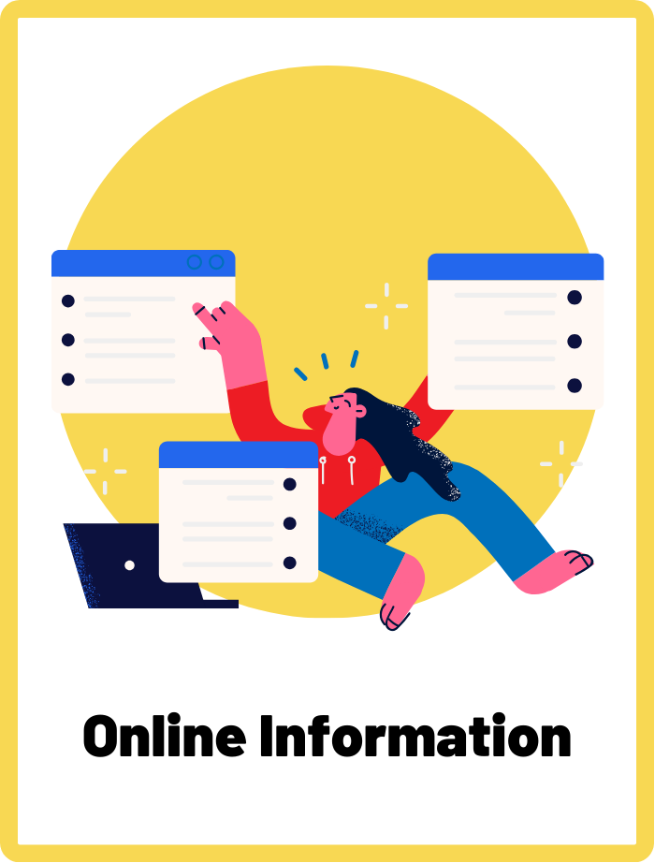
Online Information
Data or content available on the internet, which can be in various forms like text, images, videos, and more.

Slide 5

What kind of information can we find on the internet?
There are millions of things you can find on the internet, like stories, pictures, videos, and information!

Slide 6
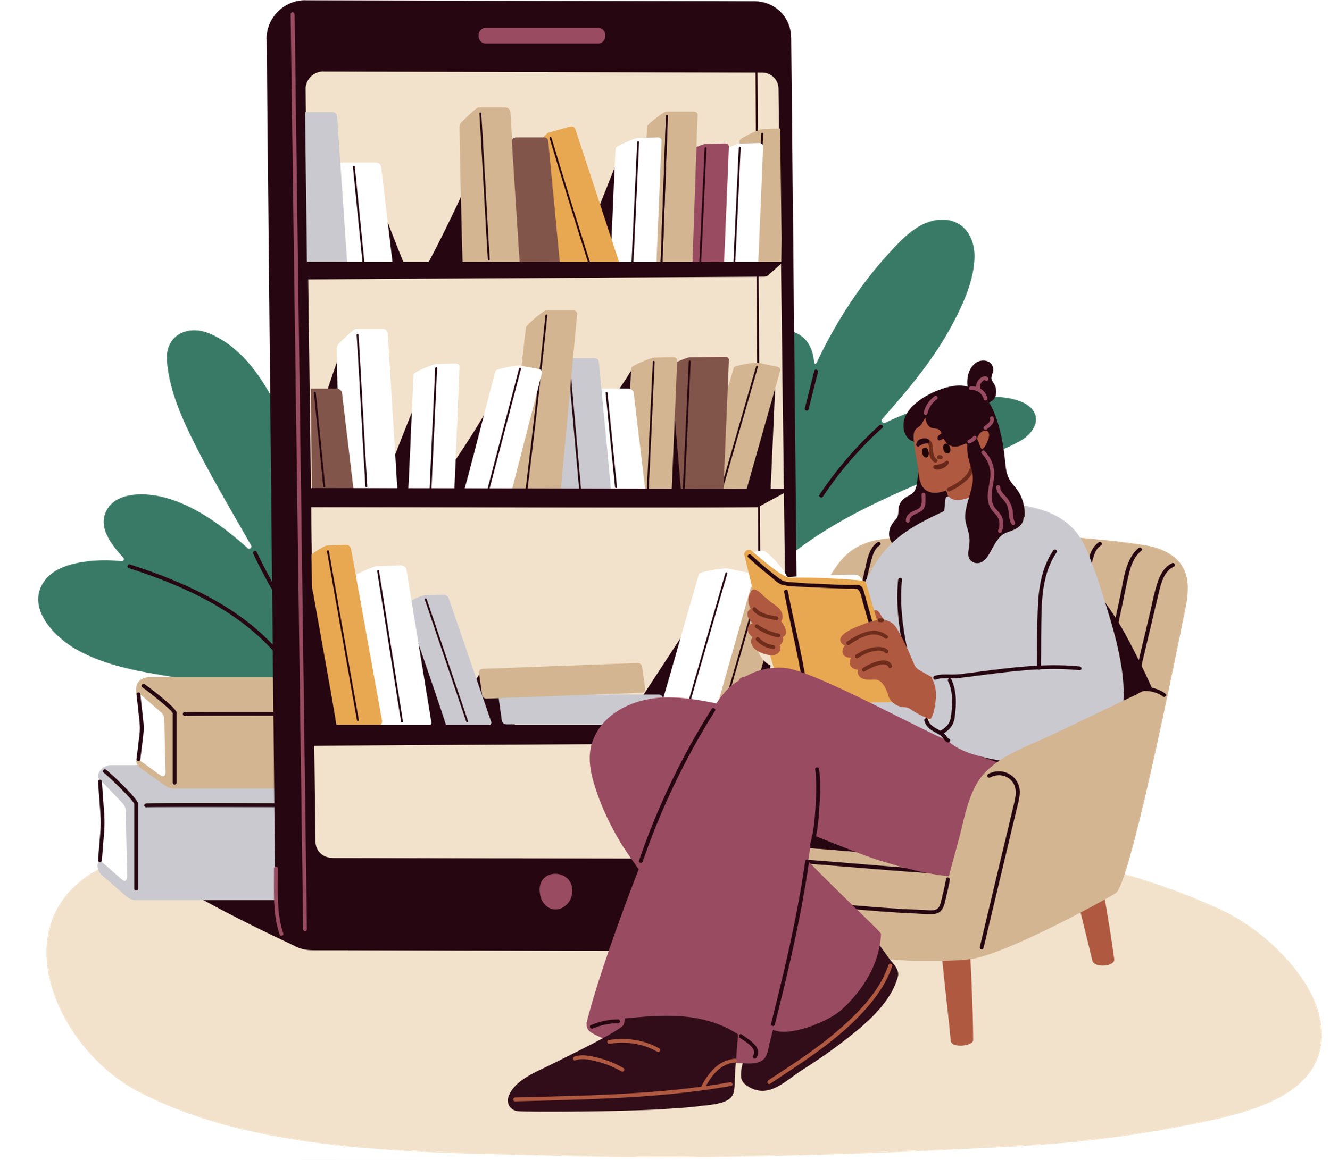
How do we use the internet to learn new things?
The internet is like a huge library full of interesting things. We use it to learn new things, find answers to our questions, and have fun.
It helps us discover cool facts and stories from all around the world!

Slide 7


Don’t believe everything you see online!
Not everything we read or see online is the same. Some things are facts, some are what people think, and some are just stories.

Slide 8
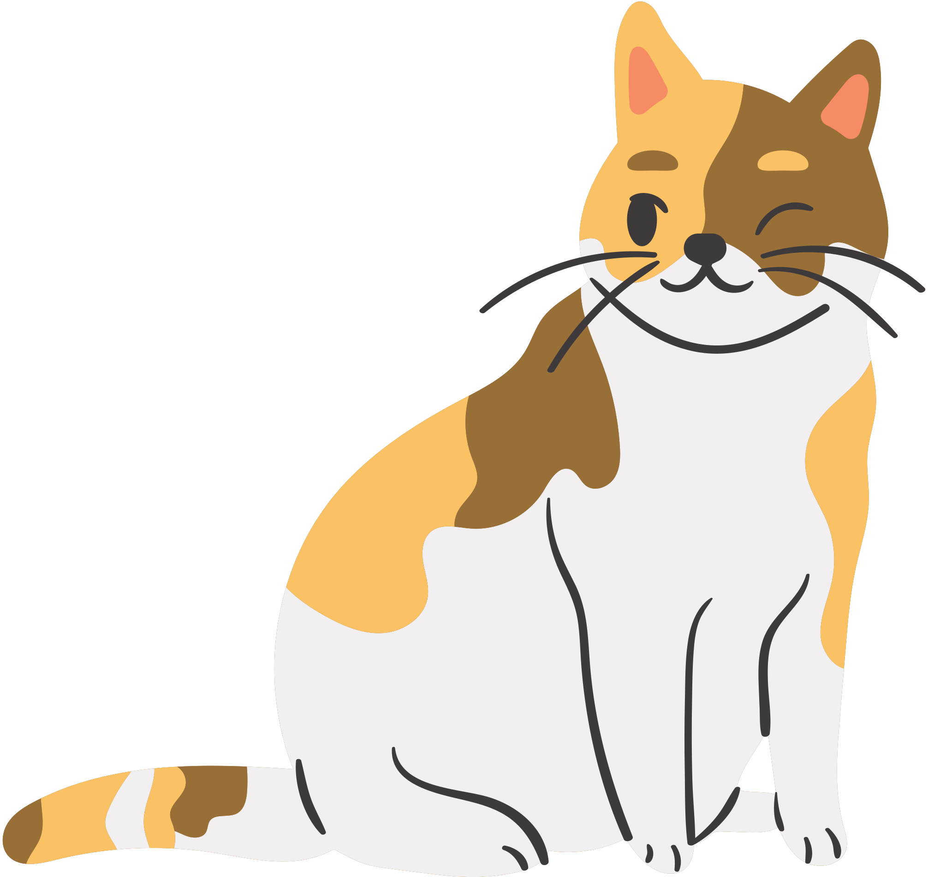


Facts, Opinions, and Stories
“A cat has four legs.”
“Chocolate ice cream is the best!”
“The Little Mermaid”
Fact
Opinion
Story

Slide 9

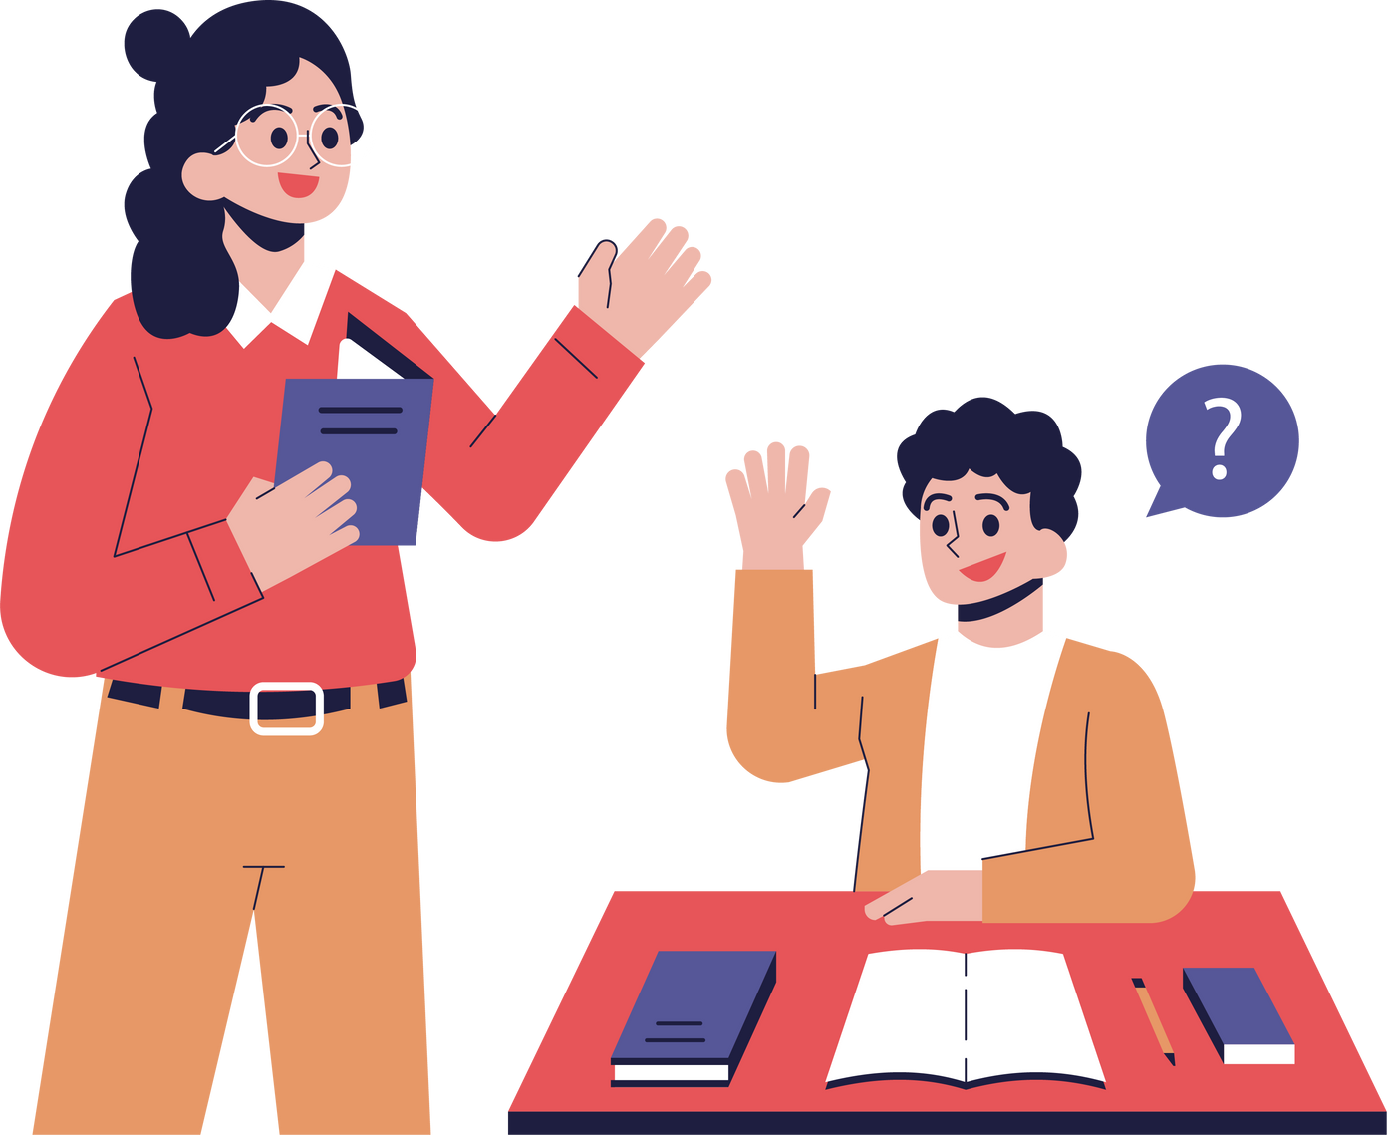
Ask for Help!
If you see something online that you’re not too sure if it’s real or not, ask grown-ups or teachers for help.

Slide 10
ACTIVITY
Sort It Out!
Can you sort the information into facts, opinions, and stories?

Slide 11
Your Mission
Look at each example and decide which group they belong to!
Ready? Let’s Play!

Slide 12
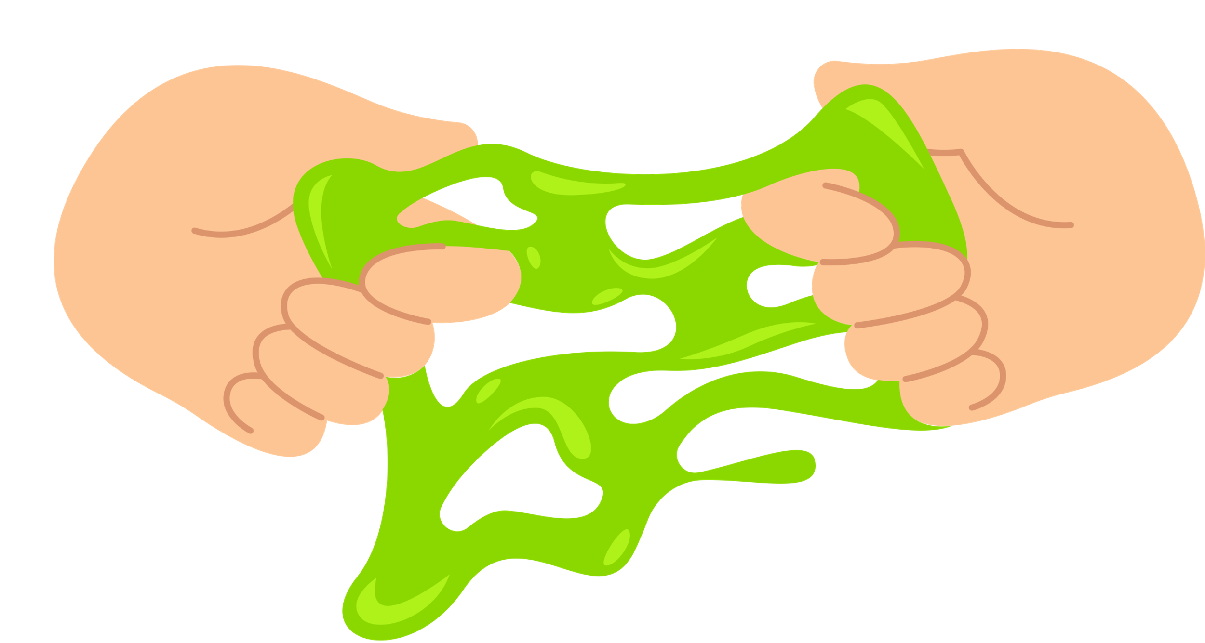
QUESTION 1
Slime is the best toy ever!
Fact?
Opinion?
Story?

Slide 13
QUESTION 1
Slime is the best toy ever!
Opinion!

Slide 14

QUESTION 2
The moon only comes out at night.
Fact?
Opinion?
Story?

Slide 15
QUESTION 2
The moon only comes out at night.
Fact!

Slide 16
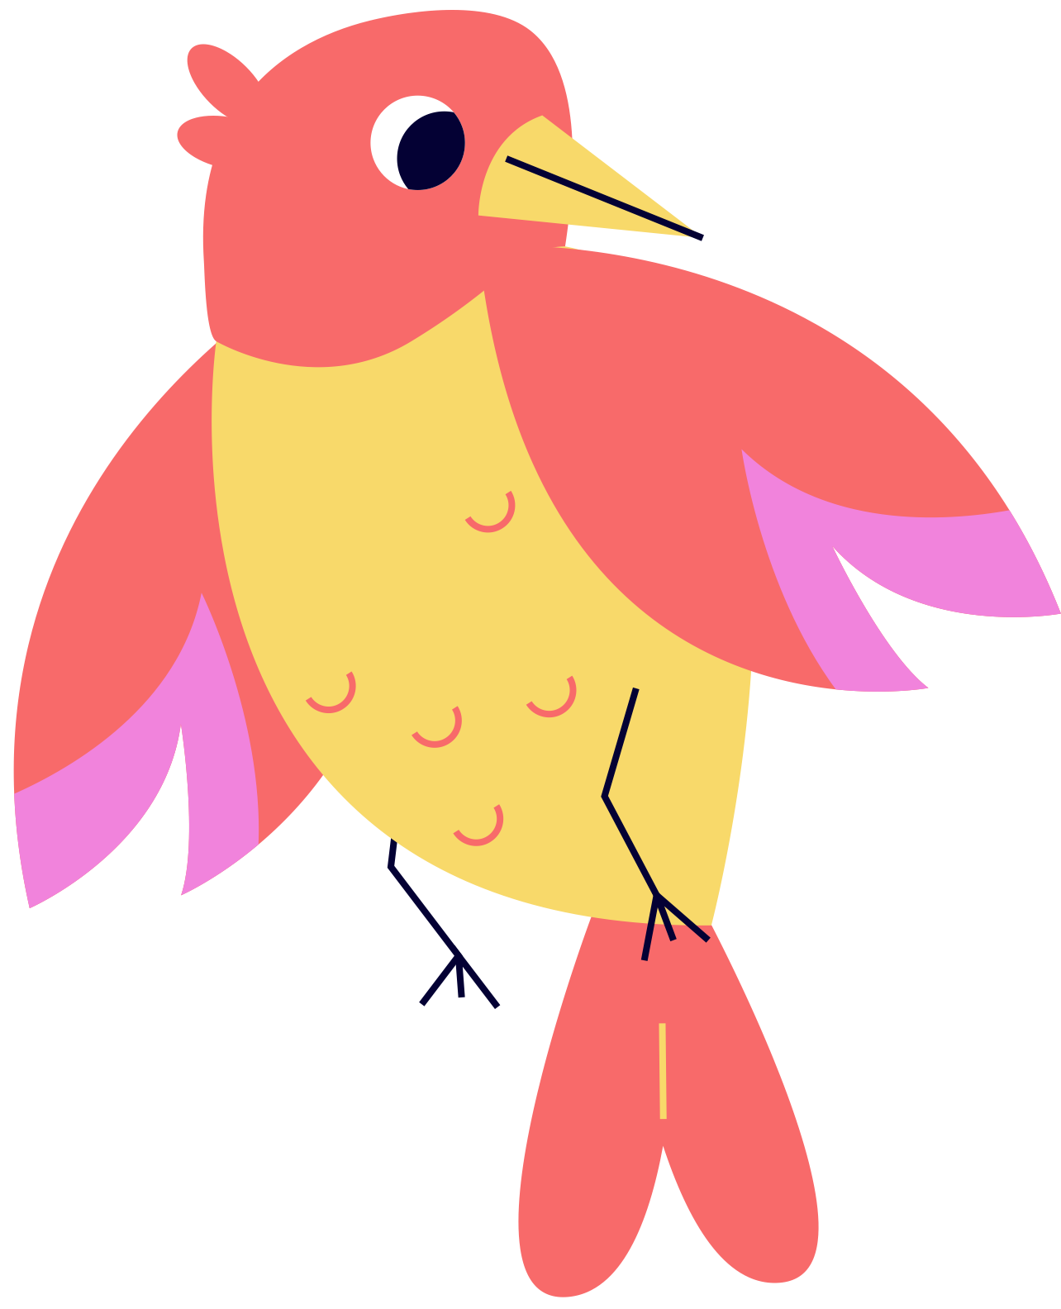
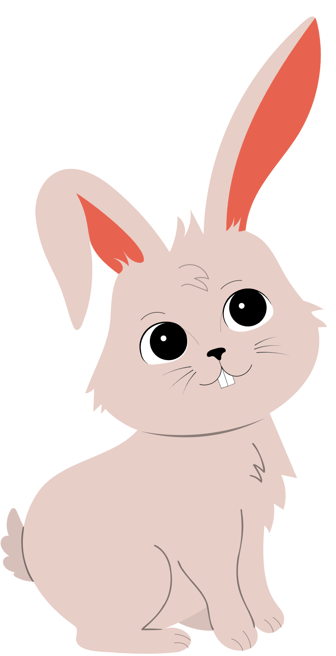

QUESTION 3
Harry is a rabbit who became friends with a bird named Soren in the woods.
Fact?
Opinion?
Story?

Slide 17
QUESTION 3
Harry is a rabbit who became friends with a bird named Soren in the woods.
Story!

Slide 18
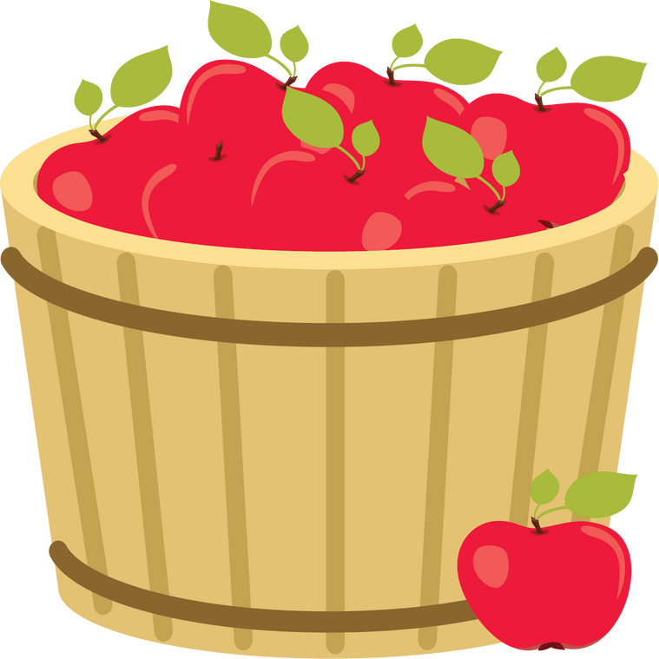

QUESTION 4
Apples and bananas grow on trees.
Fact?
Opinion?
Story?

Slide 19
QUESTION 4
Apples and bananas grow on trees.
Fact!

Slide 20

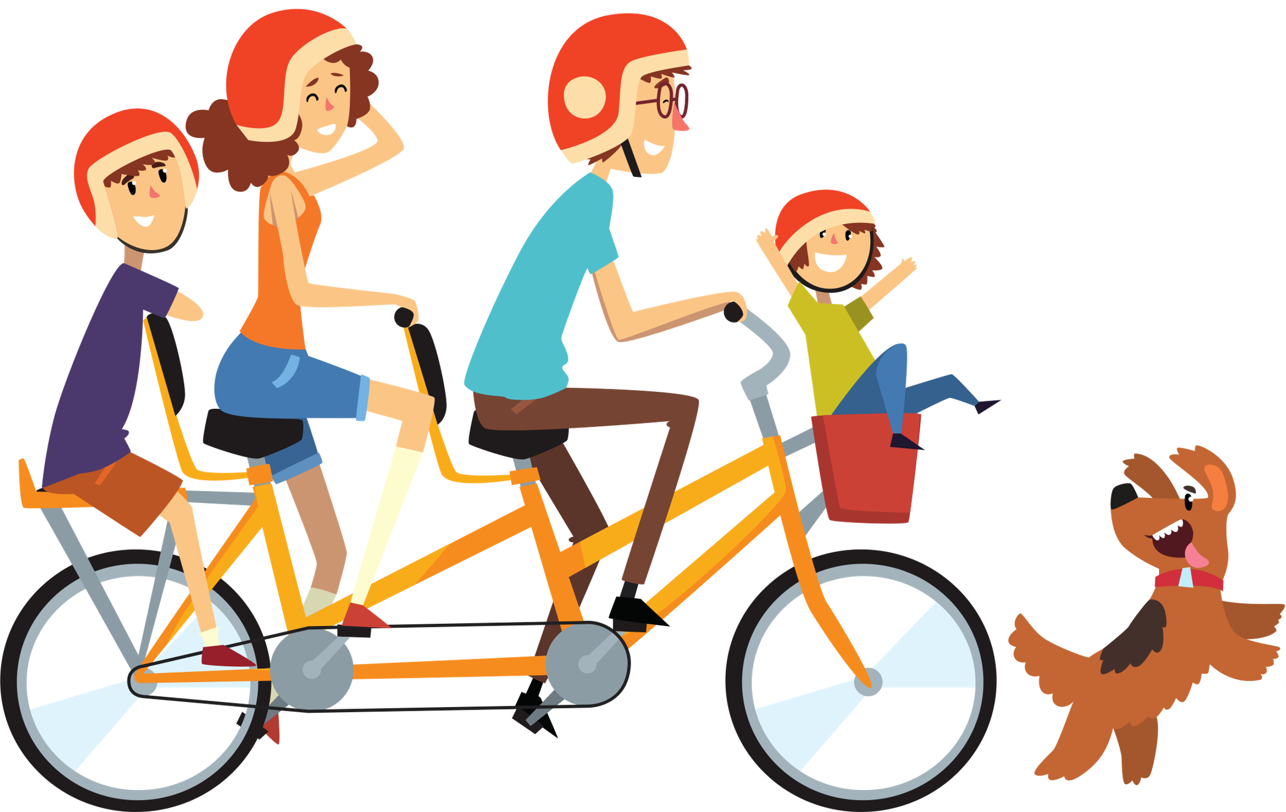
QUESTION 5
Sunday is the best day of the week.
Fact?
Opinion?
Story?

Slide 21
QUESTION 5
Sunday is the best day of the week.
Opinion!

Slide 22
WRAP UP
What have you learned today?
Let’s reflect on today’s lesson.

Slide 23
Remember This!
  Not everything we read or see online is the same. Some things are facts, some are what people think, and some are just stories.
  If you’re ever confused about something you’ve seen online, ask a grown-up or teacher for help!

Slide 24
LESSON 1.3
Well Done!

