Slide 1
Secret’s Out:
Becoming an Upstander
Lesson 13.06.02
CYBERBULLYING & ABUSE
EXERCISE-IN-A-BOX

Slide 2

Do you think cyberbullying is different from bullying in person?
WARM-UP

Slide 3
Have you ever seen someone being cyberbullied online? What did you do in that situation?
WARM-UP

Slide 4

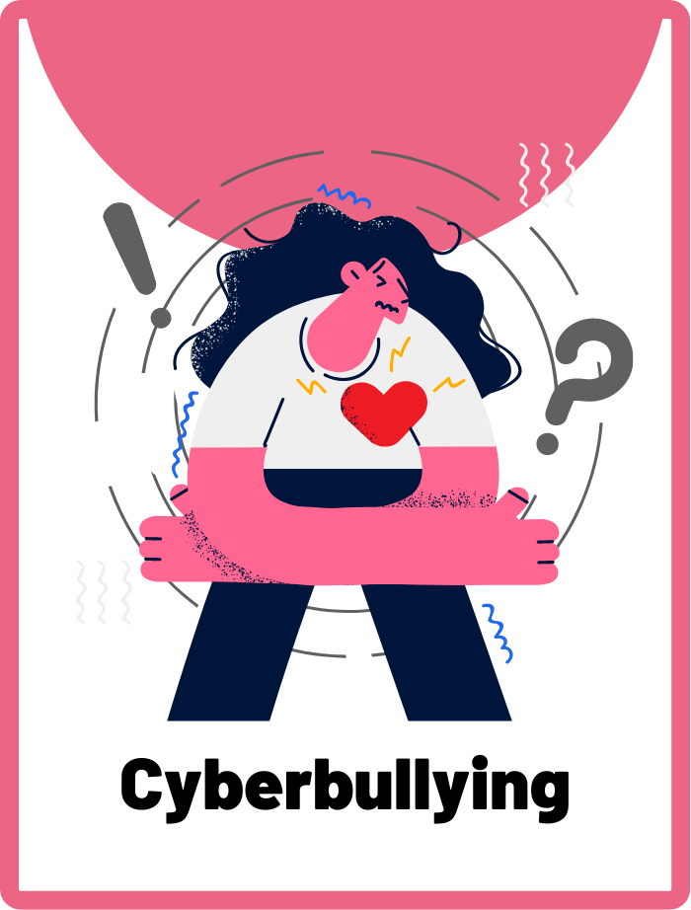
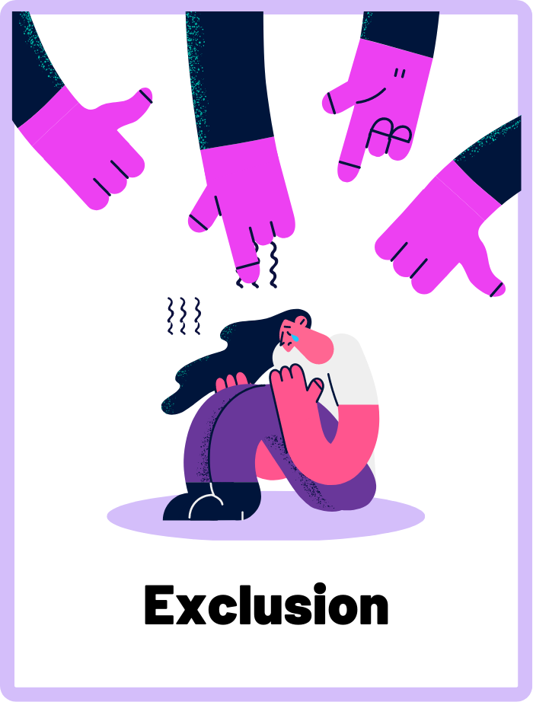
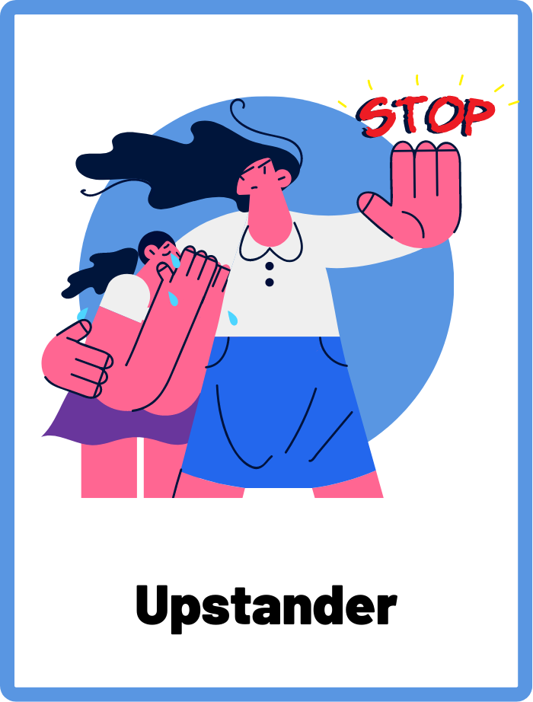
DEFINE THE KEYWORDS
What do you think these terms mean?
t

Slide 5
DEFINE
Cyberbullying
When a person goes online to repeatedly post hurtful and embarrassing content, write mean messages, or spread rumours about others with the intention to cause harm and humiliation.

Slide 6
DEFINE
Exclusion
When someone is left out or not included in a group on purpose, usually to make the person feel bad and rejected.

Slide 7
DEFINE
Upstander
A person who speaks up or takes action to stop cyberbullying or mean behaviour when they see it happening to someone else. This is the opposite of a bystander, who just watches and does nothing. Upstanders make sure everyone is treated with kindness and respect, online and offline.

Slide 8

INVESTIGATE THE SCENARIO
Read the following evidence carefully to piece together the story. Think critically about the information you are examining and consider the questions.

Slide 9
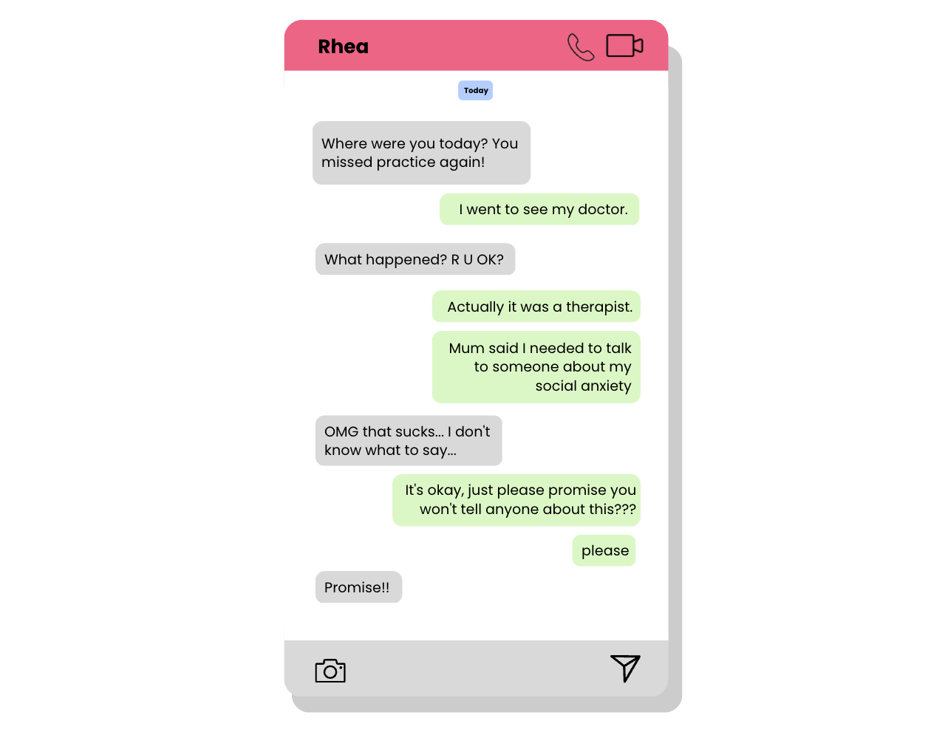
INVESTIGATE
EVIDENCE #1
LET’S DISCUSS
1. How do you think Sri was feeling when she sent these messages to Rhea?
2. If you were Rhea, how would you feel if you received such messages?

Slide 10
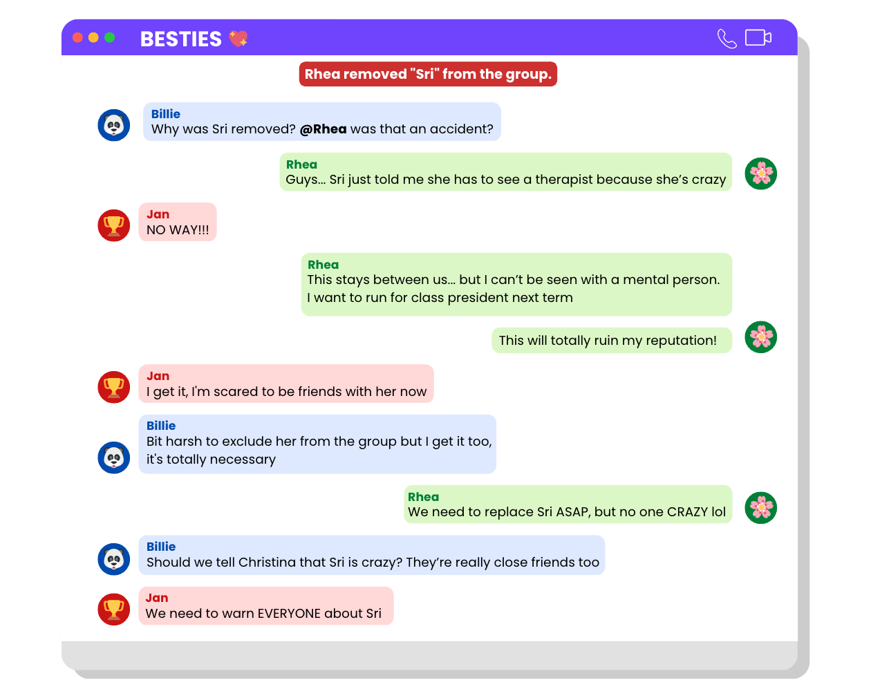
INVESTIGATE
EVIDENCE #2
LET’S DISCUSS
1. Why do you think Rhea has reacted the way she has?
2. If you were in this group chat, how would you react?
3. What would an upstander do or say in this situation?

Slide 11
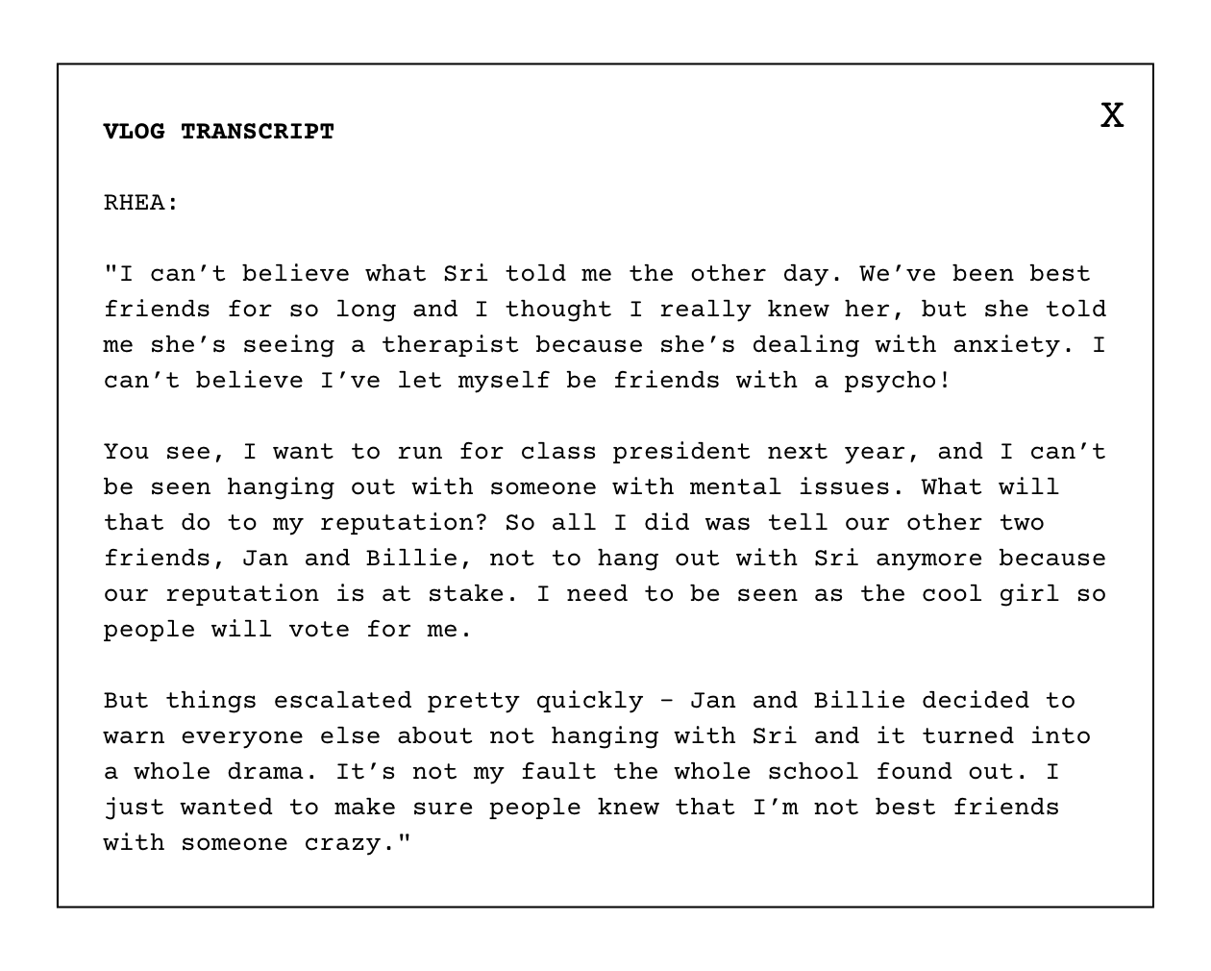
INVESTIGATE
EVIDENCE #3
LET’S DISCUSS
1. Do you agree with Rhea's motivations?
2. What do you think about Jan and Billie's role in this situation? Are they right to side with Rhea or should they have stood up for Sri?

Slide 12
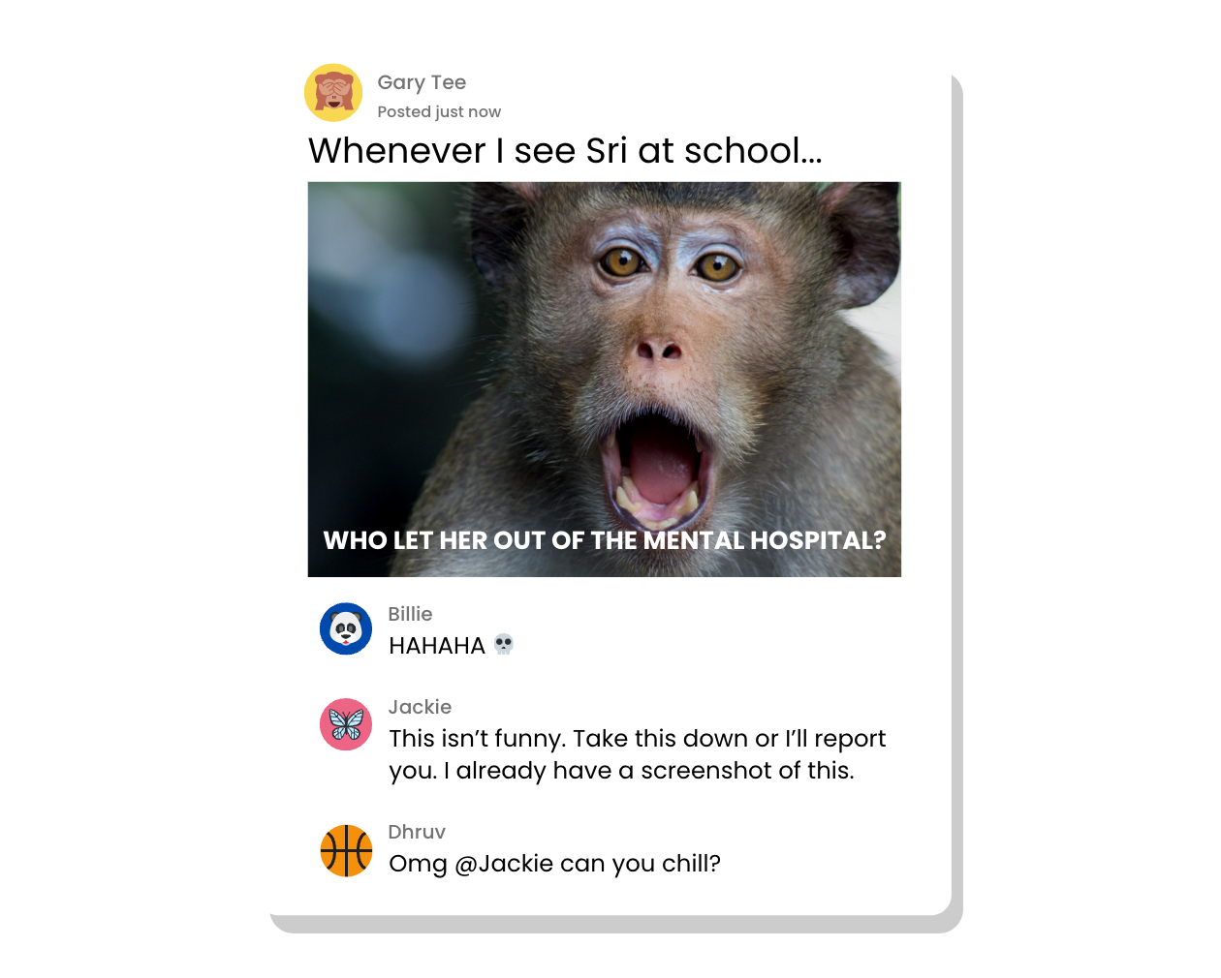
INVESTIGATE
EVIDENCE #4
LET’S DISCUSS
1. Gary heard about Sri through his classmates and decided to post this on social media. Do you think this is cyberbullying behaviour, even though Gary isn't responsible for spreading gossip about Sri?
2. What do you think of Jackie's comment? How would you describe her?
3. Billie and Dhruv are mere commenters on a funny post. What role do they play in this situation?

Slide 13
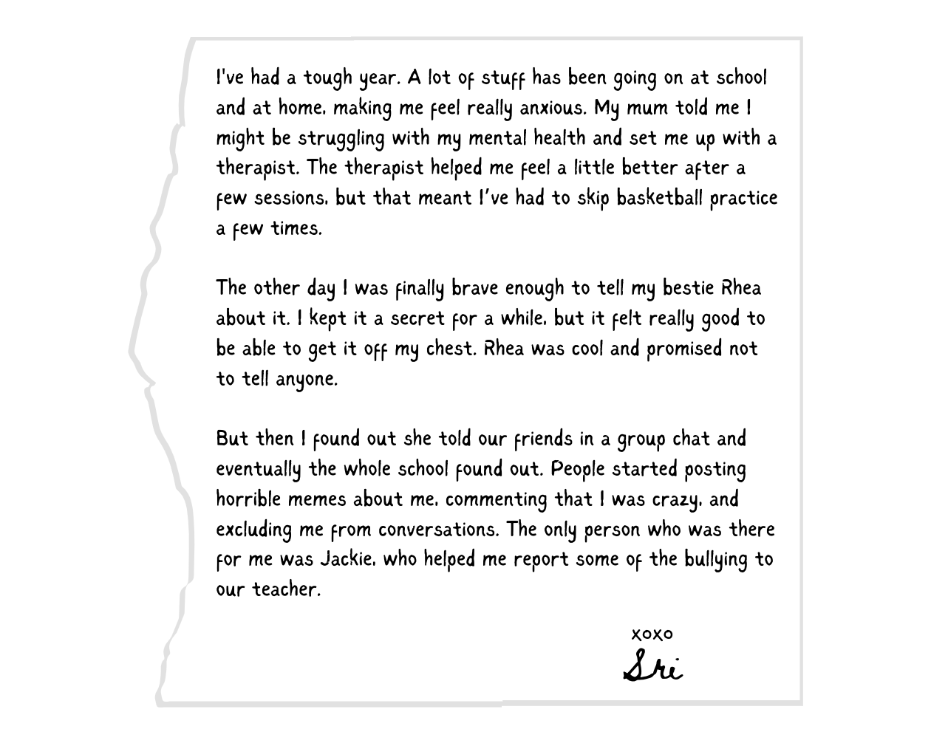
INVESTIGATE
EVIDENCE #5
LET’S DISCUSS
1. Can you think of three things Sri and Jackie can do to help this situation?
2. Why do you think people are so quick to post horrible memes and say mean things about Sri online?

Slide 14

PROJECT WORK
Write a classroom agreement on how to stop cyberbullying and be an upstander that everyone should follow in class.
The agreement should be empowering and easy for everyone to follow.

Slide 15
Write a classroom agreement on how to stop cyberbullying and be an upstander that everyone should follow in class.
What should your project outcome look like?
The agreement should be empowering and easy for everyone to follow.
Instructions and Questions to Consider:
What does it mean to be an upstander?
What are some behaviours that contribute to cyberbullying?
What are some strategies for responding to cyberbullying? Brainstorm ideas on how to prevent cyberbullying and promote upstander behaviour.
Develop a list of guidelines that everyone should follow to prevent cyberbullying and promote upstander behaviour.
What are some consequences of not following the guidelines?

Slide 16
Share Your Project!
Present your projects to the class.

Slide 17

KEY TAKEAWAYS
Cyberbullying is never acceptable. If you see or experience cyberbullying, you should take a screenshot, block the user, and report your experience to a trusted adult (like a teacher or a parent/caretaker).
Exclusion is a type of cyberbullying behaviour that is very hurtful to the individual that’s been singled out.
We can all be upstanders by standing up for ourselves and our friends to stop cyberbullying. You can be an upstander by supporting your friends, reporting cyberbullying behaviours, and telling a trusted adult.

Slide 18
Well Done!
Lesson 13.06.02

