Slide 1
The Ransomed Files
LESSON 4.2
PRIVACY & INFORMATION SECURITY
EXERCISE-IN-A-BOX

Slide 2

What settings do you currently use to keep yourself safe and your devices secure?
WARM-UP

Slide 3
Can you name some different kinds of cyber crimes?
WARM-UP

Slide 4

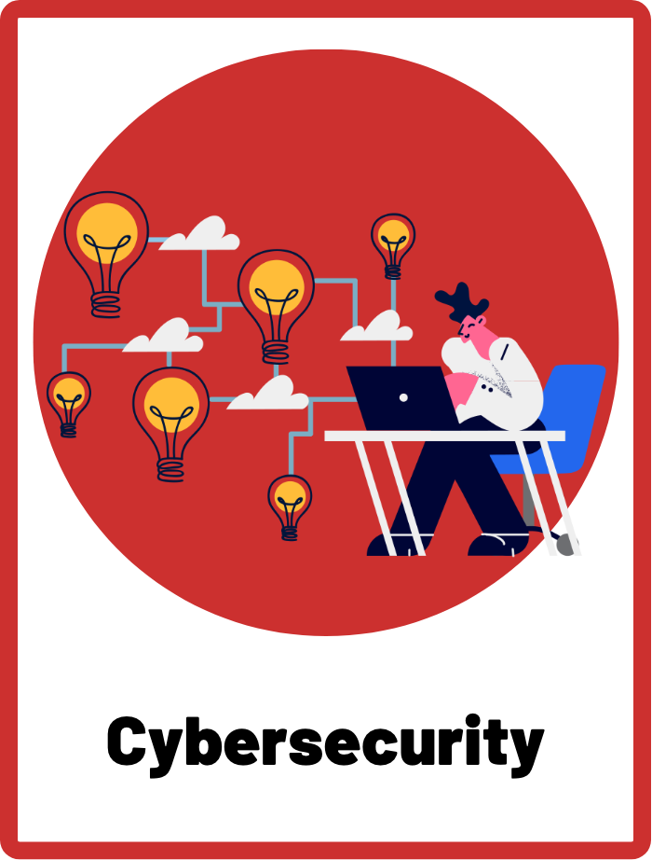
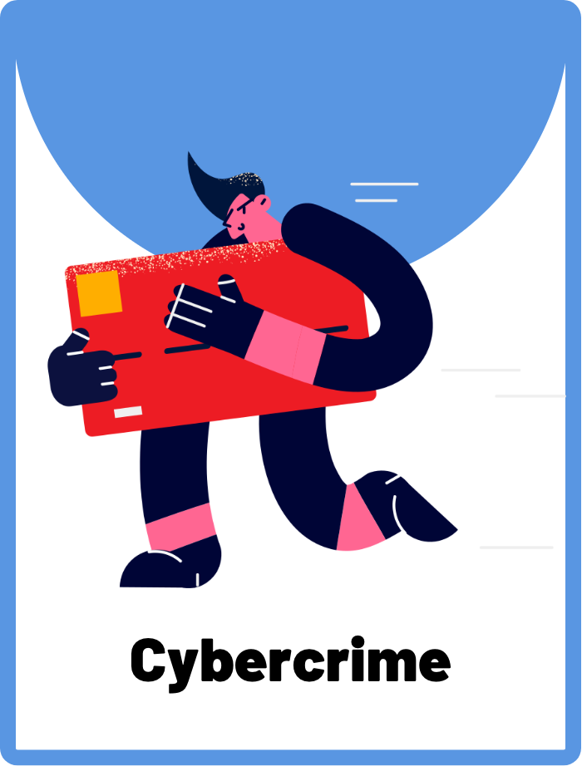
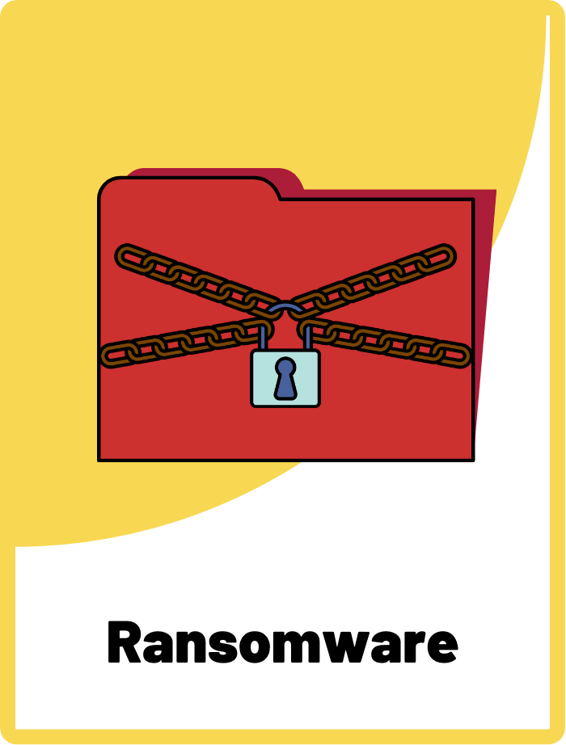
DEFINE THE KEYWORDS
What do you think these terms mean?

Slide 5
DEFINE
Cybersecurity
Cybersecurity refers to the practices and technologies used to protect devices, networks, and data from unauthorised access, theft, or damage. It involves measures like antivirus software, firewalls, and password protection to prevent cyber attacks.

Slide 6
DEFINE
Cybercrime
Cybercrime refers to criminal activities committed using the internet or other digital technologies. It can include online identity theft, hacking, fraud, and cyberstalking, among others.

Slide 7
DEFINE
Ransomware
Ransomware is like a digital "kidnapping" of your files. It is a type of malicious software that is designed to block access to a computer system or data until a ransom is paid. It can be installed through malicious email attachments or links, and once installed, it encrypts files on the victim's computer, making them inaccessible until the ransom is paid.

Slide 8

INVESTIGATE THE SCENARIO
Read the following evidence carefully to piece together the story. Think critically about the information you are examining and consider the questions.

Slide 9
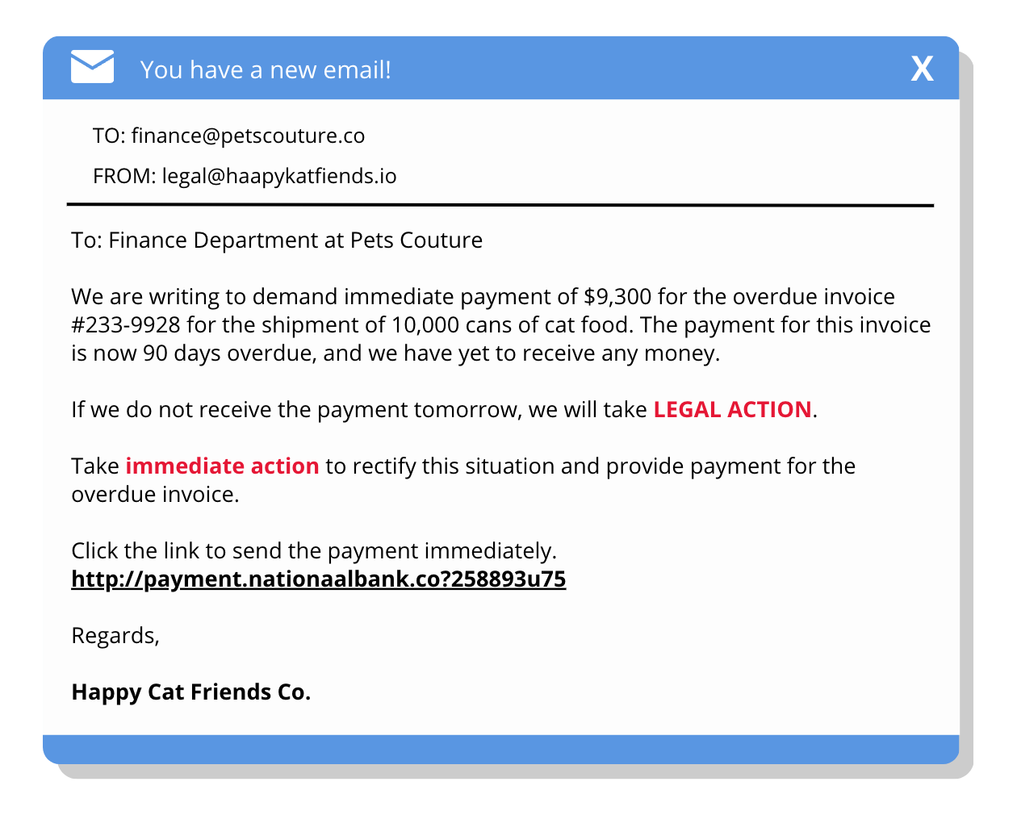
INVESTIGATE
EVIDENCE #1
LET’S DISCUSS
1. What clues can you use to determine whether or not this is a legitimate request?
2. What tactics has the sender used to persuade the recipient? Think about the tone of voice and language used.

Slide 10
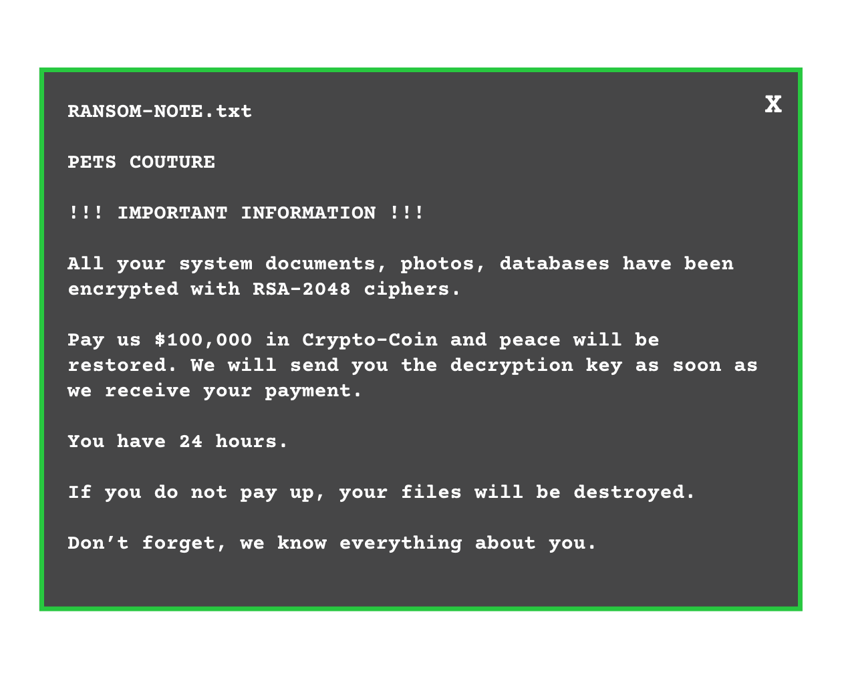
INVESTIGATE
EVIDENCE #2
LET’S DISCUSS
1. How does ransomware work? What have the hackers held hostage?
2. What are the potential risks and rewards of paying off the hackers?
3. How do these cybercriminals want to receive payment?

Slide 11
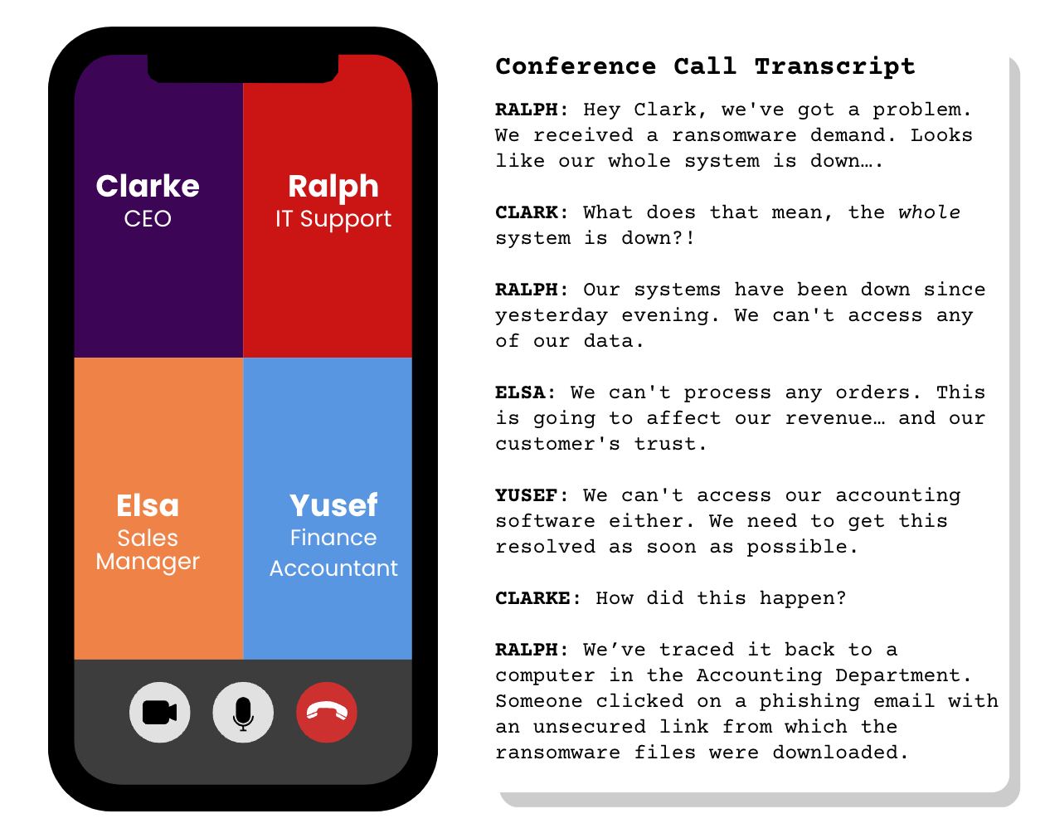
INVESTIGATE
EVIDENCE #3
LET’S DISCUSS
1. What are some of the consequences of a ransomware attack for a company?
2. How can companies prevent a ransomware attack from happening?

Slide 12
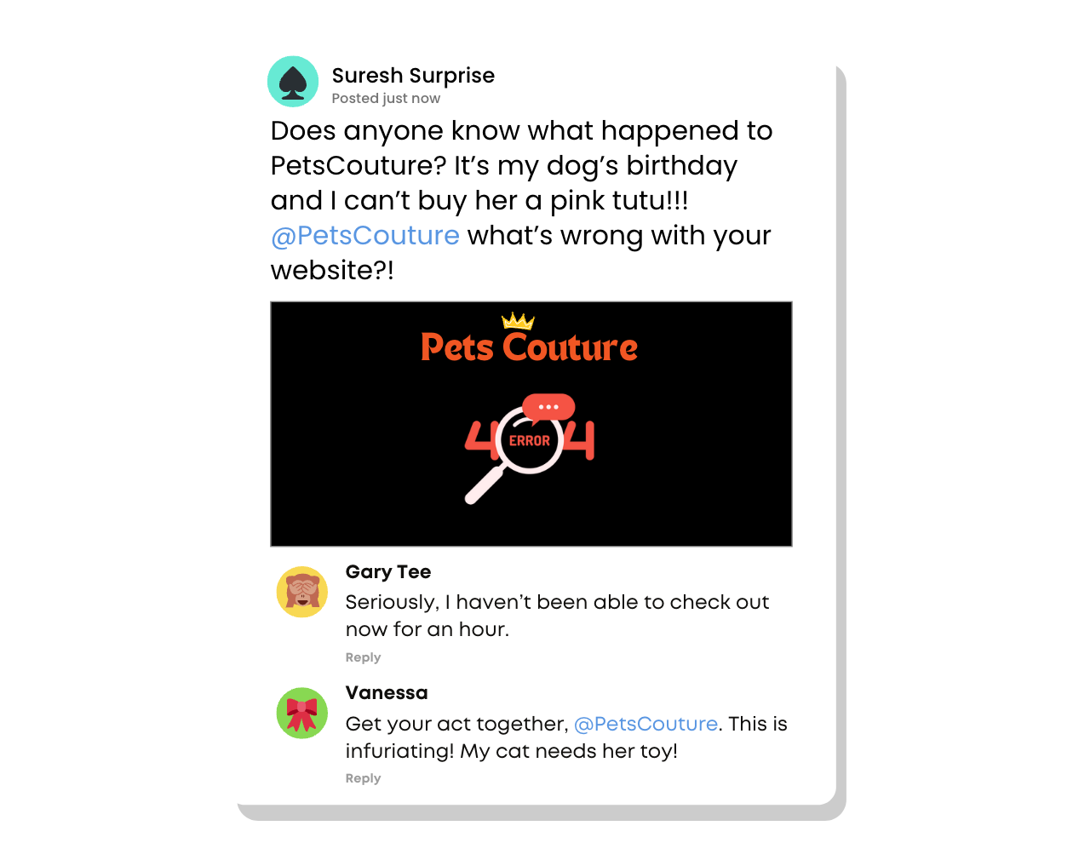
INVESTIGATE
EVIDENCE #4
LET’S DISCUSS
1. How has Pets Couture’s cyberattack affected their company’s reputation and customer trust?
2. What is the impact of the Pets Couture website being down on their business and customers?

Slide 13
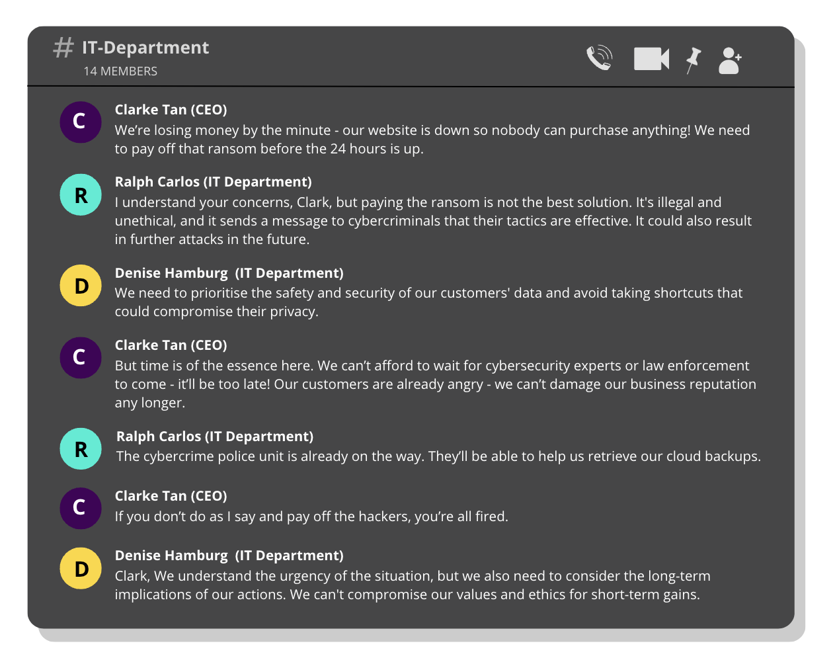
INVESTIGATE
EVIDENCE #5
LET’S DISCUSS
1. Split into two groups and conduct a mini debate. Group A will argue for Clarke to pay the ransom and Group B will argue that he should wait for the authorities to step in.

Slide 14

KEY TAKEAWAYS
Cybersecurity is a shared responsibility, and everyone has a role to play in protecting themselves and their communities from cyber threats.
Ransomware attacks can cause significant damage to individuals, businesses, and governments, including financial losses, reputational harm, and disruption of critical services.
It is important to take proactive measures to prevent cybercrimes and be cybersecure, such as keeping software up to date, using strong passwords, and backing up important data.

Slide 15
Well Done!
LESSON 4.2

