Slide 1
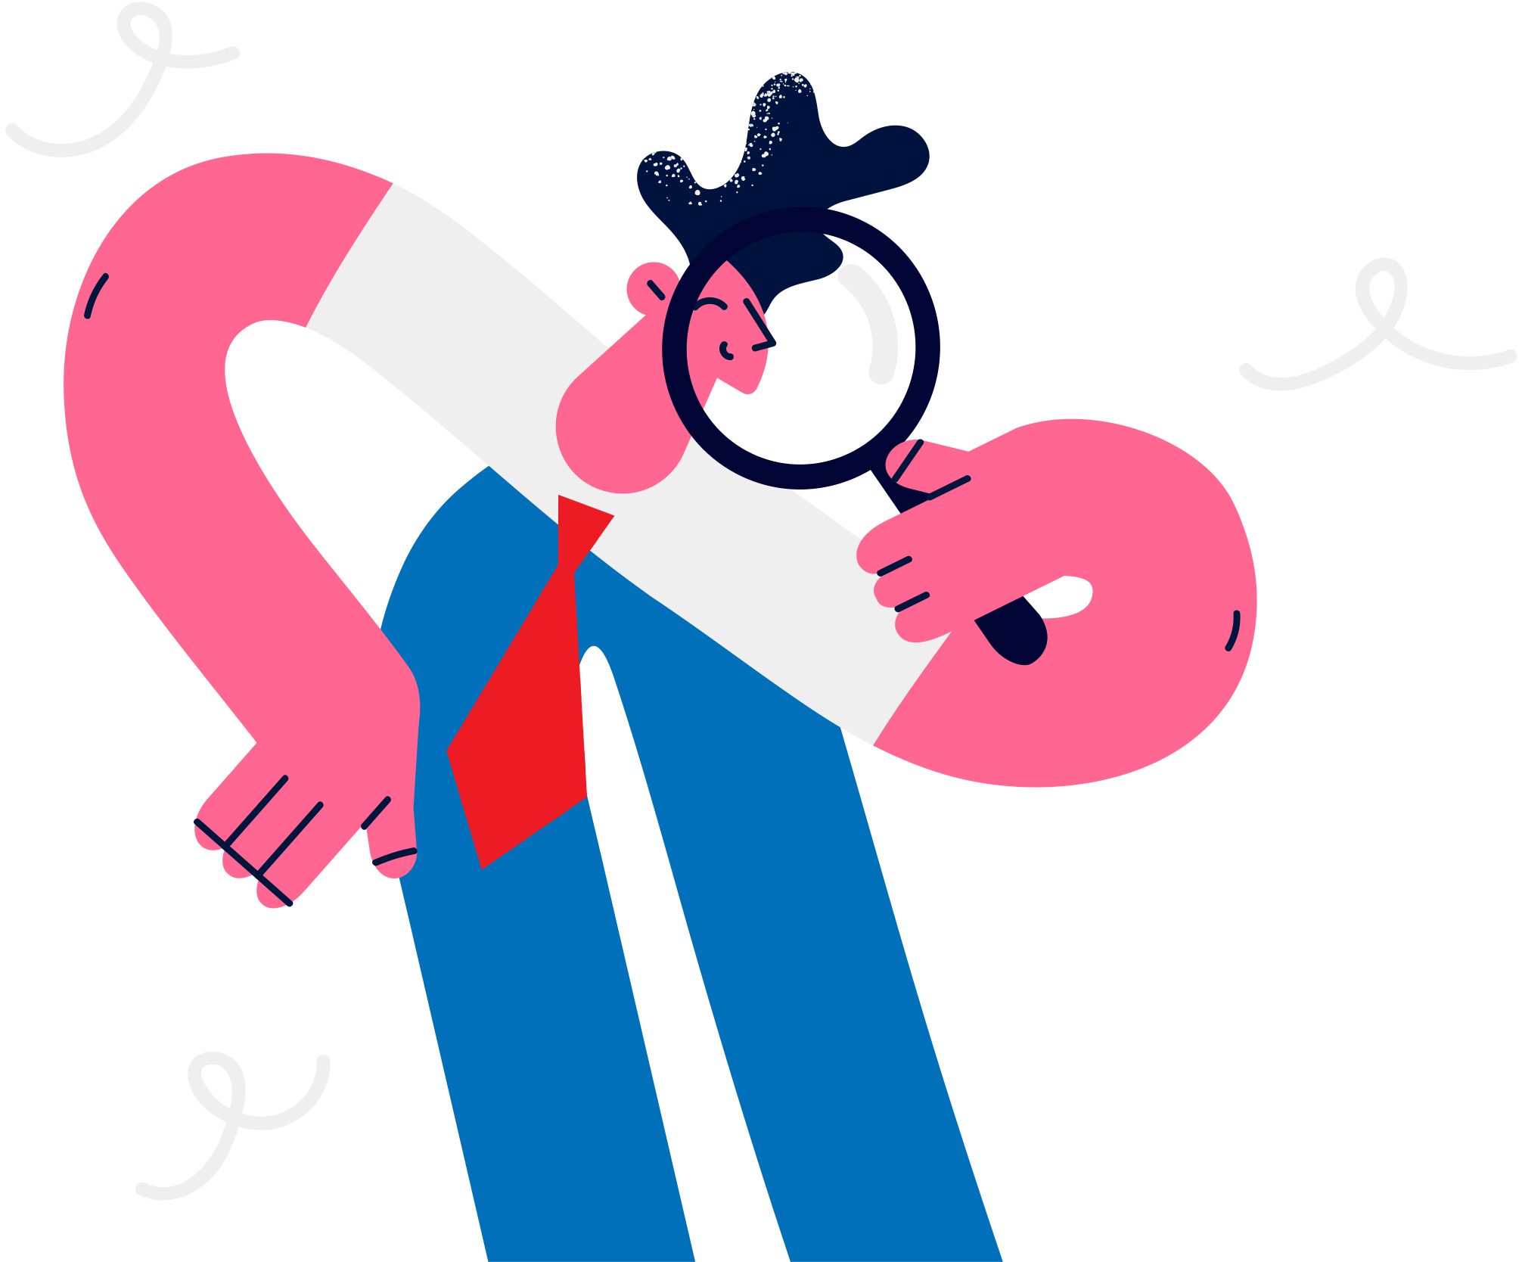
Lesson 08.03.01
DIGITAL MEDIA LITERACY
Wise Information Explorers
Searching smartly for answers online

Slide 2
Why do we search for information online
What are we learning today?
How to tell which sources we can trust

Slide 3
WARM UP QUESTION
Is everything we see and hear on the internet true?

Slide 4
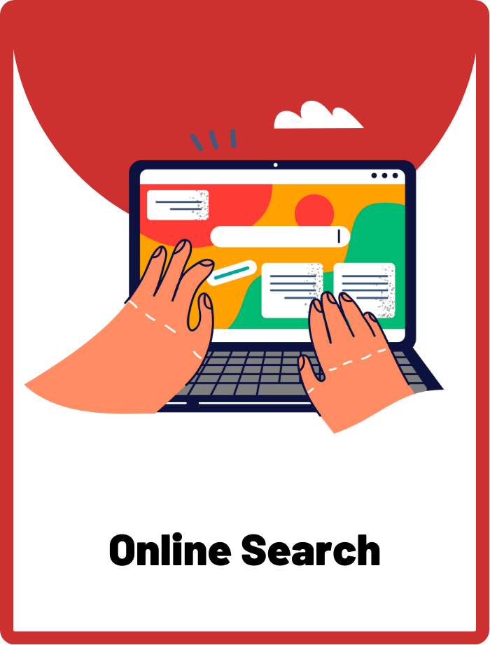
Online Search
The process of using a search engine on the internet to find specific information or websites.

Slide 5
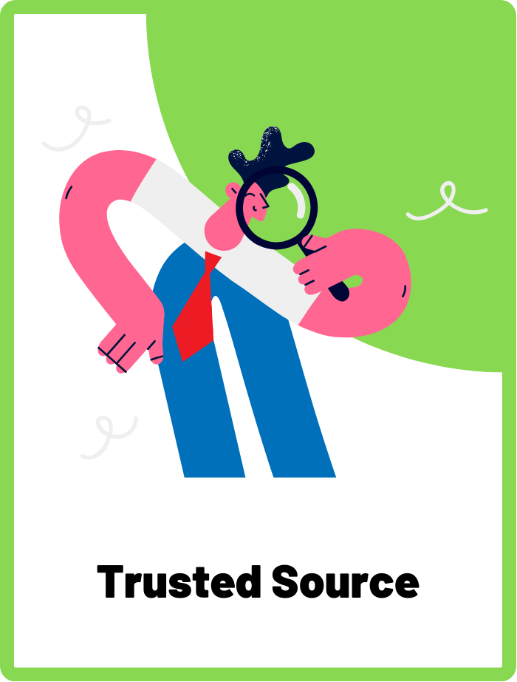
Trusted Source
A reliable and credible person or organisation providing information or content online.

Slide 6
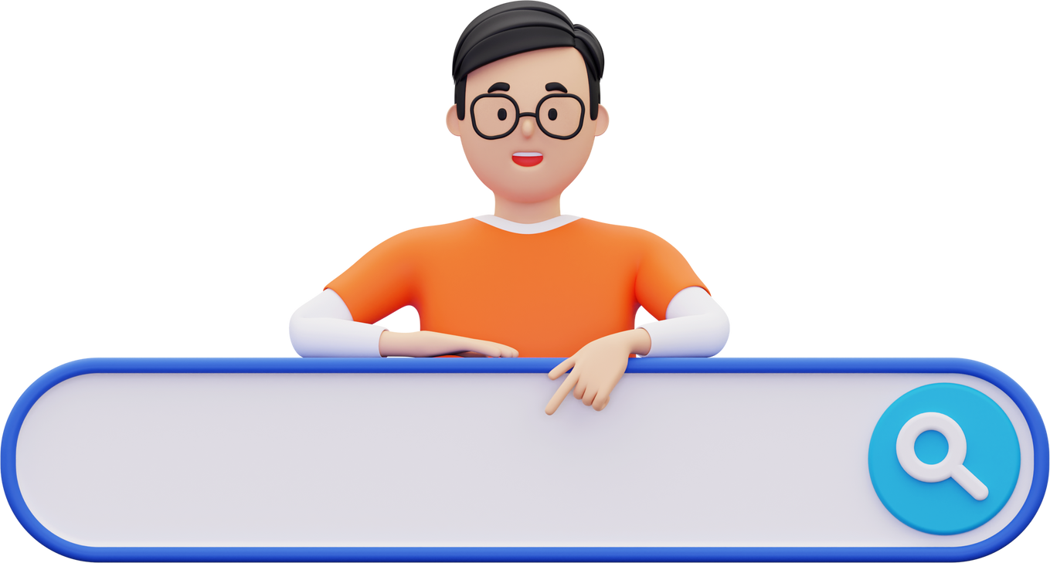
The internet is full of information!
How old is the Earth?
That’s why we search online to discover new facts, learn about exciting topics, and find solutions to our questions.

Slide 7
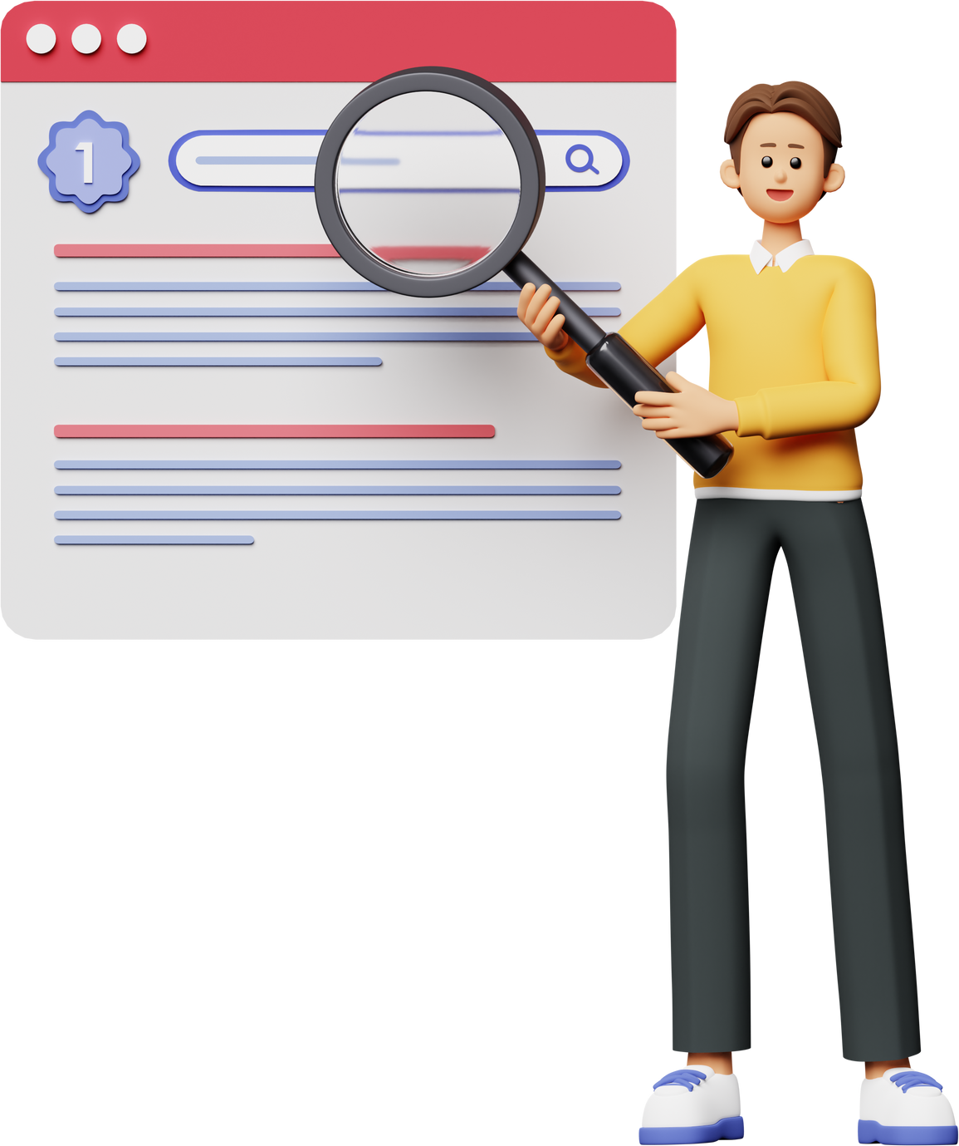
Being a Wise Information Explorer
Not everything we find online is correct, so we need to make sure we're learning from the right places.
We should be careful and choose trusted sources when we search online.

Slide 8



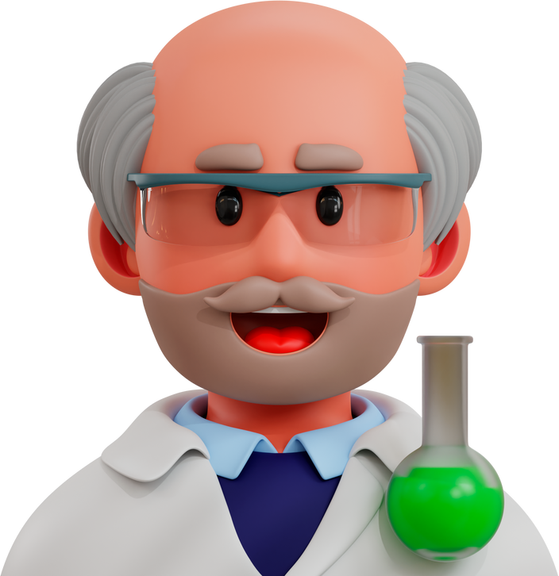

What Are Trusted Sources?
Trusted sources are websites, books, or people that we can believe and rely on for accurate information.
These sources are like the experts and teachers who know a lot about certain subjects.

Slide 9










Examples of Trusted Sources
News Outlets
Education Websites
Social Media is NOT a trusted source

Slide 10
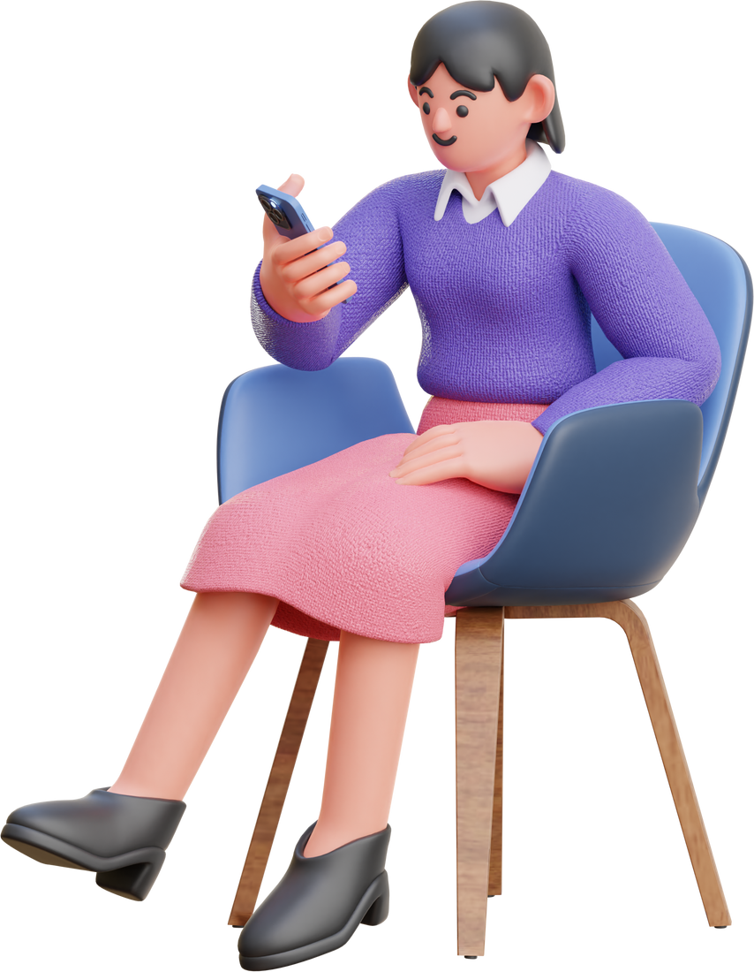
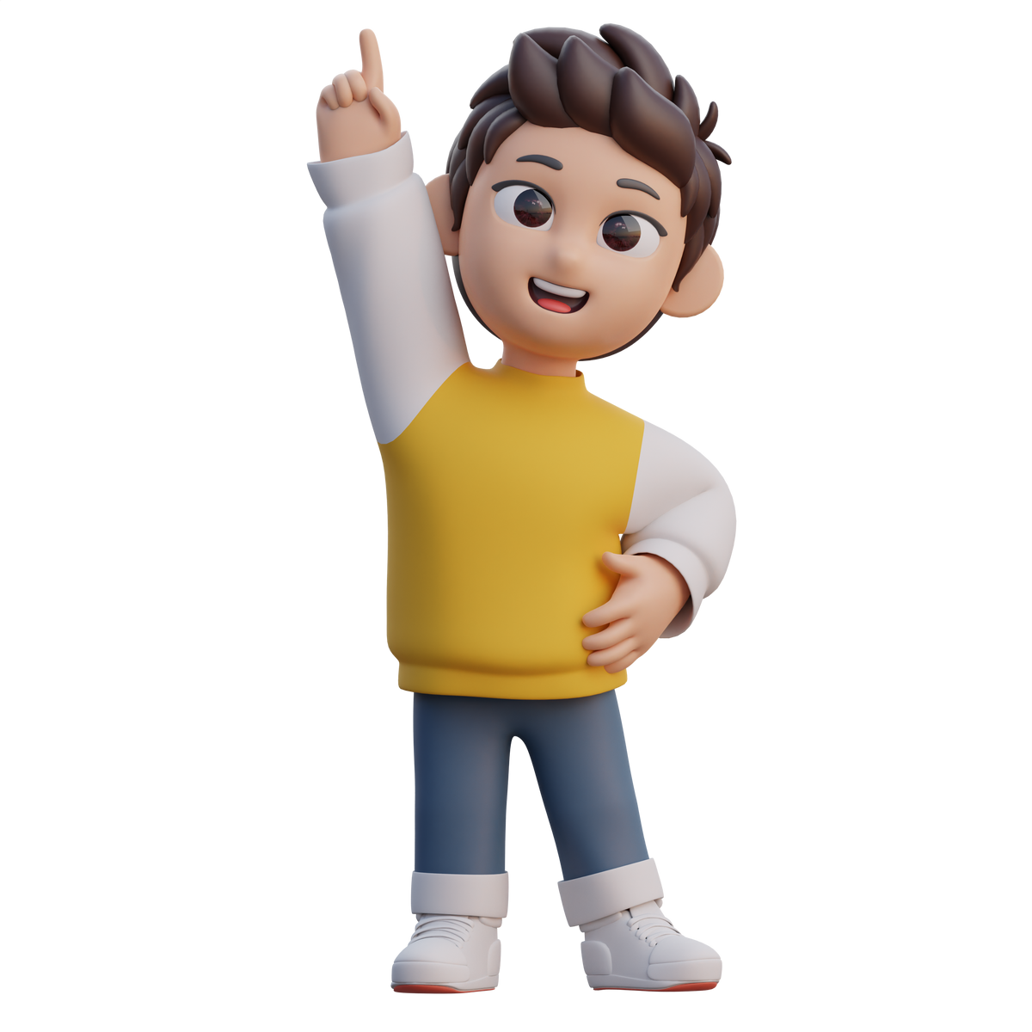
Ask For Help!
If we're not sure if a source is trustworthy or if we have questions, we can always ask a grown-up or teacher for help. They can guide us to the best sources of information.

Slide 11
ACTIVITY
Who can you trust?
Identify which sources are trustworthy and which are not.

Slide 12
Instructions
Look at each post carefully and decide whether to trust the source or not. Discuss your reasons behind your decision.

Slide 13
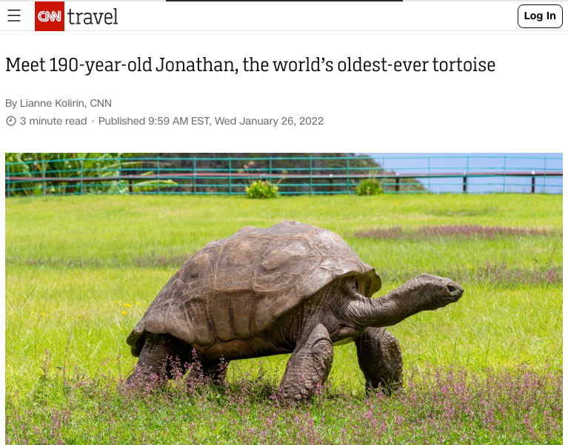
SHOULD YOU TRUST THIS?
This news site, CNN, reported that the oldest tortoise is 190 years old.

Slide 14
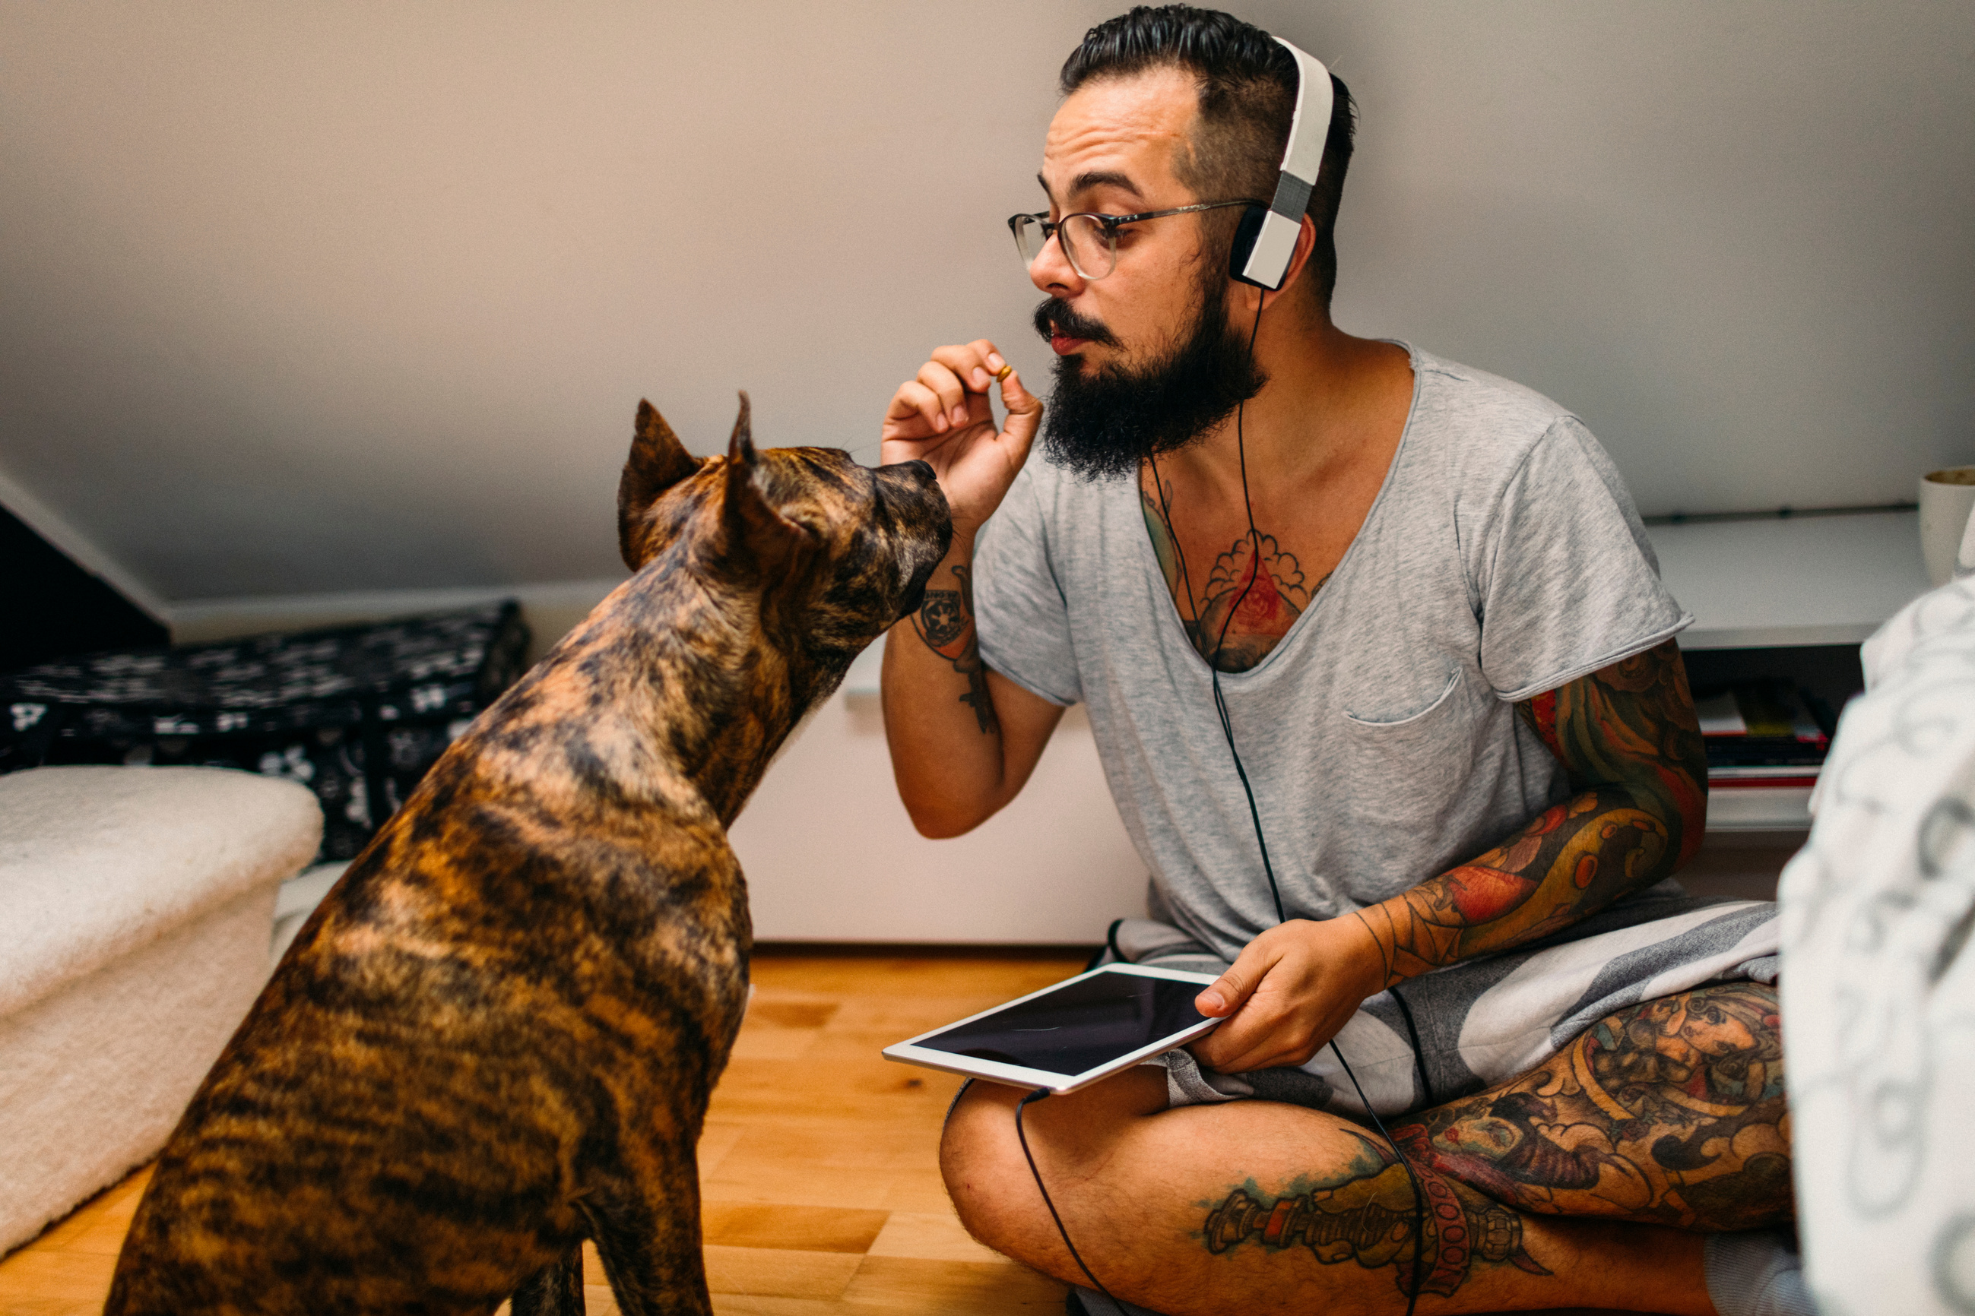

SHOULD YOU TRUST THIS?
This YouTuber claims dogs can actually speak English.
Teaching my dog to speak English!
Did you know dogs can actually speak? Watch my video as I show you how I teach my dog to speak English!

Slide 15

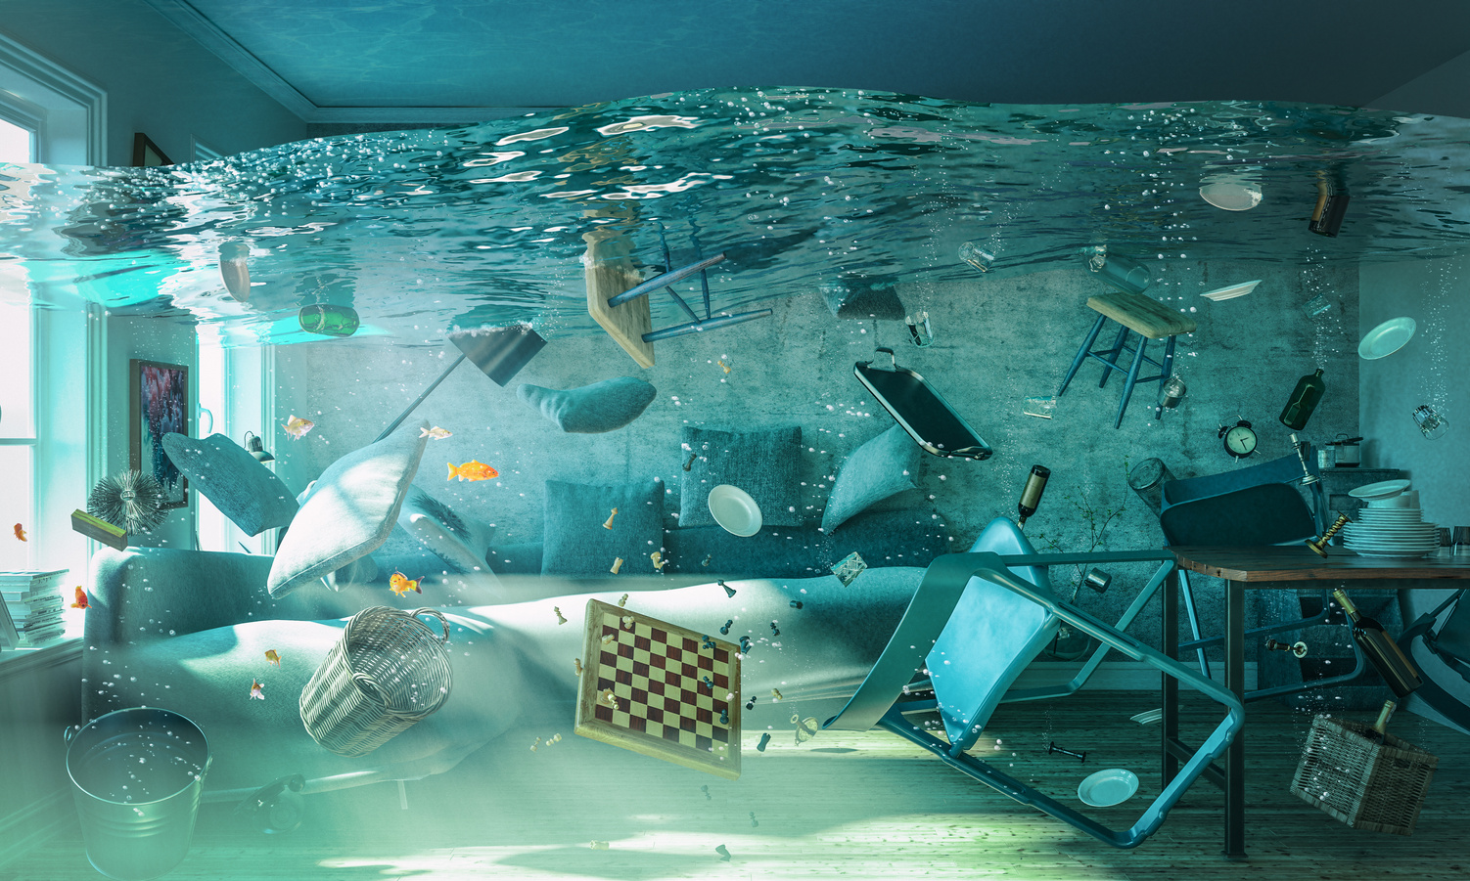
SHOULD YOU TRUST THIS?
This forwarded WhatsApp message from a classmate claims that school is cancelled tomorrow!
Sharmina
The school is flooded so we don’t have to go to school tomorrow!!!
Forwarded many times

Slide 16
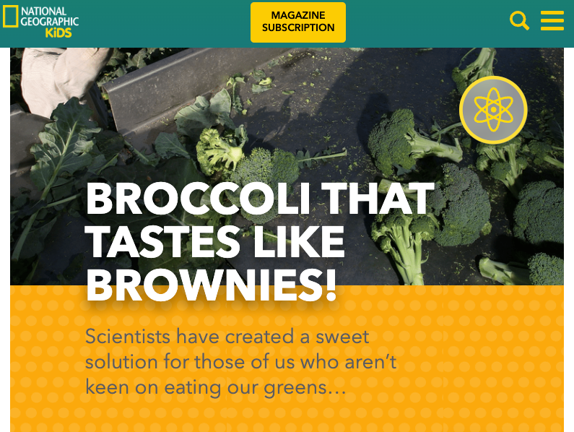
SHOULD YOU TRUST THIS?
National Geographic Kids claims that scientists have created broccoli that tastes like brownies.

Slide 17
WRAP UP
What have you learned today?
Let’s reflect on today’s lesson.

Slide 18
Remember This!
  Searching for information online is a fantastic way to learn, but we should always use trusted sources to make sure the information is correct.
  If we're not sure, we can ask someone we trust for help.

Slide 19
Lesson 08.03.01
Well Done!

