Slide 1

Lesson 09.02.01
PRIVACY & INFORMATION SECURITY
Protect Your Identity
Let’s explore our online spaces!

Slide 2
Personally Identifiable Information (PII)
What are we learning today?
Identify different types of PII
How to protect your PII online

Slide 3
WARM UP QUESTION
What types of information should we never share online?

Slide 4
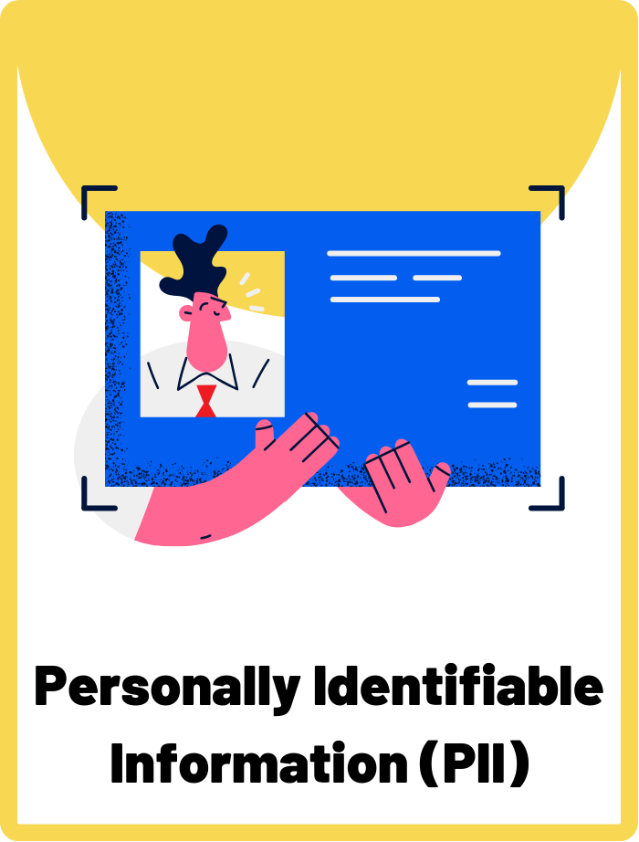
Personally Identifiable Information (PII)
Any information that can be used on its own or with other information to identify, contact, or locate a single person. This can include your full name, email address, or passport number.

Slide 5
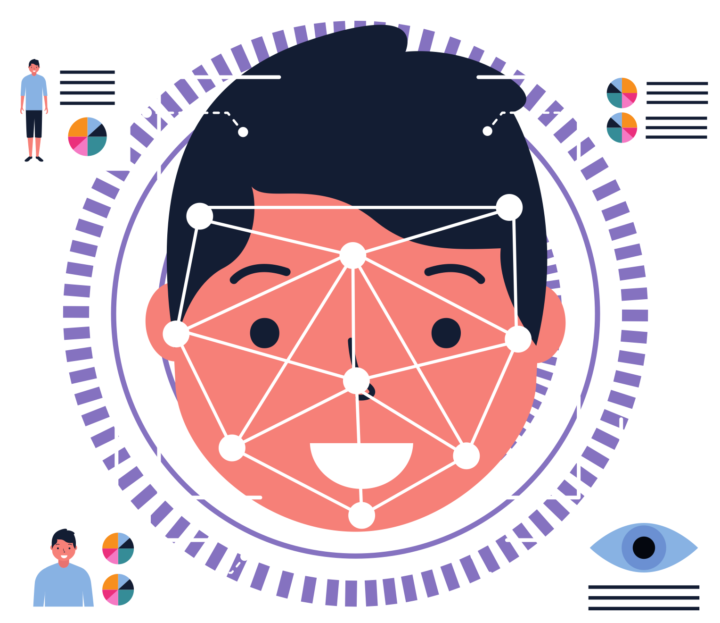
What is Personally Identifiable Information (PII)?
Full Name
Email Address
Passport Number
Student ID
Personally Identifiable Information is any information that can be used to figure out who you are, like your name, address, phone number, or even your birthday.

Slide 6
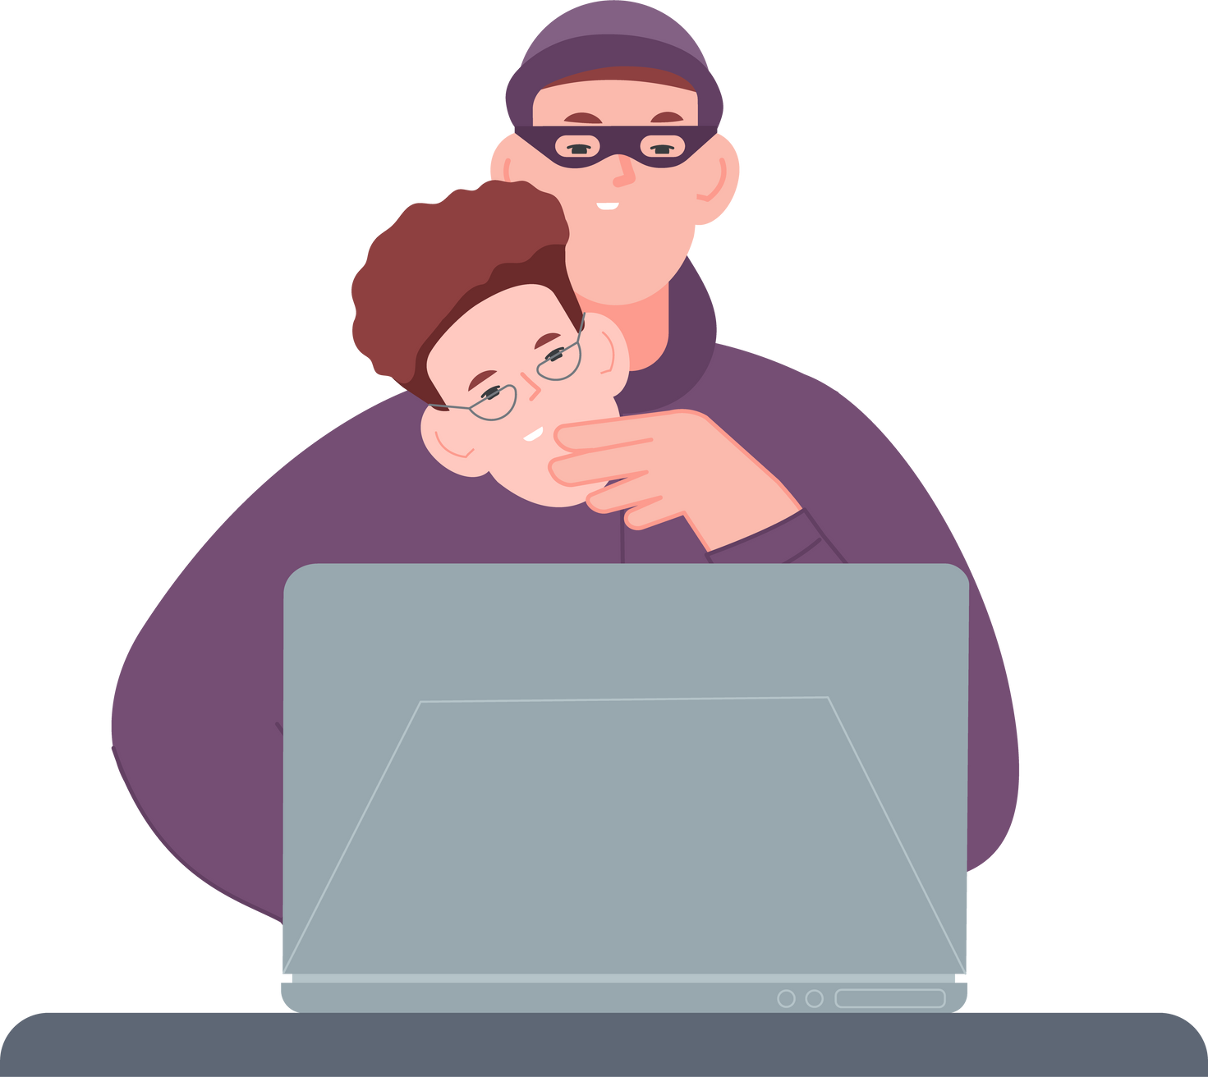
Why Does Protecting Your PII Matter?
If someone gets your PII, they could pretend to be you or know things about you that you didn’t want to share.
You should NEVER share your PII:
  On social media
  In online games
  While chatting with friends
  With people you don’t know or trust
  In public online spaces

Slide 7
Examples of PII
Can you identify which of these are considered PII, and which are not?
Phone Number
Pet’s Name
Date of Birth
Favourite Colour
Home Address
Gender
Face ID or Fingerprints
Email Address
Bank Account Number
Your Height
Favourite Subject

Slide 8
Examples of PII
The yellow boxes are considered PII because you can be identified with this information.
Phone Number
Home Address
Date of Birth
Face ID or Fingerprints
Email Address
Bank Account Number
The purple boxes not considered PII because they’re not unique enough to identify someone by itself.
Favourite Colour
Pet’s Name
Favourite Subject
Your Height
Gender

Slide 9

Ways to Protect Your PII Online
Always ask yourself: “Is this something that can identify me?”
It’s okay to keep parts of yourself a secret online!
Don’t share personal information with other people online, especially people you’ve never met before.

Slide 10
ACTIVITY
Is It Safe to Share?
Can you determine if the information is safe to share or not?

Slide 11


Instructions
Can you decide if a piece of information is safe to share online or not?
Thumbs Up to say “IT’S SAFE!”
Thumbs DOWN to say “IT’S NOT SAFE!”

Slide 12

QUESTION 1
Your first and last name
Mae Kumar
...Is It Safe to Share?
Notes:
Your first and last name - Is it safe to share your first name on a website where you play games?
Your home address - Should you tell others online where you live?
Your phone number - Can you share your phone number on social media?
Your school name - Is it okay to post which school you go to?
Your favourite colour - Is talking about your favorite color online safe?
Your parent’s workplace - Should you tell others where your parents work?
Your current location - Is it safe to share your location when you are somewhere fun?
Your pet’s name - Can you share your pet’s name and photos online?
Passwords to your accounts - Can you share your game or email password with a friend?
Your hobbies and interests - Is it okay to talk about what you like to do for fun online?

Slide 13
QUESTION 1
Your first and last name
Mae Kumar
It’s NOT safe to share!
Notes:
Your first and last name - Is it safe to share your first name on a website where you play games?
Your home address - Should you tell others online where you live?
Your phone number - Can you share your phone number on social media?
Your school name - Is it okay to post which school you go to?
Your favourite colour - Is talking about your favorite color online safe?
Your parent’s workplace - Should you tell others where your parents work?
Your current location - Is it safe to share your location when you are somewhere fun?
Your pet’s name - Can you share your pet’s name and photos online?
Passwords to your accounts - Can you share your game or email password with a friend?
Your hobbies and interests - Is it okay to talk about what you like to do for fun online?

Slide 14

QUESTION 2
Your current location
...Is It Safe to Share?
Notes:
Your home address - Should you tell others online where you live?
Your phone number - Can you share your phone number on social media?
Your school name - Is it okay to post which school you go to?
Your favourite colour - Is talking about your favorite color online safe?
Your parent’s workplace - Should you tell others where your parents work?
Your current location - Is it safe to share your location when you are somewhere fun?
Your pet’s name - Can you share your pet’s name and photos online?
Passwords to your accounts - Can you share your game or email password with a friend?
Your hobbies and interests - Is it okay to talk about what you like to do for fun online?

Slide 15
QUESTION 2
Your current location
It’s NOT safe to share!
Notes:
Your home address - Should you tell others online where you live?
Your phone number - Can you share your phone number on social media?
Your school name - Is it okay to post which school you go to?
Your favourite colour - Is talking about your favorite color online safe?
Your parent’s workplace - Should you tell others where your parents work?
Your current location - Is it safe to share your location when you are somewhere fun?
Your pet’s name - Can you share your pet’s name and photos online?
Passwords to your accounts - Can you share your game or email password with a friend?
Your hobbies and interests - Is it okay to talk about what you like to do for fun online?

Slide 16
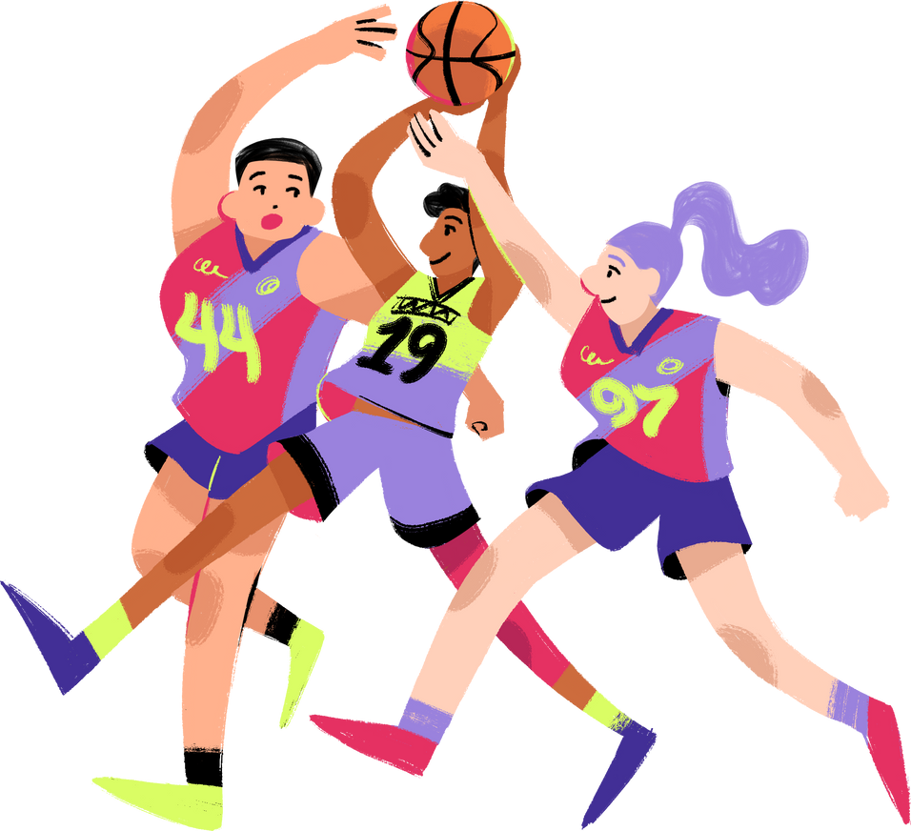
QUESTION 3
Your hobbies and interests
...Is It Safe to Share?
Notes:
Your phone number - Can you share your phone number on social media?
Your school name - Is it okay to post which school you go to?
Your favourite colour - Is talking about your favorite color online safe?
Your parent’s workplace - Should you tell others where your parents work?
Your current location - Is it safe to share your location when you are somewhere fun?
Your pet’s name - Can you share your pet’s name and photos online?
Passwords to your accounts - Can you share your game or email password with a friend?
Your hobbies and interests - Is it okay to talk about what you like to do for fun online?

Slide 17
QUESTION 3
Your hobbies and interests
It’s safe to share!
Notes:
Your phone number - Can you share your phone number on social media?
Your school name - Is it okay to post which school you go to?
Your favourite colour - Is talking about your favorite color online safe?
Your parent’s workplace - Should you tell others where your parents work?
Your current location - Is it safe to share your location when you are somewhere fun?
Your pet’s name - Can you share your pet’s name and photos online?
Passwords to your accounts - Can you share your game or email password with a friend?
Your hobbies and interests - Is it okay to talk about what you like to do for fun online?

Slide 18

QUESTION 4
Your school name
...Is It Safe to Share?
Notes:
Your phone number - Can you share your phone number on social media?
Your school name - Is it okay to post which school you go to?
Your favourite colour - Is talking about your favorite color online safe?
Your pet’s name - Can you share your pet’s name and photos online?
Passwords to your accounts - Can you share your game or email password with a friend?

Slide 19
QUESTION 4
Your school name
It’s NOT safe to share!
Notes:
Your phone number - Can you share your phone number on social media?
Your school name - Is it okay to post which school you go to?
Your favourite colour - Is talking about your favorite color online safe?
Your pet’s name - Can you share your pet’s name and photos online?
Passwords to your accounts - Can you share your game or email password with a friend?

Slide 20

QUESTION 5
Your favourite food
...Is It Safe to Share?
Notes:
Your phone number - Can you share your phone number on social media?
Your school name - Is it okay to post which school you go to?
Your favourite colour - Is talking about your favorite color online safe?
Your pet’s name - Can you share your pet’s name and photos online?
Passwords to your accounts - Can you share your game or email password with a friend?

Slide 21
QUESTION 5
Your favourite food
It’s safe to share!
Notes:
Your phone number - Can you share your phone number on social media?
Your pet’s name - Can you share your pet’s name and photos online?
Passwords to your accounts - Can you share your game or email password with a friend?

Slide 22
WRAP UP
What have you learned today?
Let’s reflect on today’s lesson.

Slide 23
Remember This!
  Protecting your PII helps keep you safe online. Always think carefully about what you share and ask for help if you’re not sure.
  Your personal information is special and unique to you – it’s important to keep it safe, just like you would keep a treasure safe.

Slide 24
Lesson 09.02.01
Well Done!

