Slide 1
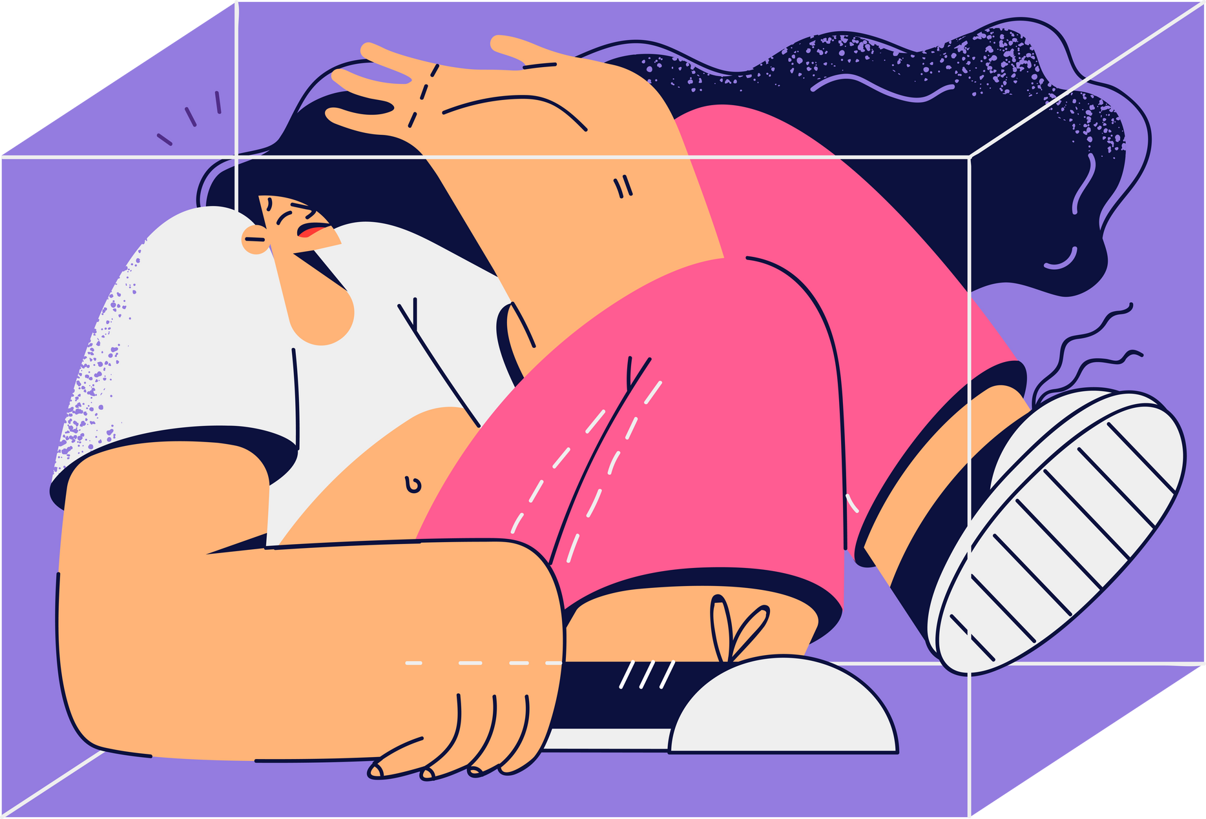

Lesson 15.01.01
DIGITAL IDENTITY
Bursting the Filter Bubble
How is content recommended to us?
CYBERLITE.ORG
2023-2024 Ⓒ Cyberlite Books Pte. Ltd. All Rights Reserved.

Slide 2
Recommendation algorithms shape the content we encounter online
What are we learning today?
Filter bubbles have an impact on the way we consume content
CYBERLITE.ORG
2023-2024 Ⓒ Cyberlite Books Pte. Ltd. All Rights Reserved.

Slide 3
WARM UP QUESTION
How do you think websites know what kind of things to show or suggest to us?
CYBERLITE.ORG
2023-2024 Ⓒ Cyberlite Books Pte. Ltd. All Rights Reserved.

Slide 4
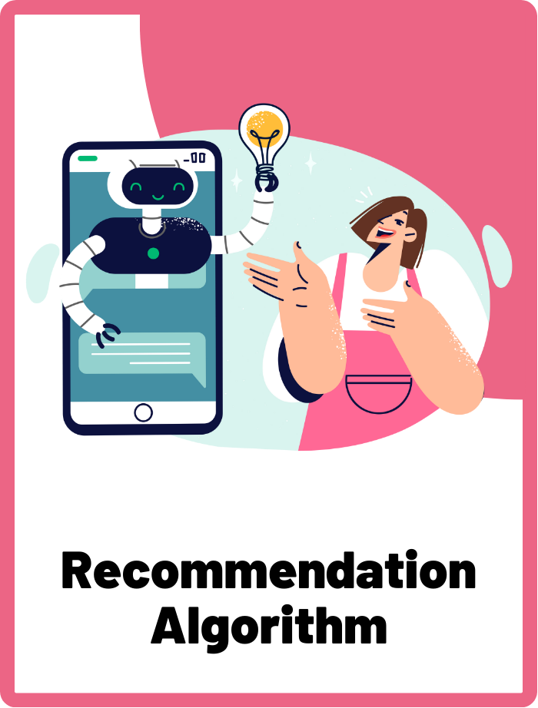
Recommendation Algorithm
Computer algorithms used by online apps and websites to suggest content to users based on their preferences and behaviours.
CYBERLITE.ORG
2023-2024 Ⓒ Cyberlite Books Pte. Ltd. All Rights Reserved.

Slide 5
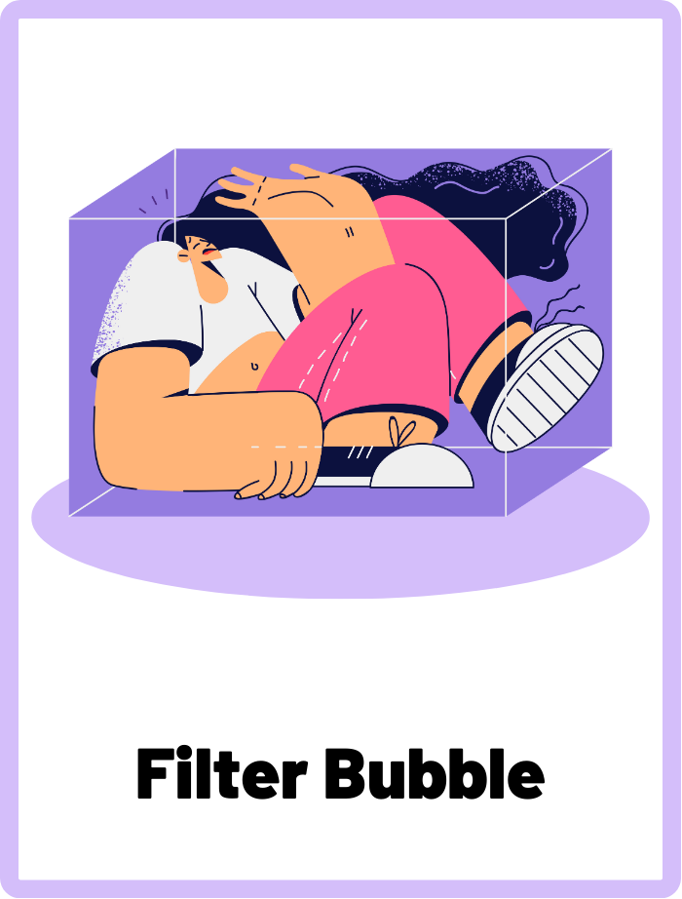
Filter Bubble
A situation where an internet user encounters only information and opinions that conform to and reinforce their own beliefs, caused by recommendation algorithms that personalise an individual's online experience.
CYBERLITE.ORG
2023-2024 Ⓒ Cyberlite Books Pte. Ltd. All Rights Reserved.

Slide 6
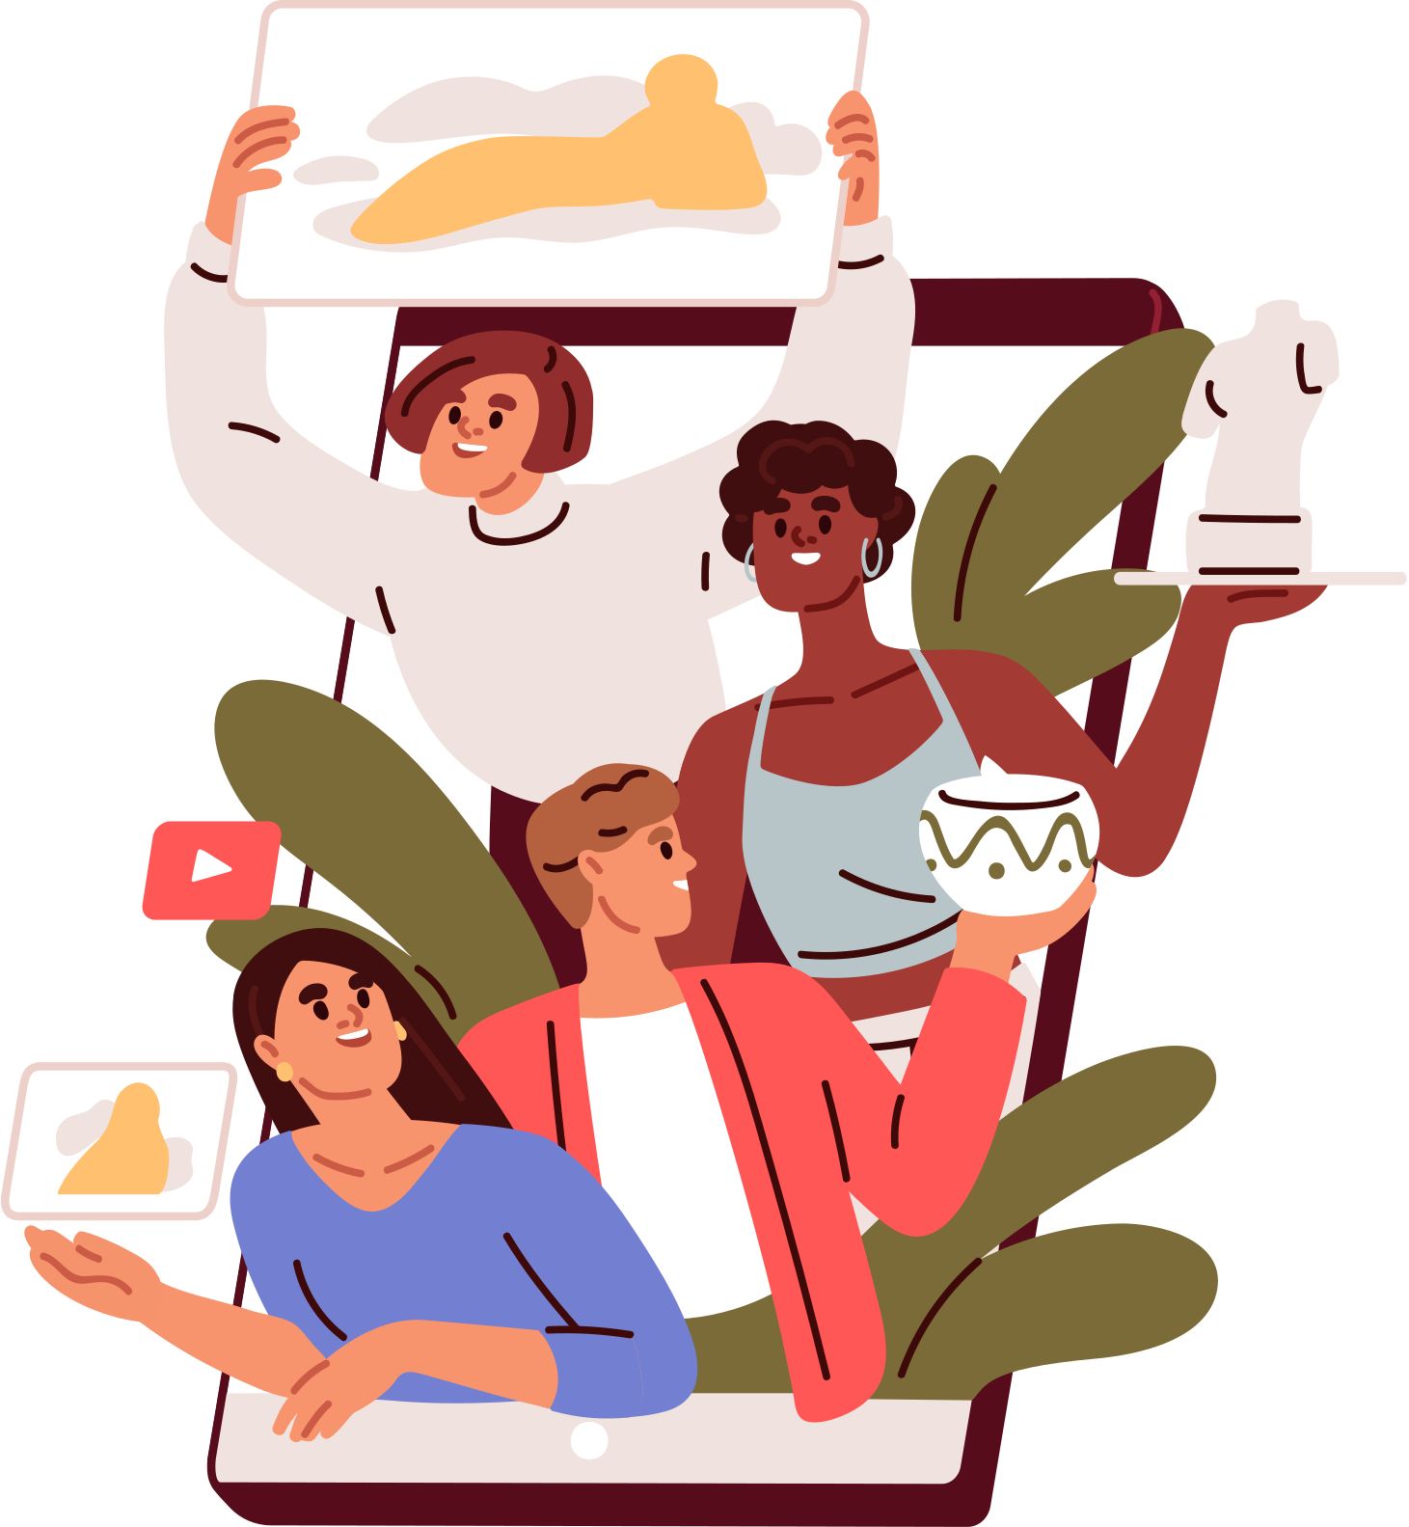
What Are Recommendation Algorithms?
Recommendation algorithms are the behind-the-scenes mechanisms used by online platforms to suggest content, products, or connections to users.
They are designed to keep users engaged and offer content that aligns with their preferences.
CYBERLITE.ORG
2023-2024 Ⓒ Cyberlite Books Pte. Ltd. All Rights Reserved.

Slide 7

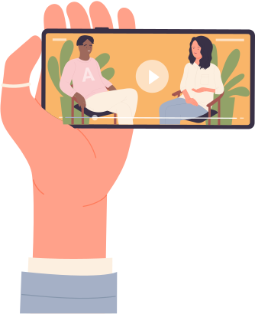
Example:
On YouTube, the algorithm works on a user’s homepage and “Up Next” panel.
Recommendations may be determined by:
  Subscriptions to channels
  Similar content based on what you’re currently watching
  Likes, saves, comments, and shares
CYBERLITE.ORG
2023-2024 Ⓒ Cyberlite Books Pte. Ltd. All Rights Reserved.

Slide 8


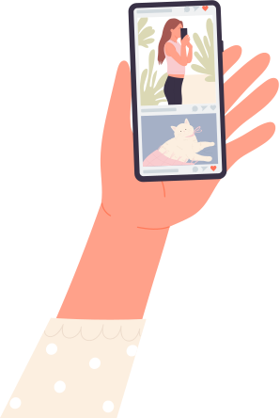
Example:
On Instagram, the algorithm works on a user’s feed and Explore page.
Recommendations may be determined by:
  The accounts the user follows
  Likes, saves, and shares by the user
  Information about the post, like how popular it is and how others are interacting with it
CYBERLITE.ORG
2023-2024 Ⓒ Cyberlite Books Pte. Ltd. All Rights Reserved.

Slide 9

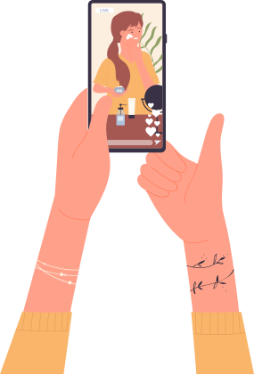
Example:
On TikTok, the algorithm works on a user’s “For You” page.
Recommendations may be determined by:
  Types of videos a user has engaged with, like watch time and interactions
  Likes, saves, shares, and comments by the user
  Video information like captions, sounds, and hashtags
CYBERLITE.ORG
2023-2024 Ⓒ Cyberlite Books Pte. Ltd. All Rights Reserved.

Slide 10
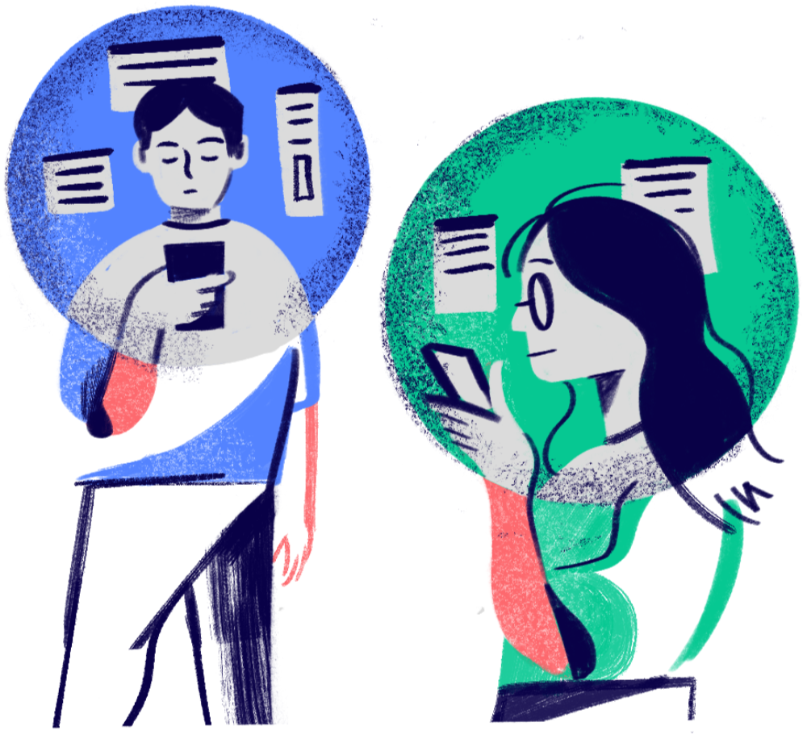
What is a Filter Bubble?
A filter bubble is a concept where your online experiences are personalised based on your past behaviour, interests, and interactions.
It results in only seeing content and information that align with your existing preferences.
CYBERLITE.ORG
2023-2024 Ⓒ Cyberlite Books Pte. Ltd. All Rights Reserved.

Slide 11


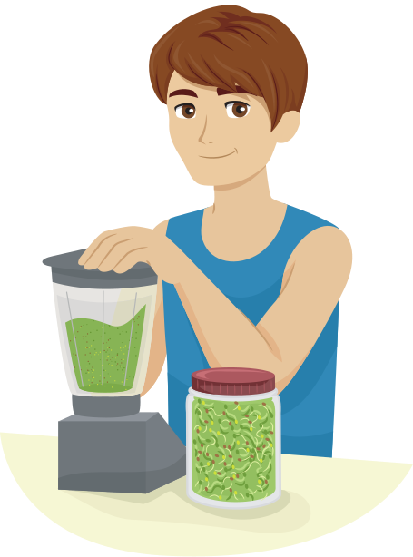



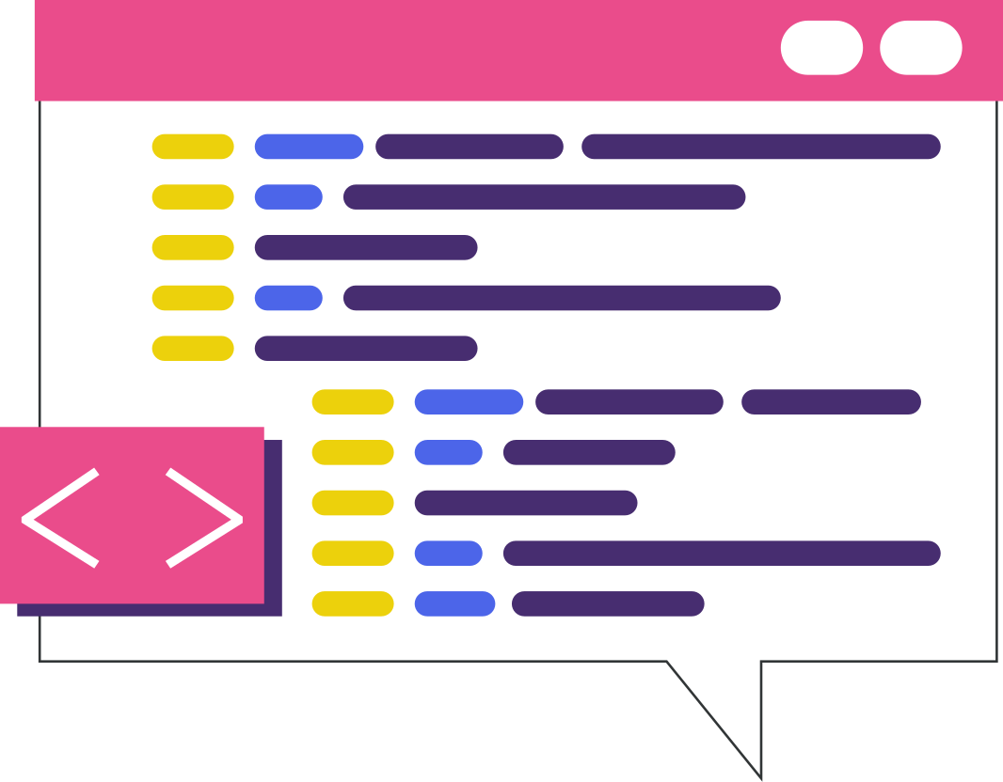
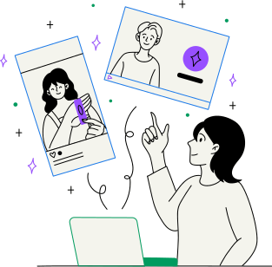
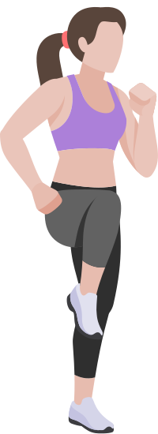

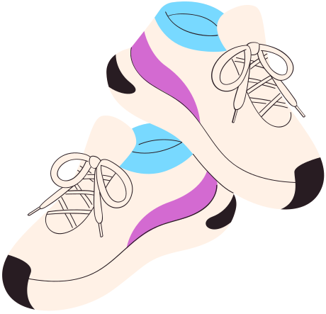

Recommendation Algorithms and Filter Bubbles at Work
The algorithm recommends a mix of content, and learns your preferences through your likes
The algorithm learns that you like healthy eating and workout videos
The app will prioritise health and fitness content since it thinks you’ll enjoy it the most
You end up in a filter bubble where your feed is filled with only health and fitness content
You like a post from an influencer for a healthy green smoothie recipe
CYBERLITE.ORG
2023-2024 Ⓒ Cyberlite Books Pte. Ltd. All Rights Reserved.

Slide 12
Why Should You Be Aware of Filter Bubbles?
While recommendations can make your online experience more enjoyable, it also limits your exposure to diverse perspectives and ideas, reinforcing the filter bubble effect.
Filter bubbles can limit your exposure to diverse viewpoints and create a sense of information isolation. They may reinforce existing beliefs and lead to echo chambers.
CYBERLITE.ORG
2023-2024 Ⓒ Cyberlite Books Pte. Ltd. All Rights Reserved.

Slide 13
Breaking Out of the Filter Bubble
Actively seek out content from diverse sources and engage with content that challenges your existing beliefs.
Consciously diversify your online interactions
Counter the influence of recommendation algorithms and access a broader range of information.
CYBERLITE.ORG
2023-2024 Ⓒ Cyberlite Books Pte. Ltd. All Rights Reserved.

Slide 14
ACTIVITY
Filter Bubble Scenarios
Predict the filter bubbles these people might fall into and the impact.
CYBERLITE.ORG
2023-2024 Ⓒ Cyberlite Books Pte. Ltd. All Rights Reserved.

Slide 15
Instructions
  Split into pairs or small groups.
  There are three profiles to choose from. Choose a profile to work on.
  In your groups, discuss the critical thinking questions.
  Present your predictions to the rest of the class.
CYBERLITE.ORG
2023-2024 Ⓒ Cyberlite Books Pte. Ltd. All Rights Reserved.

Slide 16



Critical Thinking Questions
Akhil, 15
Frequently watches nature documentaries, likes environmental posts, and follows wildlife conservation pages.
Analyse the profiles. Discuss and predict the kind of content the user might start seeing in their social media feeds or search engine results based on their online behaviours.
Consider these questions:
  The types of new posts, videos, or articles the user might be recommended.
  How the user's perception of ‘normal’ or ‘popular’ might be skewed based on these recommendations.
  The diversity (or lack thereof) of the content they are exposed to.
Natsuko, 19
Often searches for and watches fast food cooking videos, follows celebrity chefs who specialize in quick recipes.
Hakim, 22
Regularly reads and comments on political blogs, follows several political figures, and shares news articles related to political events.
CYBERLITE.ORG
2023-2024 Ⓒ Cyberlite Books Pte. Ltd. All Rights Reserved.

Slide 17
Group Sharing!
Share your work with the rest of the class.
CYBERLITE.ORG
2023-2024 Ⓒ Cyberlite Books Pte. Ltd. All Rights Reserved.

Slide 18
WRAP UP
What have you learned today?
Let’s reflect on today’s lesson.
CYBERLITE.ORG
2023-2024 Ⓒ Cyberlite Books Pte. Ltd. All Rights Reserved.

Slide 19
Remember This!
  Filter bubbles are created and maintained by recommendation algorithms, and understanding this relationship empowers you to take control of your online experience.
  Actively seek out diverse content and engage with different perspectives to broaden your digital horizons.
CYBERLITE.ORG
2023-2024 Ⓒ Cyberlite Books Pte. Ltd. All Rights Reserved.

Slide 20
Lesson 15.01.01
Well Done!
CYBERLITE.ORG
2023-2024 Ⓒ Cyberlite Books Pte. Ltd. All Rights Reserved.

