Slide 1
Escape the Attack
Lesson 13.02.02
PRIVACY & INFORMATION SECURITY
EXERCISE-IN-A-BOX

Slide 2

Have you ever heard of the word "hacker"? What comes to mind when you think of a hacker?
WARM-UP

Slide 3

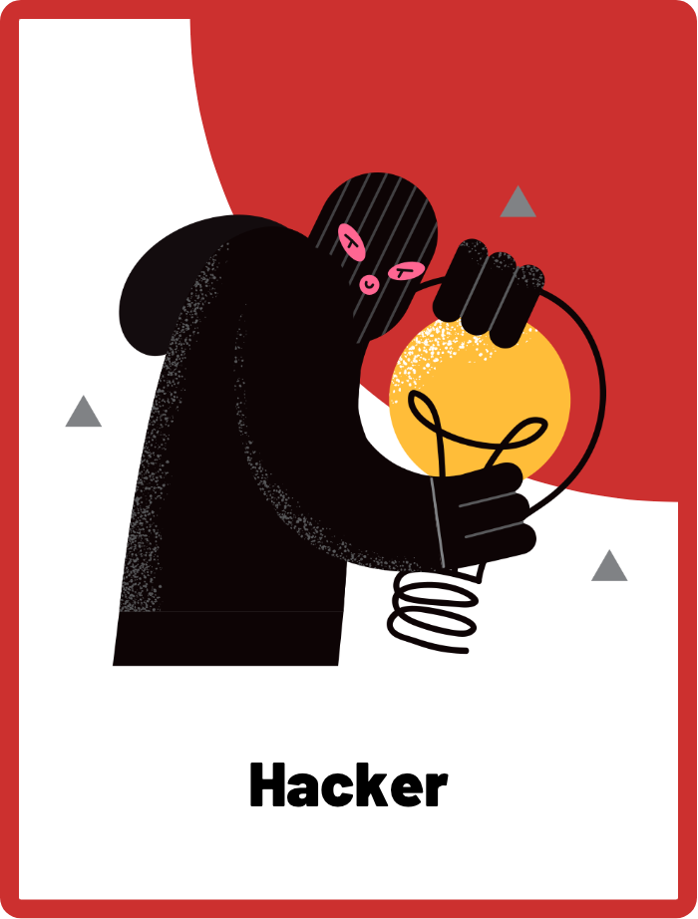
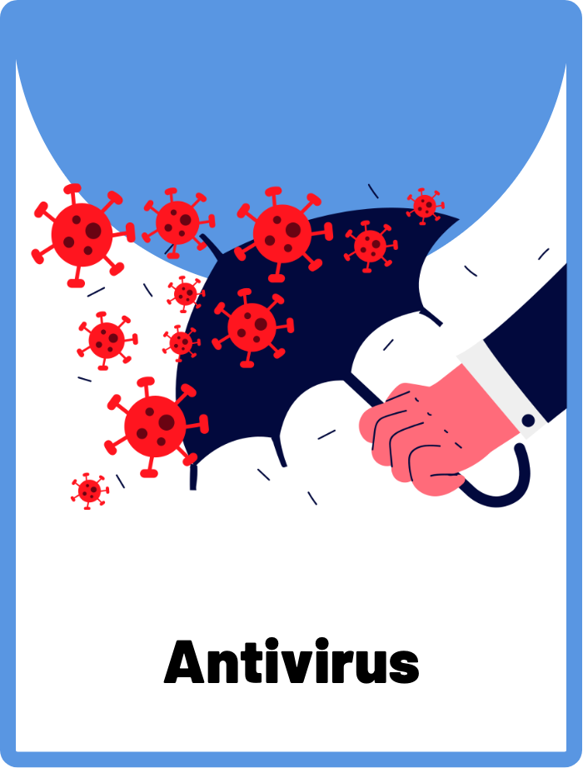

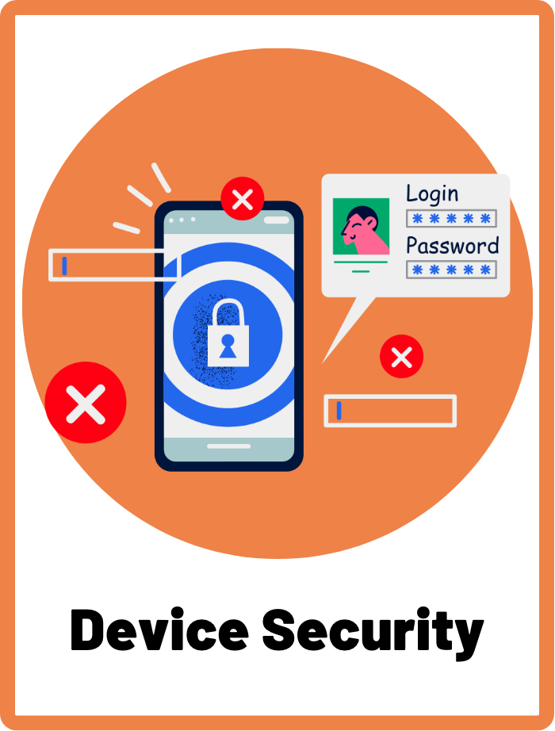
DEFINE THE KEYWORDS
What do you think these terms mean?

Slide 4
DEFINE
Hacker
There are many types of hackers, but the one we need to watch out for are the black hat hackers. A black hat hacker is a person who uses their computer skills with bad intentions to gain access to computer systems or data that they’re not supposed to access.

Slide 5
DEFINE
Antivirus
Antivirus is a software that helps protect your digital devices from getting infected by harmful software, or what is known as “viruses”. Just like how your body has an immune system to fight off germs, antivirus software helps your computer defend itself from bad things that can harm it.

Slide 6
DEFINE
Patching
Patching refers to the process of updating your software to fix any viruses or bugs that have been discovered. It's important to patch your software regularly to ensure that any security holes are closed and your device is protected from potential threats.

Slide 7
DEFINE
Device Security
Device security means taking steps to keep your electronic devices, such as your phone, tablet or computer, safe from potential harm. This includes using strong passwords, installing antivirus software, being careful about what you download or click on, and regularly updating your software to fix any security issues.

Slide 8

INVESTIGATE THE SCENARIO
Read the following evidence carefully to piece together the story. Think critically about the information you are examining and consider the questions.

Slide 9
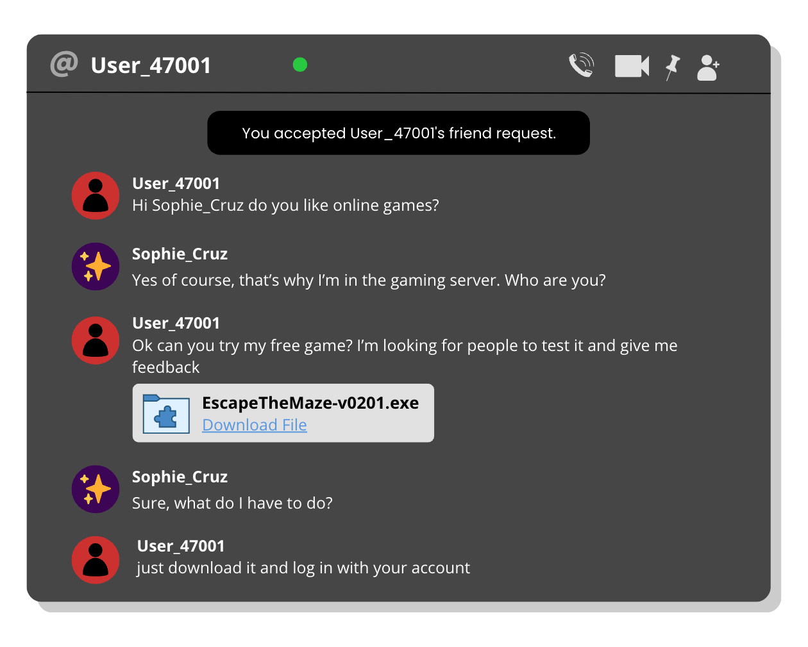
INVESTIGATE
EVIDENCE #1
TIP TO REMEMBER: Never click or download links from unknown users who you don’t trust!
LET’S DISCUSS
1. If you were Sophie, what would you do and how would you respond to User_47001?
2. What tactics have the hacker used to get Sophie to click on the link?

Slide 10
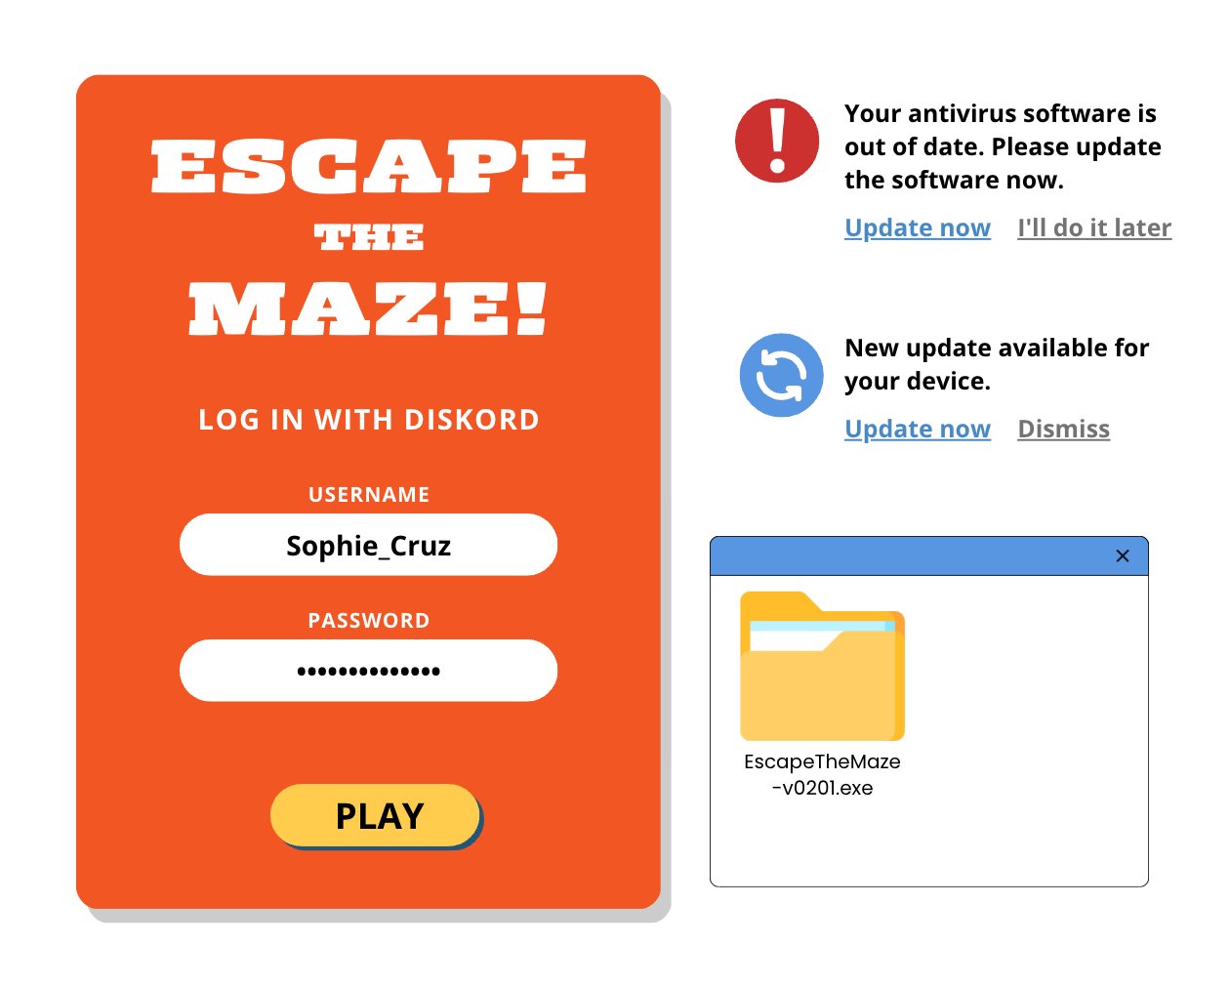
INVESTIGATE
EVIDENCE #2
TIP TO REMEMBER: Always update your devices whenever you see a patching notification. Also, install antivirus to make sure you don’t download any viruses!
LET’S DISCUSS
1. Sophie chooses to ignore the patching update for her antivirus software. What are the potential consequences of that?
2. Why is it not a good idea to enter your credentials (username and password) to an unofficial app?

Slide 11
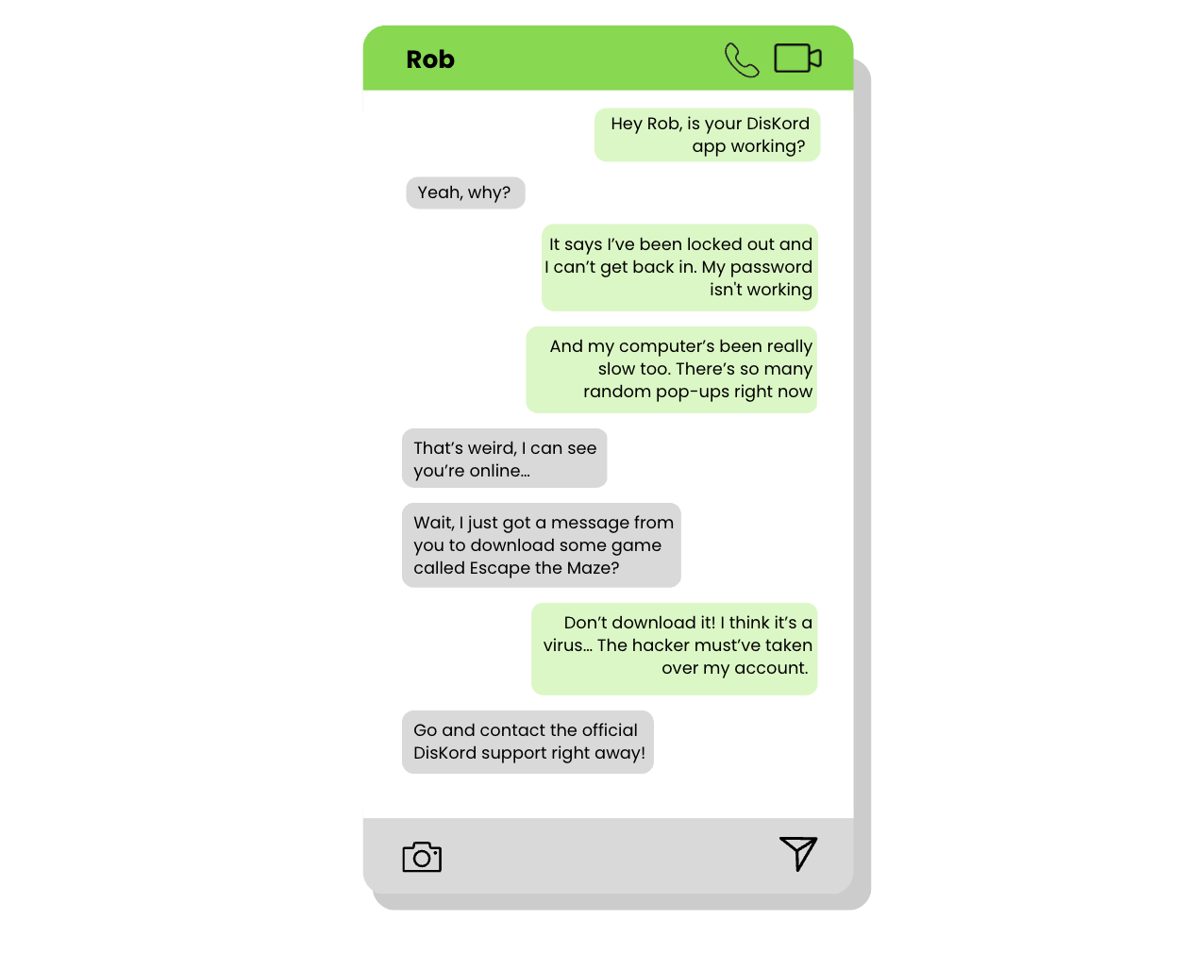
INVESTIGATE
EVIDENCE #3
TIP TO REMEMBER: If you receive a strange request from a friend out of the blue, call them directly to verify that their account hasn’t been hacked.
LET’S DISCUSS
1. Why do you think Sophie has been locked out of her DisKord account?
2. If you were Rob and you received a strange request from a friend, what should you do?

Slide 12
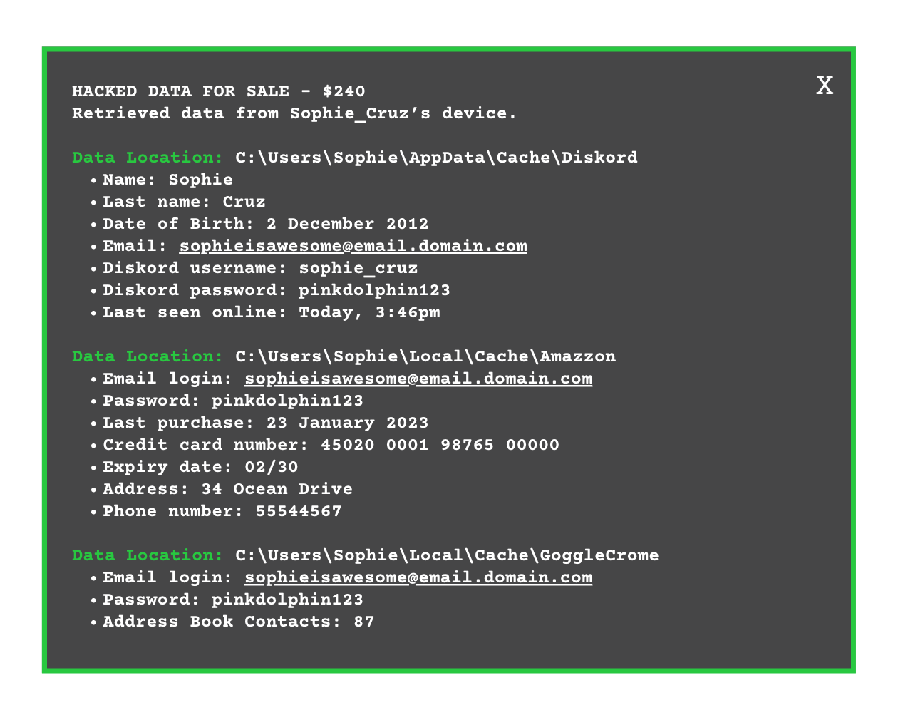
INVESTIGATE
EVIDENCE #4
TIP TO REMEMBER: Your personal data is very valuable and can be sold for lots of money on illegal platforms. This is a great motivation for many black hat hackers.
LET’S DISCUSS
1. What kind of information is most valuable to a hacker?
2. How do you think the hacker has been able to access Sophie’s data?
3. What security mistakes has Sophie made?

Slide 13
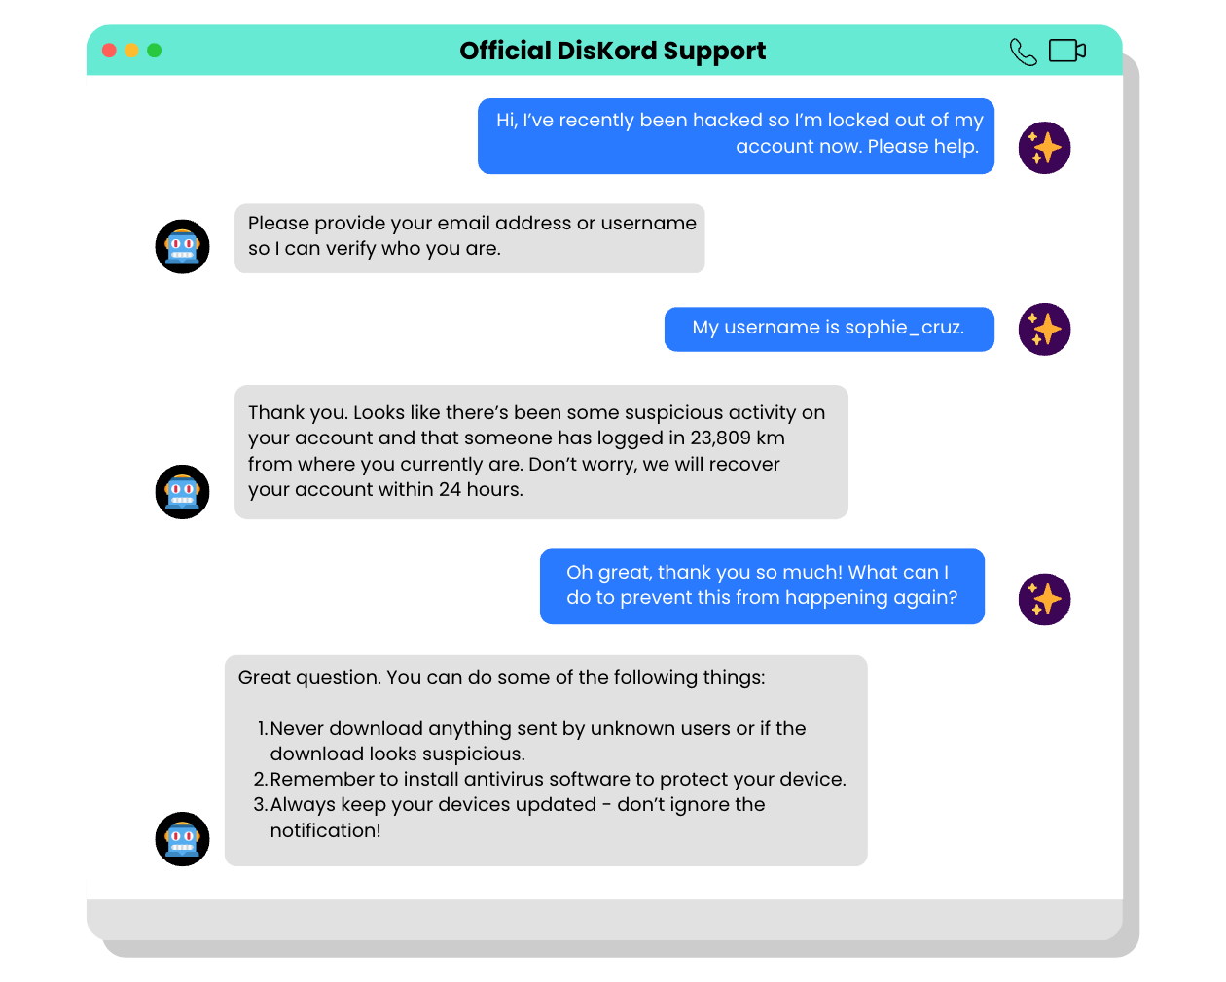
INVESTIGATE
EVIDENCE #5
TIP TO REMEMBER: If you are ever locked out of your account, always contact the official support centre of the game or app you’re using. They can help you recover your account and block the person who stole your credentials.
LET’S DISCUSS
1. Can you think of other ways to protect yourself from computer viruses?

Slide 14

PROJECT WORK
Research and create a visual report on a black, white, green, blue, or red hat hacker.
Hackers are not always bad people. The ones we should watch out for are black hat hackers, but did you know there are other types of hackers? Your report should illustrate what a hacker does, their main motivations, and who their target is.

Slide 15
Research and create a visual report on a black, white, green, blue, or red hat hacker.
What should your project outcome look like?
Hackers are not always bad people. The ones we should watch out for are black hat hackers, but did you know there are other types of hackers? Your report should illustrate what a hacker does, their main motivations, and who their target is.
Instructions and Questions to Consider:
Choose a colour hat hacker to research (black hat, white hat, green hat, blue hat, or red hat).
What does the colour hat of your chosen hacker represent? What kind of activities does the hacker engage in?
What motivates the hacker to engage in these activities?
Who are the typical targets of their attacks? Is it individuals or big companies?
Compile your research into a visual report.

Slide 16
Share Your Project!
Present your projects to the class.

Slide 17

KEY TAKEAWAYS
Hackers are people who try to gain unauthorised access to devices and systems. They can have good or bad intentions, and their actions can have a big impact on individuals and organisations.
Antivirus software and patching are important tools for protecting devices from malware and cyber attacks.
Remember to keep your devices up to date.
Never click or download anything online that’s not from an official website.
If your friend sends you a strange request or message out of the blue, communicate with them on a different channel to make sure their account hasn’t been hacked.

Slide 18
Well Done!
Lesson 13.02.02

