Slide 1
Friendship Requested
LESSON 3.5
ONLINE RELATIONSHIPS
EXERCISE-IN-A-BOX

Slide 2

Have you ever talked to someone online that you didn’t know in real life? How did you meet them?
WARM-UP

Slide 3

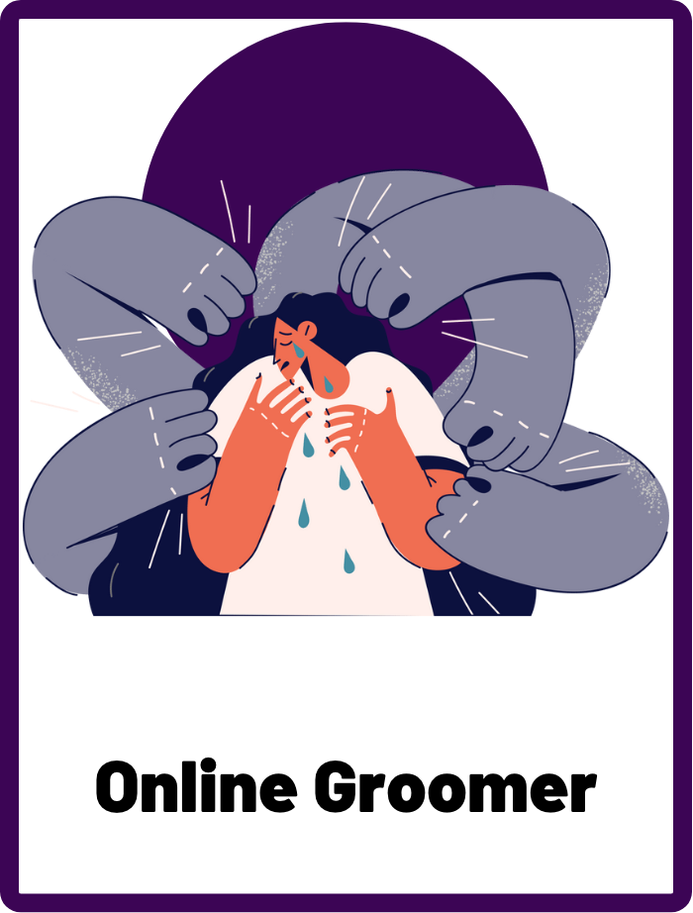
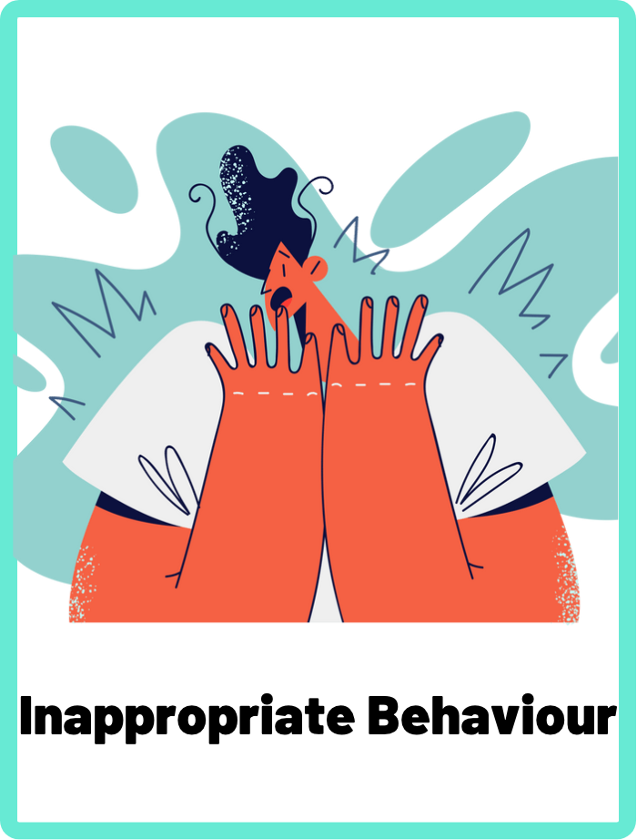
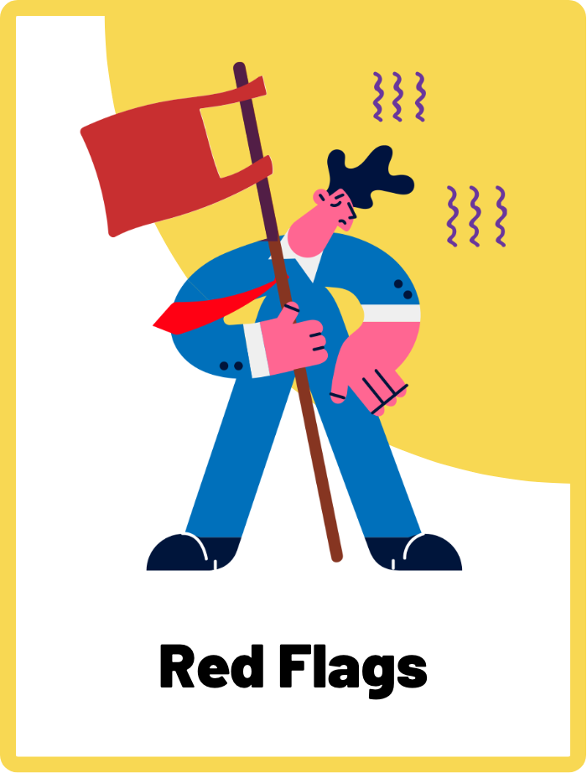
DEFINE THE KEYWORDS
What do you think these terms mean?

Slide 4
DEFINE
Online Groomer
An online groomer or predator is a person who builds a relationship with a young person online, with the intention of exploiting or abusing them. Groomers often use tricks and manipulative tactics to gain a young person's trust and establish a relationship with them. They may try to convince the young person to share personal information or images, or to meet in person.

Slide 5
DEFINE
Inappropriate Behaviour
Inappropriate behaviours refer to actions or communications that violate someone's online boundaries or make them feel uncomfortable or unsafe. These behaviours can take many forms and include things like cyberbullying, harassment, sharing or requesting inappropriate content, and online grooming.

Slide 6
DEFINE
Red Flags
Red flags refer to warning signs or indicators that something may be wrong or potentially unsafe. In the context of online safety, red flags can be behaviours, communications, or situations that make someone feel uncomfortable, scared, or threatened. Red flag feelings, on the other hand, are the emotions or gut reactions that someone may experience when encountering a red flag. These feelings can include things like fear, anxiety, discomfort, or a sense that something is not right.

Slide 7

INVESTIGATE THE SCENARIO
Read the following evidence carefully to piece together the story. Think critically about the information you are examining and consider the questions.

Slide 8
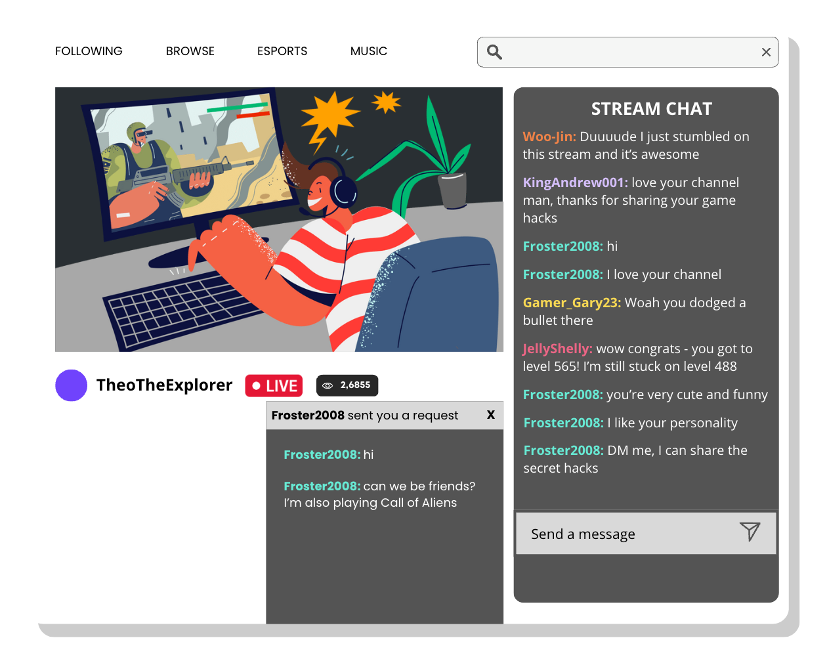
INVESTIGATE
EVIDENCE #1
LET’S DISCUSS
1. What’s different about Froster2008’s tone of voice compared to the other commenters?
2. Why is it a bad idea to accept a stranger’s friend request or direct message?

Slide 9
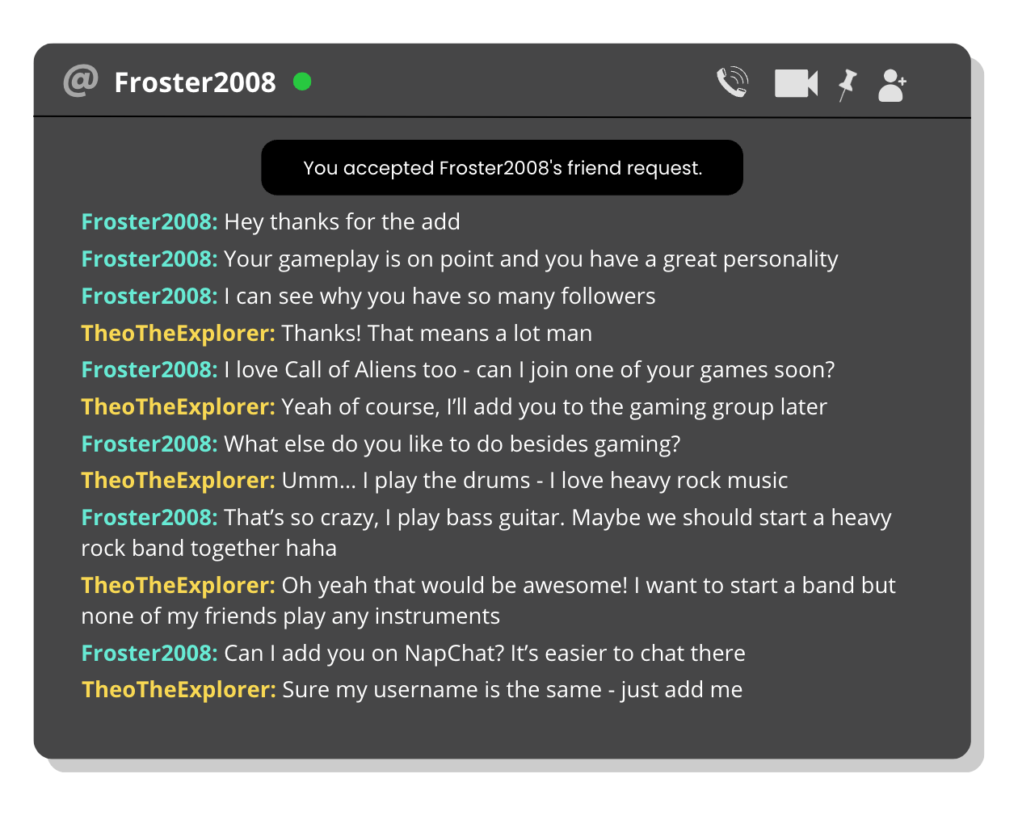
INVESTIGATE
EVIDENCE #2
LET’S DISCUSS
1. What manipulation tactics has Froster2008 used to get Theo to be his friend?
2. What is Froster2008 trying to achieve by moving to a different platform (Napchat)?

Slide 10
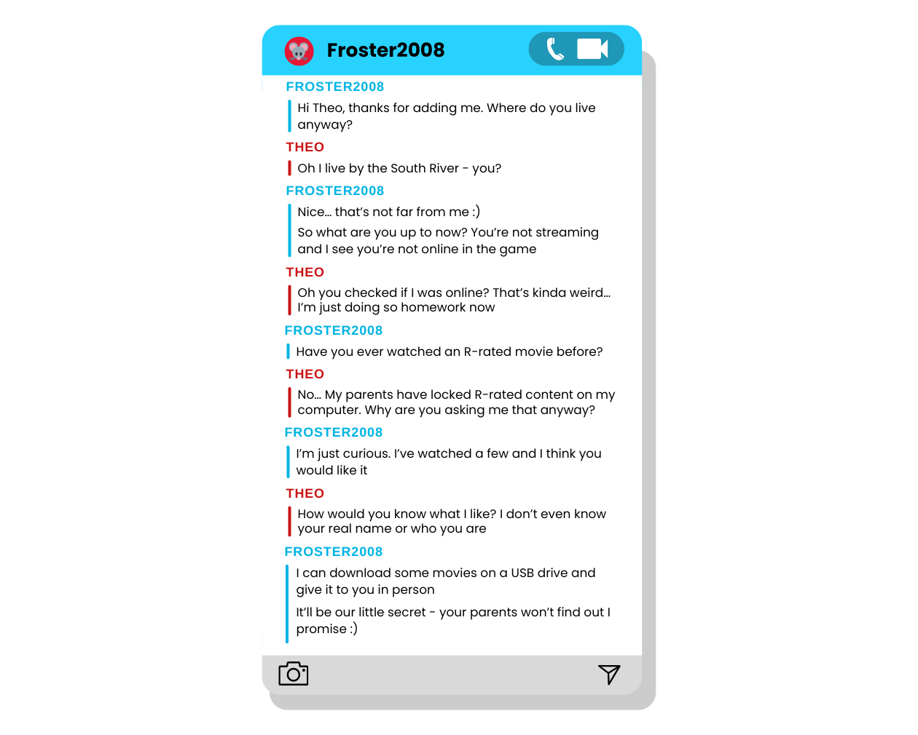
INVESTIGATE
EVIDENCE #3
LET’S DISCUSS
1. When does Froster2008 cross the line and display inappropriate behaviour?
2. How do you think this conversation makes Theo feel?
3. Identify the red alert words or sentences in this conversation and describe why it’s dangerous or harmful.

Slide 11
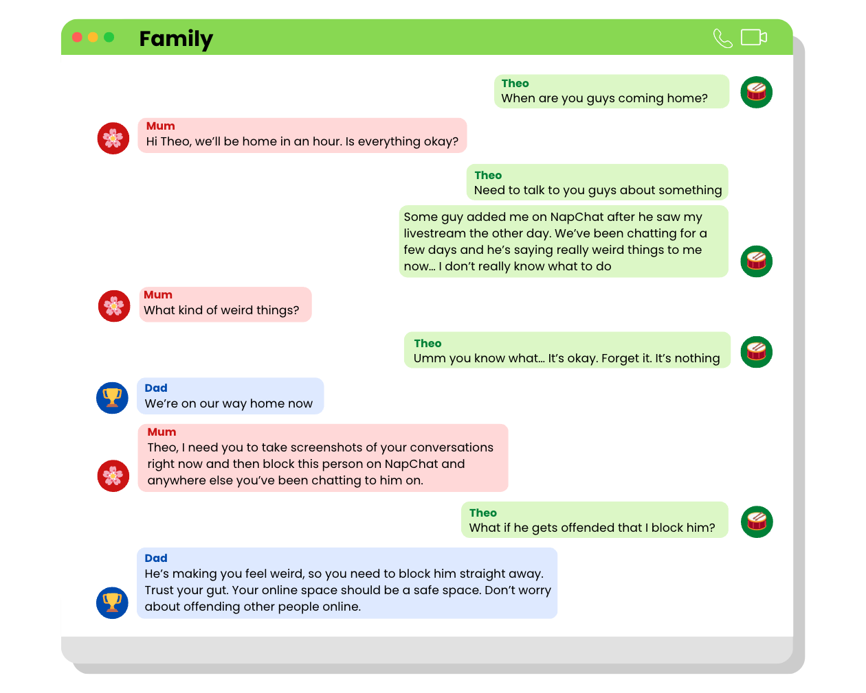
INVESTIGATE
EVIDENCE #4
LET’S DISCUSS
1. Do you think Theo did the right thing by telling his mum and dad that he feels weird about his conversation with Froster2008?
2. If you ever encounter red flags or red flag feelings, what should you do?

Slide 12
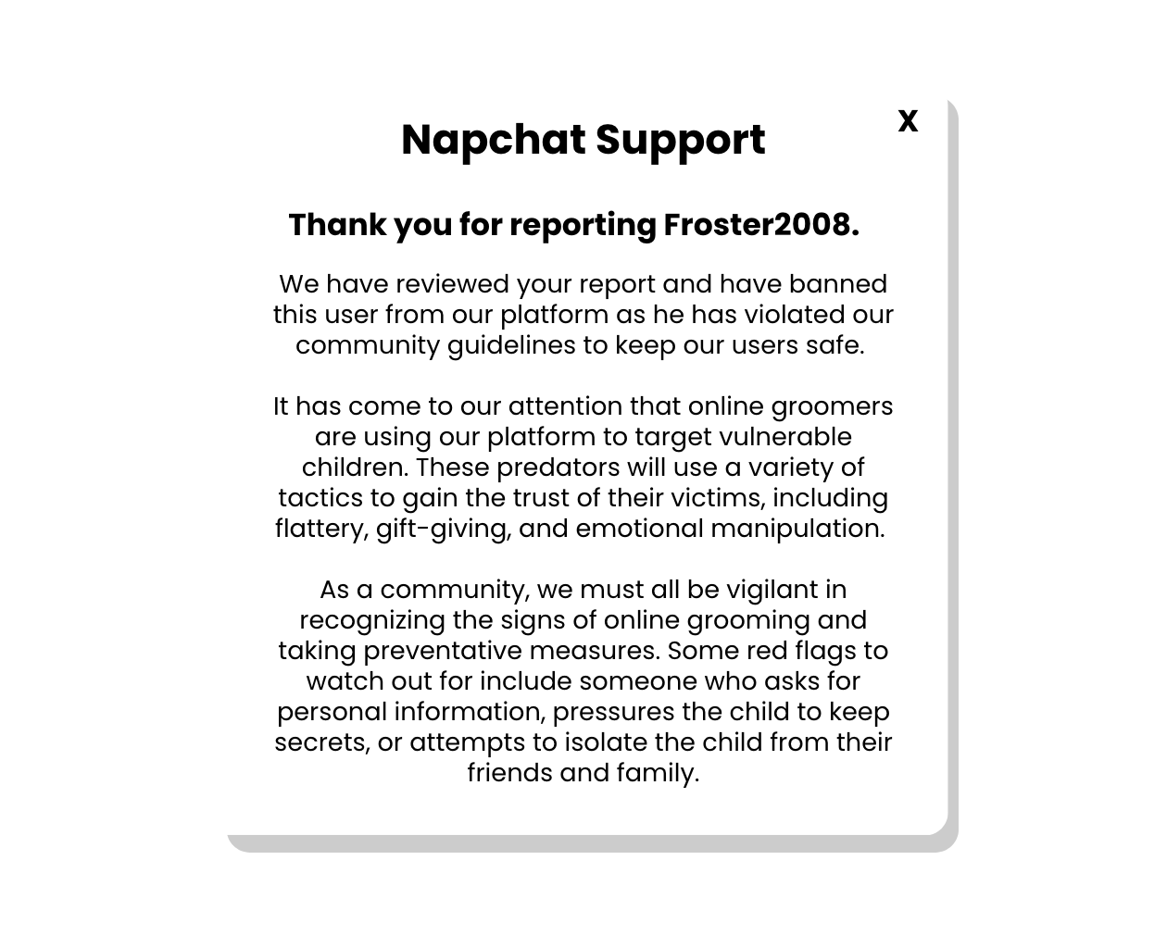
INVESTIGATE
EVIDENCE #5
LET’S DISCUSS
1. Why is it important to report users like Froster2008 for inappropriate behaviours to apps, games, and social media platforms?
2. Does it matter if Froster2008 was offended that Theo reported him?

Slide 13

KEY TAKEAWAYS
Online groomers and predators exist in all corners of the internet, so be alert when you’re online and never befriend people you don’t know in real life. You can never be sure of who you’re talking to online.
Always listen to your gut and look out for red flags and red flag feelings.
If you encounter someone online that’s making you feel anxious, worried, or uncomfortable, tell a trusted adult like your parents, caretakers, teachers, or older sibling.
Reporting inappropriate behaviour won’t get you in trouble. By doing so, you are helping to protect yourself and others.

Slide 14
Well Done!
LESSON 3.5

