Slide 1
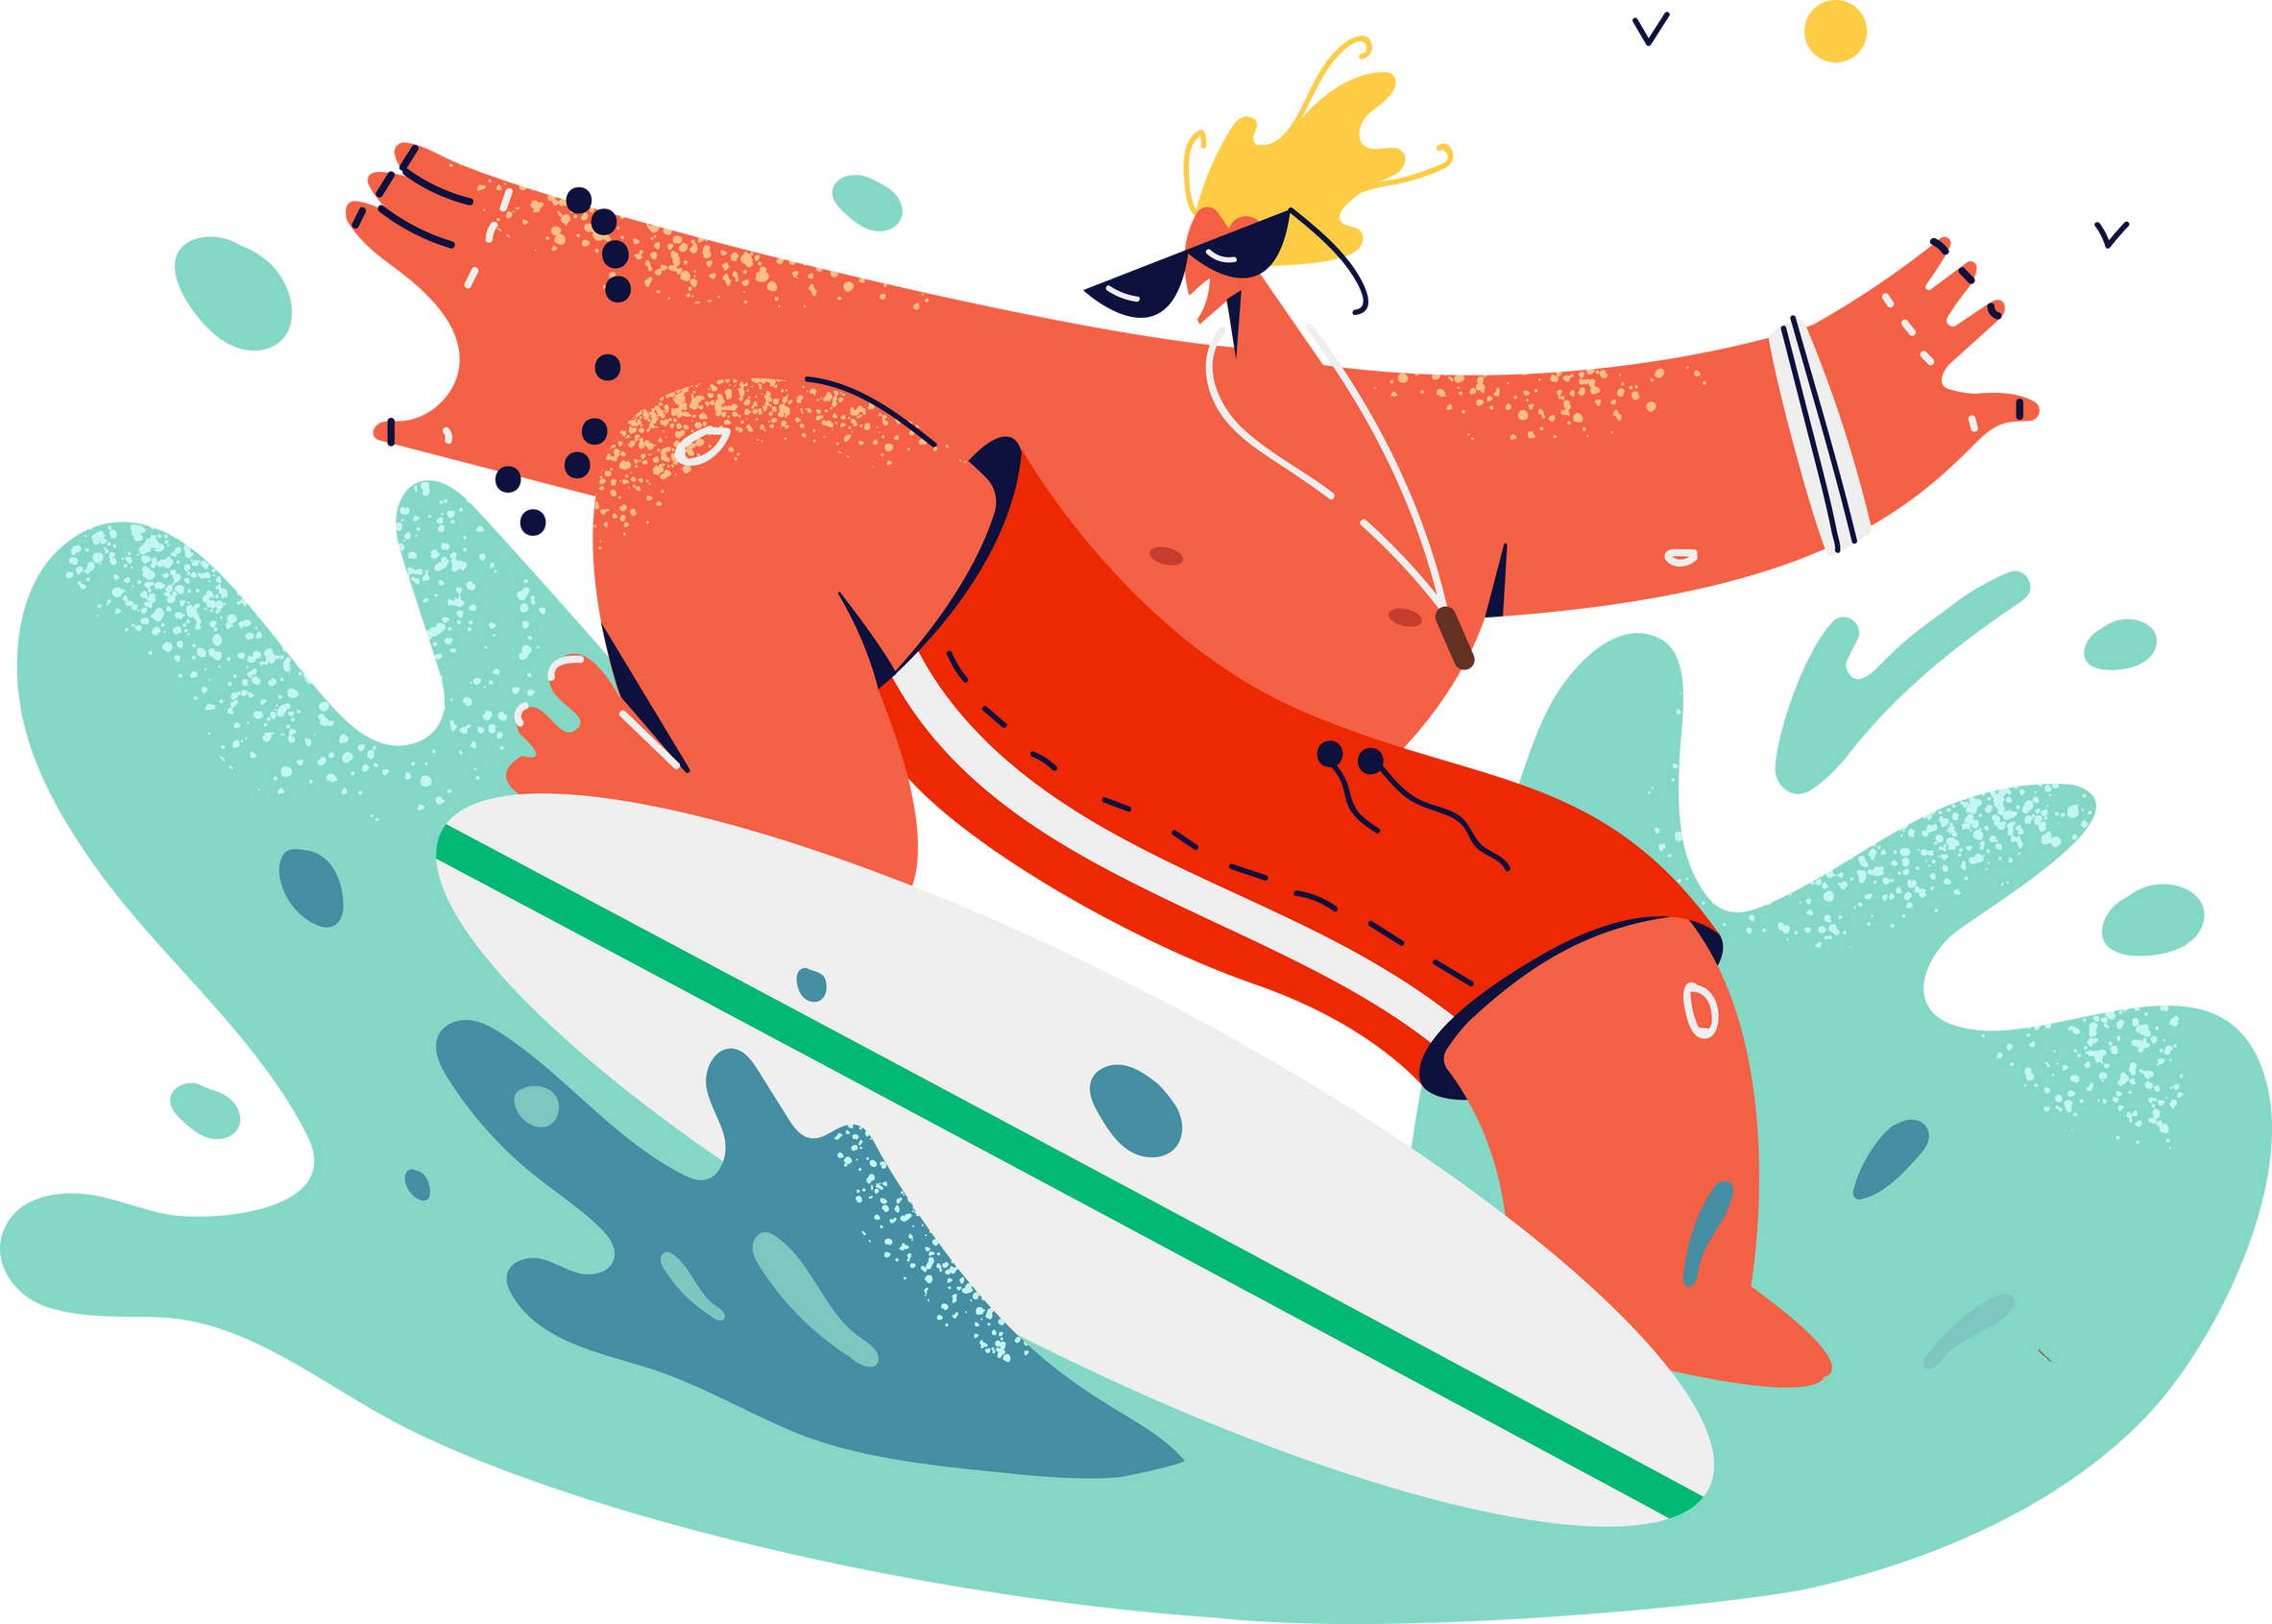
Lesson 07.02.01
PRIVACY & INFORMATION SECURITY
Surfing Safely
Navigating the internet with secure steps

Slide 2
There are websites that are appropriate and safe for children, and websites that are not appropriate.
What are we learning today?
The rules of safe browsing

Slide 3
WARM UP QUESTION
What do we use the internet for?

Slide 4
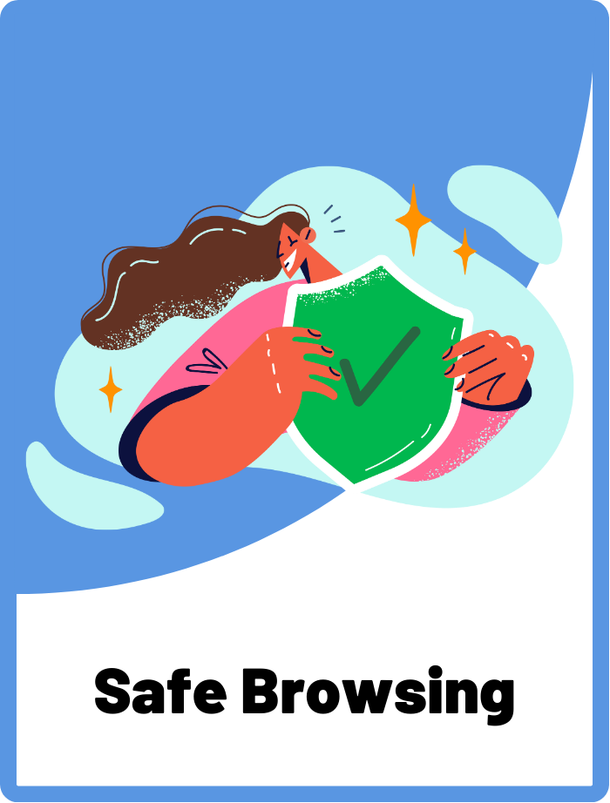
Safe Browsing
Using the internet in a way that keeps personal information secure and avoids harmful websites.

Slide 5
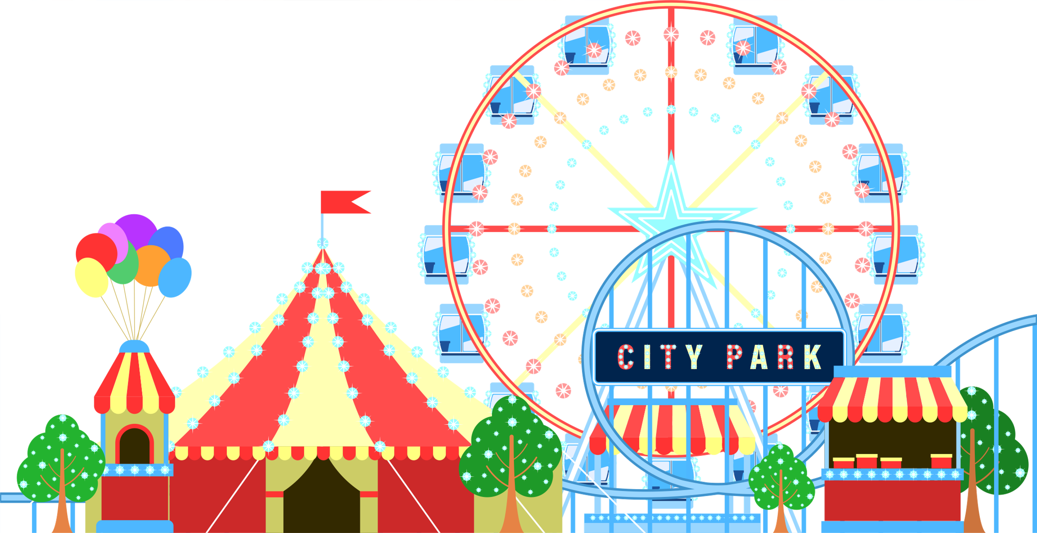
The Internet is like a Theme Park
Think of the internet as a giant, magical theme park. In this park, there are lots of different areas to play in, just like different websites on the internet.

Slide 6
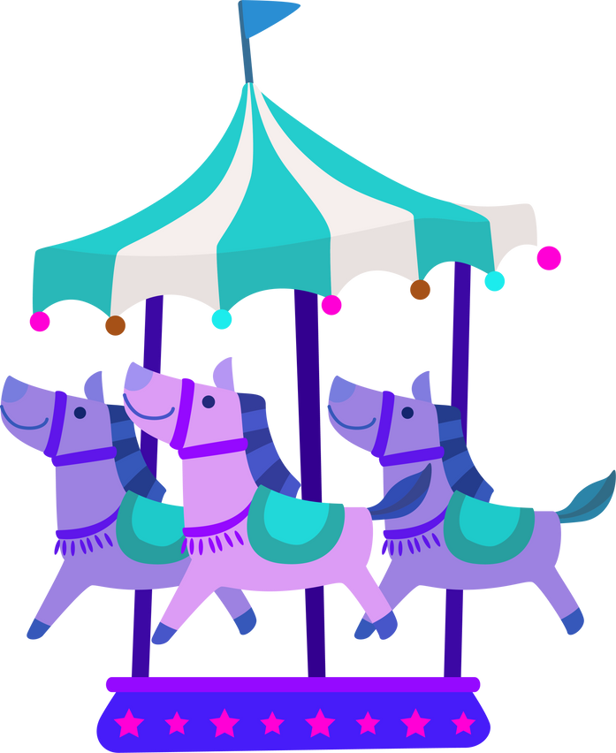
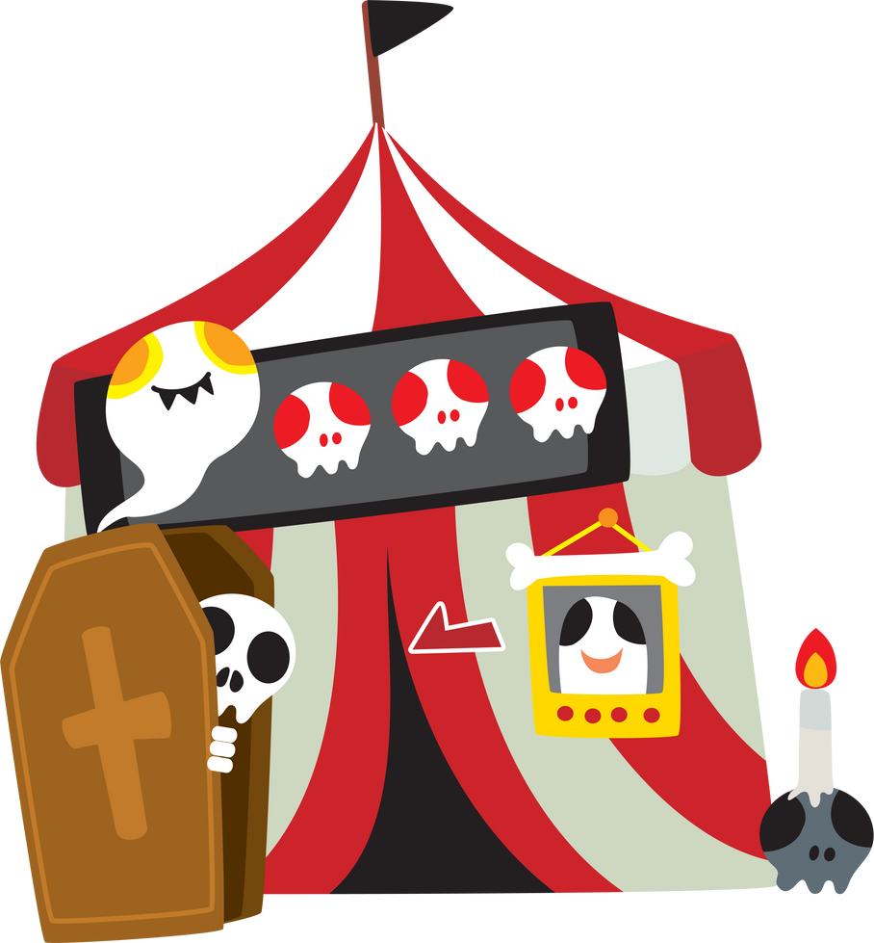
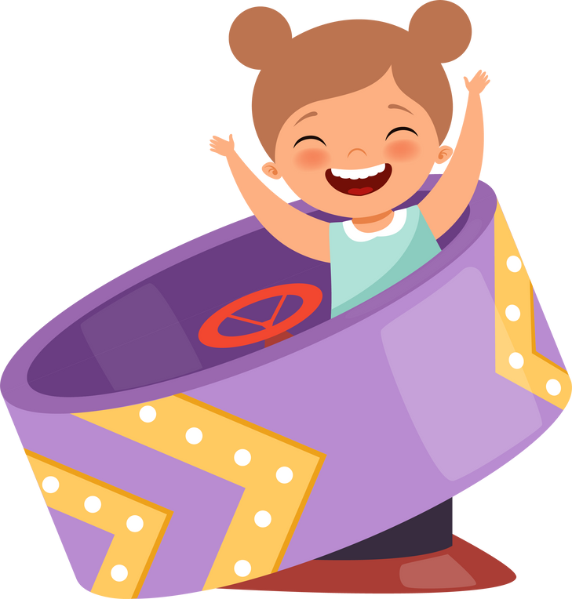

Surfing Safely Online
Just like a theme park in the real world...
13+ ONLY
...there are areas on the internet that are safe for kids...
...and other places that are for older teens and adults only!

Slide 7




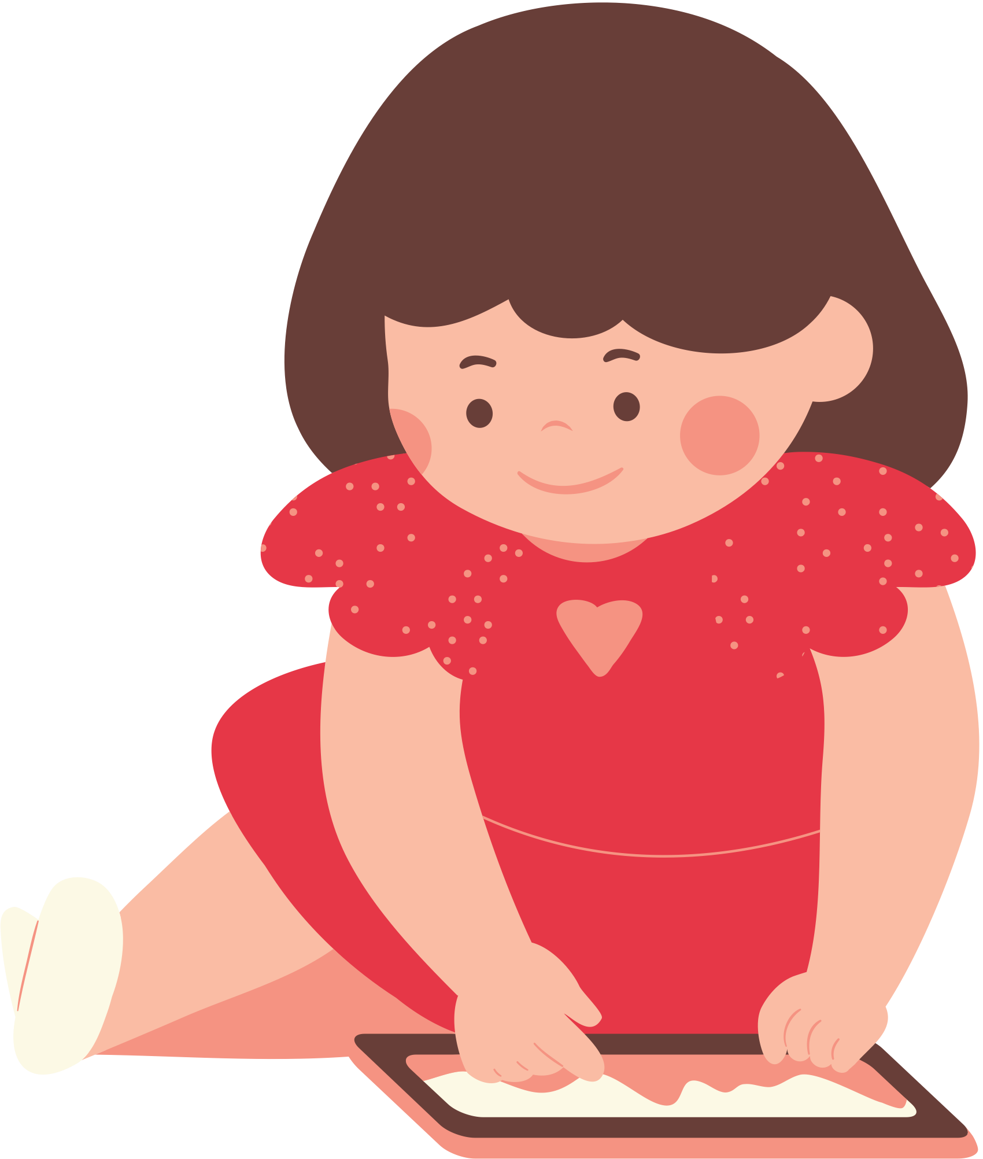

Safe to Play Areas
There are safe websites that are made just for kids, with games, cartoons, and learning activities that are just right for you.
What are some apps or websites you like to visit?

Slide 8
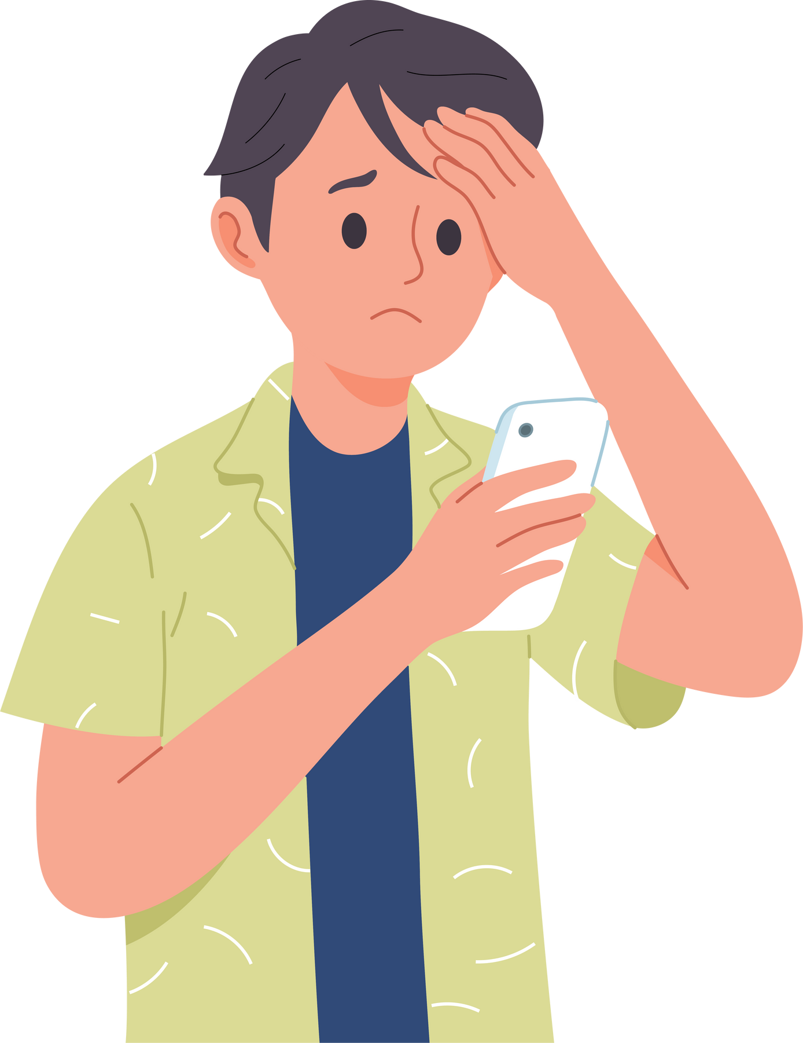
Stay Away Areas
Like the theme park, some areas are not safe for kids to play in. These are websites that might have content that is confusing, scary, or not meant for kids.
That’s why you should always ask a parent or teacher for permission before visiting a new website or downloading an app!

Slide 9
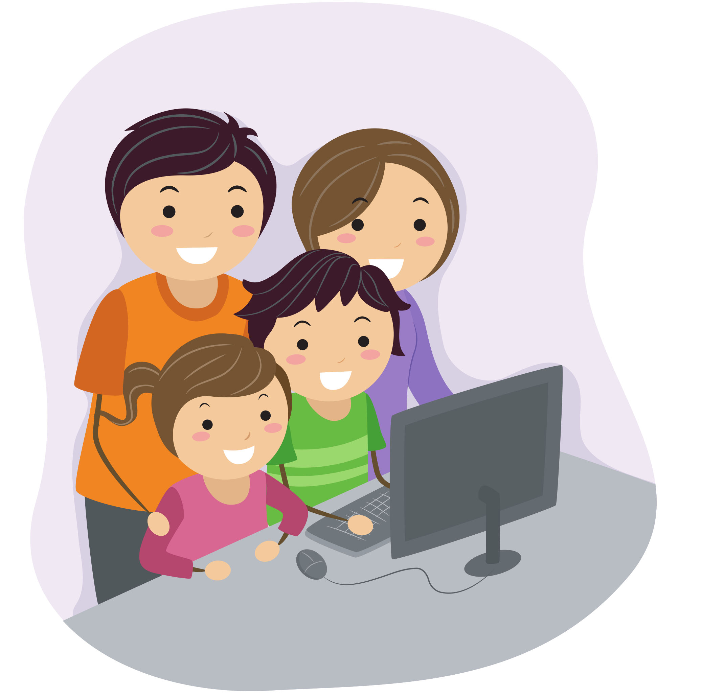

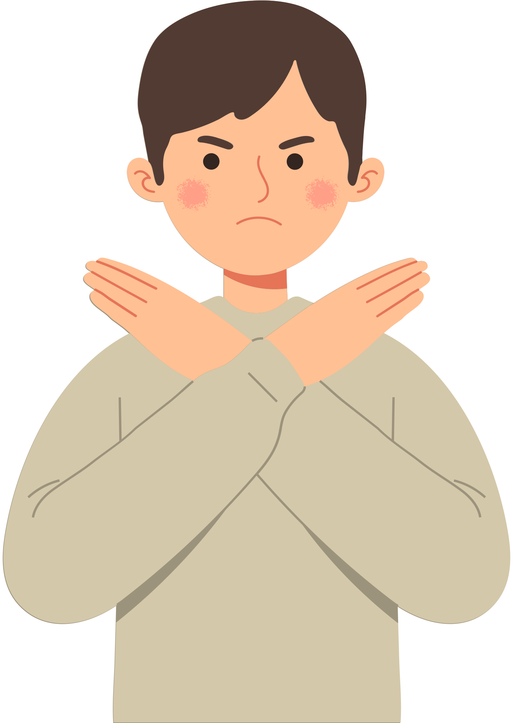

Rules for Safe Browsing
Just like how there are rules for playing safely in the theme park, there are rules for being safe online!
Ask for Permission
Be careful what you click on
Don’t talk to strangers

Slide 10
ACTIVITY
Safe to Play or Stay Away?
Decide with a thumbs up or thumbs down!

Slide 11


Instructions
Can you tell if something is safe or not safe?
Thumbs Up to say “IT’S SAFE!”
Thumbs DOWN to say “IT’S NOT SAFE!”

Slide 12
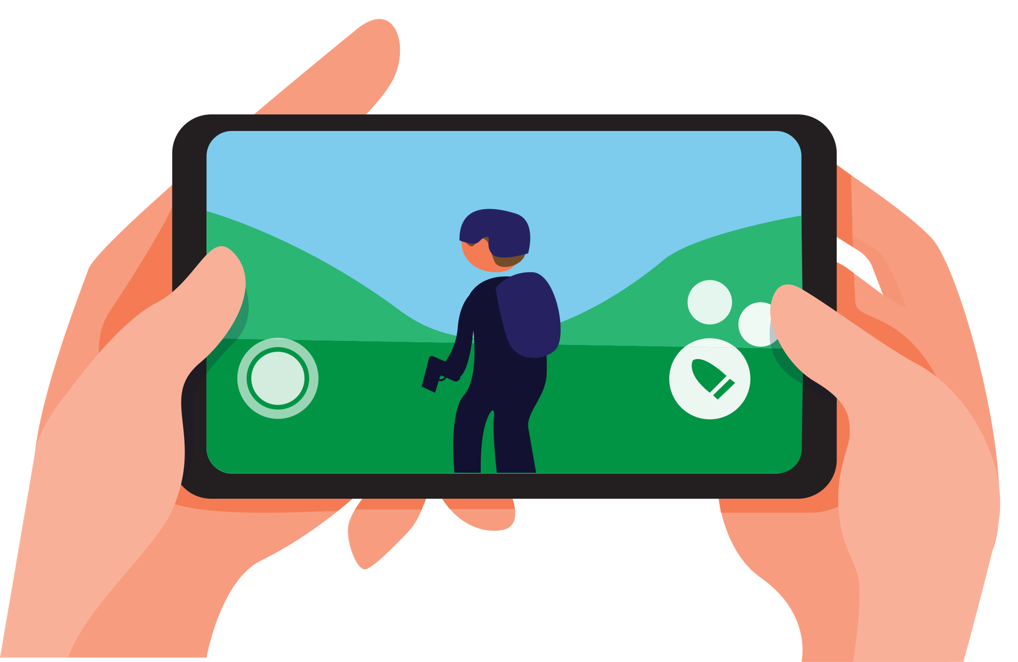
QUESTION 1
This game for 13+ year olds
Safe?
Not Safe?

Slide 13
QUESTION 1
This game for 13+ year olds
Not Safe!

Slide 14
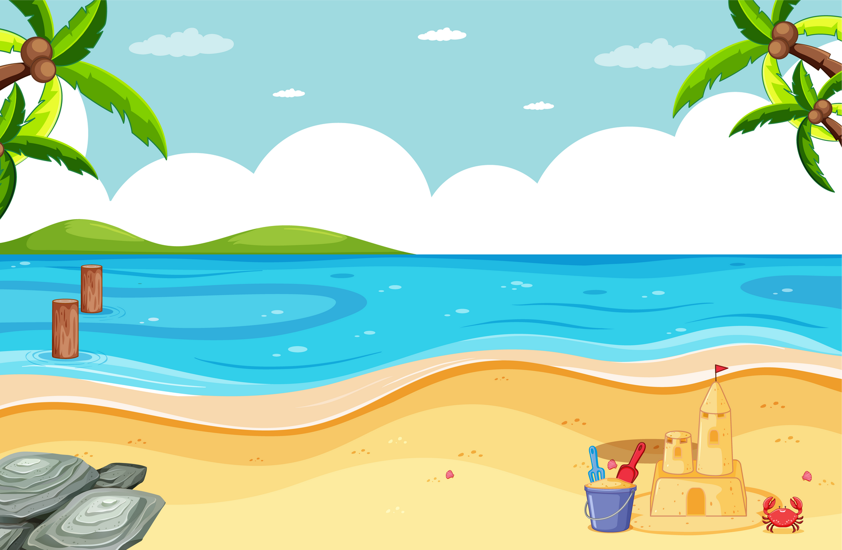

QUESTION 2
This video on YouTube Kids
Safe?
Not Safe?

Slide 15
QUESTION 2
This video on YouTube Kids
Safe!

Slide 16
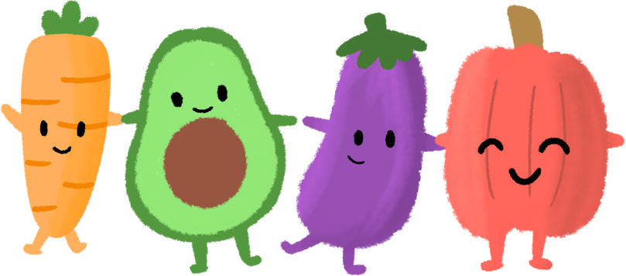
QUESTION 3
This app that teaches math
1...2...3...4!
Safe?
Not Safe?

Slide 17
QUESTION 3
This app that teaches math
1...2...3...4!
Safe!

Slide 18

QUESTION 4
This news website
Safe?
Not Safe?

Slide 19
QUESTION 4
This news website
Not Safe!

Slide 20
WRAP UP
What have you learned today?
Let’s reflect on today’s lesson.

Slide 21
Remember This!
  Always be smart and careful when you're using the internet.
  Follow the rules for safe browsing:
    Ask for permission
    Be careful what you click on
    Don’t talk to strangers
  Ask for help from a parent or teacher if you’re worried or confused which websites are safe to play and which ones you should stay away from.

Slide 22

Lesson 07.02.01
Well Done!
CYBERLITE.ORG
2023-2024 Ⓒ Cyberlite Books Pte. Ltd. All Rights Reserved.

