Slide 1
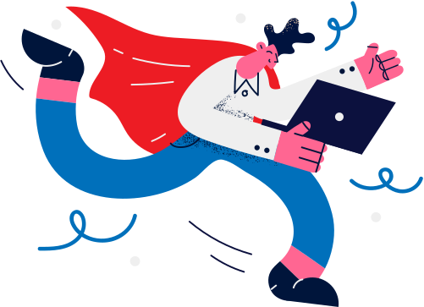

Lesson 09.01.01
DIGITAL IDENTITY
Positive Digital Citizens
Exploring our roles as digital citizens
CYBERLITE.ORG
2023-2024 Ⓒ Cyberlite Books Pte. Ltd. All Rights Reserved.

Slide 2
The qualities of a positive digital citizen
What are we learning today?
Responsible online behaviours
CYBERLITE.ORG
2023-2024 Ⓒ Cyberlite Books Pte. Ltd. All Rights Reserved.

Slide 3
WARM UP QUESTION
What do you think it means to be a good person online?
CYBERLITE.ORG
2023-2024 Ⓒ Cyberlite Books Pte. Ltd. All Rights Reserved.

Slide 4

Positive Digital Citizen
Someone who engages responsibly, ethically, and safely in the digital world, contributing positively to online communities.
CYBERLITE.ORG
2023-2024 Ⓒ Cyberlite Books Pte. Ltd. All Rights Reserved.

Slide 5
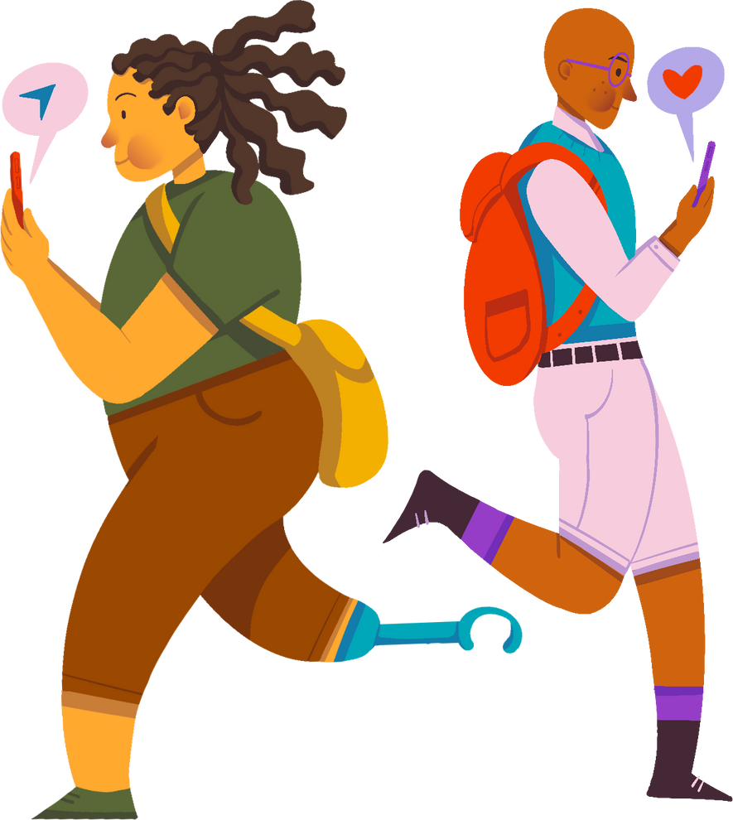
What is a positive digital citizen?
A positive digital citizen is someone who uses the internet and technology in a friendly and helpful way.
It's like being a good friend both online and offline, and it makes the online world a better place!
CYBERLITE.ORG
2023-2024 Ⓒ Cyberlite Books Pte. Ltd. All Rights Reserved.

Slide 6
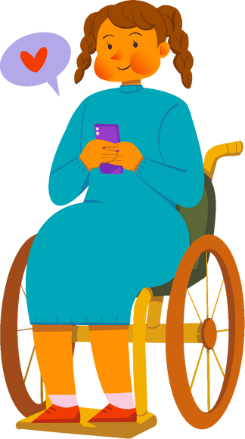
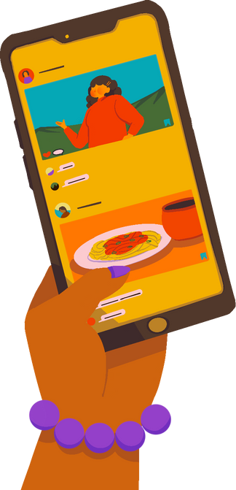
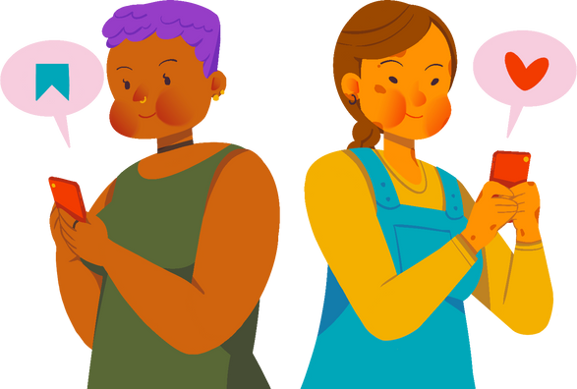
What are good online behaviours?
Being kind and nice to others online
Helping friends when they need it
Using technology to learn and explore
What other positive behaviours can you think of?
CYBERLITE.ORG
2023-2024 Ⓒ Cyberlite Books Pte. Ltd. All Rights Reserved.

Slide 7
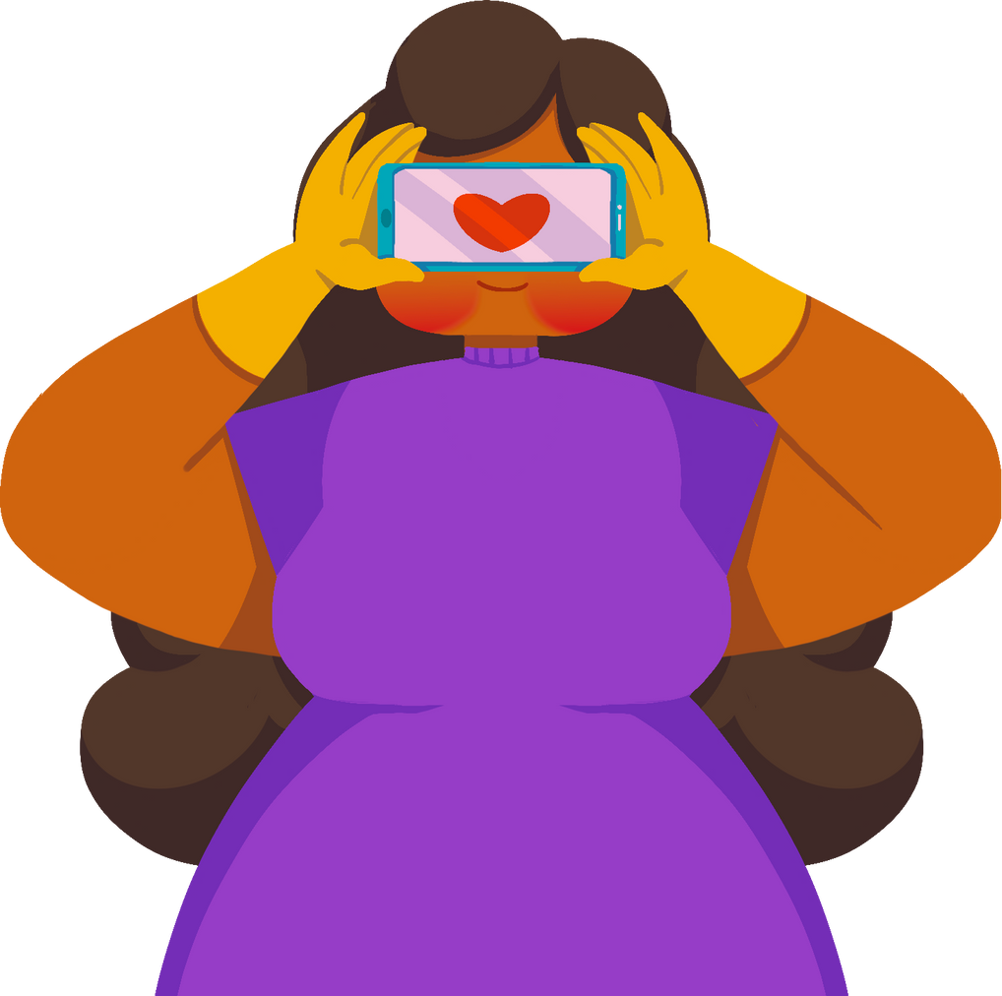
Why should we be positive digital citizens?
Being a positive digital citizen helps create a safe and happy online community for everyone.
It's important to treat others on the internet just like we'd want to be treated in real life.
CYBERLITE.ORG
2023-2024 Ⓒ Cyberlite Books Pte. Ltd. All Rights Reserved.

Slide 8
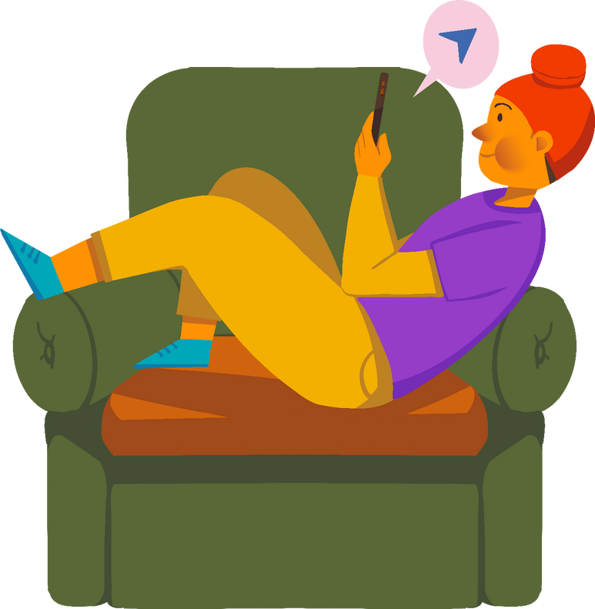
Rules to Remember
Be kind and respectful when you talk to others online. Use polite words and good manners.
Think before you post or comment. Make sure your words and actions won't hurt someone's feelings.
Don’t share any personal information to others online, especially with people you don’t know in real life.
Report any mean or worrying things you see online to a trusted adult. Make cyberspace a positive experience for everyone!
CYBERLITE.ORG
2023-2024 Ⓒ Cyberlite Books Pte. Ltd. All Rights Reserved.

Slide 9
ACTIVITY
My Positive Pledge
Write a pledge to be a positive digital citizen.
CYBERLITE.ORG
2023-2024 Ⓒ Cyberlite Books Pte. Ltd. All Rights Reserved.

Slide 10
What You’ll Need
  Paper or notebook
  Pens or pencils
  Stickers or other decorative materials
You can also complete this activity with a computer using Microsoft Word or Google Docs!
CYBERLITE.ORG
2023-2024 Ⓒ Cyberlite Books Pte. Ltd. All Rights Reserved.

Slide 11
Instructions
I pledge to be a positive digital citizen by...
Let’s create a pledge to be positive digital citizens! This pledge is like making a promise to behave appropriately when you go online.
1. At the top of your paper, write this:
“I pledge to be a positive digital citizen by...”
CYBERLITE.ORG
2023-2024 Ⓒ Cyberlite Books Pte. Ltd. All Rights Reserved.

Slide 12
Instructions
I pledge to be a positive digital citizen by...
  Being kind and nice to others online
2. Think about the behaviours of being a positive digital citizen we’ve learned today. Write down a list of these behaviours you promise to keep.
Look at this example on the right.
Try and think of at least three more good behaviours!
CYBERLITE.ORG
2023-2024 Ⓒ Cyberlite Books Pte. Ltd. All Rights Reserved.

Slide 13

Instructions
I pledge to be a positive digital citizen by...
  Being kind and nice to others online
  Helping my friends when they need it.
  Thinking before I post or comment.
  Telling an adult if I see something mean or worrying.
3. Decorate your pledge and keep it somewhere you’ll see often. Remember to sign your name and write down the date when you’re finished with the pledge!
Date
CYBERLITE.ORG
2023-2024 Ⓒ Cyberlite Books Pte. Ltd. All Rights Reserved.

Slide 14
Group Sharing!
Share your pledge with the rest of the class.
CYBERLITE.ORG
2023-2024 Ⓒ Cyberlite Books Pte. Ltd. All Rights Reserved.

Slide 15
WRAP UP
What have you learned today?
Let’s reflect on today’s lesson.
CYBERLITE.ORG
2023-2024 Ⓒ Cyberlite Books Pte. Ltd. All Rights Reserved.

Slide 16
Remember This!
  Being a positive digital citizen means being a good friend online and helping make the internet a fun and safe place for everyone.
  Be kind and respectful online. Treat others online the same way you’d want to be treated in the real world.
  Don’t share any personal information about yourself online, especially with people you don’t know.
  Report any mean or worrying things you see online to an adult you trust, like a teacher or parent.
CYBERLITE.ORG
2023-2024 Ⓒ Cyberlite Books Pte. Ltd. All Rights Reserved.

Slide 17
Lesson 09.01.01
Well Done!
CYBERLITE.ORG
2023-2024 Ⓒ Cyberlite Books Pte. Ltd. All Rights Reserved.

