Slide 1
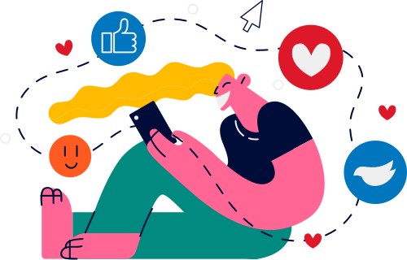

Lesson 13.01.01
DIGITAL IDENTITY
Social Media Personas
Reflecting on online personas and the power of curated feeds
CYBERLITE.ORG
2023-2024 Ⓒ Cyberlite Books Pte. Ltd. All Rights Reserved.

Slide 2
The influence of social media on digital identity
What are we learning today?
How curated feeds on social media influence our perceptions
Exploring online personas and their impact
CYBERLITE.ORG
2023-2024 Ⓒ Cyberlite Books Pte. Ltd. All Rights Reserved.

Slide 3
WARM UP QUESTION
How might the way we present ourselves on social media be different from how we are in real life?
CYBERLITE.ORG
2023-2024 Ⓒ Cyberlite Books Pte. Ltd. All Rights Reserved.

Slide 4
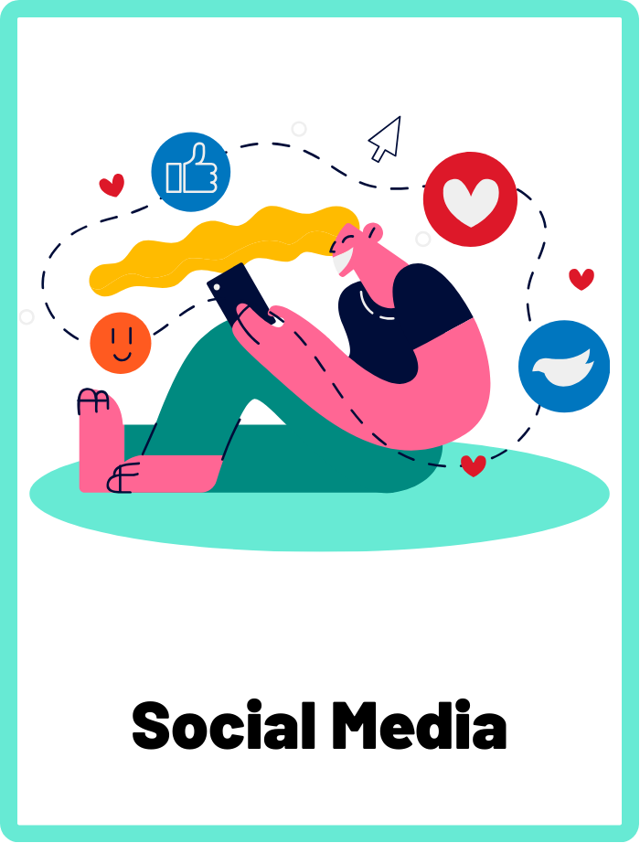
Social Media
Apps and websites designed for social interaction and communication, allowing users to share content, connect with others, and engage in online communities.
CYBERLITE.ORG
2023-2024 Ⓒ Cyberlite Books Pte. Ltd. All Rights Reserved.

Slide 5
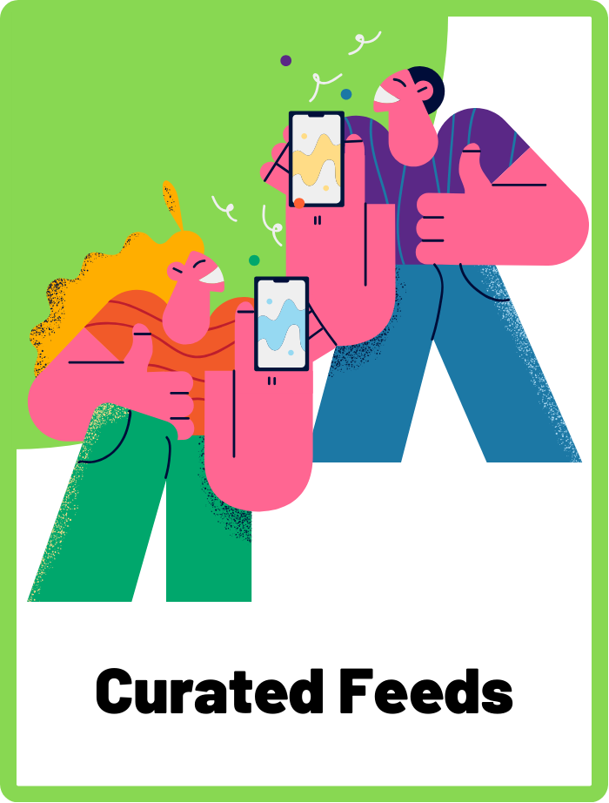
Curated Feeds
The process of selectively choosing and organising photos, videos, and posts on a social media profile, to deliberately shape how others perceive the profile.
CYBERLITE.ORG
2023-2024 Ⓒ Cyberlite Books Pte. Ltd. All Rights Reserved.

Slide 6
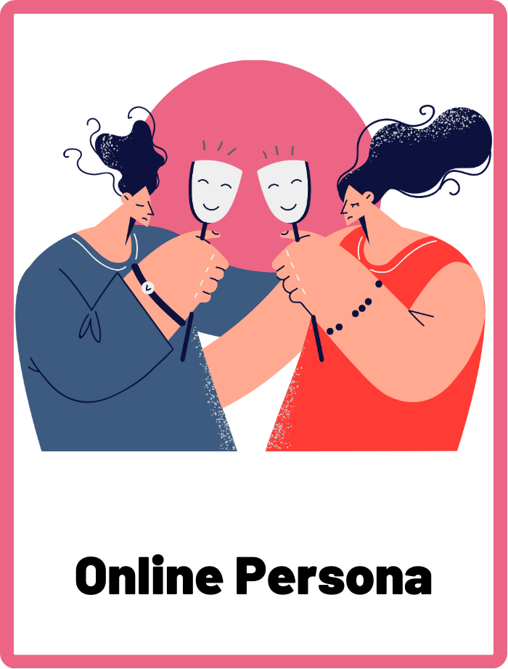
Online Persona
The identity or personality that an individual presents in online communities and interactions.
CYBERLITE.ORG
2023-2024 Ⓒ Cyberlite Books Pte. Ltd. All Rights Reserved.

Slide 7
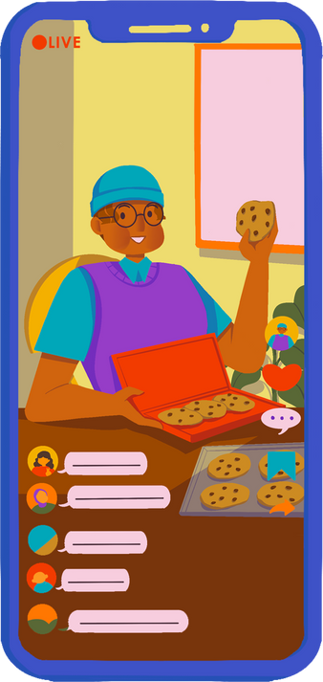
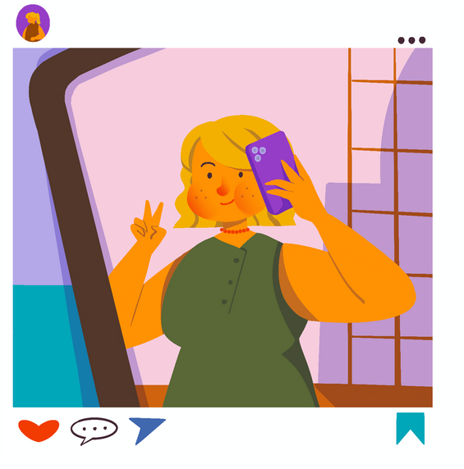
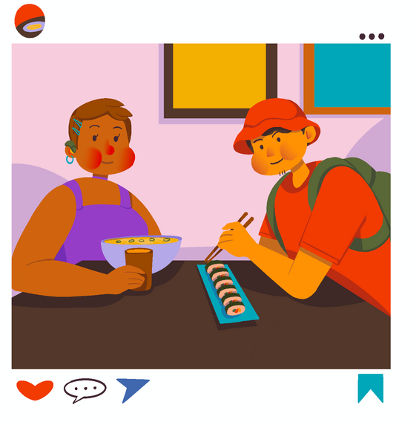
Why do people use social media?
People use social media to connect with friends, express themselves, and share their interests.It's a way to showcase highlights of their lives and engage with a broader audience.
CYBERLITE.ORG
2023-2024 Ⓒ Cyberlite Books Pte. Ltd. All Rights Reserved.

Slide 8

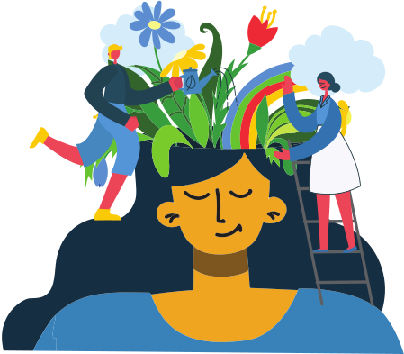
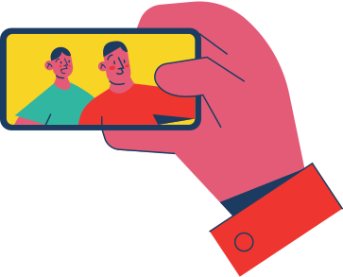
Social Media Motivations
There are many different motivations for individuals to post on social media.
Gain popularity
Document memories with friends and family
Creative expression
What other reasons can you think of?
CYBERLITE.ORG
2023-2024 Ⓒ Cyberlite Books Pte. Ltd. All Rights Reserved.

Slide 9
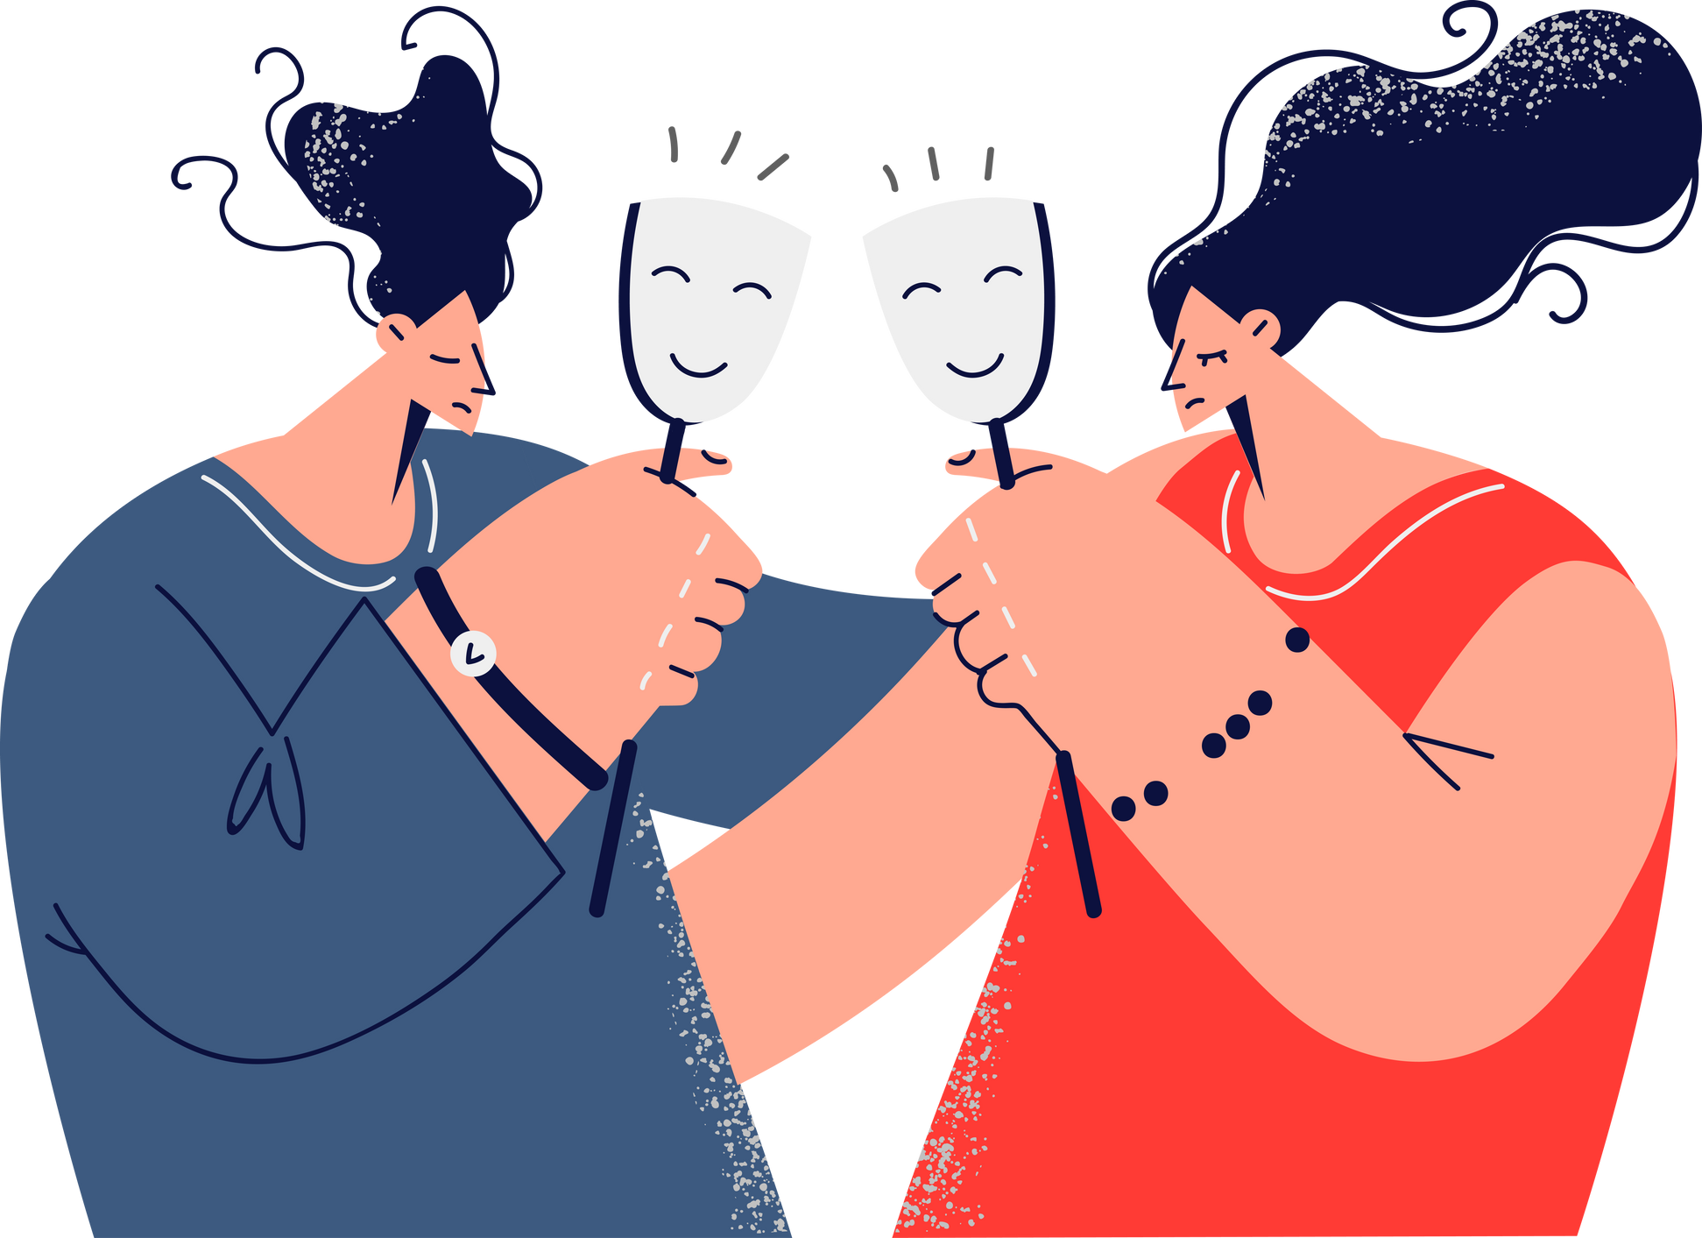
Invention of Online Personas
An online persona is the version of yourself that you present to the world on social media.
It's the image and message you want others to see and engage with.
CYBERLITE.ORG
2023-2024 Ⓒ Cyberlite Books Pte. Ltd. All Rights Reserved.

Slide 10
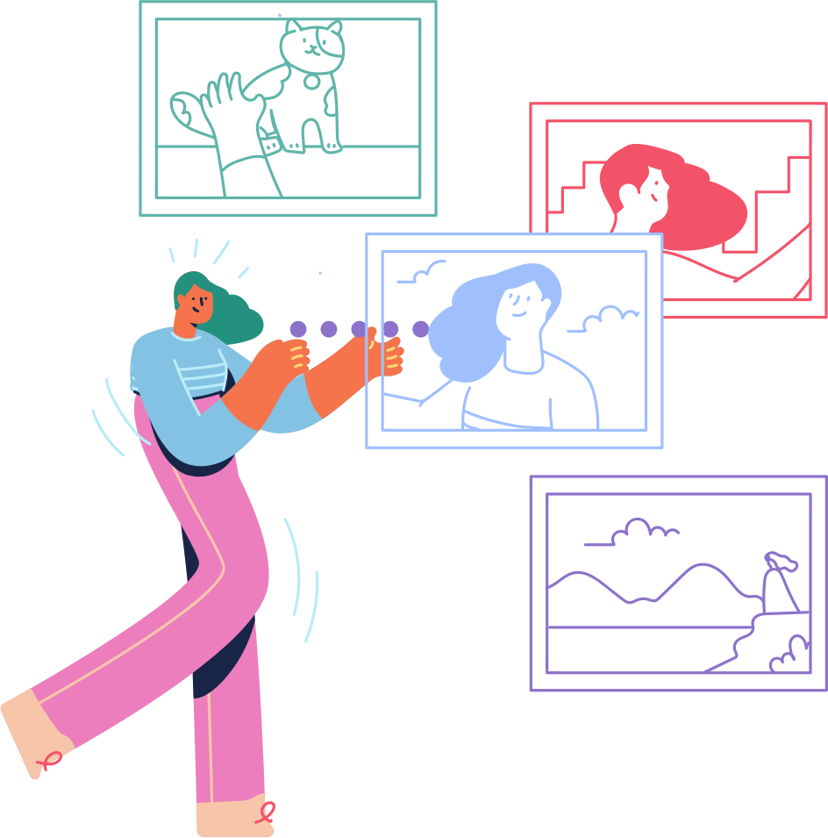
Understanding Curated Feeds
Because anyone can choose what they want to upload on social media, they can invent an online persona however they want.
This is called a curated feed. It is when people carefully choose and organise what they post on their social media profiles to shape how others perceive them.
CYBERLITE.ORG
2023-2024 Ⓒ Cyberlite Books Pte. Ltd. All Rights Reserved.

Slide 11
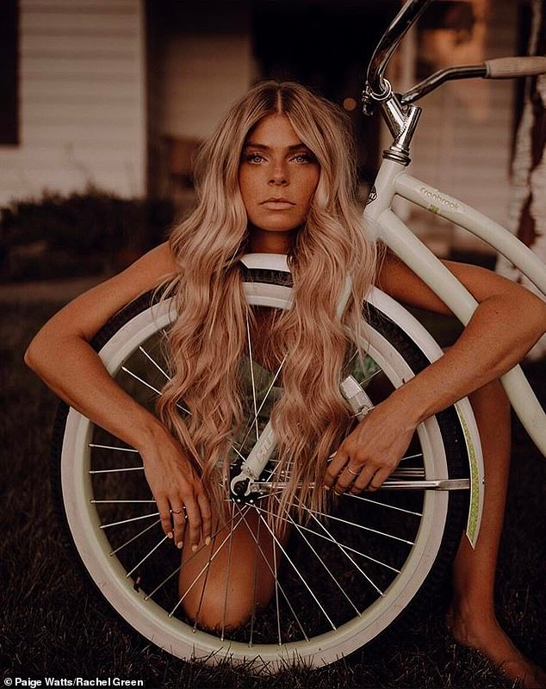
Instagram photos look perfect, but...
On Instagram, you often see beautifully edited and meticulously composed photos that seem flawless.
These photos can create an idealised image of people's lives, making everything appear perfect.
Credit: Paige Watts/Rachel Green via DailyMail.co.uk
CYBERLITE.ORG
2023-2024 Ⓒ Cyberlite Books Pte. Ltd. All Rights Reserved.

Slide 12
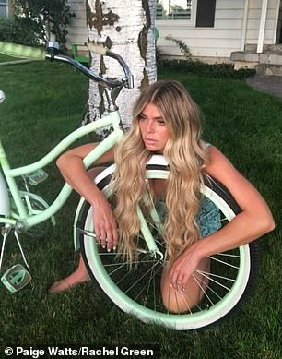
...here’s the reality!
Behind the scenes, many Instagram photos are carefully staged, edited, and filtered to achieve that polished look.
It's not always a true reflection of everyday life!
Credit: Paige Watts/Rachel Green via DailyMail.co.uk
CYBERLITE.ORG
2023-2024 Ⓒ Cyberlite Books Pte. Ltd. All Rights Reserved.

Slide 13
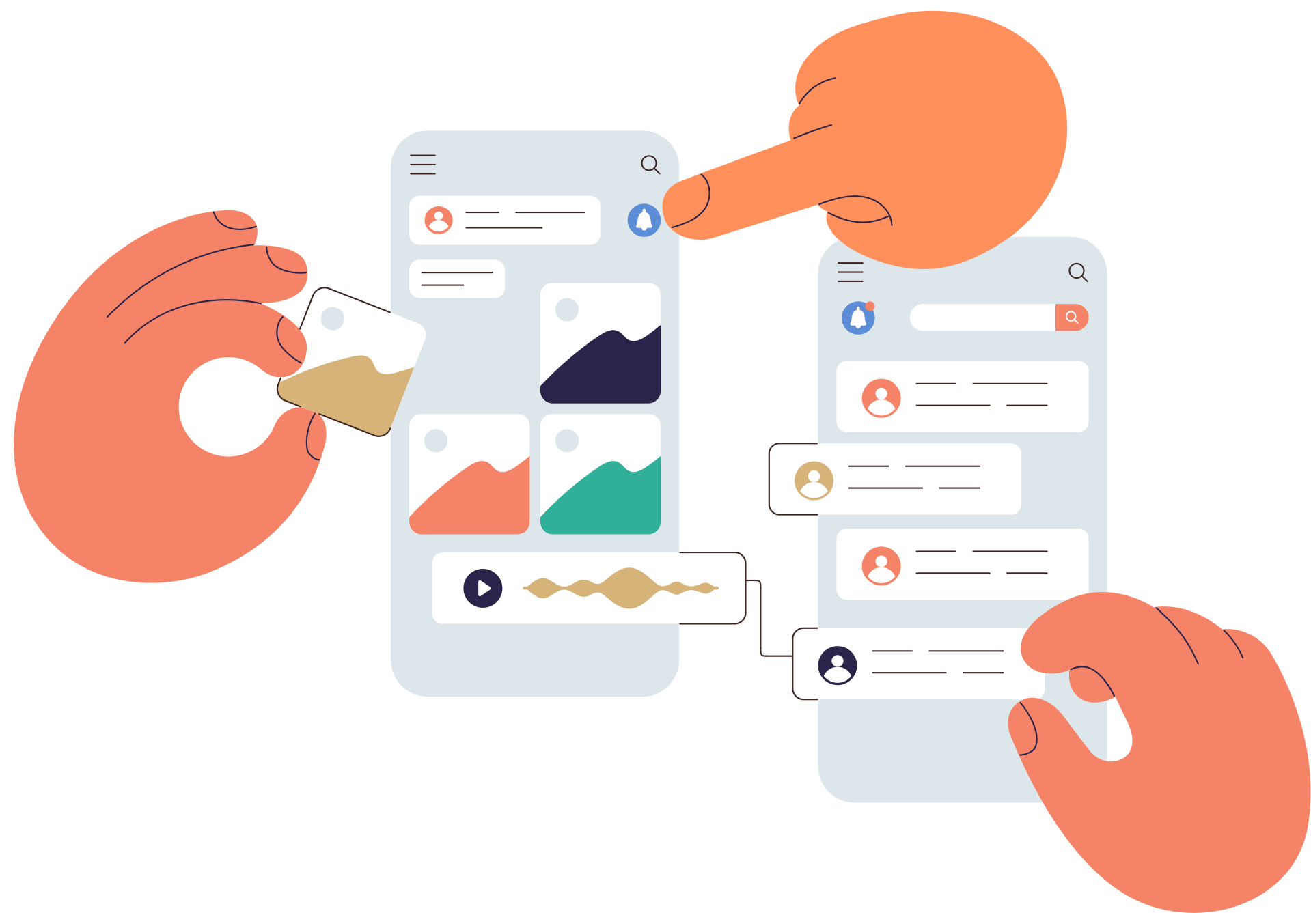
Balancing Reality and Curation
It's crucial to remember that curated feeds often show the best parts of someone's life, not the full picture. What you see on social media is a snapshot, and it doesn't always reflect reality.
CYBERLITE.ORG
2023-2024 Ⓒ Cyberlite Books Pte. Ltd. All Rights Reserved.

Slide 14
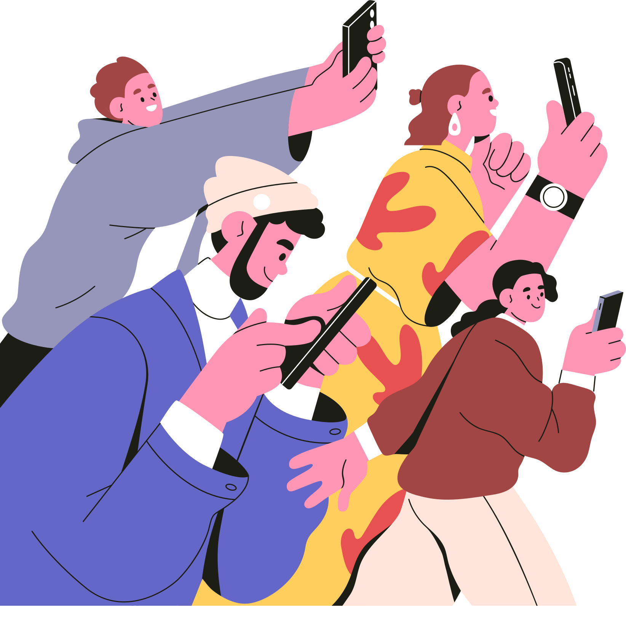
Be a Savvy Social Media User
Always keep in mind that what you see on social media is curated and doesn't necessarily represent someone's entire life.
Don't compare your own life to what you see online because it may not be the complete story.
Likes and comments can be fun and encouraging, but they don't define your worth
CYBERLITE.ORG
2023-2024 Ⓒ Cyberlite Books Pte. Ltd. All Rights Reserved.

Slide 15
ACTIVITY
Instagram vs Reality
Work in small groups for this activity!
CYBERLITE.ORG
2023-2024 Ⓒ Cyberlite Books Pte. Ltd. All Rights Reserved.

Slide 16
What You’ll Need
  A smart phone with a camera
  Photo editing app like Canva
CYBERLITE.ORG
2023-2024 Ⓒ Cyberlite Books Pte. Ltd. All Rights Reserved.

Slide 17
Instructions
Your task is to create a “Instagram-worthy” image that is heavily edited or filtered.
  Work in pairs or small groups.
  Take some photos! You can take photos of each other, your environment, or any object of your choice.
  Upload your photos to a photo editing app like Canva.
  Apply filters to make your photo Instagram-worthy. For example, you can add colour filters, remove backgrounds, or add objects to your photo.
  Share the edited photo side by side with the original one and see the difference!
CYBERLITE.ORG
2023-2024 Ⓒ Cyberlite Books Pte. Ltd. All Rights Reserved.

Slide 18

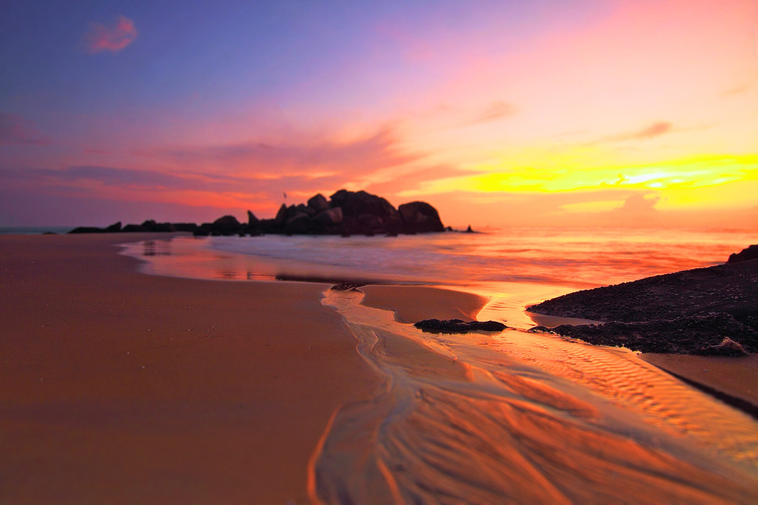
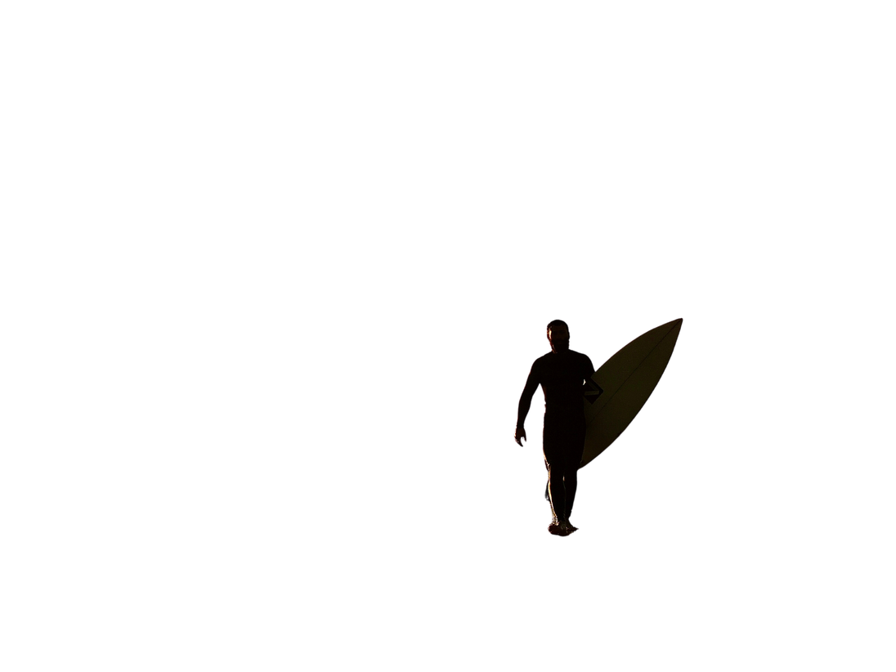
Example
This example has been created in Canva. Edits to the photo include: two kinds of filters, colour-correction, and a cut-out of a surfer from another photo!
Original photo
Edited photo
CYBERLITE.ORG
2023-2024 Ⓒ Cyberlite Books Pte. Ltd. All Rights Reserved.

Slide 19
Group Sharing!
Share and desscribe your work with the class.
CYBERLITE.ORG
2023-2024 Ⓒ Cyberlite Books Pte. Ltd. All Rights Reserved.

Slide 20
WRAP UP
What have you learned today?
Let’s reflect on today’s lesson.
CYBERLITE.ORG
2023-2024 Ⓒ Cyberlite Books Pte. Ltd. All Rights Reserved.

Slide 21
Remember This!
  Don’t believe everything you see on social media, because it’s often curated to reflect someone’s online persona.
  What you see on social media is often edited with intention and may not always represent the genuine, unfiltered reality.
  It's important to take breaks from social media and spend time with friends, family, and outdoor activities.
  Finding a balance between your online and offline life is key to your well-being.
CYBERLITE.ORG
2023-2024 Ⓒ Cyberlite Books Pte. Ltd. All Rights Reserved.

Slide 22
Lesson 13.01.01
Well Done!
CYBERLITE.ORG
2023-2024 Ⓒ Cyberlite Books Pte. Ltd. All Rights Reserved.

