Slide 1
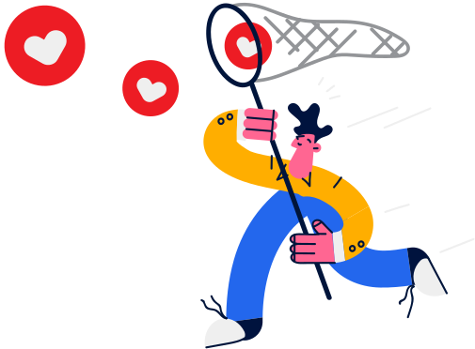

Lesson 12.01.01
DIGITAL IDENTITY
Questioning Online Motivations
Why does anyone go online?
CYBERLITE.ORG
2023-2024 Ⓒ Cyberlite Books Pte. Ltd. All Rights Reserved.

Slide 2
Reflect on what motivates you to go online
What are we learning today?
Compare the differences between positive and negative online motivations of others
CYBERLITE.ORG
2023-2024 Ⓒ Cyberlite Books Pte. Ltd. All Rights Reserved.

Slide 3
WARM UP QUESTION
What are some reasons people use the internet?
CYBERLITE.ORG
2023-2024 Ⓒ Cyberlite Books Pte. Ltd. All Rights Reserved.

Slide 4
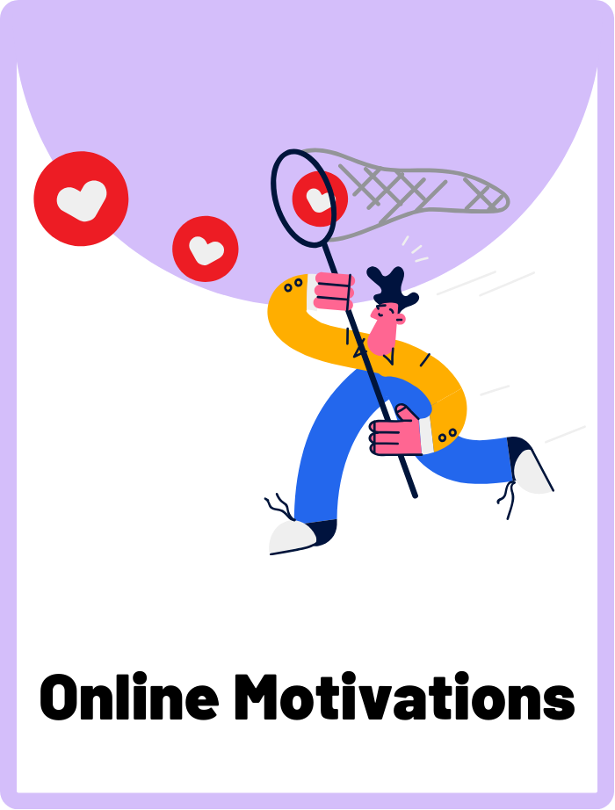
Online Motivations
The reasons or driving forces behind an individual's behaviours and interactions in online environments.
CYBERLITE.ORG
2023-2024 Ⓒ Cyberlite Books Pte. Ltd. All Rights Reserved.

Slide 5
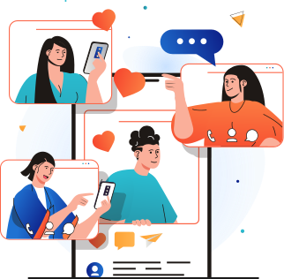
What are online motivations?
Online motivations are the reasons why people do things on the internet. It could be to connect with friends, learn something new, have fun, or even be creative.
CYBERLITE.ORG
2023-2024 Ⓒ Cyberlite Books Pte. Ltd. All Rights Reserved.

Slide 6
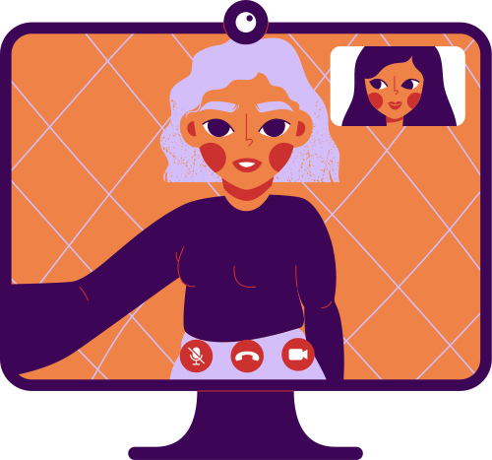
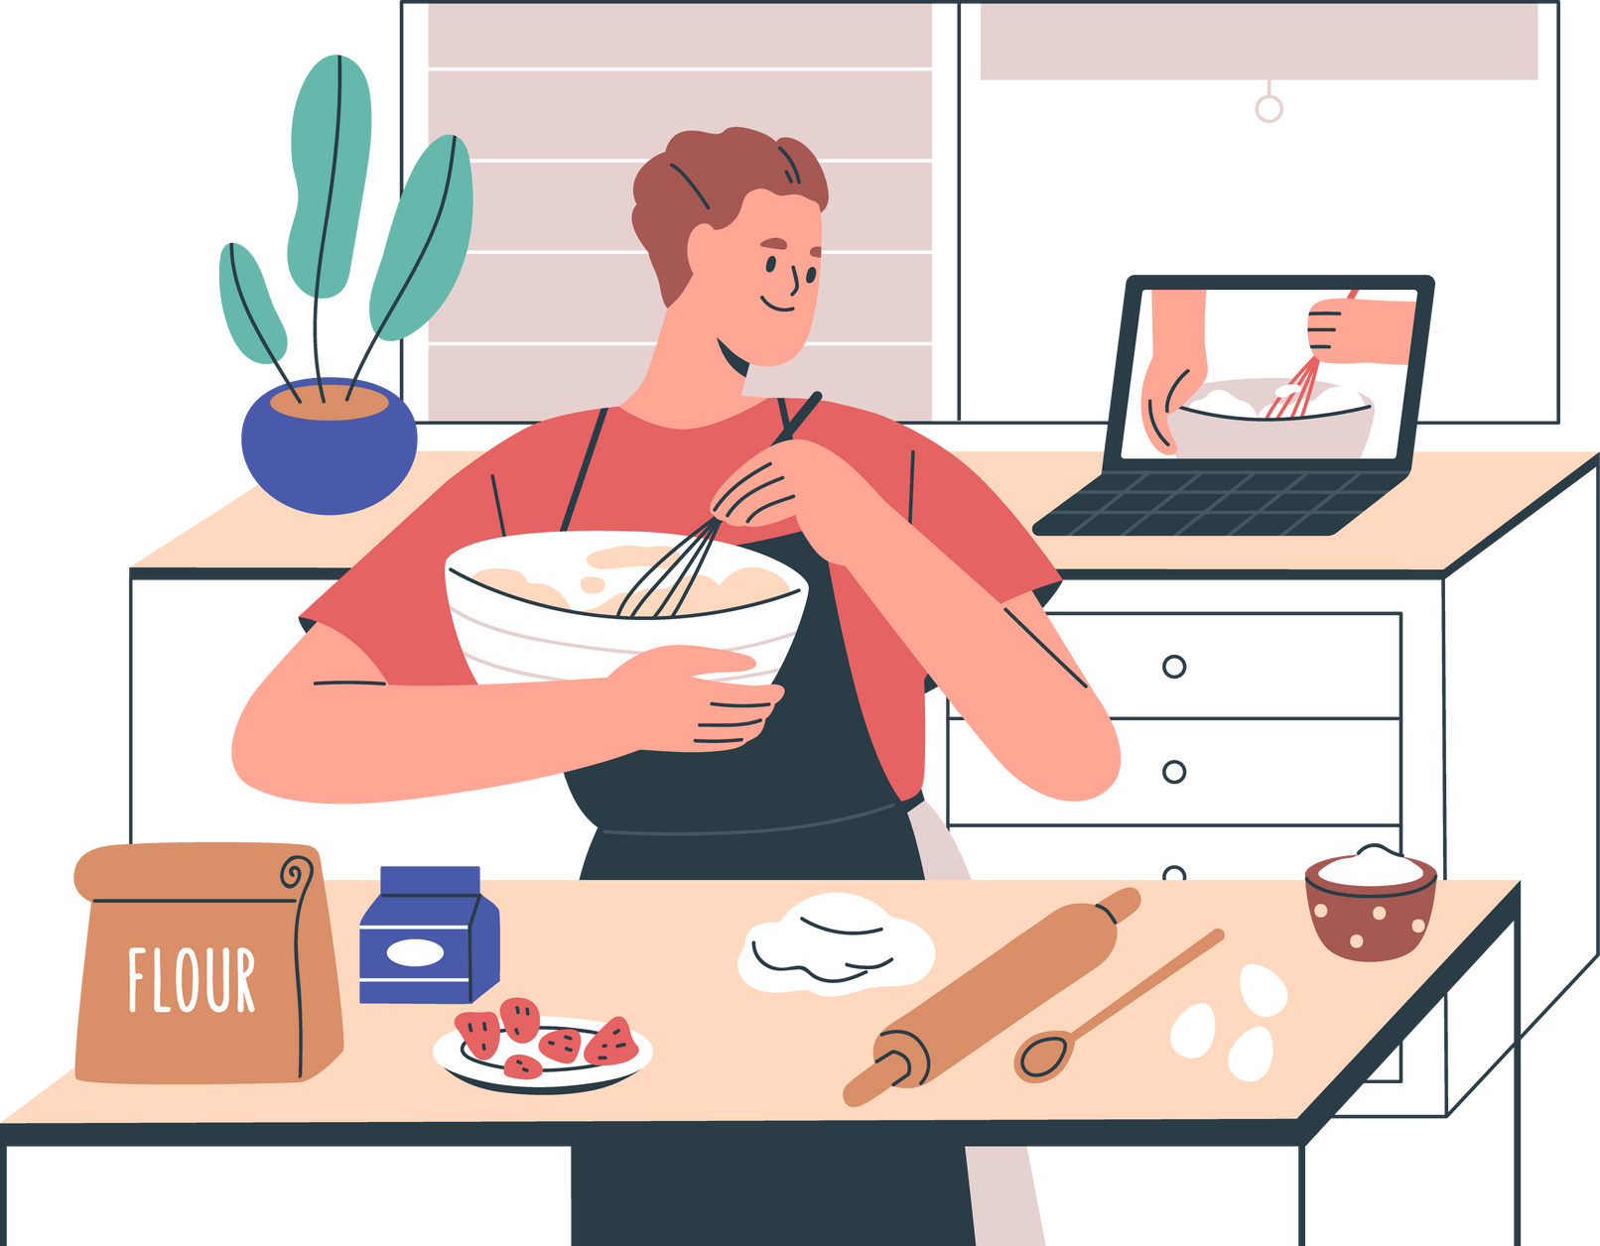

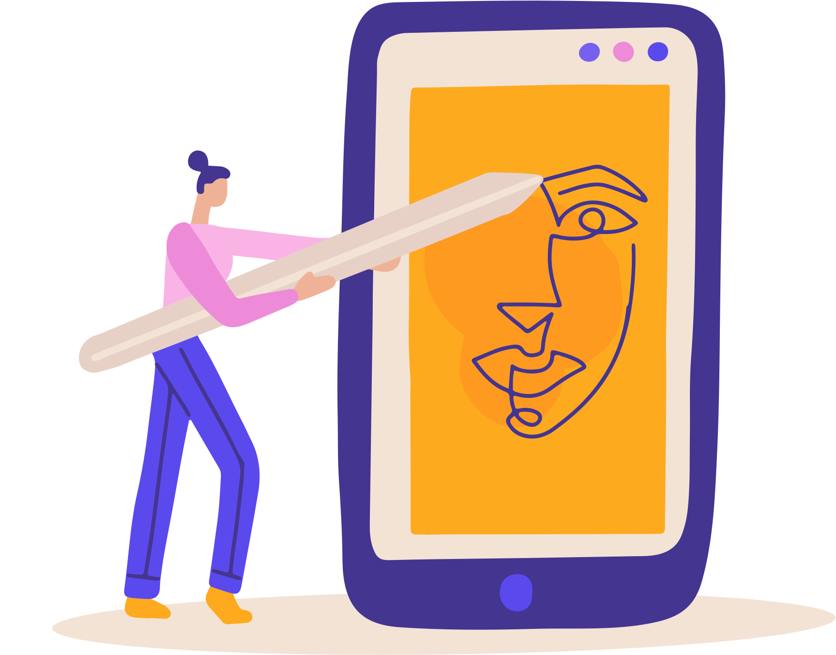
Common Online Motivations
Socialising
Many people use the internet to talk to friends, make new ones, and share their lives.
Learning
Some go online to learn new skills, research, find information, or study.
Entertainment
The internet is a fun place for games, videos, and exploring new interests.
Creativity
Some use the internet to express themselves through art, writing, or music.
What are your personal motivations for going online?
CYBERLITE.ORG
2023-2024 Ⓒ Cyberlite Books Pte. Ltd. All Rights Reserved.

Slide 7

Why should we care?
Understanding online motivations helps us navigate the digital world better. It helps us know why people behave the way they do and how to respond.
It's like having a map to understand the internet and why people use it.
CYBERLITE.ORG
2023-2024 Ⓒ Cyberlite Books Pte. Ltd. All Rights Reserved.

Slide 8
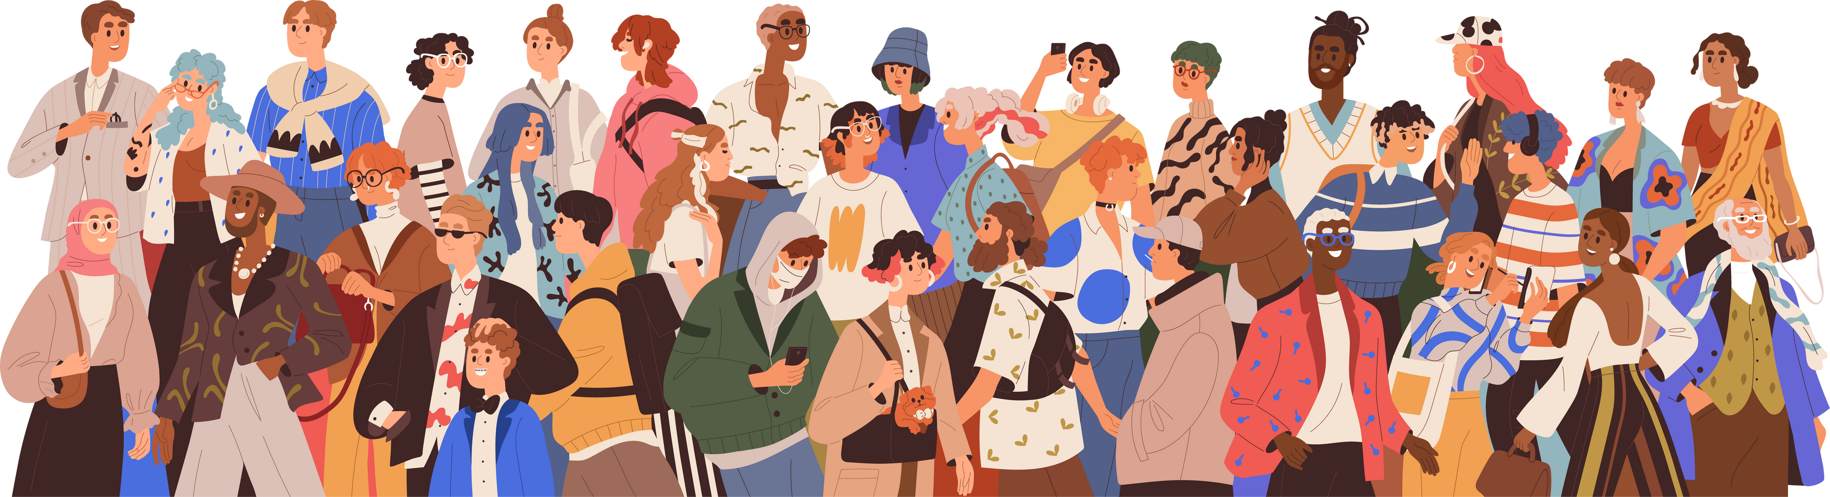
Positive and Negative Motivations
There are billions of people who use the internet everyday. You might have seen them in online games, social media, and websites.
It’s important to be able to recognise what kind of motivations people have when they interact with you in cyberspace.
CYBERLITE.ORG
2023-2024 Ⓒ Cyberlite Books Pte. Ltd. All Rights Reserved.

Slide 9
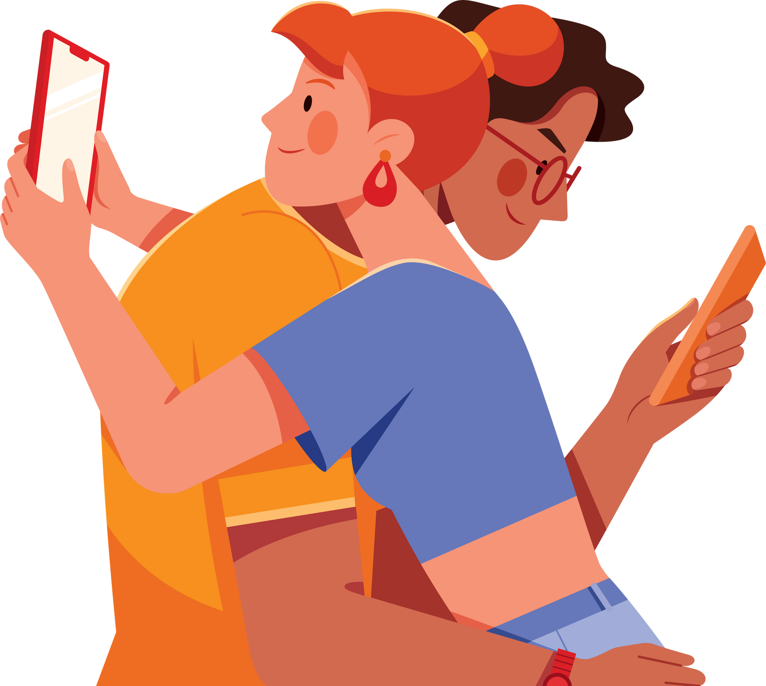
Positive and Negative Motivations
Some people have positive motivations like teaching others how to solve maths problems or sharing family recipes.
Others may have negative motivations, like tricking you into giving away your password or causing disruption in society.
CYBERLITE.ORG
2023-2024 Ⓒ Cyberlite Books Pte. Ltd. All Rights Reserved.

Slide 10
ACTIVITY
Motivation Mystery
Can you figure out the online motivations of these characters?
CYBERLITE.ORG
2023-2024 Ⓒ Cyberlite Books Pte. Ltd. All Rights Reserved.

Slide 11
Instructions
  You will be shown four different people who go online.
  Individually or in pairs, brainstorm a list of possible motivations for each character's online actions.
  Think creatively and empathetically!
CYBERLITE.ORG
2023-2024 Ⓒ Cyberlite Books Pte. Ltd. All Rights Reserved.

Slide 12
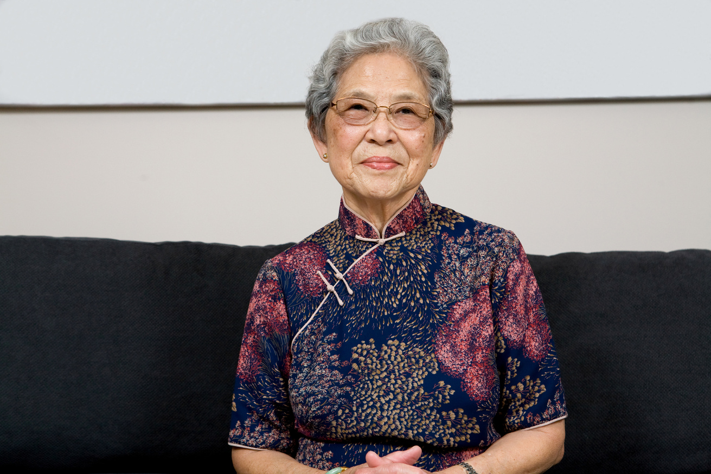
Example
Let’s go through this example together as a class. Read Sue’s online activities and discuss her online motivations. What other motivations can you think of?
Sue, 75
ONLINE ACTIVITIES
  Shares old photos on Facebook
  Video calls her grandchildren
ONLINE MOTIVATIONS
  Likes to share memories with friends
  Connecting with family
CYBERLITE.ORG
2023-2024 Ⓒ Cyberlite Books Pte. Ltd. All Rights Reserved.

Slide 13


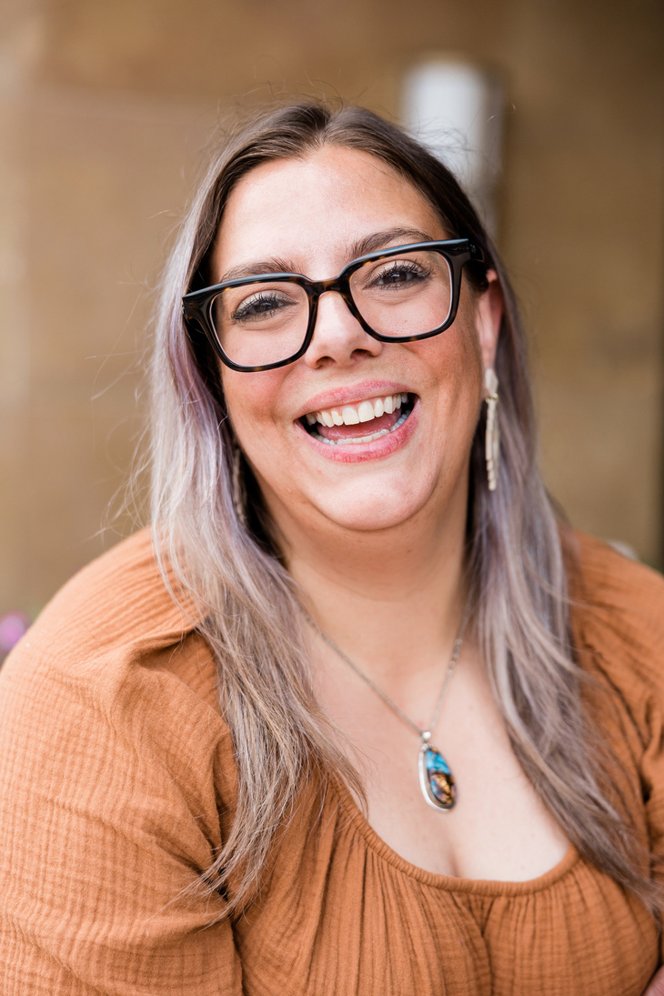

Brainstorm Their Online Motivations
Here are the online activities of four individuals. What can you tell about their online motivations?
Darren, 20
Amira, 16
ONLINE ACTIVITIES
ONLINE ACTIVITIES
  Livestreams gaming sessions
  Gives his followers advice about beating hard levels in the games
  Published study guides for exams on her blog
  Helps other students with difficult problems
Amanda, 42
Anonymous, ??
ONLINE ACTIVITIES
ONLINE ACTIVITIES
  Posts photos on Instagram about her jewellery business
  Shares discount codes to her customers through email
  Posts fake news videos on TikTok
  Writes controversial and provocative comments under news articles
CYBERLITE.ORG
2023-2024 Ⓒ Cyberlite Books Pte. Ltd. All Rights Reserved.

Slide 14
What did you conclude?
Let’s take a look at some possible motivations. Share and discuss your thoughts with the class.
Darren, 20
Amira, 16
ONLINE MOTIVATIONS
ONLINE MOTIVATIONS
  Seek online community
  Gain popularity on social media
  Share gaming skills
  Share her knowledge
  Help out classmates
  Build a good digital footprint for her university application
Amanda, 42
Anonymous, ??
ONLINE MOTIVATIONS
ONLINE MOTIVATIONS
  Promote her business online
  Marketing of products
  Reach new customers
  Negative motivations
  Seek attention
  Cause disruption amongst people
CYBERLITE.ORG
2023-2024 Ⓒ Cyberlite Books Pte. Ltd. All Rights Reserved.

Slide 15
WRAP UP
What have you learned today?
Let’s reflect on today’s lesson.
CYBERLITE.ORG
2023-2024 Ⓒ Cyberlite Books Pte. Ltd. All Rights Reserved.

Slide 16
Remember This!
  Knowing why people use the internet can help us be better online citizens and enjoy the digital world while being respectful of others.
  Whenever you interact with someone you don’t know online, ask yourself what their motivation is - is it positive or negative?
  Understanding your personal motivations for going online can also help to better manage your digital wellbeing.
CYBERLITE.ORG
2023-2024 Ⓒ Cyberlite Books Pte. Ltd. All Rights Reserved.

Slide 17
Lesson 12.01.01
Well Done!
CYBERLITE.ORG
2023-2024 Ⓒ Cyberlite Books Pte. Ltd. All Rights Reserved.

