Slide 1


Lesson 10.02.01
PRIVACY & INFORMATION SECURITY
Clean Cyber Hygiene
How do hackers get into our cyber space?

Slide 2
Hackers and their motivations
What are we learning today?
How to protect ourselves against hackers

Slide 3
WARM UP QUESTION
Have you ever heard of the word "hacker"? What comes to mind when you think of a hacker?

Slide 4

Black Hat Hacker
A person who illegally breaks into computer systems or networks with harmful intentions, like stealing or damaging information.

Slide 5
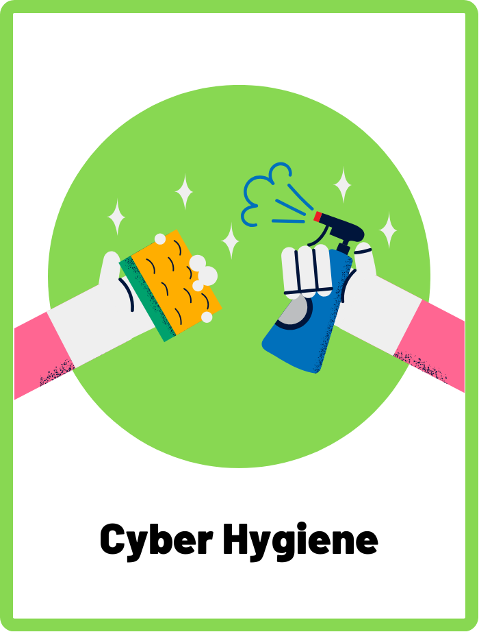
Cyber Hygiene
The regular habits and practices that keep your digital devices safe and secure. This includes regular updates, using strong passwords, avoiding suspicious downloads, and being aware of online threats.

Slide 6
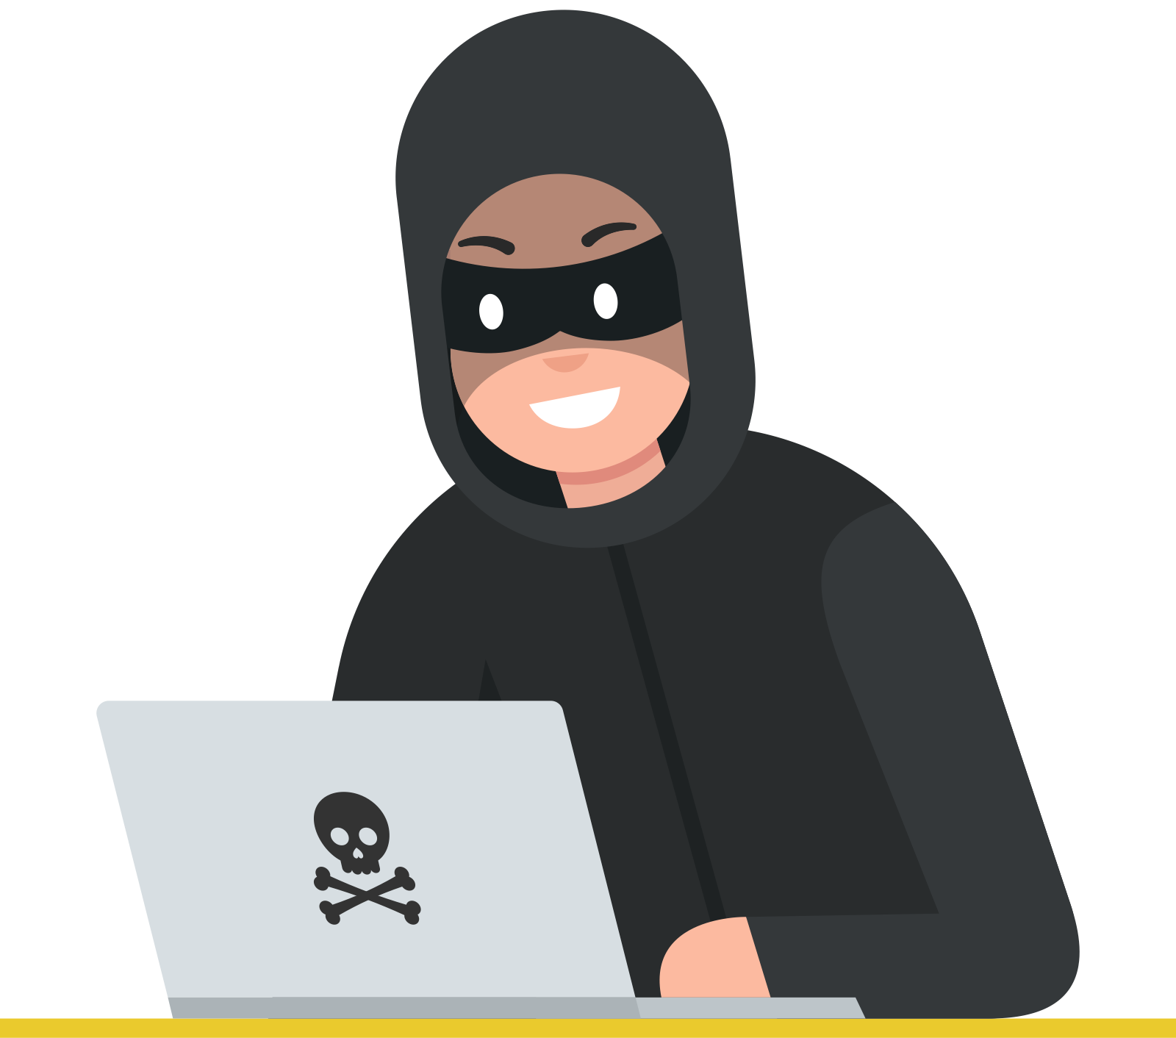

Who are Black Hat Hackers?
Black hat hackers are people who use their computer skills to break into systems or networks to steal, change, or destroy information. They are like the burglars of the internet.
Did you know that there are also white hat hackers? They are ethical hackers who work to help people!

Slide 7
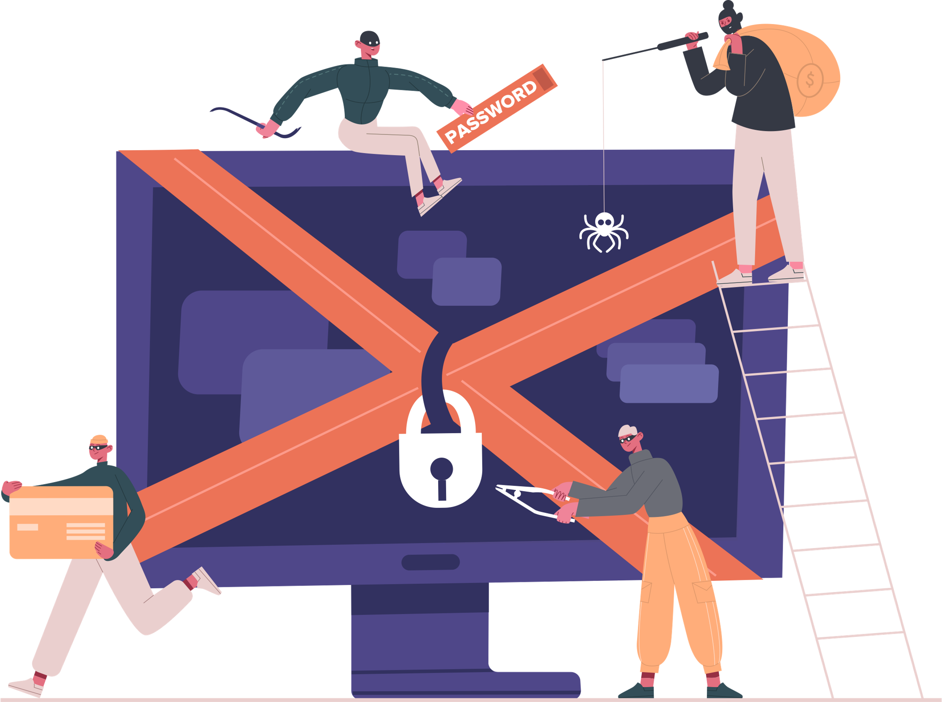


Why Do They Hack?
A black hat hacker’s motivations can include:
  Stealing money
  Causing trouble and harm to others
  Spying on your online activities
  Accessing your accounts without your permission

Slide 8
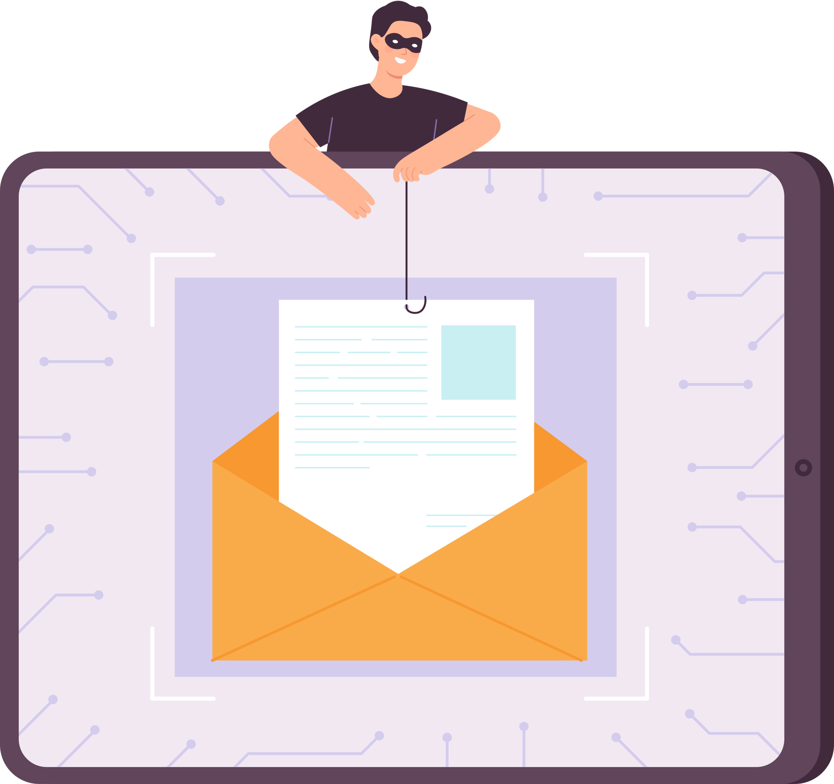
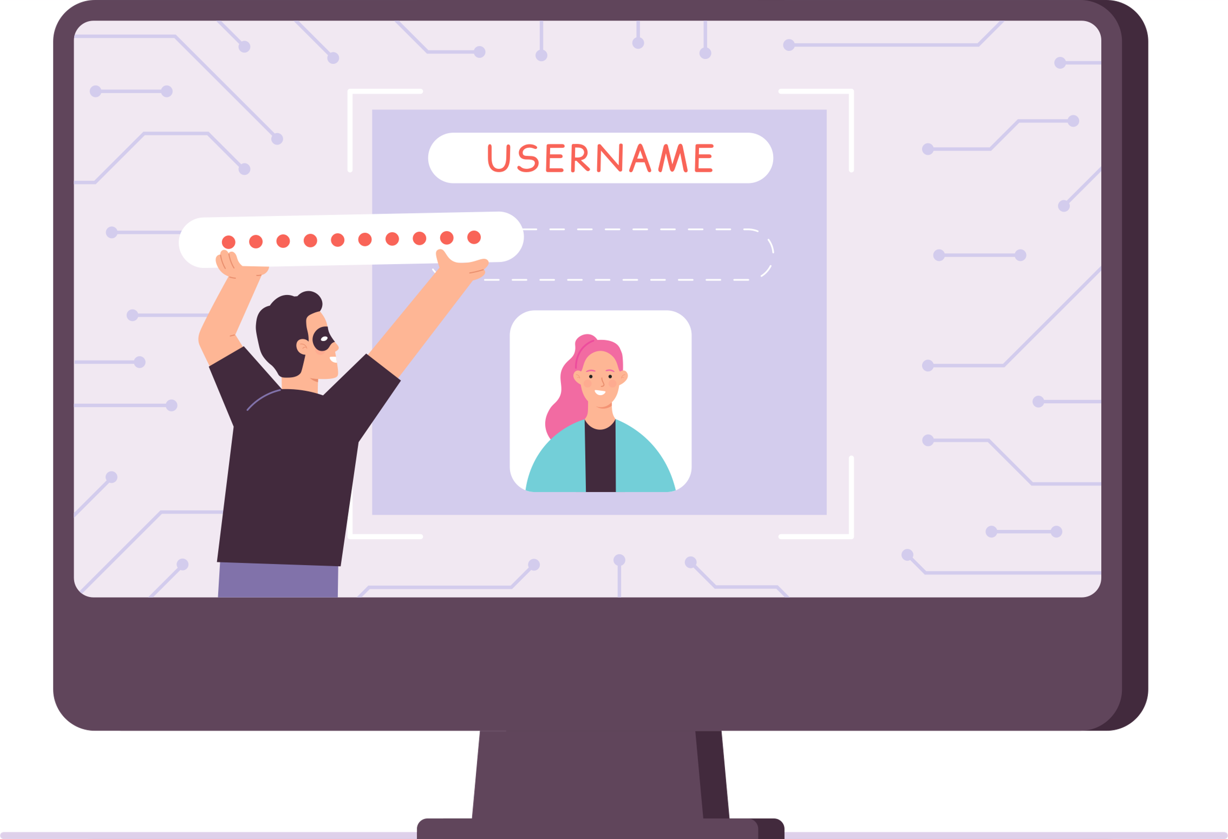
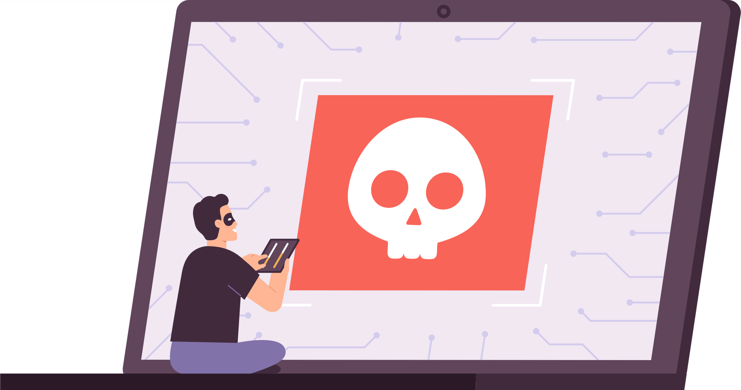
Common Tricks Used By Hackers
Hackers try all sorts of ways to sneak into our online accounts without being noticed.
Fake Emails or Websites
Guessing Passwords
Virus & Malware

Slide 9

That’s Why We Need to Practice Good Cyber Hygiene!
Cyber hygiene involves regular habits that help in keeping your information and devices safe and secure from black hat hackers.
It's like brushing your teeth or washing your hands, but for the internet!

Slide 10


Daily Cyber Hygiene Rules
https://www.google.com
1. Always check for the HTTPS and padlock when visiting a website.
This means the site is safe and protected.

Slide 11
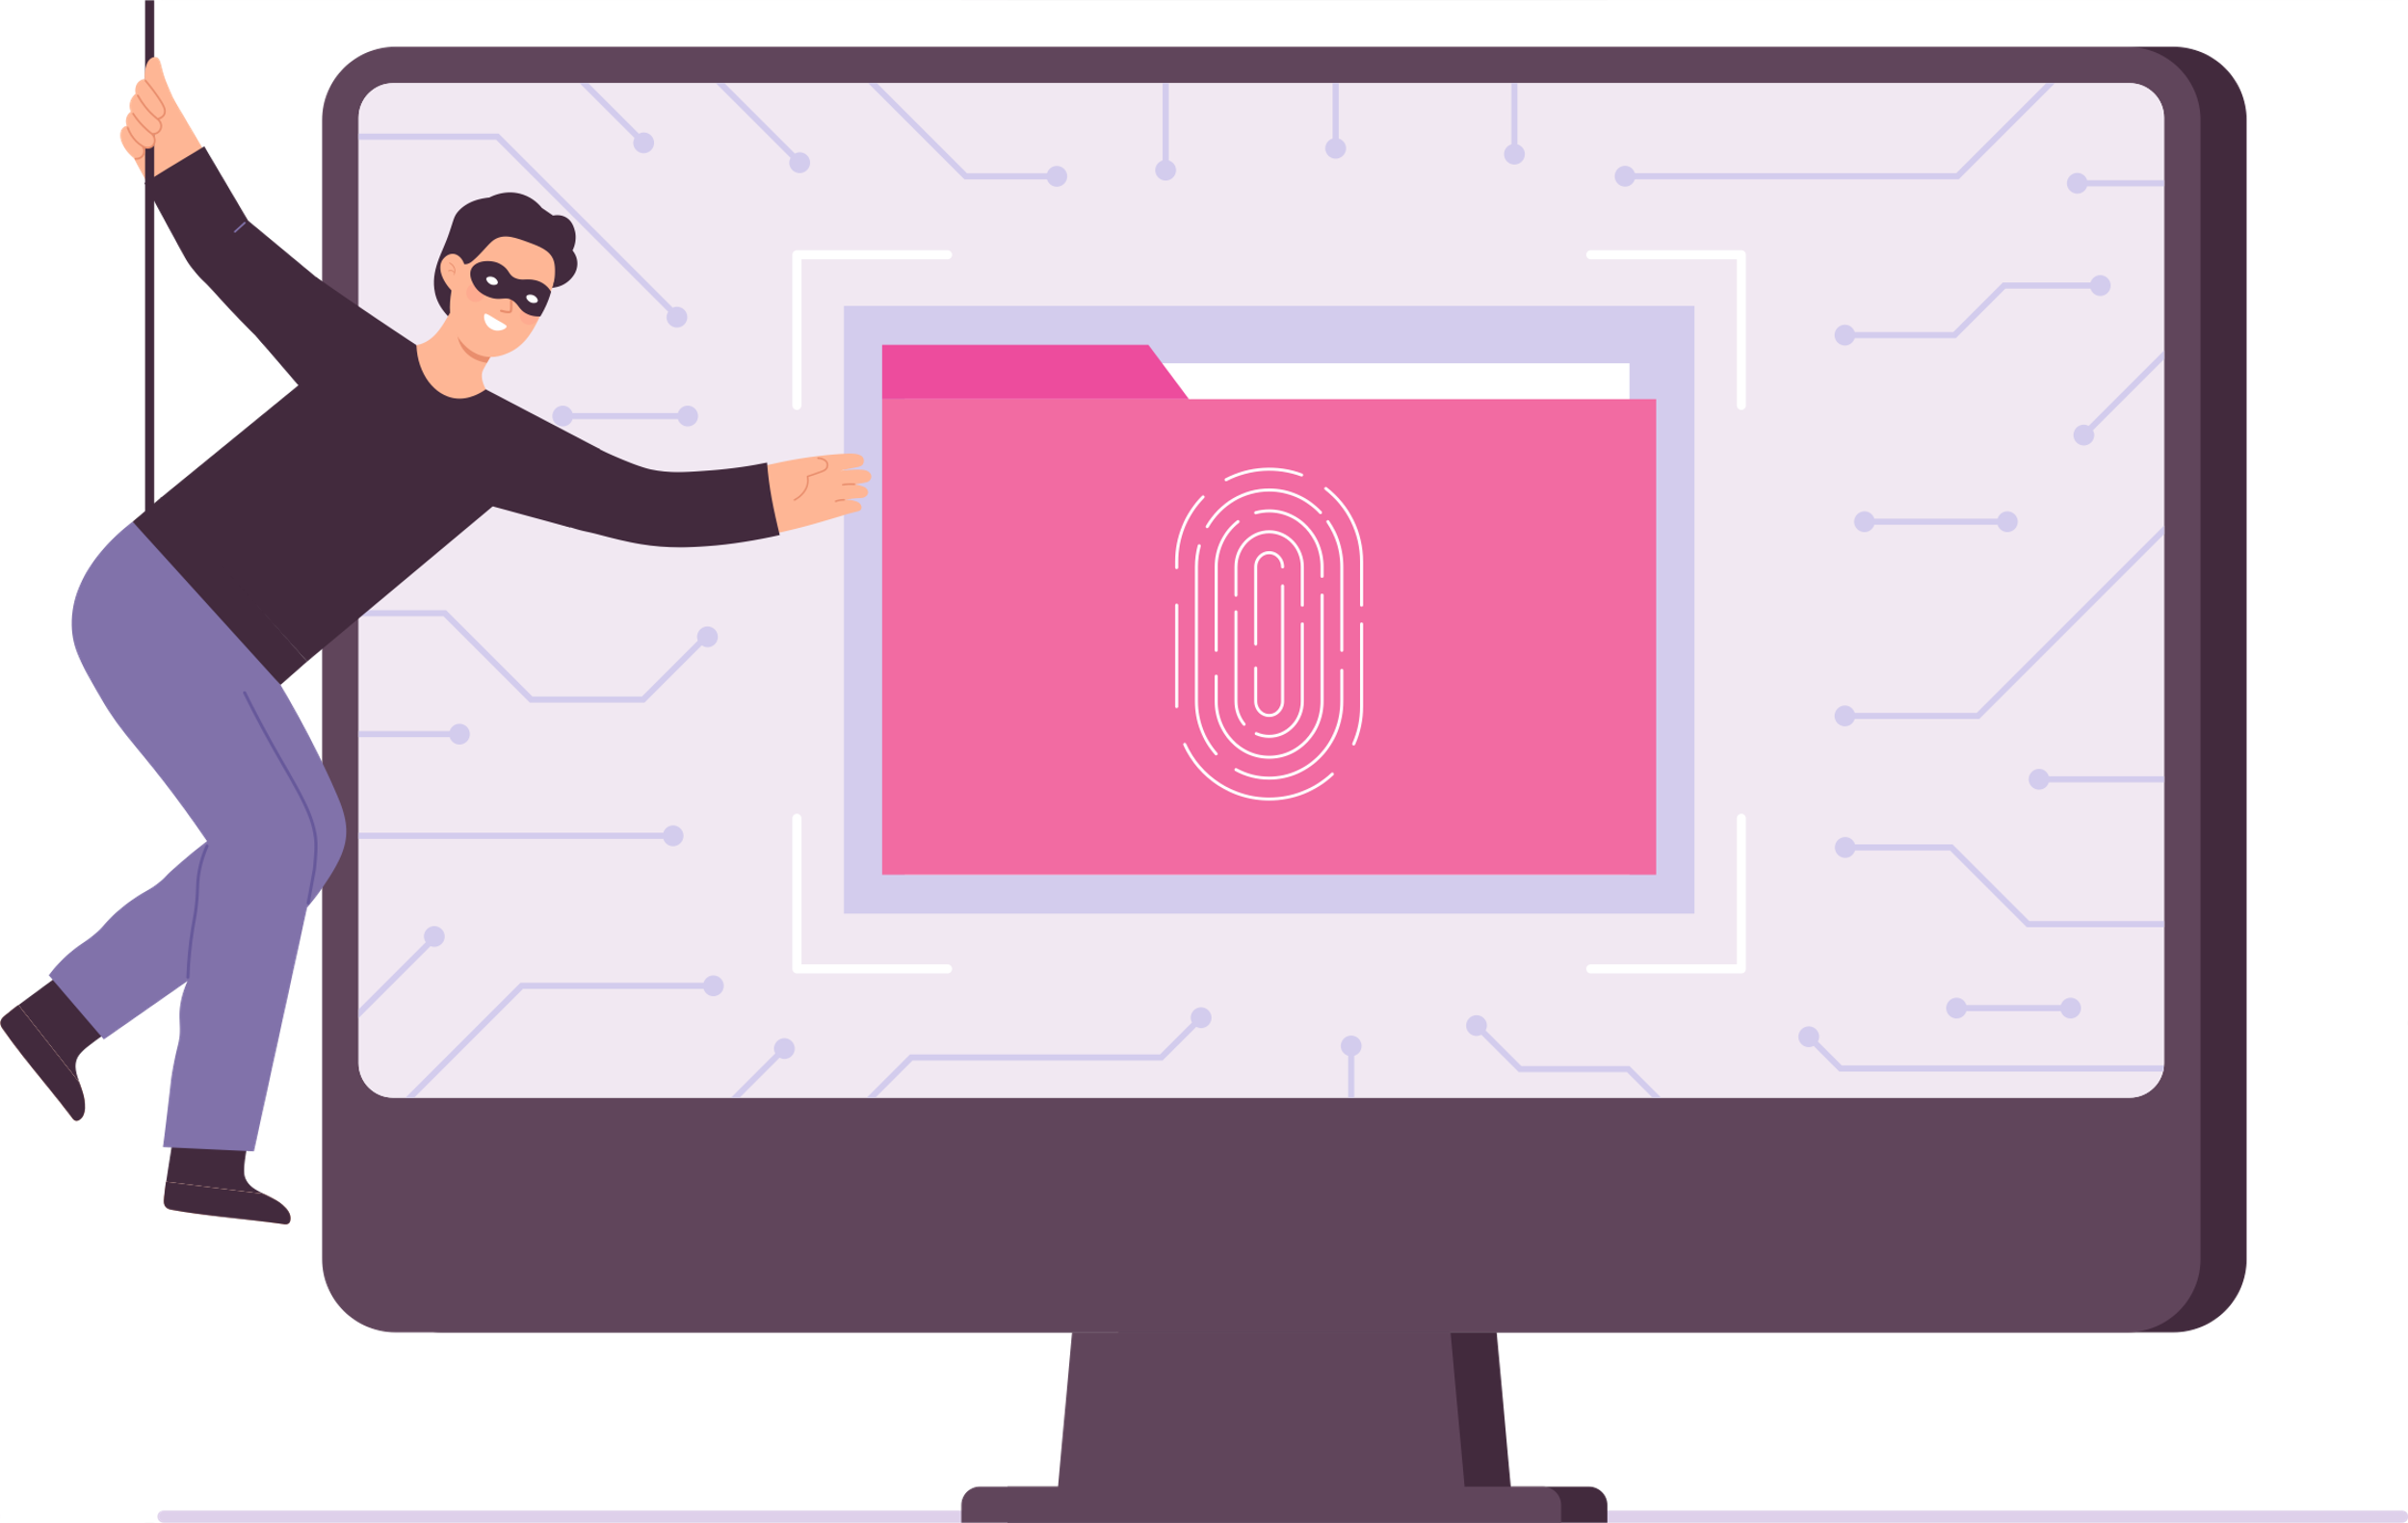
Daily Cyber Hygiene Rules
2. Be careful what you click on!
Don’t download or click on links sent from people you don’t know.

Slide 12
Daily Cyber Hygiene Rules
3. Make sure your passwords are long, strong, and secure!
Don’t share your passwords with anyone else.

Slide 13
ACTIVITY
Cyber Hygiene Classroom Checklist
Let’s create a classroom checklist together!

Slide 14

As a class, come up with a cyber hygiene rule to follow for each of the following:
A rule for visiting secure websites
A rule for clicking on links
A rule for passwords
A rule for downloads
Other cyber safety rules to follow

Slide 15
Display your checklist!
Write or type out your checklist and display it somewhere you will see everyday, like inside your notebook or on the whiteboard!

Slide 16
WRAP UP
What have you learned today?
Let’s reflect on today’s lesson.

Slide 17
Remember This!
  Black hat hackers are people who try to break into computers and networks for bad reasons.
  Cyber hygiene is about keeping your information and devices safe every day.
  Always look for HTTPS and a padlock in your browser to know a website is secure.
  Be careful what you click on, and never download or click on links from people you don’t know.
  Make sure your passwords are long, strong, and secure!

Slide 18
Lesson 10.02.01
Well Done!

