Slide 1

Lesson 12.03.01
DIGITAL MEDIA LITERACY
Seeing Isn’t
Always Believing
Spotting false and manipulated online content.

Slide 2
Identifying manipulated photos and videos online
What are we learning today?
Learn the impact of presenting information in false context
Develop critical thinking skills to spot mainpulated content

Slide 3
WARM UP QUESTION
What do you think it means when something has been “photoshopped”?

Slide 4

Manipulated Content
Information, photos, or videos that have been altered or distorted to mislead or deceive the audience.

Slide 5
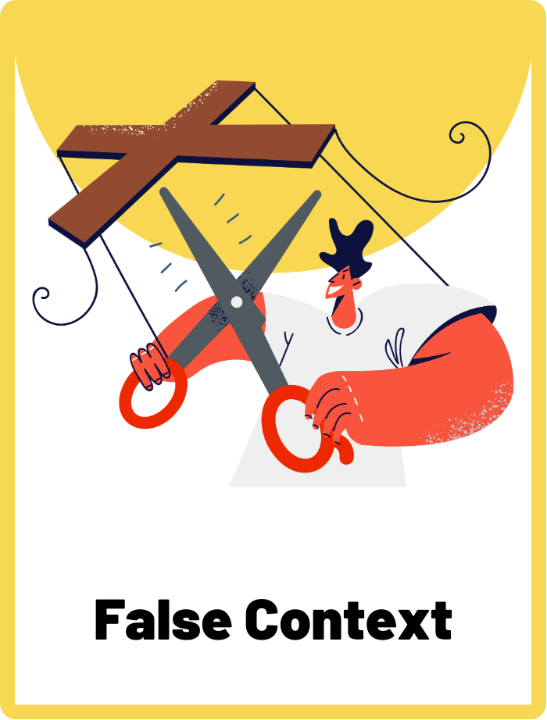
False Context
Providing misleading information about the context of a situation or event to give a false impression.

Slide 6
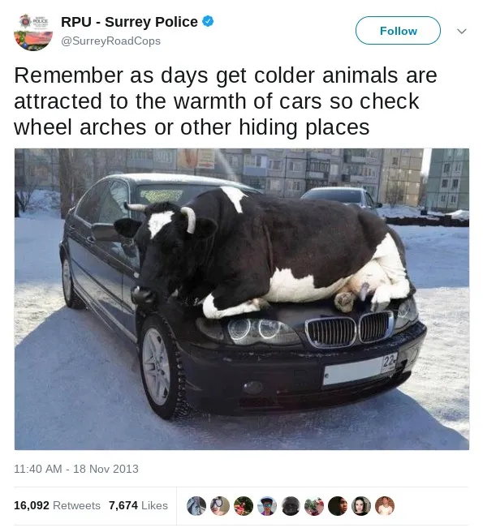
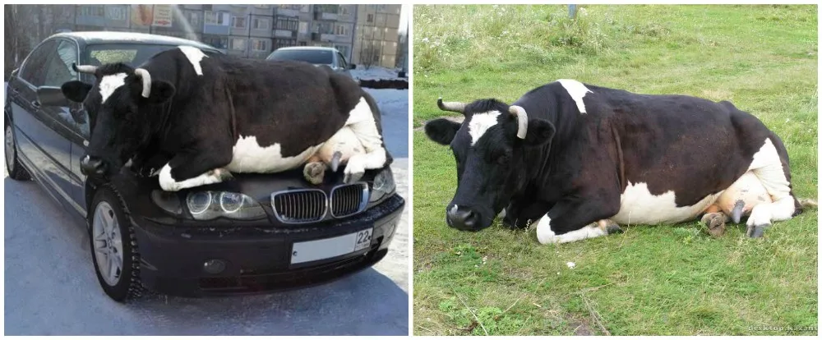
Is there anything strange about this image?
Source: Snopes.com

Slide 7
This is an example of manipulated content!
Source: Snopes.com
Manipulated content simply means images or videos that have been edited to trick the audience. You might know this as a “photoshopped image”.

Slide 8
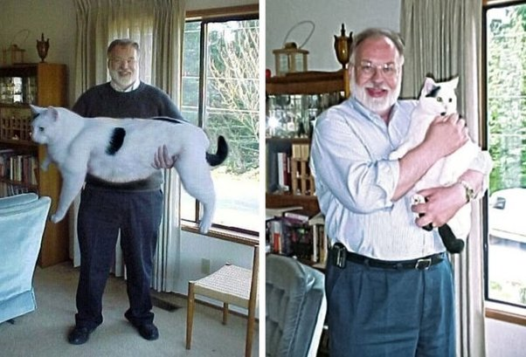
Why do people manipulate content?
To create sensational or shocking effects, to spread misinformation, or for entertainment.
Sometimes it's done to push a certain agenda or viewpoint.
👈 This photo shows a man holding a giant cat. Turns out the photo was manipulated and the cat is regular sized!
Manipulated image
Original image
Source: Quora.com

Slide 9
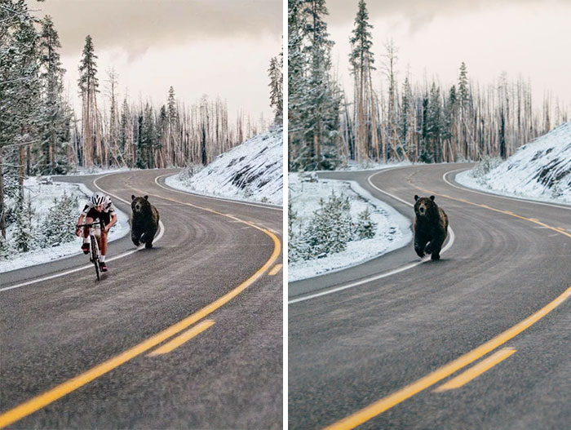
What would happen if people believed this photo was real?
People might start to panic and feel scared or anxious!
Manipulated content can be harmful because it can misleads people into believing something that is not true. It can contribute to the spread of misinformation.
Manipulated image
Original image
Source: BoredPanda.com

Slide 10

Understanding False Context
Another type of manipulation involves taking a photo or video out of context to tell a false story. This means the original photo or video has been used in a story that is unrelated to its original setting

Slide 11


Out of Context
“This is the first time I’ve seen giraffes in the wild on safari. They’re beautiful!”
BREAKING NEWS
The only giraffe left in the world has been spotted in Africa!
Original Post
False Context
This photo has been taken out of context and is now used in a fake news story. Can you think of why this might be harmful?

Slide 12



Look out for these clues!
Check for signs of manipulation
Fact-check for the original source
Use critical thinking

Slide 13
ACTIVITY
Headline Heroes
Can you capture attention with your headlines?

Slide 14
What You’ll Need
  Paper or notebook
  Pencil or pen
Instructions
The following images have been taken out of context. Your task is to write down an attention-grabbing headline to go with each image to make your readers want to click on your link.

Slide 15

QUESTION 1
Can you think of an attention grabbing headline for this photo?

Slide 16
QUESTION 1
Share your headlines!
“Kids run away from giant bird at the park”
“Girls compete to hug Taylor Swift first”

Slide 17

QUESTION 2
Can you think of an attention grabbing headline for this photo?

Slide 18
QUESTION 2
Can you think of an attention grabbing headline for this photo?
“Singer wins talent show despite not having a voice!”
“Famous singer gets booed off stage!”

Slide 19

QUESTION 3
Can you think of an attention grabbing headline for this photo?

Slide 20
QUESTION 3
Can you think of an attention grabbing headline for this photo?
“Shocking: Woman marries the first robot husband!”
“Man wins the best halloween costume as a robot!”

Slide 21

QUESTION 4
Can you think of an attention grabbing headline for this photo?

Slide 22
QUESTION 4
Can you think of an attention grabbing headline for this photo?
“Students discover alien goo in science class!“
“Young boy worried after seeing his snot is blue”

Slide 23

Seeing isn’t always believing!
It is easy for photos or videos to be manipulated and taken out of context. Even if you read something online that has a compelling image, always think twice and verify.

Slide 24
WRAP UP
What have you learned today?
Let’s reflect on today’s lesson.

Slide 25
Remember This!
  Manipulated content and false context can be deceptive and misleading.
  It is easy for photos or videos to be taken out of context. Don’t always believe what you see.
  Look out for clues of manipulated or “photoshopped” images or videos.
  Use critical thinking skills to check if the information you see online is accurate.
  Think twice and verify anything you read online.

Slide 26
Lesson 12.03.01
Well Done!

