Slide 1
Sarah’s Double Life
Lesson 14.01.02
DIGITAL IDENTITY
EXERCISE-IN-A-BOX

Slide 2

Have you ever noticed someone on social media who seems to have a different personality online than they do in real life?
WARM-UP

Slide 3
Have you ever seen a post on social media that made you feel like your life wasn't as good as someone else's?
WARM-UP

Slide 4

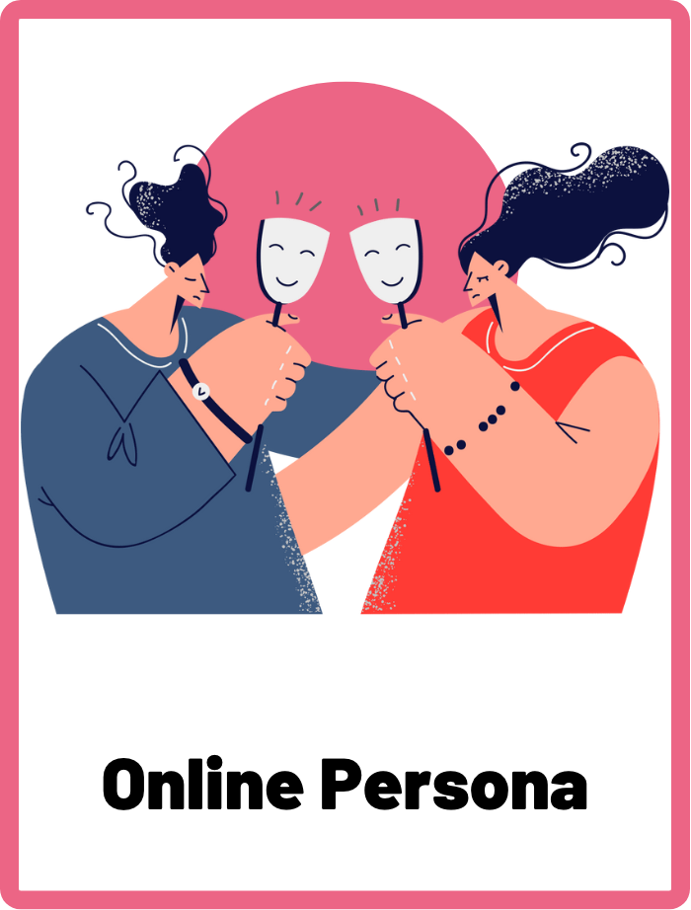
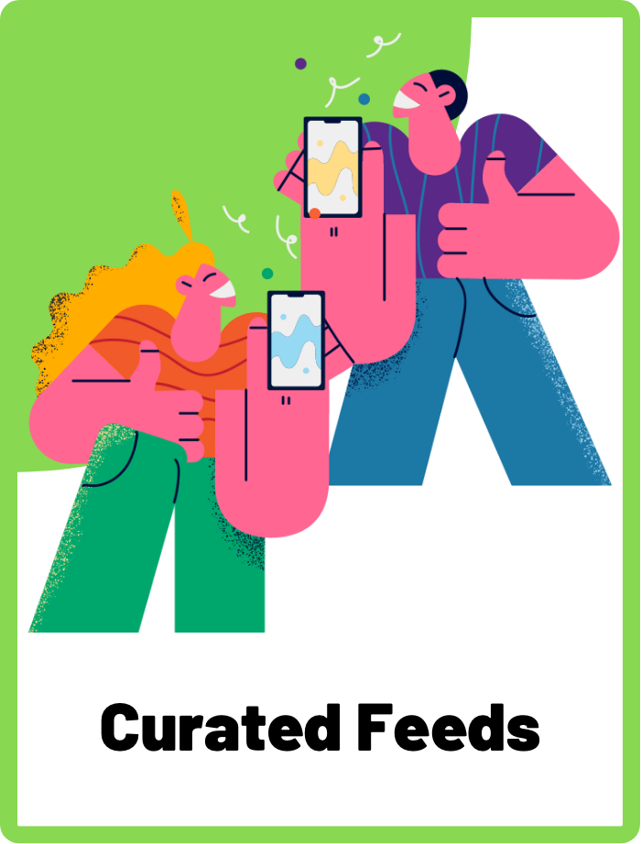
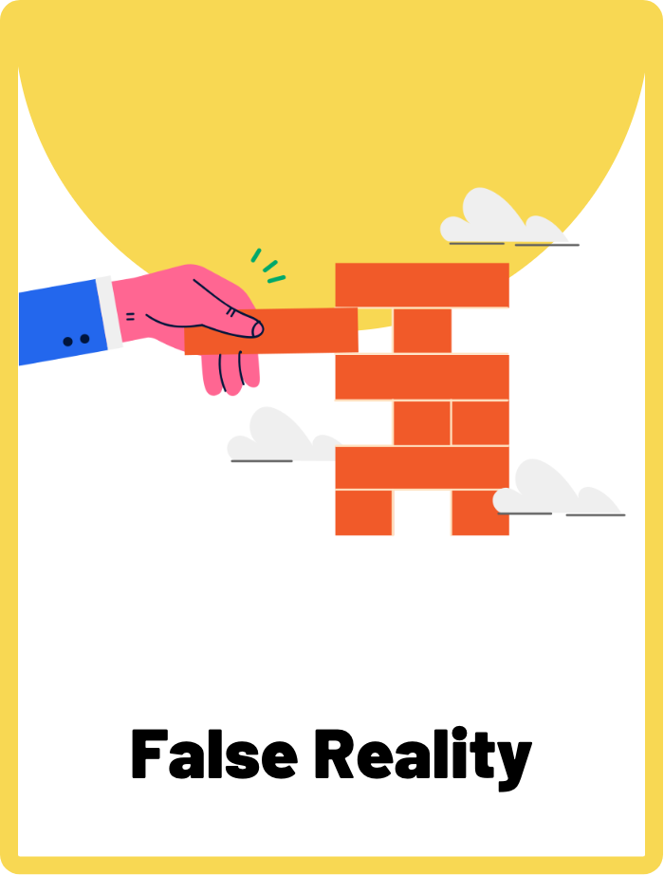
DEFINE THE KEYWORDS
What do you think these terms mean?

Slide 5
DEFINE
Online Persona
An online persona refers to the image or impression a person creates of themselves online through their social media profiles and activity. It is the way a person presents themselves to others online, and it can be different from their real-life personality.

Slide 6
DEFINE
Curated Feeds
A curated feed on social media refers to a collection of posts, images, and videos that have been specifically selected and arranged by an individual or platform to present a certain image or theme. It is a carefully crafted collection of content that aims to showcase the best version of a person or brand.

Slide 7
DEFINE
False Reality
False reality on social media refers to the idea that social media can often present a distorted or inaccurate view of reality.

Slide 8

INVESTIGATE THE SCENARIO
Read the following evidence carefully to piece together the story. Think critically about the information you are examining and consider the questions.

Slide 9
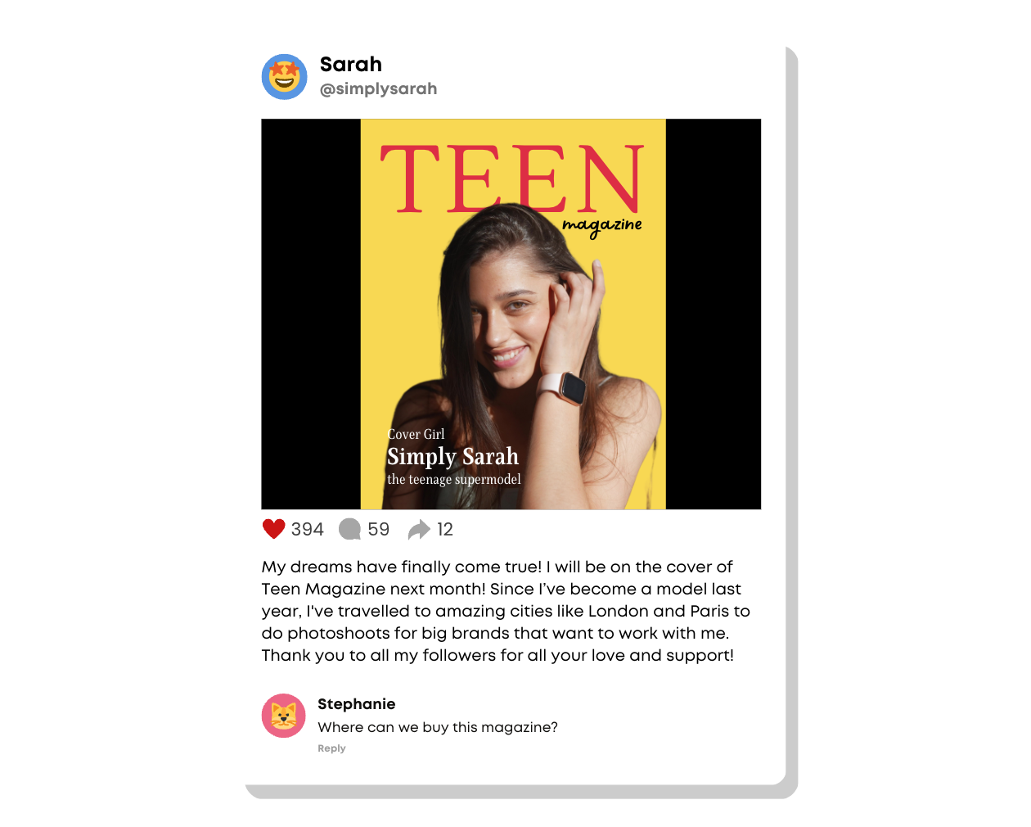
INVESTIGATE
EVIDENCE #1
LET’S DISCUSS
1. What does Sarah want her audience to know about her life?

Slide 10
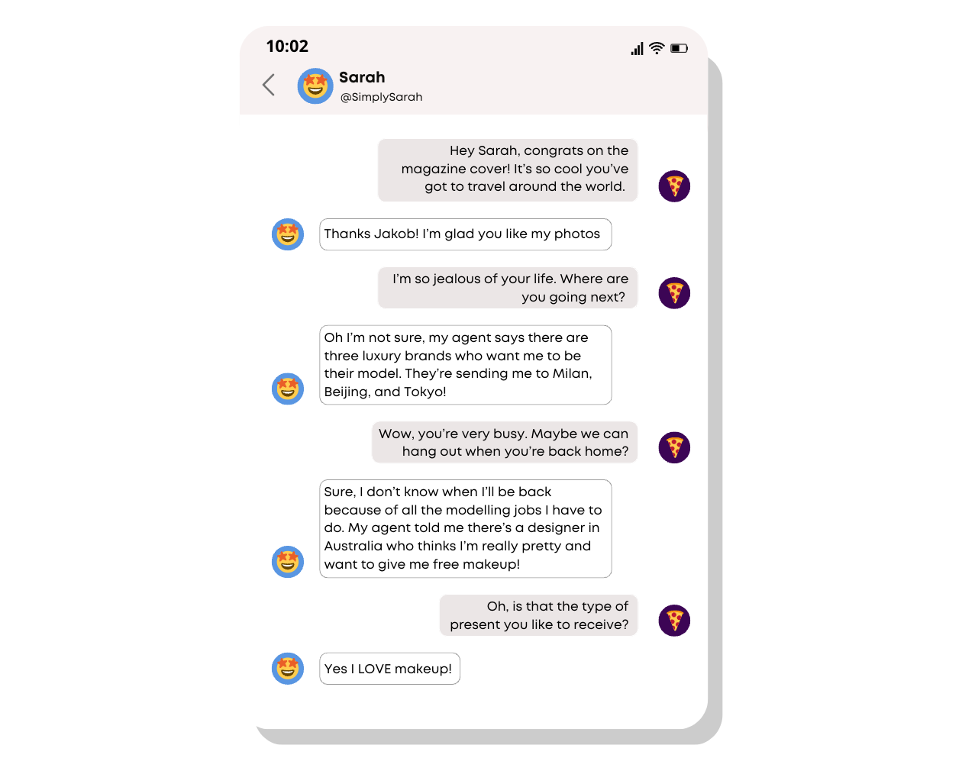
INVESTIGATE
EVIDENCE #2
LET’S DISCUSS
1. Do you think Sarah's social media feed is curated to present a certain image of herself? Why or why not?
2. Jakob likes Sarah because of what he sees on social media. Do you think it’s a good idea for Jakob to believe everything he sees online?

Slide 11
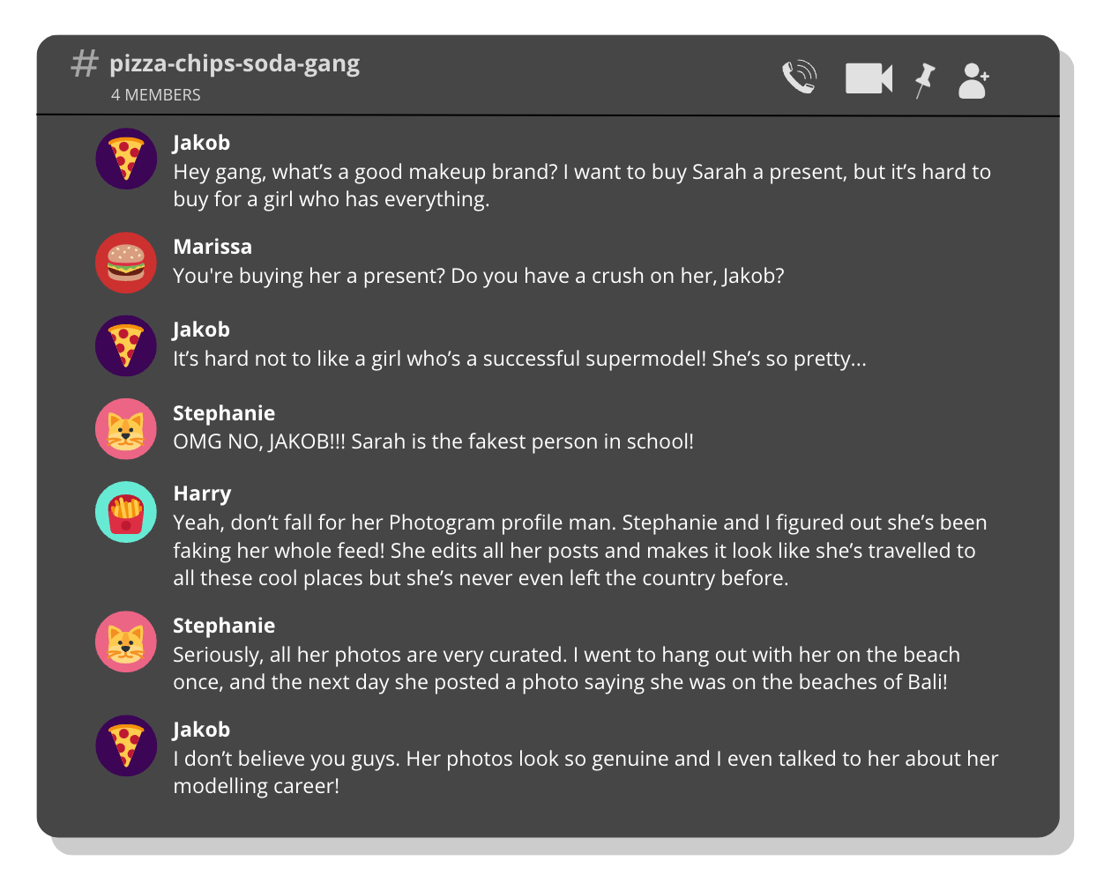
INVESTIGATE
EVIDENCE #3
LET’S DISCUSS
1. Stephanie describes an incident where Sarah posted a photo under false pretences. Which of the three keywords best describes this?
2. Why is it hard for Jakob to believe what Stephanie and Harry were telling him? Discuss how false realities and curated feeds can make it difficult for people to see the truth.

Slide 12
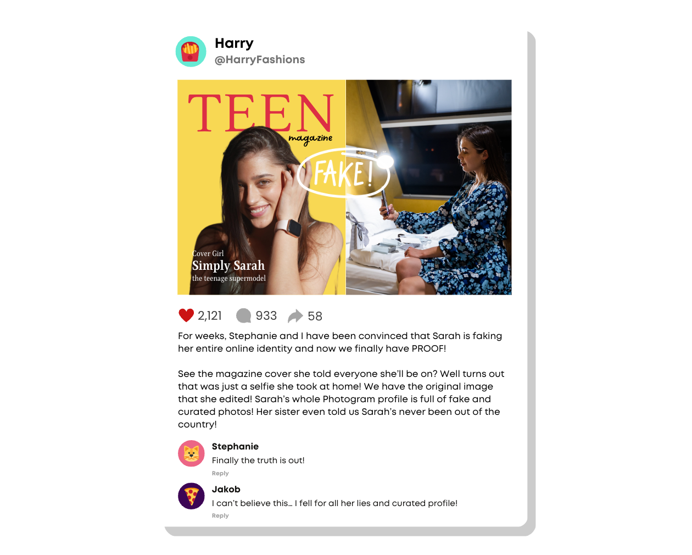
INVESTIGATE
EVIDENCE #4
LET’S DISCUSS
1. What do you think is Sarah’s motivations for posting false images online?
2. Discuss why we should not always believe what we see online.

Slide 13
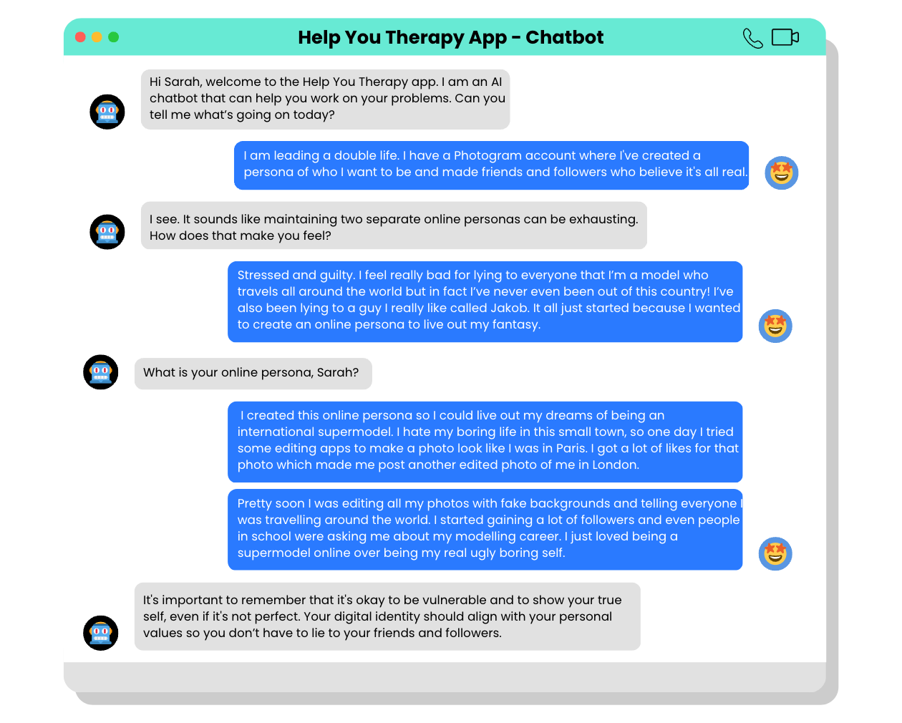
INVESTIGATE
EVIDENCE #5
LET’S DISCUSS
1. Do you think Sarah’s reasons behind creating an online persona is justified?
2. Do you think by curating her feed and creating a false reality for herself that Sarah has done anything wrong?

Slide 14

PROJECT WORK
Conduct a social media audit on a public figure, such as a celebrity or influencer.
A social media audit is an inspection or a review of a person’s social media profile.

Slide 15
Conduct a social media audit on a public figure, such as a celebrity or influencer.
What should your project outcome look like?
A social media audit is an inspection or a review of a person’s social media profile.
Your project should be presented in a report or presentation.
Instructions and Questions to Consider:
Choose a public figure with a large following on social media.
Research the chosen celebrity or influencer's online presence and analyse their social media accounts.
Identify patterns and themes in their posts. What topics do they consistently cover? What kind of content do they share?
What do their posts reveal about their values and beliefs?
How do they portray themselves online? Is their online persona consistent with their real-life identity?
What impact does their online presence have on their followers and fans?

Slide 16
Share Your Project!
Present your projects to the class.

Slide 17

KEY TAKEAWAYS
You shouldn’t believe everything you see online, as people tend to choose to present their online personas instead of their whole personalities.
Social media is full of curated feeds. If you feel overwhelmed, anxious, or jealous of what you see online, check in with your mental wellbeing and log off.
False realities make it hard for people to see the truth as it is a distorted or inaccurate representation of reality.

Slide 18
Well Done!
Lesson 14.01.02

