Slide 1
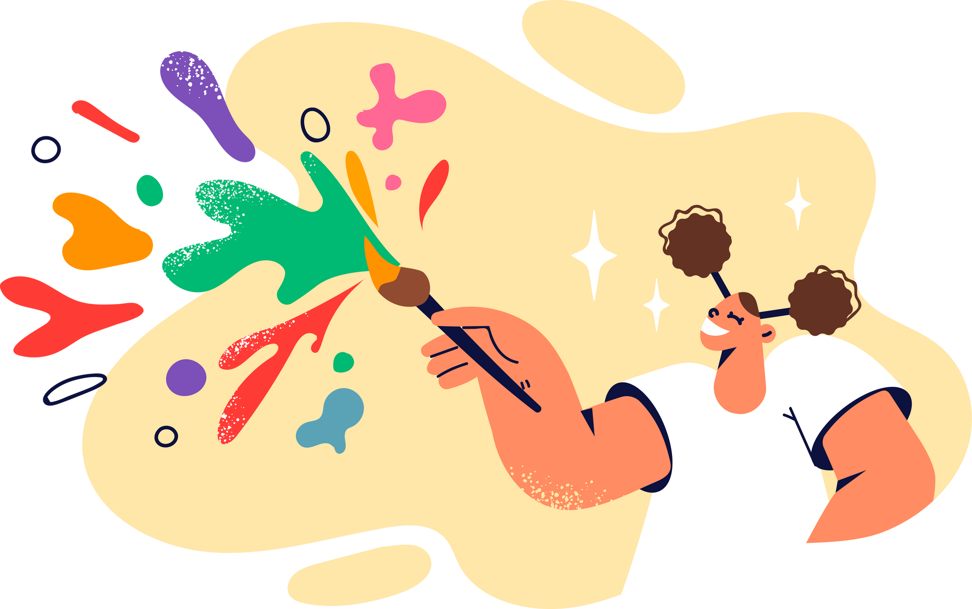
LESSON 3.10
GENERATIVE AI
Generating Images with AI
Prompt Engineering Lab Series

Slide 2
Using AI Tools Safely and Responsibly
Before we get started with the lesson, we must first remember these rules of using generative AI tools safely and responsibly.
1. Never share your personal and sensitive information when interacting with AI.
2. Be aware of AI's limitations and potential biases in its responses.
3. AI has a tendency to fabricate information at times. Always remember to fact-check any AI-generated information before using it.
4.Use AI ethically: respect privacy, avoid harmful content, and think critically

Slide 3
What You’ll Need
  Computer with internet access
  Access to a generative AI tool such as ChatGPT, Microsoft Copilot, or Gemini.
Disclaimer:
  Before using these tools, remember to check with your school and the app or site’s terms of use. Many AI tools require students to be at least 13 years old, and may require parental consent for those under 18 years old.
  The outcomes of exercises in this toolkit may differ from provided examples, as they depend on your specific inputs and the AI tools employed.
  Generative AI tools may at times produce inaccurate or fabricated information. Please verify and fact-check outputs using discretion and critical thinking.

Slide 4
WHAT ARE WE LEARNING TODAY?
Prompt Engineering Skill Here

Slide 5

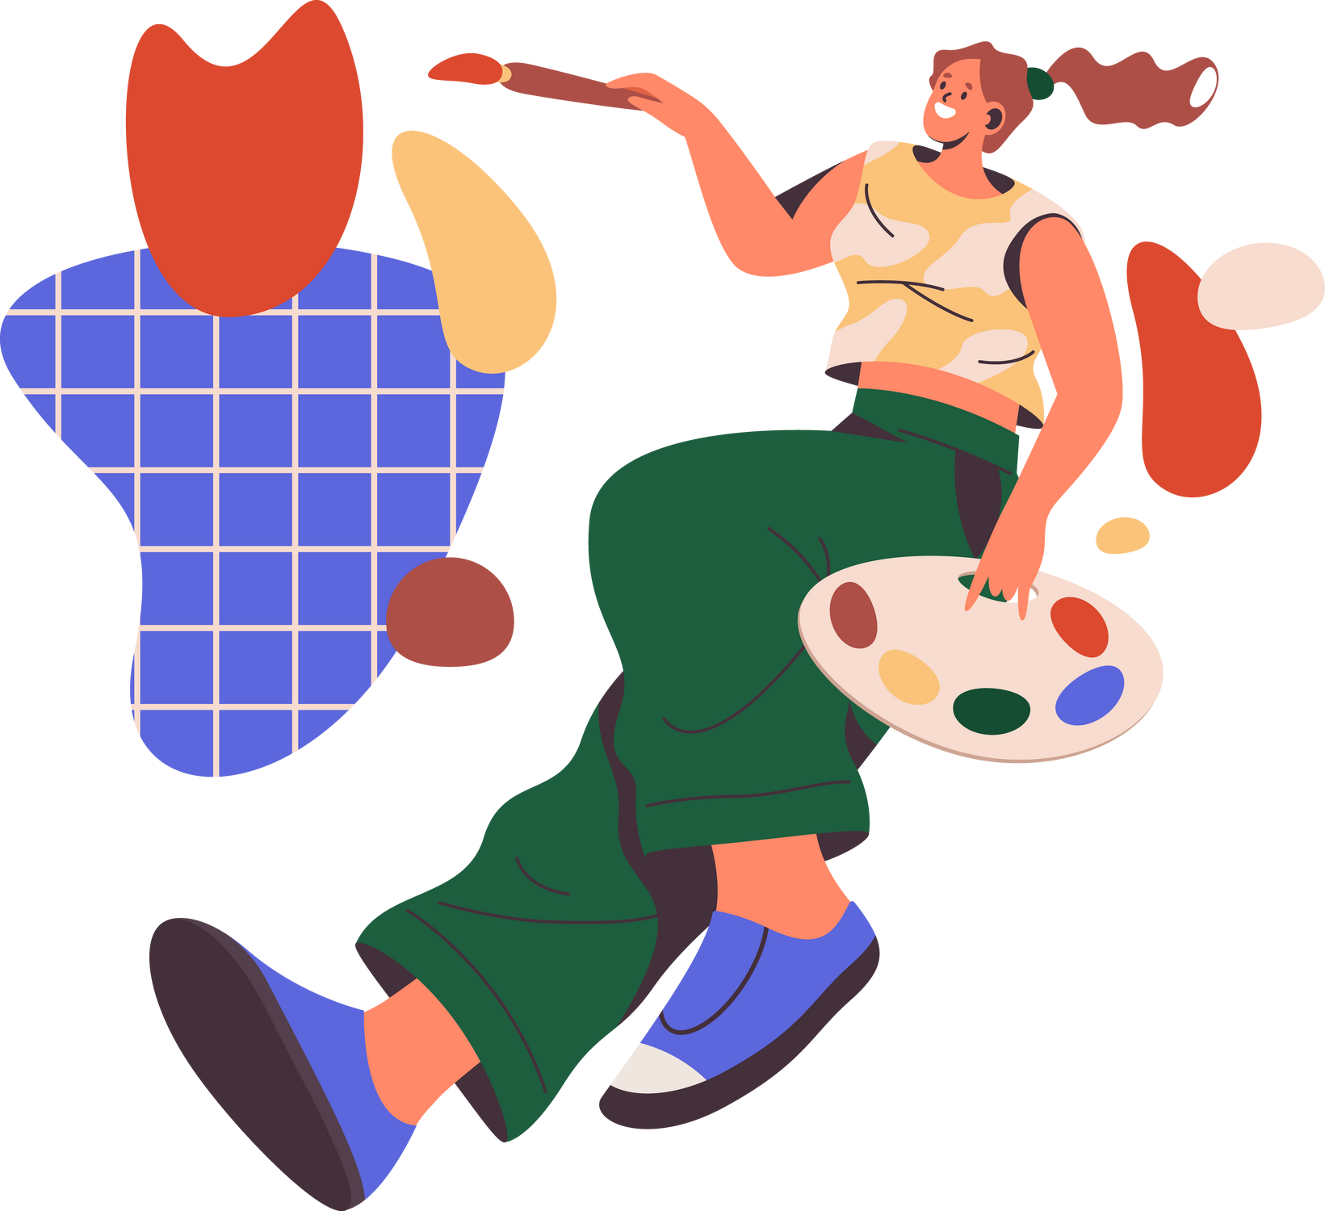
You are the artist, and AI is your paintbrush.
Generative AI can generate lots of creative outputs, such as images, videos, and even music! We can use text-based prompts to describe the picture and AI will do the rest of the work.

Slide 6
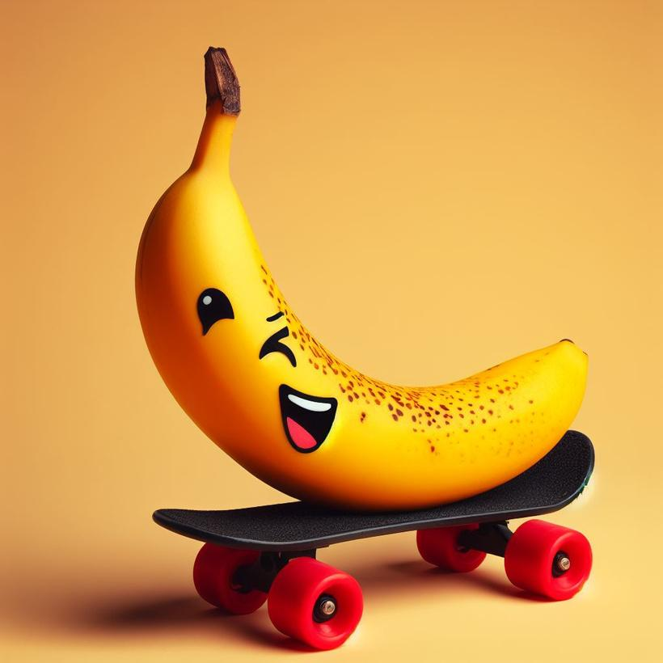
Prompts for Image Generation
To generate images, you can let your prompts be as open-ended or specific as you want!
Open-ended prompts like “a banana on a skateboard” means the AI will come up with creative interpretations of your instruction.
This image was AI-generated on Image Creator by Bing.

Slide 7
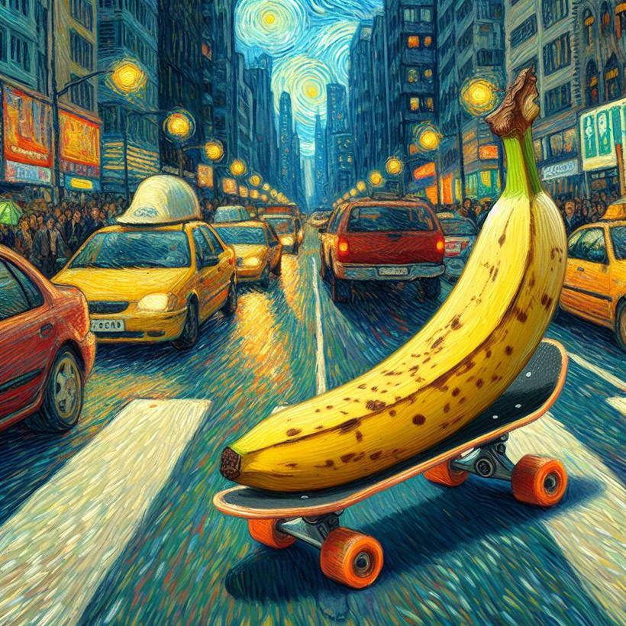
Prompts for Image Generation
More specific prompts like “a banana on a skateboard in a busy city in the style of a Van Gogh painting” will direct the AI in the direction you want.
This image was AI-generated on Image Creator by Bing.

Slide 8

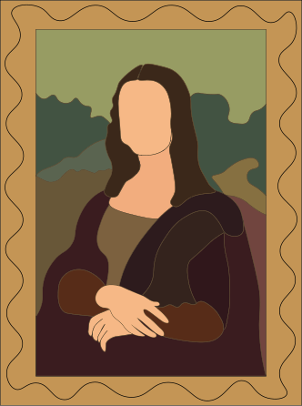


What can you specify?
When crafting prompts for AI image generation, including specific details can significantly influence the output.
Artistic Style
Specify a particular artist's style or an art movement. For example, "in the style of Leonardo da Vinci" or "like Art Nouveau."
Colour Scheme
Dictate the colours to be predominantly used, such as "monochrome," "pastel colours," or "vibrant and contrasting hues."
Mood or Atmosphere
Describe the desired mood, like "serene and peaceful," "mysterious and eerie," or "joyful and lively."
Setting and Location
Specify a place or setting, such as "rainforest," "medieval castle," "busy urban street," or "an alien planet.”

Slide 9

Credit and Citation
Being transparent with your use of AI tools is an important part of being a safe and responsible user. Whenever you have generated content with the help of generative AI, you must give proper credit and cite your source.
For example:
“This image was AI-generated on Image Creator by Bing.”

Slide 10
GROUP EXERCISE
Let’s Explore Together!
Try these examples to see the skills in action.

Slide 11

Generate an AI Image
1. Enter this prompt into Image Creator:
Try This Prompt!
An astronaut cat floating in space...
2. Choose one of the following details to add to your prompt:
    “...in a photorealistic style”
    “...in pastel colours”
    “...with an adventurous mood”
3. Click ‘Generate’!
4. Share your new artistic creations with the class!

Slide 12
TRY IT YOURSELF
Independent Exploration Task
Apply the skills you’ve learned in this task.

Slide 13
Your Task
Your task is to create a poster for a movie about a mysterious figure known as the Colour Thief who steals colours from the world, turning everything into shades of grey.
Using generative AI tools, use your imagination to create a prompt that will produce an eye-catching poster. You can decide on what the Colour Thief should look like, the genre of the movie, and artistic style.

Slide 14
Group Sharing!
What did you come up with?

Slide 15
LESSON 3.10
Well Done!

