Slide 1

Lesson 08.02.01
PRIVACY & INFORMATION SECURITY
Secret Codes of Safety
Creating strong passwords for your digital world

Slide 2
The basic rules of password security
What are we learning today?
How to create strong passwords for your online accounts

Slide 3
WARM UP QUESTION
Why do you think we use passwords for our games or devices?

Slide 4
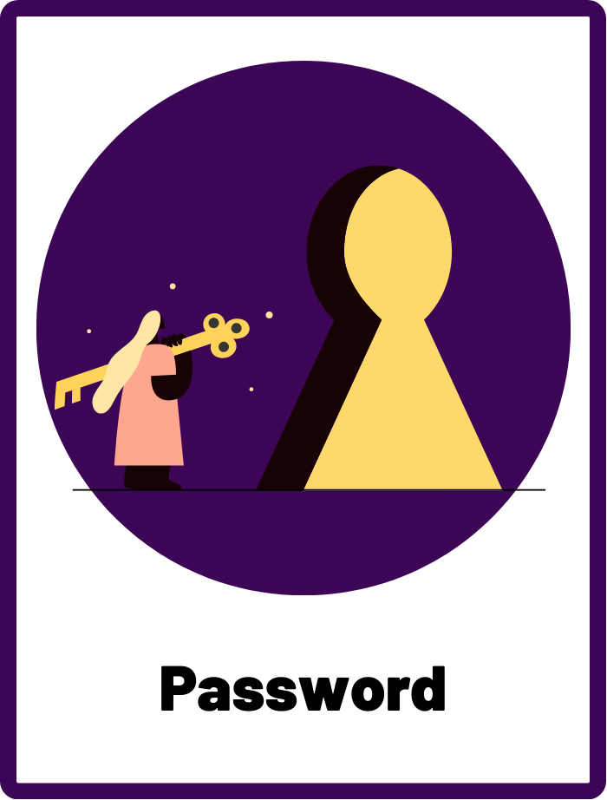
Password
A secret combination of letters, numbers, and/or symbols used to access and protect personal accounts and information.

Slide 5
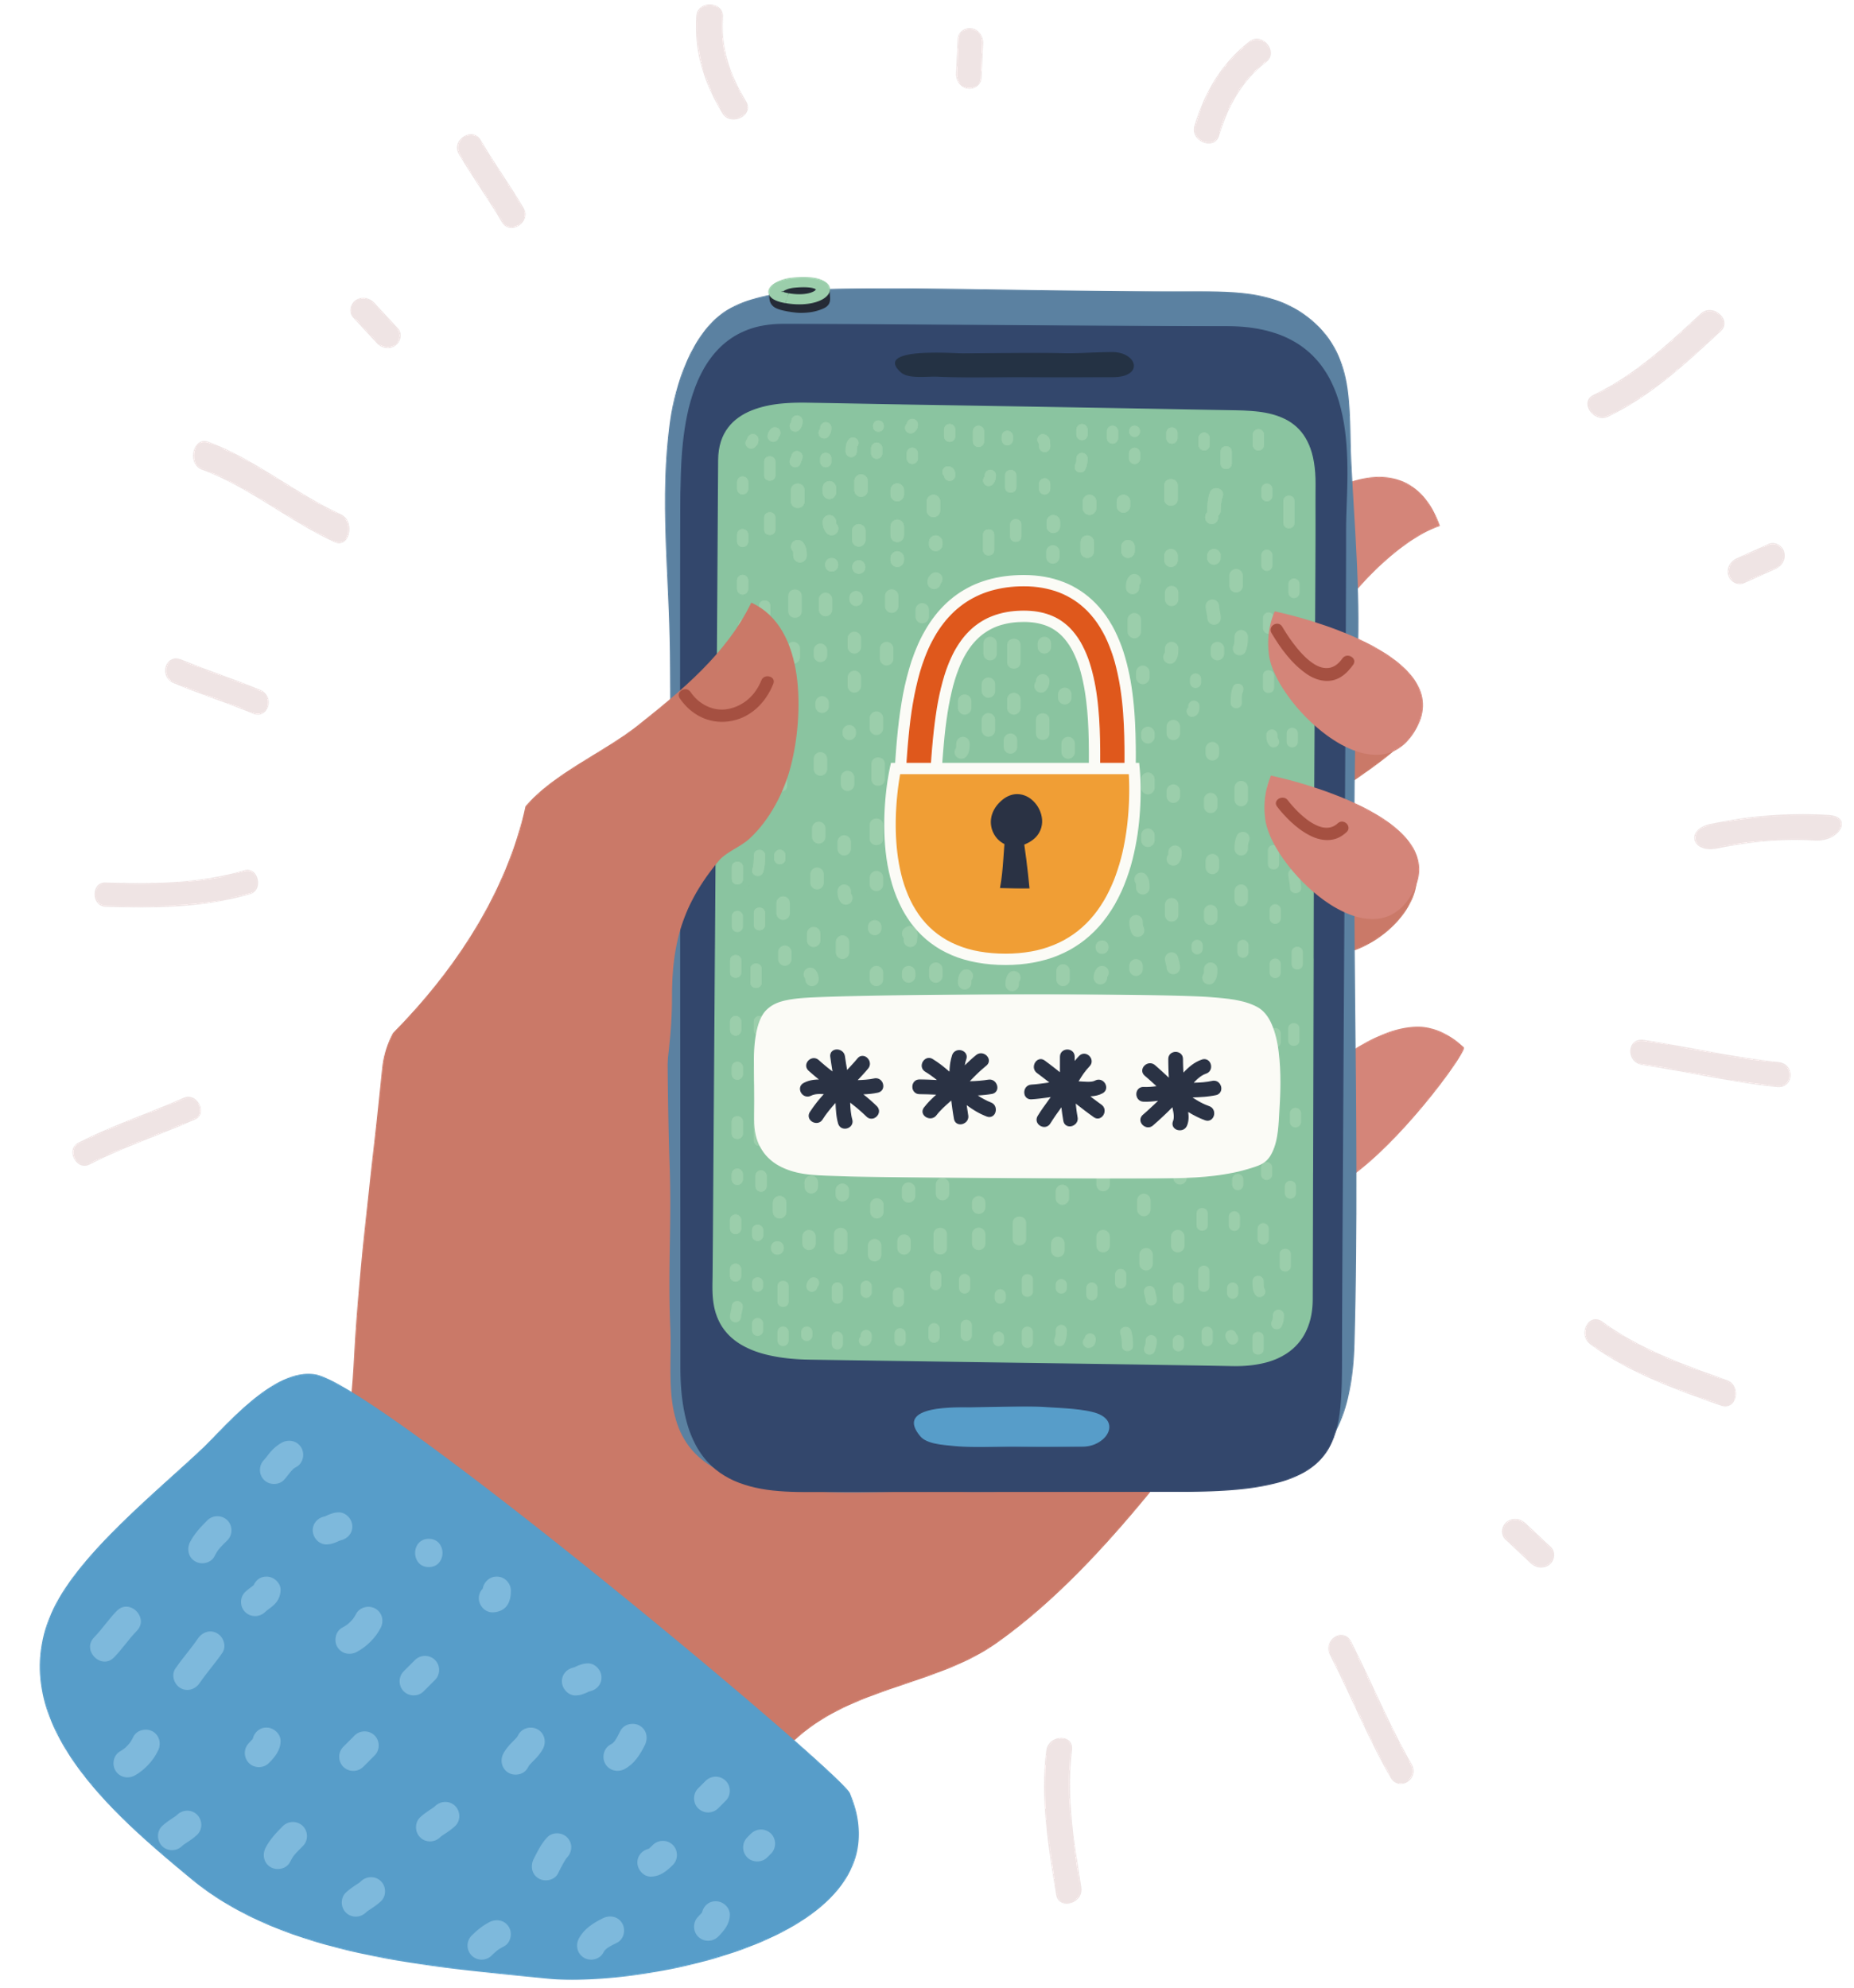
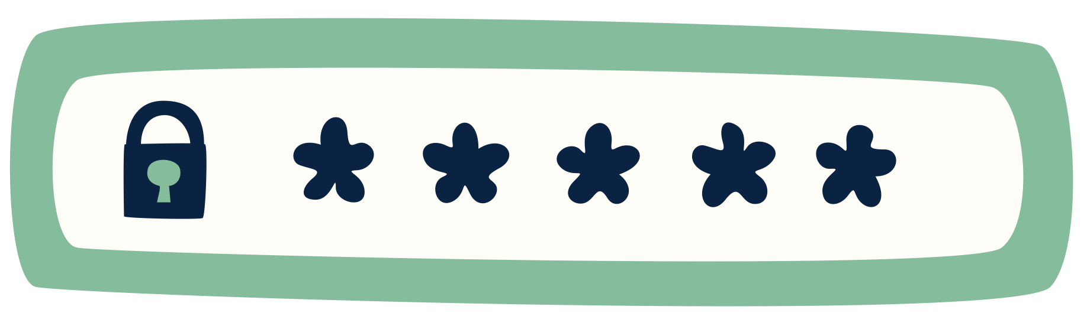
What is a Password?
A password is like a secret code that you use to get into your online games, apps, or websites. It's your special key that only you should know.

Slide 6
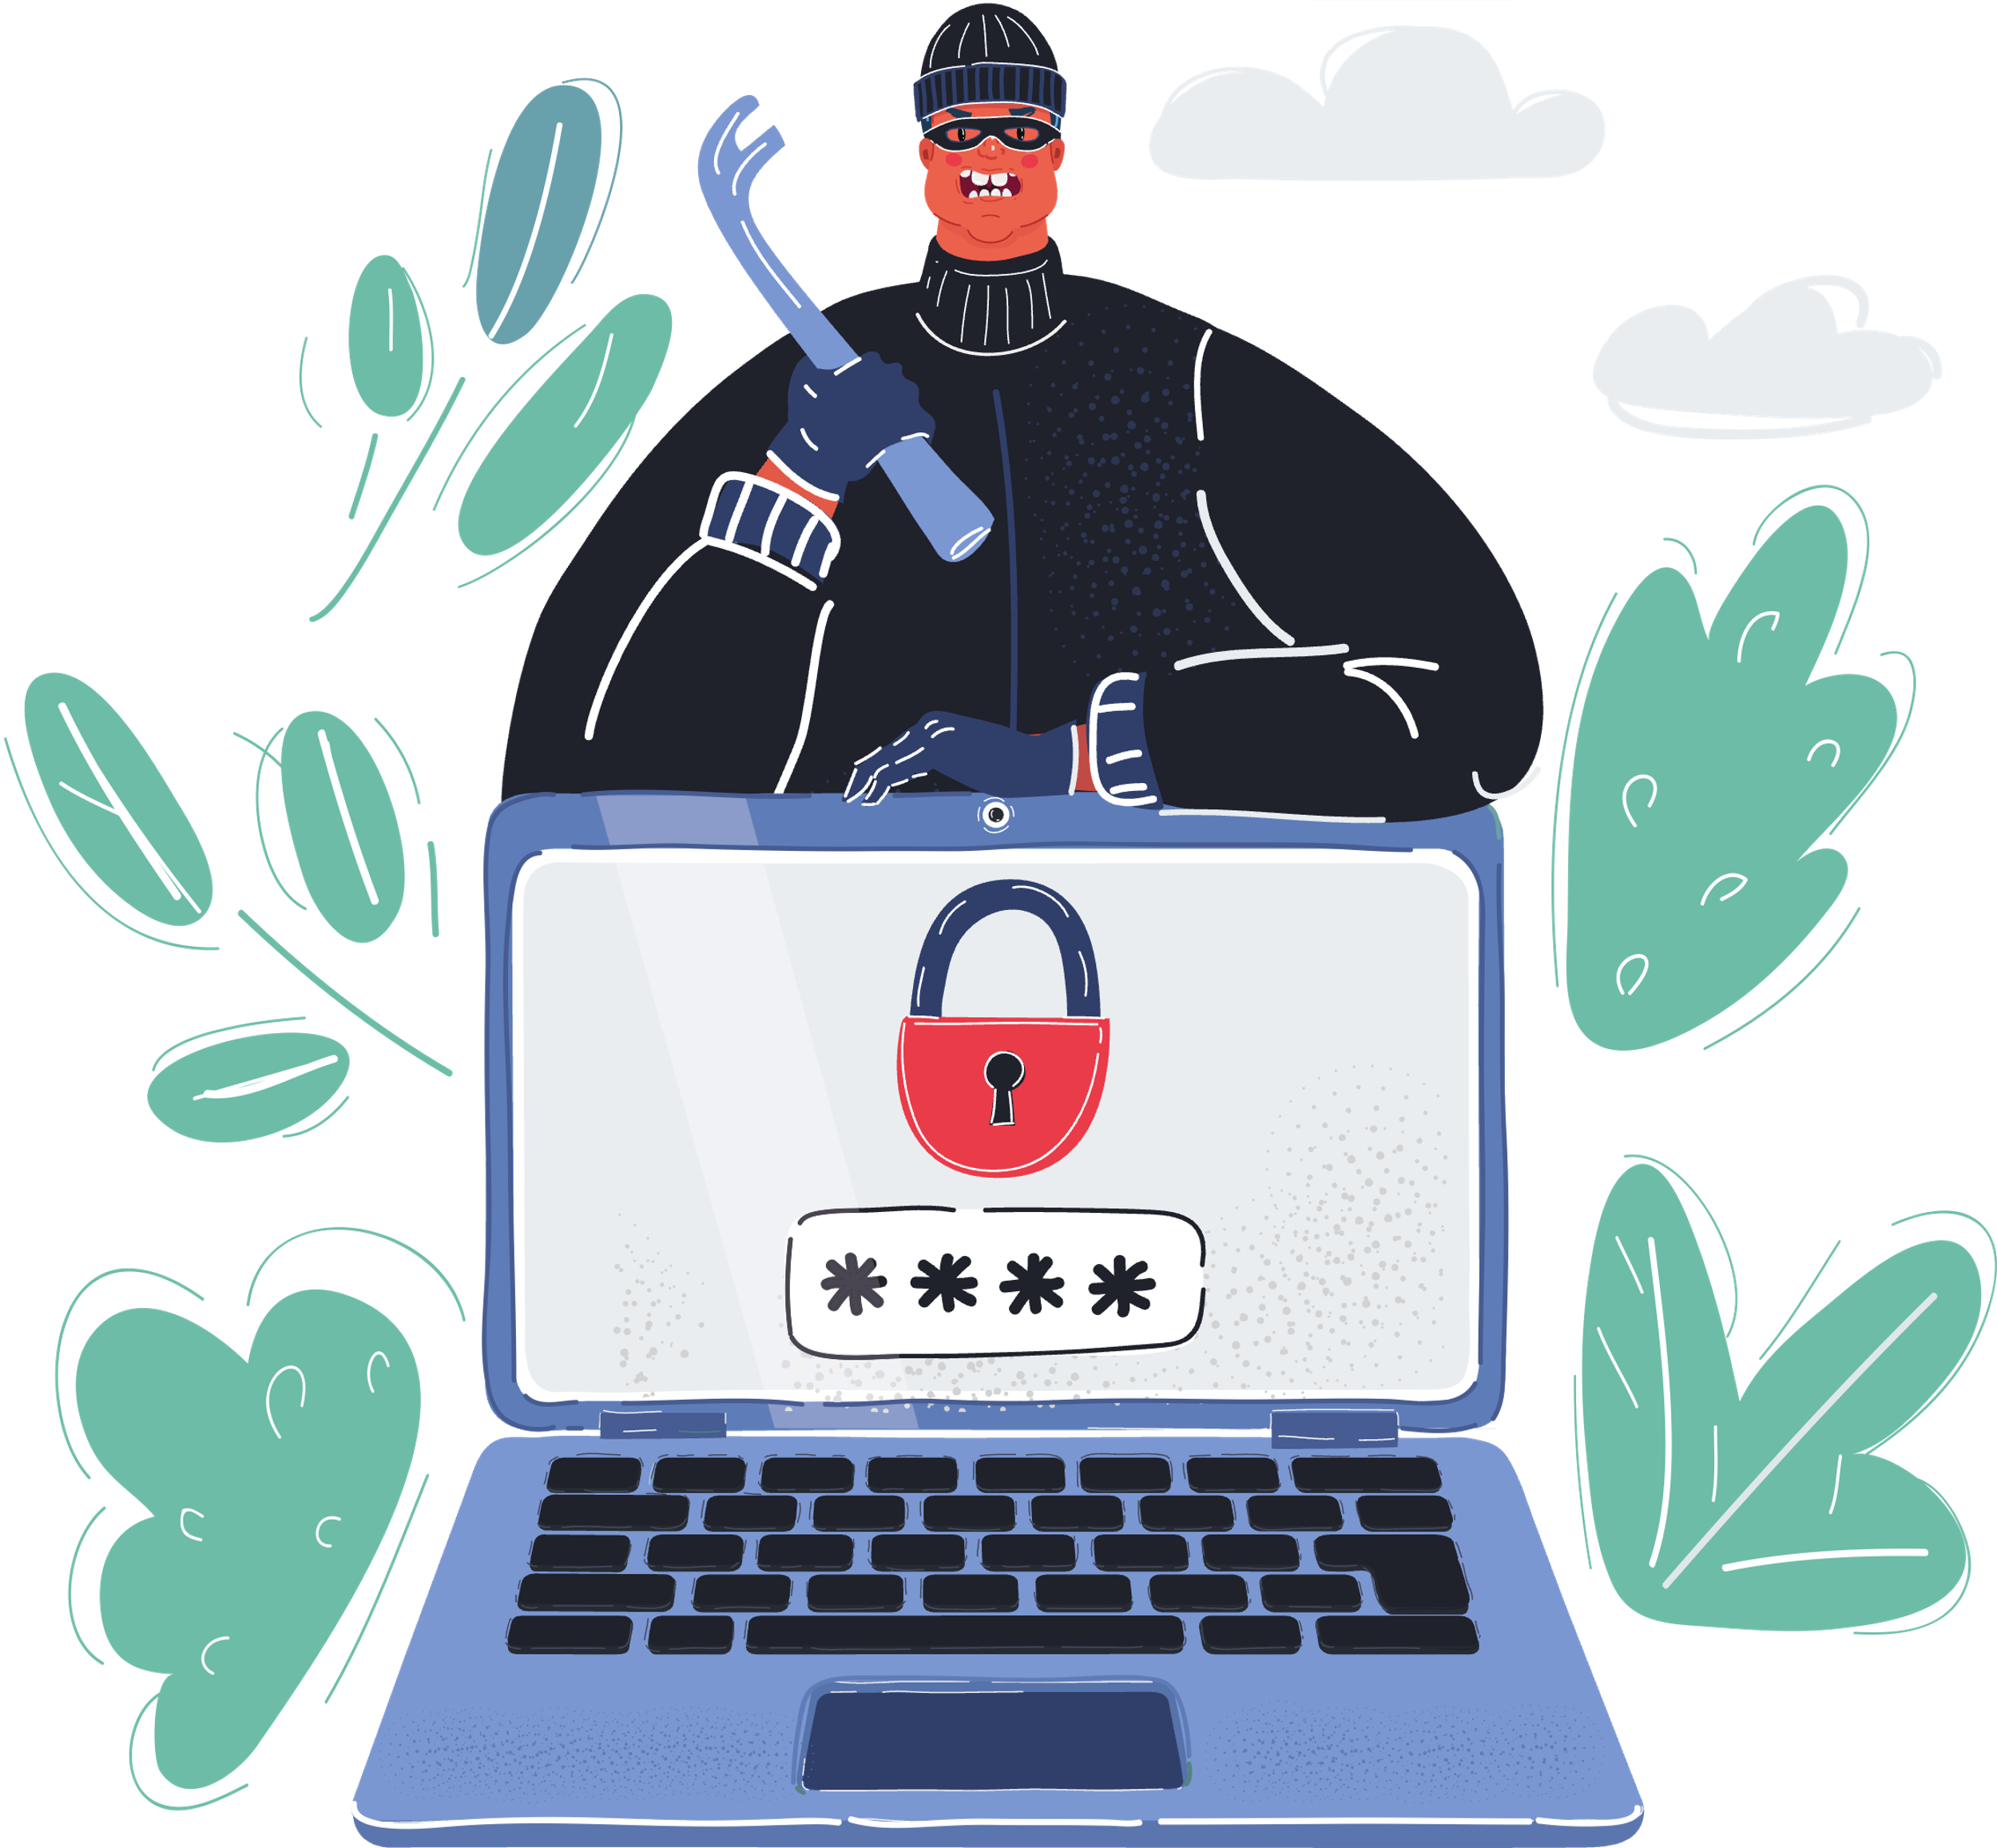
Why are Passwords Important?
Passwords keep your information, like your games or messages, safe from others who shouldn't see them.

Slide 7
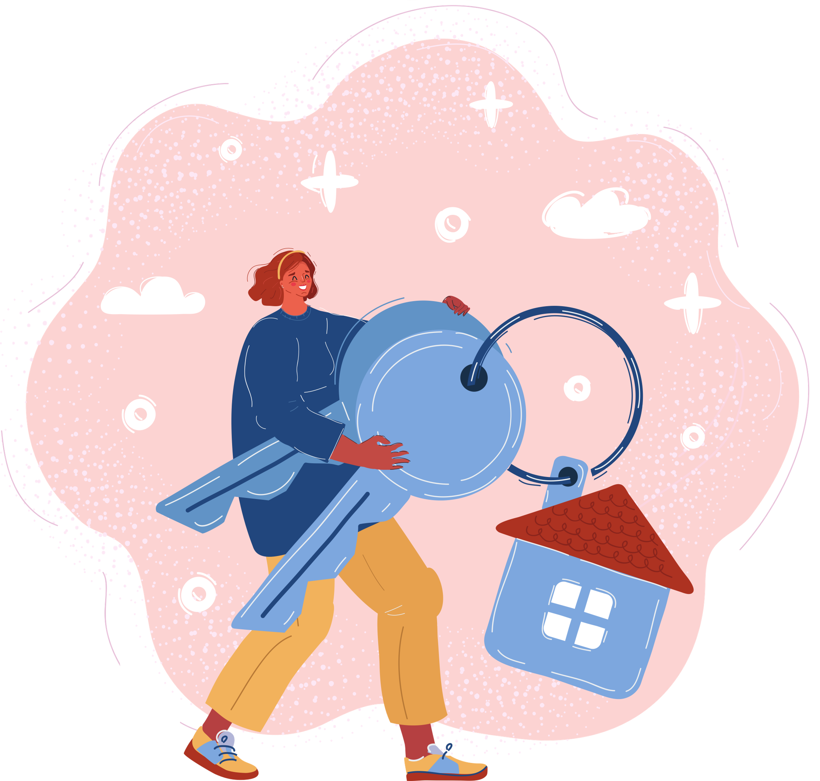
Passwords are Your Secret Keys
Imagine your password as a key that protects your house from criminals coming into your home without your permission.

Slide 8

Rules for Strong Passwords
A strong password should be...
LONG
A strong password is more than 12 characters long
STRONG
Mix in letters, numbers, and symbols so the password is hard to guess
SECURE
Use different passwords for each online account
DON’T DO THIS!
Don’t use words that are easy to guess, like your name or “password”, and NEVER share your passwords with anyone else!

Slide 9
Which Password is Stronger?
Discuss which password is stronger in each row.
apple
App!e579?
OR
Purp1eM0nkeY!
monkey
OR
password
Ch0colateBLu3D0g2
OR

Slide 10

Which Password is Stronger?
Did you get them right?
apple
App!e579?
OR
Purp1eM0nkeY!
monkey
OR
password
Ch0colateBLu3D0g2
OR

Slide 11
ACTIVITY
Password Practice
Let’s practise making strong passwords!

Slide 12
What You’ll Need
  Paper or notepad
  Pencil or pen

Slide 13
Instructions
Example
1. Write down your favourite ice cream flavour and animal in one line on your paper.
Make sure there are at least 12 letters!
RaspberryRabbit

Slide 14
Instructions
Example
2. Replace vowels with the following symbols or numbers:
RaspberryRabbit
R@spb3rryR@bb!t
REPLACE
WITH THIS
A
@
E
3
I
!
O
0
U
?

Slide 15
Instructions
Great job, you’ve just created a long and strong password!
R@spb3rryR@bb!t
Remember to create new passwords for each online account, and never share it with your friends!

Slide 16
WRAP UP
What have you learned today?
Let’s reflect on today’s lesson.

Slide 17
Remember This!
  Your password is your secret key for your online world. It unlocks your personal online accounts.
  Never share your passwords with your friends.
  Make your passwords long, strong, and secure!

Slide 18
Lesson 08.02.01
Well Done!

