Slide 1
The Mascara Controversy
LESSON 3.3
DIGITAL MEDIA LITERACY
EXERCISE-IN-A-BOX

Slide 2

Have you ever come across an influencer who was trying to sell you a product or service?
WARM-UP

Slide 3

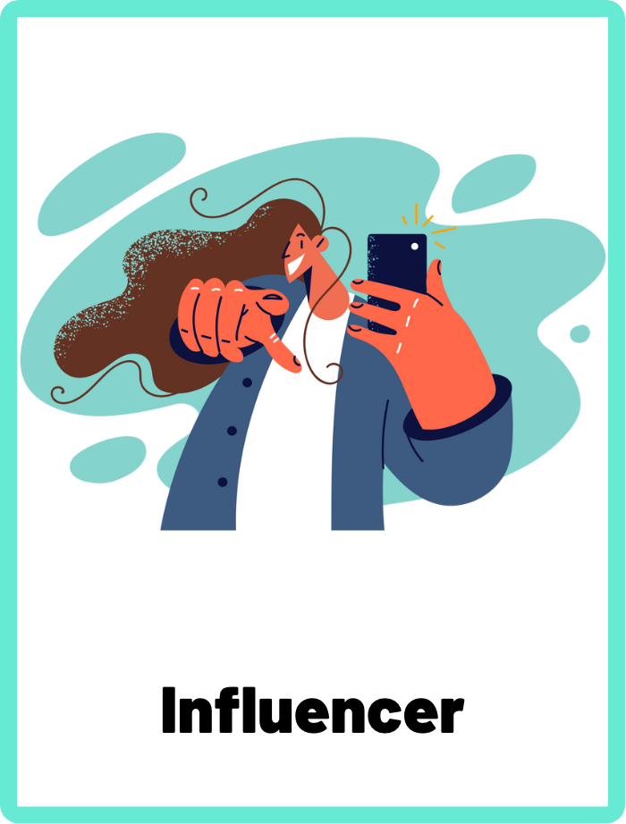
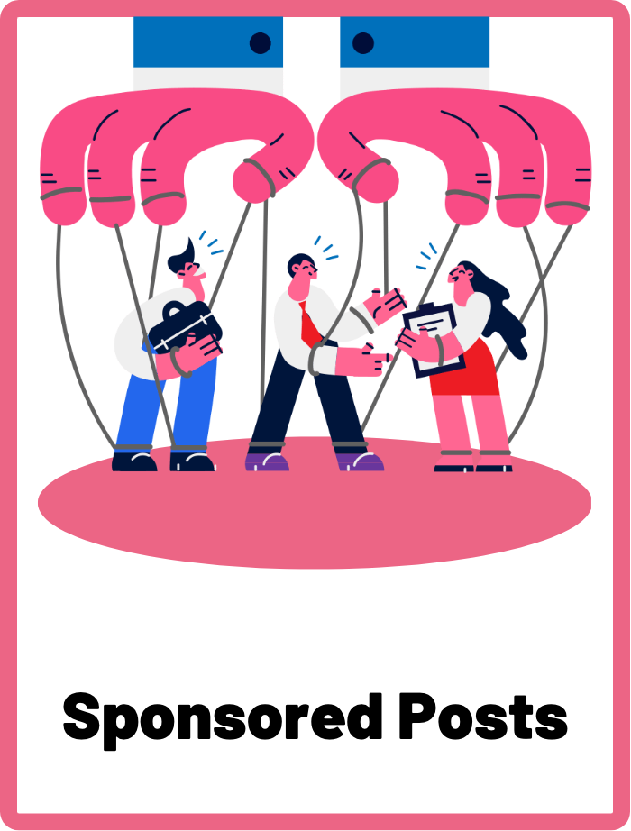
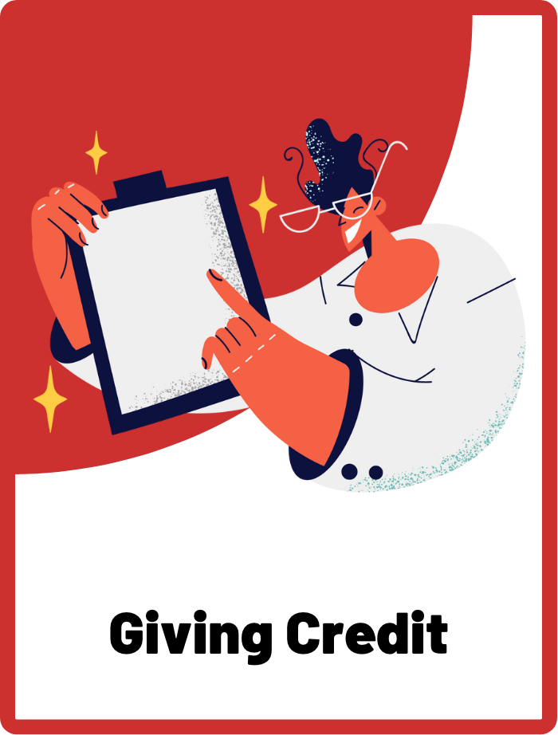
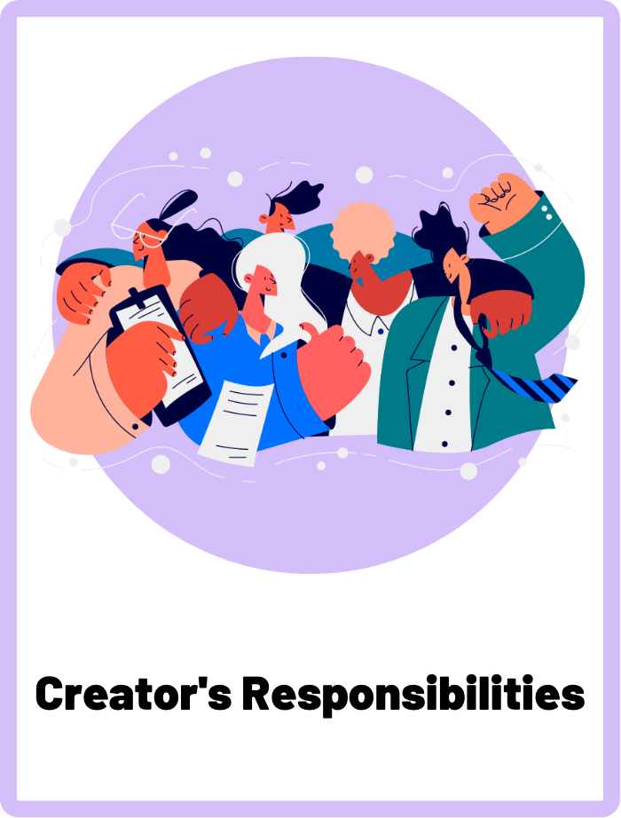
DEFINE THE KEYWORDS
What do you think these terms mean?

Slide 4
DEFINE
Influencer
A person who has built a large following on social media platforms and has the power to influence the opinions and purchasing decisions of their audience. They use their online presence to create and share content that is meant to appeal to their followers and inspire them to take action, such as buying a certain product or supporting a particular cause.

Slide 5
DEFINE
Sponsored Posts
Sponsored posts are a type of online content where the creator or influencer has received payment or incentives in exchange for promoting a product or brand. These posts can appear on various social media platforms and are often marked with hashtags such as #ad or #sponsored to disclose their commercial nature.

Slide 6
DEFINE
Giving Credit
Giving credit is an important aspect of digital media literacy and responsible online behaviour. It means acknowledging the work of others and crediting the original source of content used in your own posts, such as images, videos or ideas. This can include citing sources for written content, using proper image credits for photos, or tagging original content creators when sharing their work on social media.

Slide 7
DEFINE
Creator’s Responsibilities
As digital content creators, individuals have a responsibility to uphold ethical standards and contribute to a safe and respectful online community. Some of the key responsibilities of creators include creating original content, ensuring accuracy, maintaining authenticity, respecting intellectual property rights, and promoting a safe and respectful online community.

Slide 8

INVESTIGATE THE SCENARIO
Read the following evidence carefully to piece together the story. Think critically about the information you are examining and consider the questions.

Slide 9
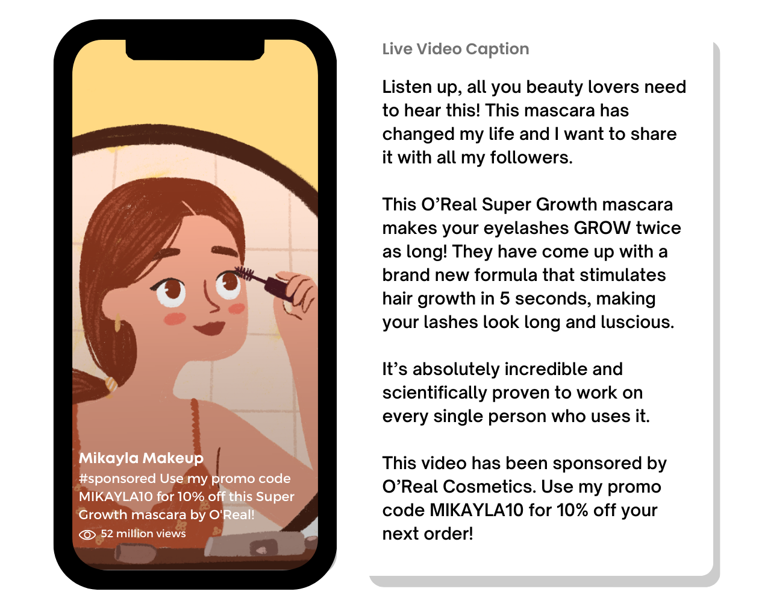
INVESTIGATE
EVIDENCE #1
LET’S DISCUSS
1. What should you take into consideration when you see sponsored posts?
2. Why are social media influencers required to tell their audience if a post has been sponsored or is an advertisement?
3. What responsibility does Mikayla have as an influencer, in terms of transparency and authenticity in her content?

Slide 10
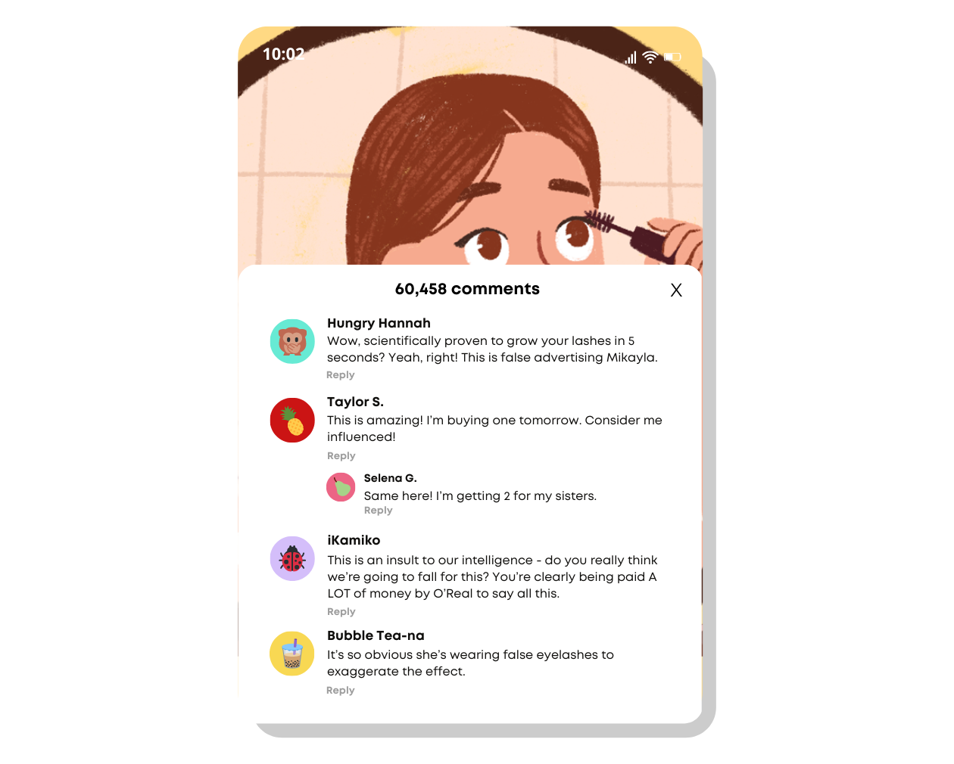
INVESTIGATE
EVIDENCE #2
LET’S DISCUSS
1. How can consumers be more critical of the products and advertisements they see on social media and in mainstream media?
2. Should influencers be held to the same standards as mainstream advertisements when it comes to honesty and accuracy?

Slide 11
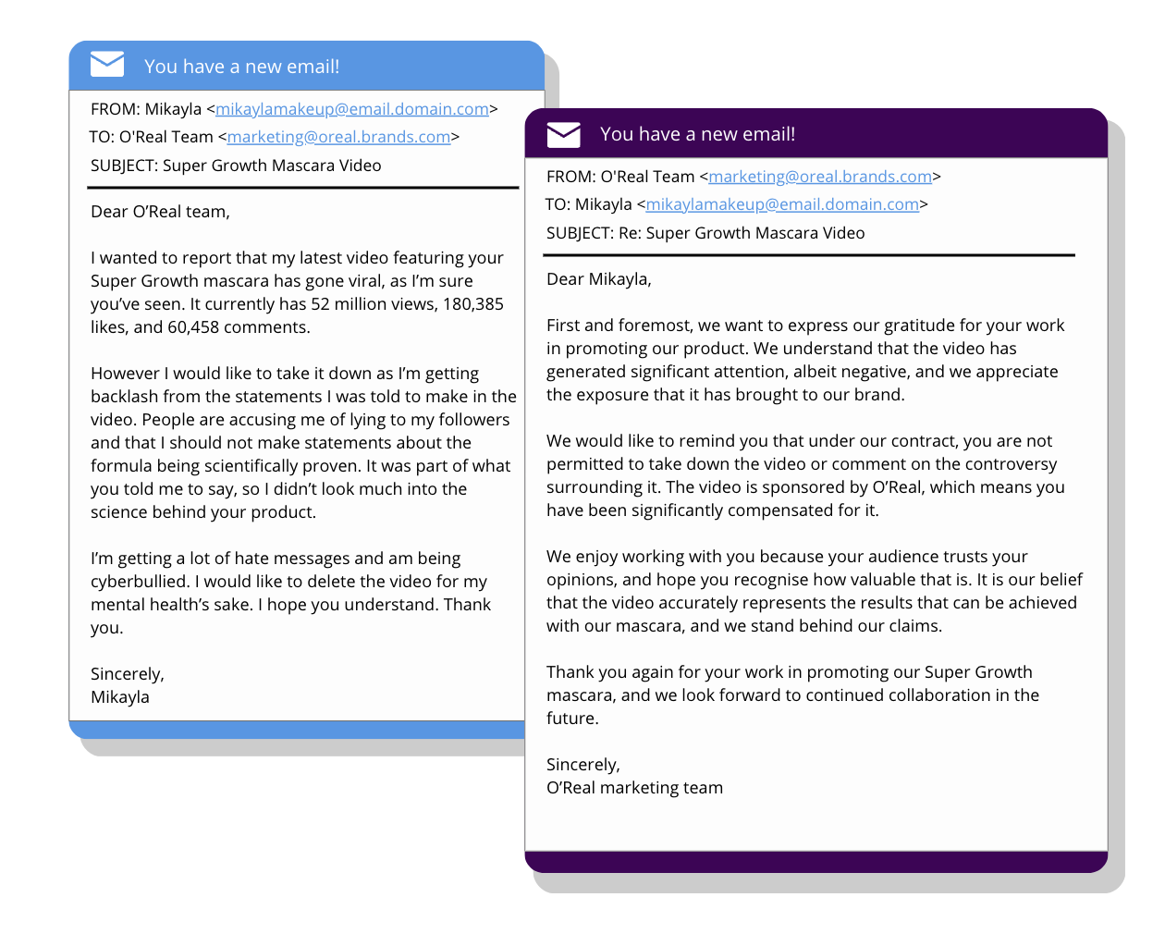
INVESTIGATE
EVIDENCE #3
LET’S DISCUSS
1. Why do you think brands like O’Real like to work with social media influencers like Mikayla?
2. Do you think Mikayla would have said anything differently in her video if she wasn’t sponsored by O’Real?
3. Is it fair for O’Real to tell Mikayla she’s not allowed to take down the video, even though it’s hurting her mental health?

Slide 12
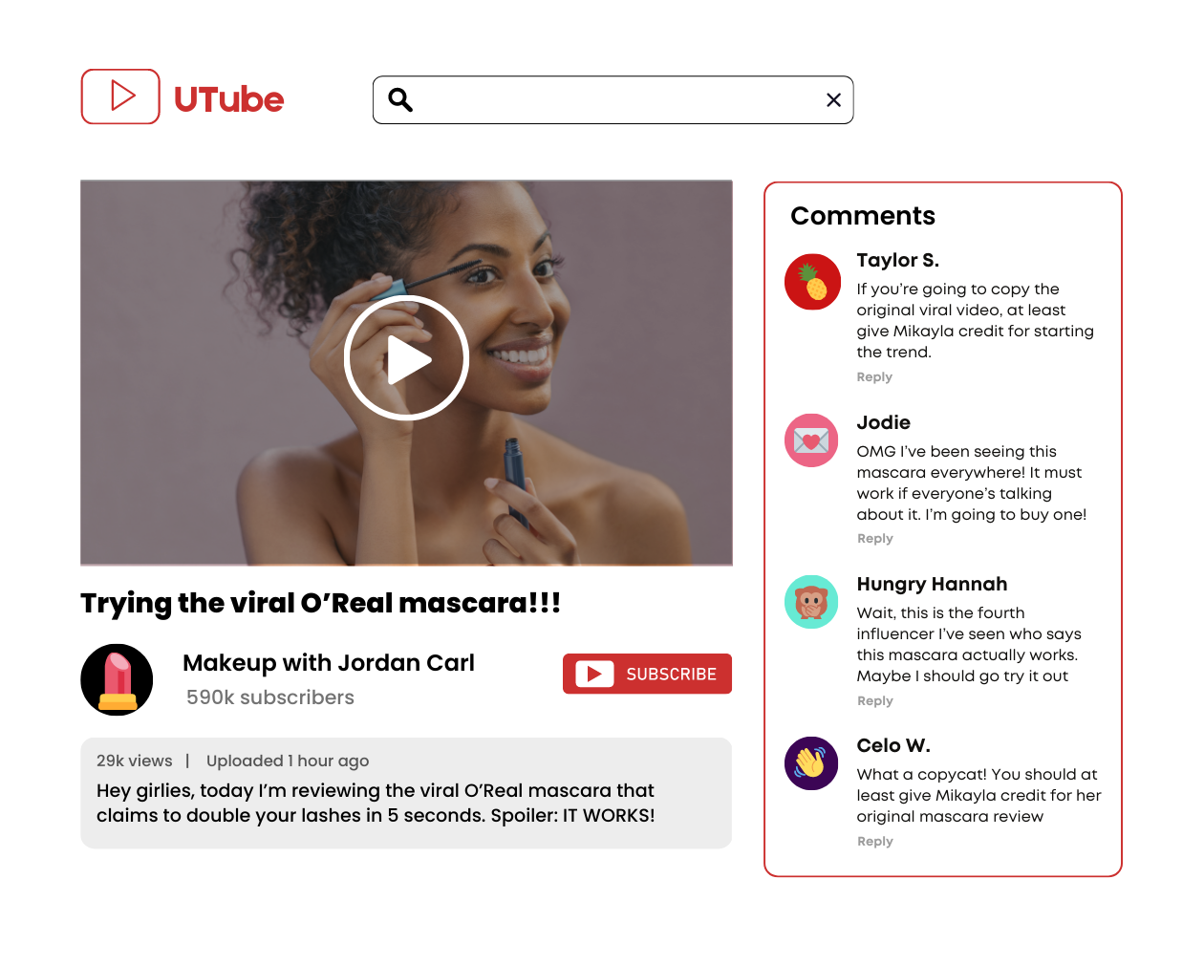
INVESTIGATE
EVIDENCE #4
LET’S DISCUSS
1. Why is it important to give influencers and content creators like Mikayla credit for the original idea?
2. How can failing to give credit to the original content creator impact their work?

Slide 13
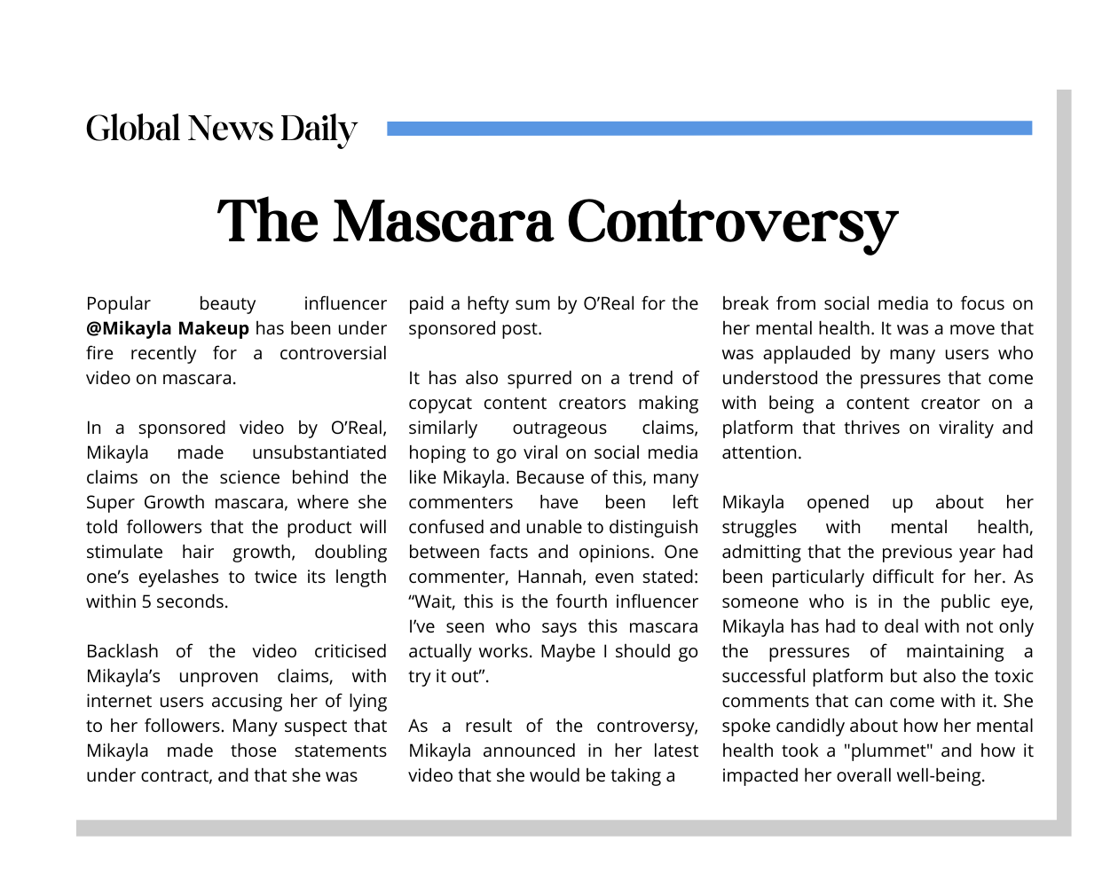
INVESTIGATE
EVIDENCE #5
LET’S DISCUSS
1. If you see multiple copycat videos of people repeating the same claims that the mascara actually works, does it mean it becomes a fact?
2. How can we differentiate between facts and opinions when it comes to content on social media?

Slide 14

KEY TAKEAWAYS
Social media influencers are not sources of truth and facts. They may share personal opinions or promote a product for commercial reasons, so their content should never be taken at face value for fact.
Sponsored posts mean the influencer or content creator has been paid to promote a certain product by the brand.
Always use critical judgement when viewing anything on social media.
Giving credit to original creators is an important aspect of digital media literacy and responsible online behaviour as it fosters a collaborative and positive culture online.
When you want to post anything online, consider your personal responsibilities as a content creator and the ethical standards you should aim to achieve.

Slide 15
Well Done!
LESSON 3.3

