Slide 1
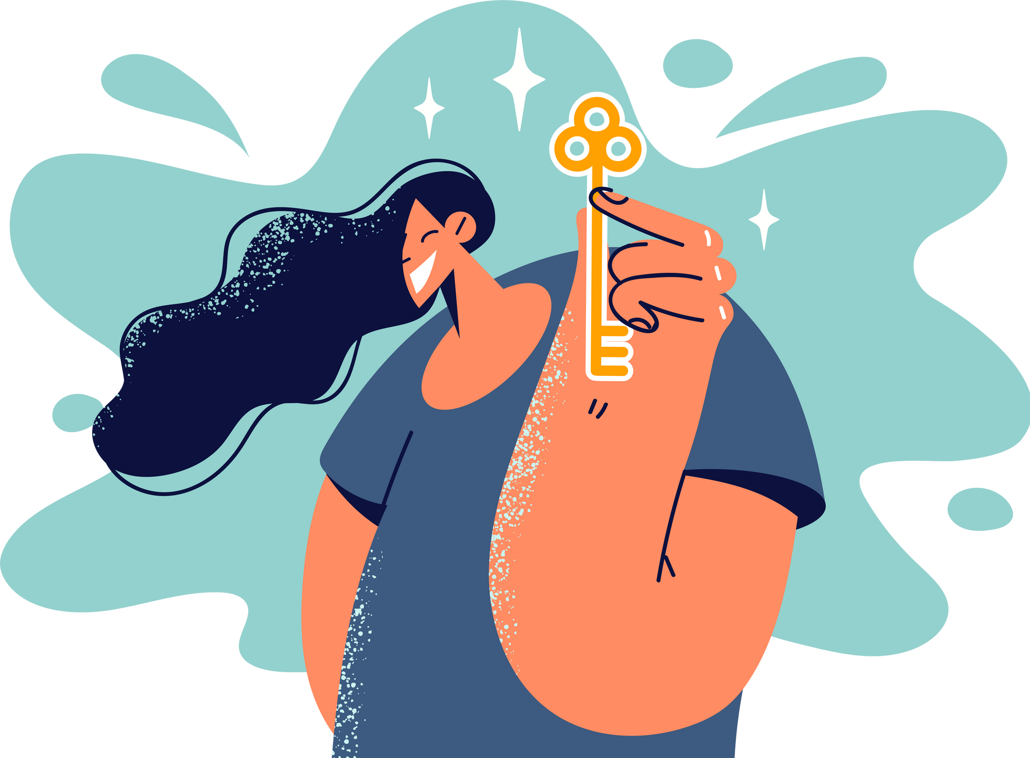
Lesson 09.03.01
DIGITAL MEDIA LITERACY
Digital Ownership and Copyright
Who owns content online?

Slide 2
Understanding ownership of content
What are we learning today?
Recognise the importance of respecting copyright

Slide 3
WARM UP QUESTION
What does it mean to “own” something online, like a video or photo?

Slide 4
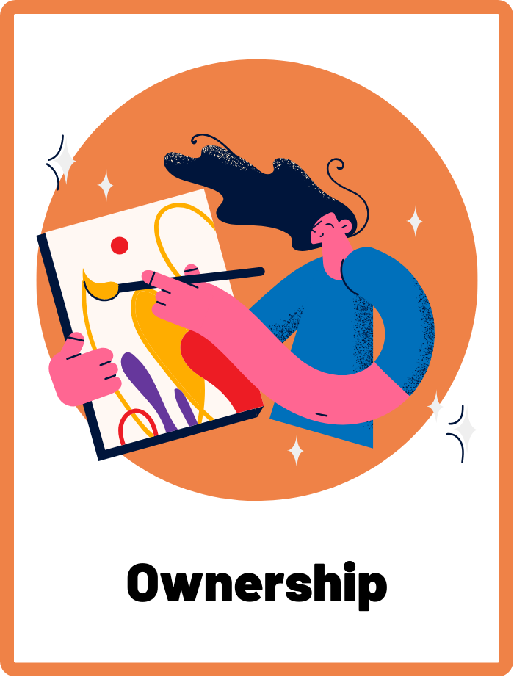
Ownership
The fact of owning something, including intellectual property like digital content.

Slide 5
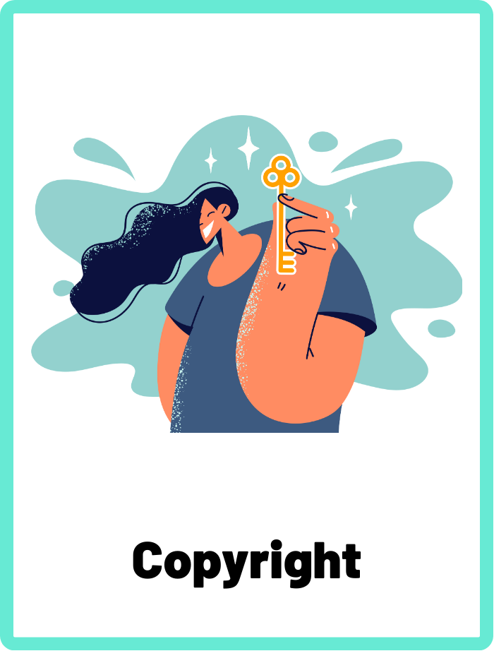
Copyright
A legal term describing the rights creators have over their original works, which prevents others from using the work without permission.

Slide 6
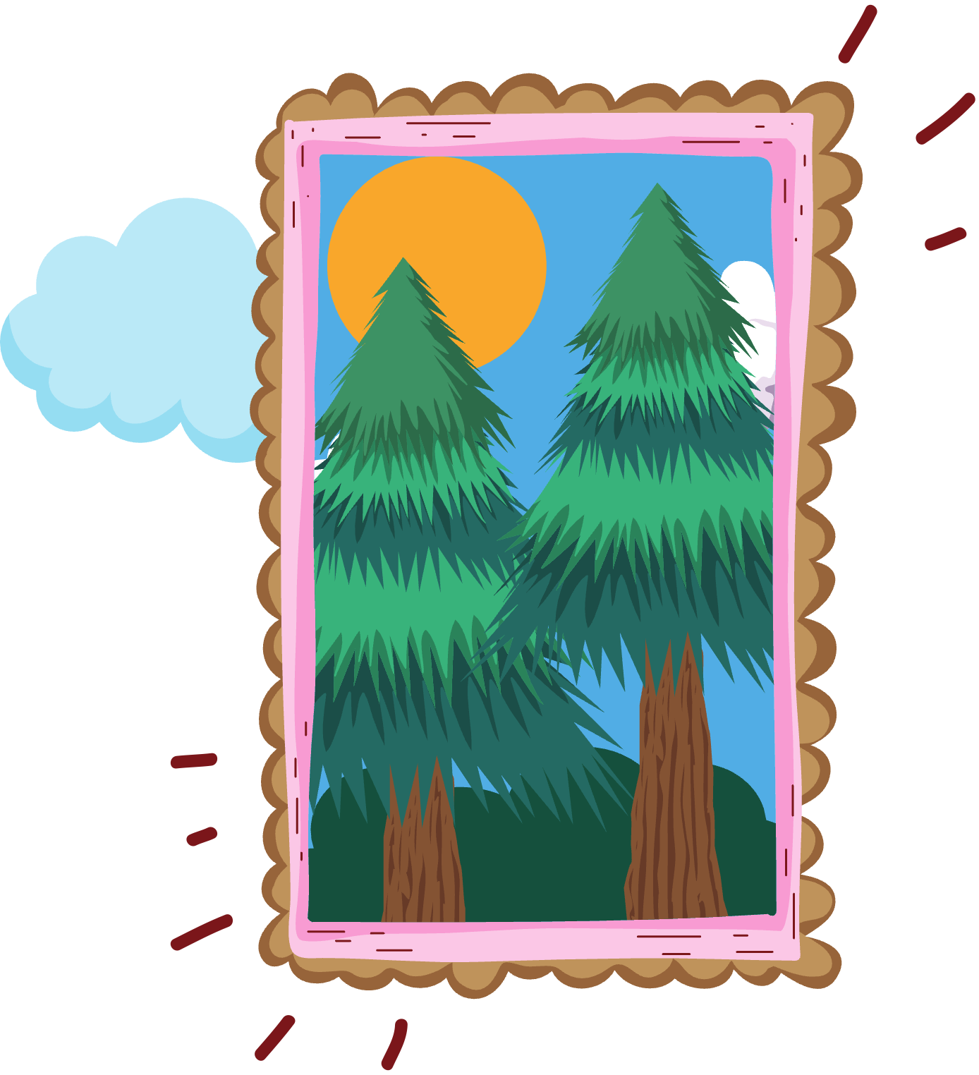
Imagine this...
You just painted this beautiful picture in class, but your classmate Akhil takes your picture and writes his name on it.
Who does that picture belong to now?

Slide 7
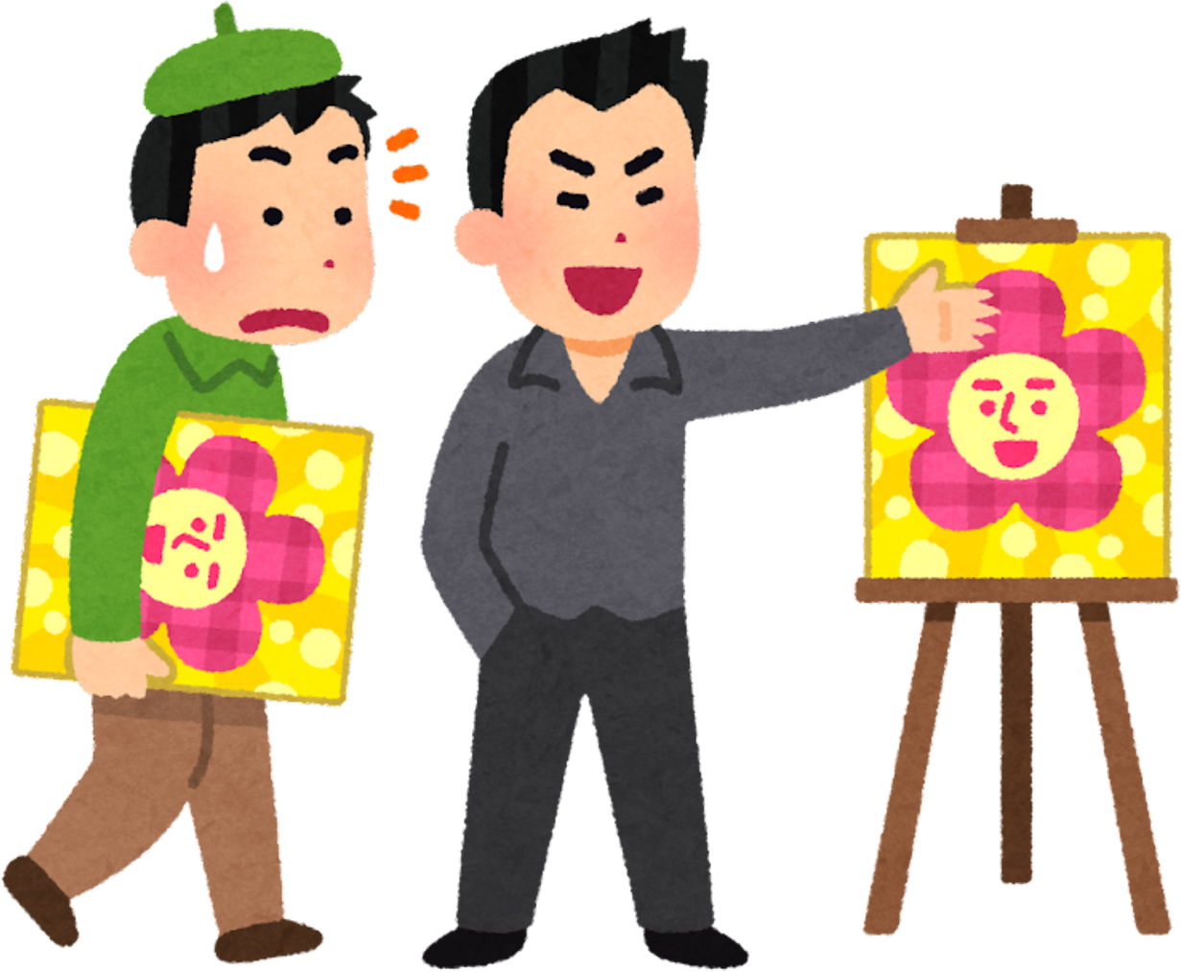
Creating Our Own Digital Content
When we make our own pictures, videos, or stories, we own the copyright! Taking something that we didn’t make and claiming it as our own work is wrong, because we don’t own the copyright to it.

Slide 8

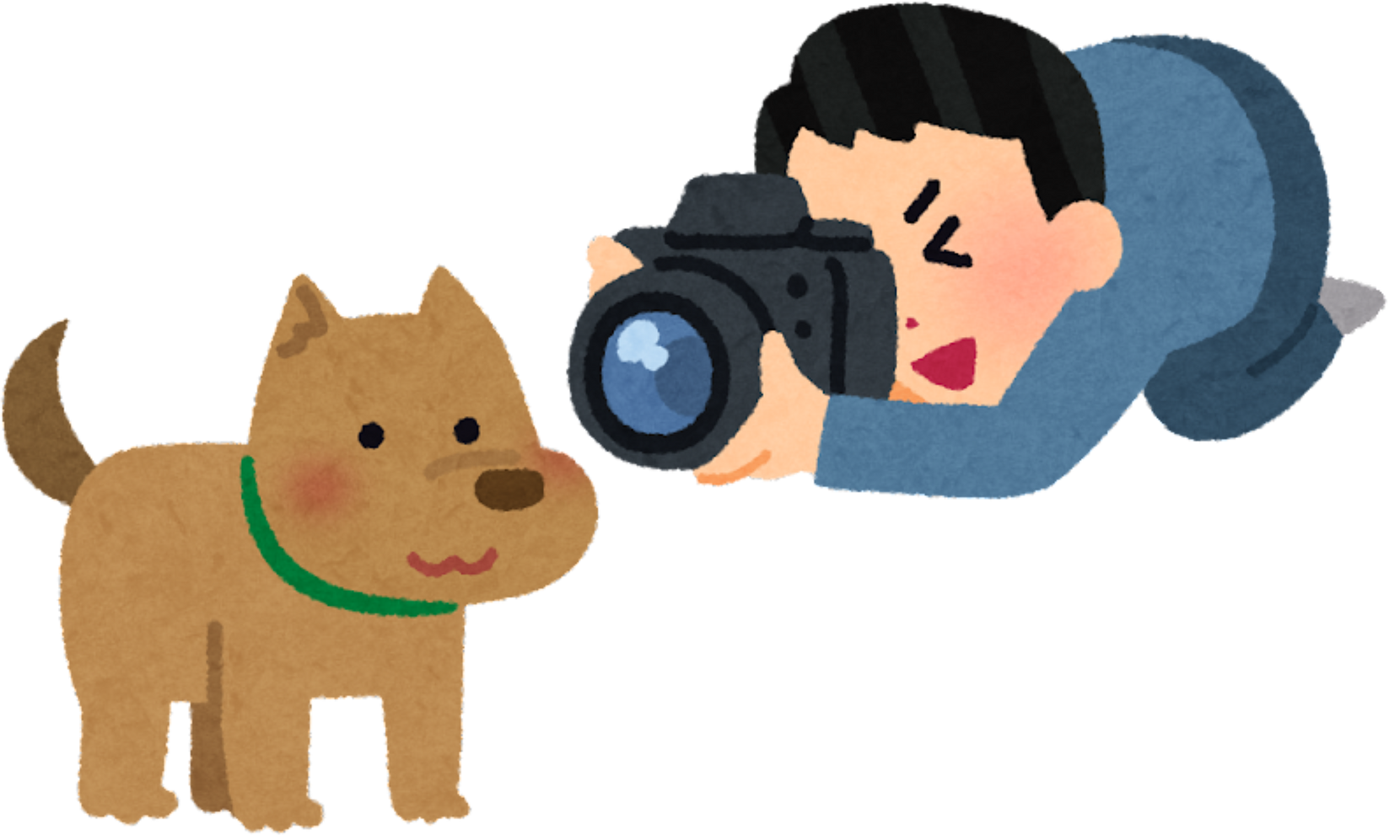
What is Copyright?
Copyright is like a special rule that says who owns a piece of digital content, like a picture, video, or story, and who can use it.
If you take an original photo on your camera, then you own the copyright! You can then give permission to who can use your photo.

Slide 9
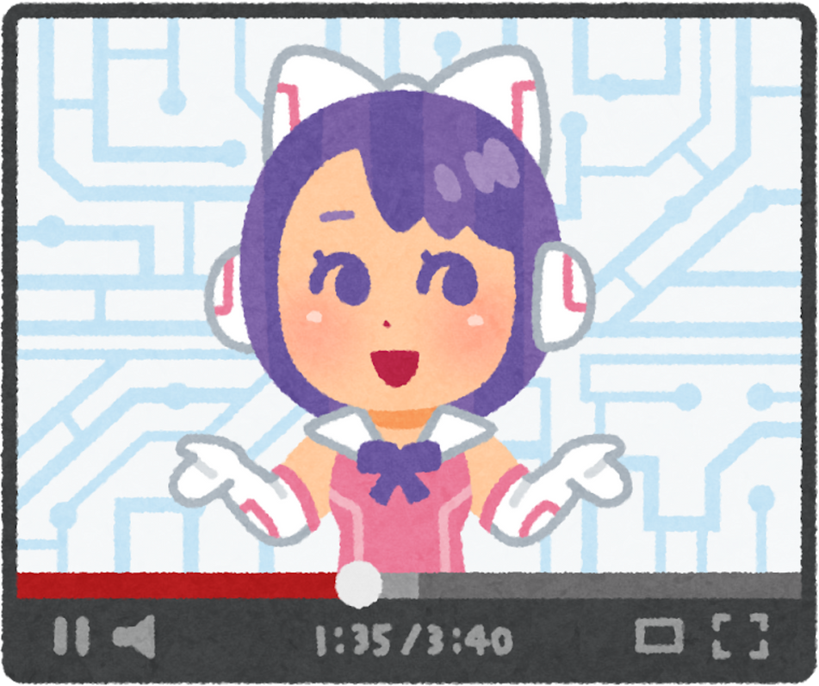
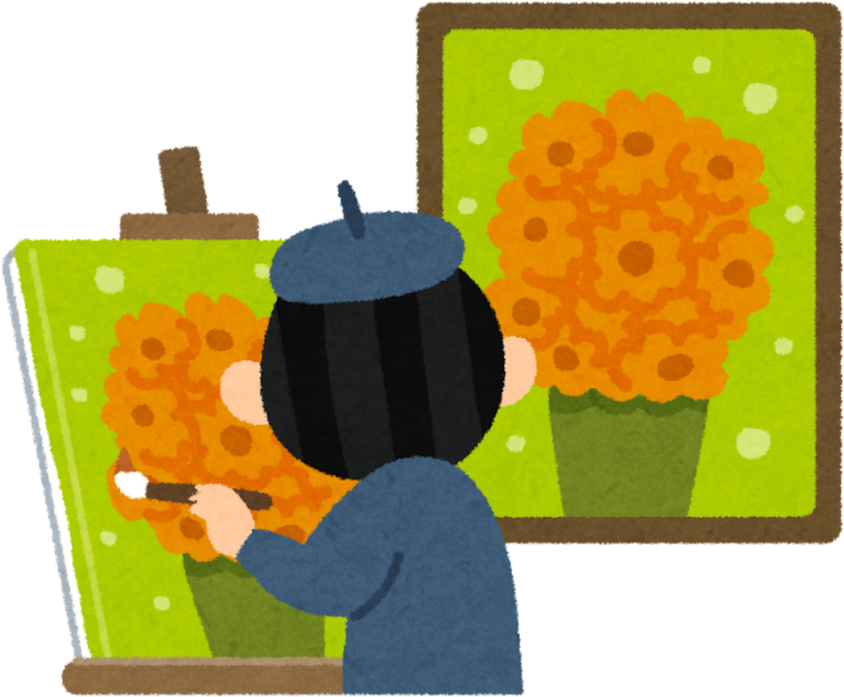

Copying Other People’s Work
You can get in trouble if you claim other people’s work as your own and don’t respect copyright laws! Here are some examples of what NOT to do:
Uploading a TV show onto your own YouTube channel, pretending that you own it
Posting an original artwork of an artist and claiming you created it
Copying the words of a story you read online and submitting as your own homework

Slide 10
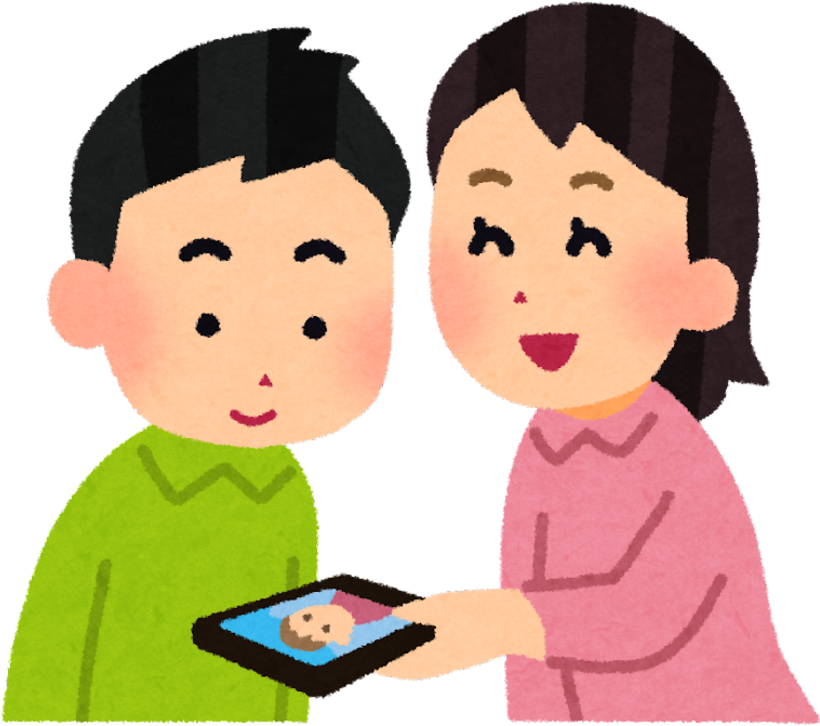
Respecting Copyright and Ownership
Copyright helps creators protect their work and make sure others don't use it without permission.
We should always respect copyright by asking for permission if we want to use someone else's digital content, like a picture or music.

Slide 11
ACTIVITY
The Invisible Author
Roleplay this scenario and discuss the story!

Slide 12
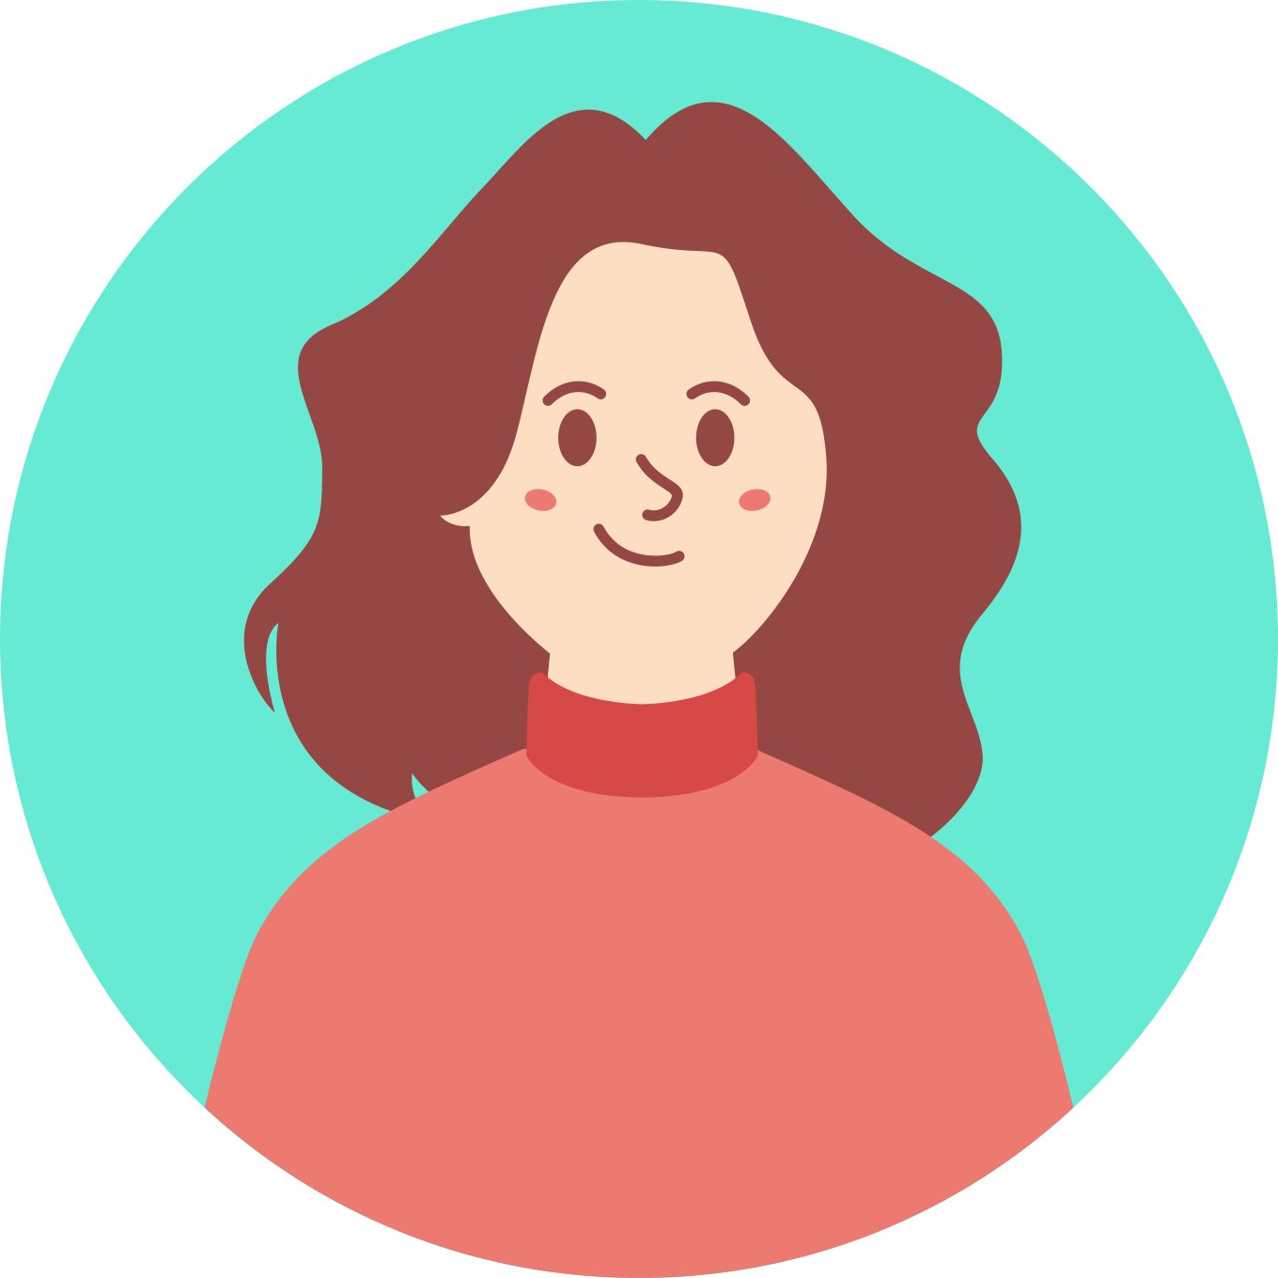

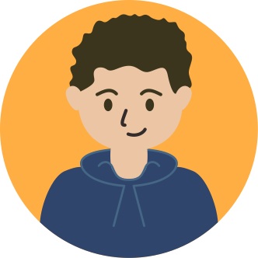
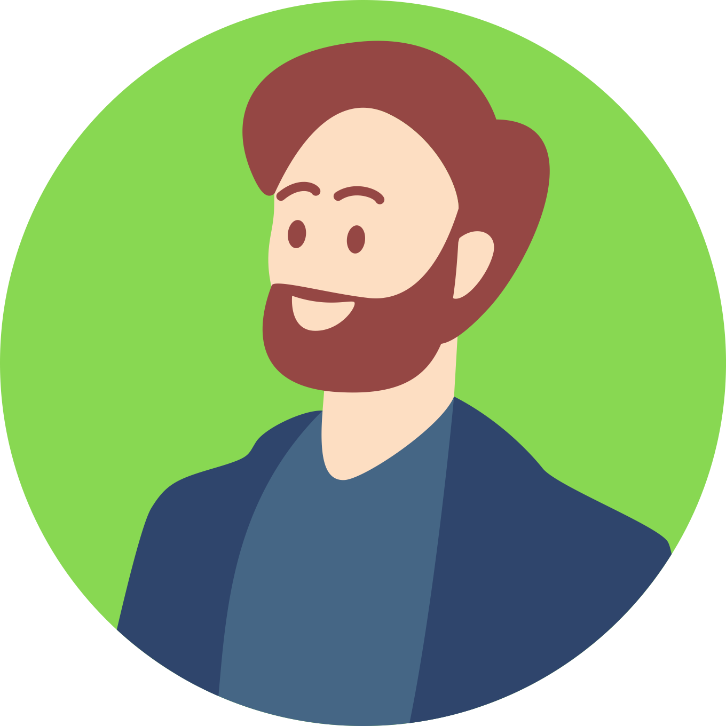
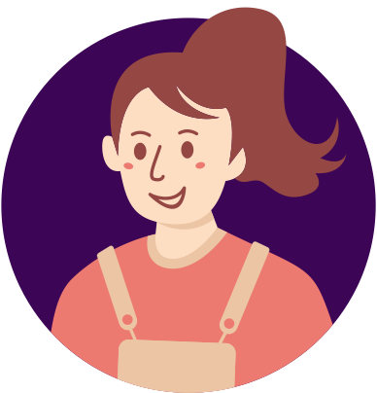
Instructions
We need five volunteers to read the story out loud as these characters!
Casey
Morgan
Enzo
Mr. Jordan
Narrator

Slide 13
The Invisible Author
Narrator
The students of Evergreen School are preparing for a "Creative Writing Exhibition" to showcase their talents. Casey is writing a story in a private notebook during recess. Morgan peeks over Casey’s shoulder, looking impressed.
Morgan
Wow, Casey, your story is amazing! You’re going to submit it for the exhibition, right?
Casey
I don’t know... I love writing, but I’m nervous about everyone reading my work. I think I’ll keep this one to myself for now.
Narrator
Morgan nods but is clearly disappointed. Later, Morgan finds Casey’s notebook left behind, reads the story again, and decides to type it up and submit it under Morgan's name, thinking it’s too good not to be shared.

Slide 14
Narrator
During the exhibition, Enzo and other students are gathered around Morgan, praising the story.
Enzo
Morgan, I had no idea you could write like this! This story is the highlight of the exhibition!
Morgan
(Feeling guilty but also enjoying the praise) Thanks, Enzo! I worked really hard on it.
Narrator
Casey walks by and overhears the conversation, looking hurt but says nothing. Mr. Jordan, noticing Casey’s reaction, approaches.

Slide 15
Mr. Jordan
Casey, is everything okay? You seem upset.
Narrator
Casey hesitantly explains the situation to Jordan, who then gathers Morgan, Casey, and Enzo for a discussion.
Mr. Jordan
Morgan, it’s clear you recognised the talent in Casey’s story, but how do you think Casey feels about what happened?
Casey
It made me really upset to hear Enzo praising you for the story that I’ve worked really hard on.

Slide 16
Morgan
I... I thought I was helping by sharing Casey’s story. But now, I see I should have asked for permission first. Casey, I’m really sorry. I didn’t mean to take credit for your work.
Enzo
I had no idea the story was Casey’s. It’s really important to make sure the right person gets credit for their creativity.
Mr. Jordan
Let’s think about how we can make this right and what we can learn from this situation.

Slide 17
LET’S DISCUSS
Why is it important to ask for permission before sharing someone else's work, even if you think it deserves more attention?

Slide 18
LET’S DISCUSS
How might Casey have felt seeing Morgan receive praise for the story?

Slide 19
LET’S DISCUSS
What are some ways Morgan can make amends to Casey for using the story without permission, and how can we ensure proper credit is given to creators in the future?

Slide 20
WRAP UP
What have you learned today?
Let’s reflect on today’s lesson.

Slide 21
Remember This!
  As digital citizens, we should always be honest and fair with digital content.
  Copyright is like a way to protect and share digital content. We should always ask for permission and give credit to creators when using their work.
  Always say where you go the content from when you’re posting anything online.

Slide 22
Lesson 09.03.01
Well Done!

