Slide 1

LESSON 2.3
DIGITAL MEDIA LITERACY
Fact-Checking Detectives
Be a smart media consumer

Slide 2
Recognising misinformation and fake news
What are we learning today?
How to fact-check online information

Slide 3
WARM UP QUESTION
What can you do to make sure a story or fact you read online is actually true?

Slide 4
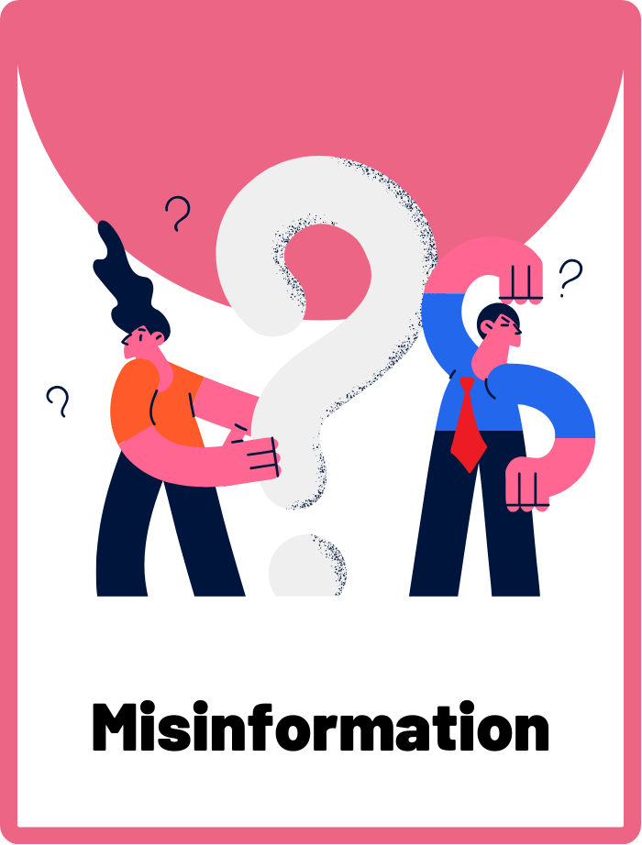
Misinformation
False or inaccurate information, especially that which is spread deliberately to deceive.

Slide 5
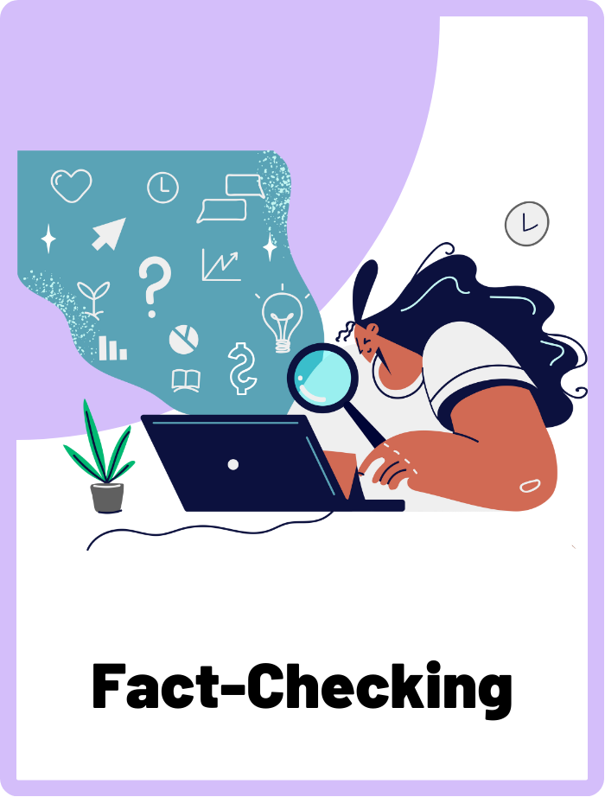
Fact-Checking
The process of checking and verifying facts and claims in a text to determine their accuracy and truthfulness.

Slide 6

Have you ever believed something that turned out to be fake?
When we go online to look for information, it might not always be accurate. That’s because online information can come from anyone, anywhere, and may not always be true.
Unlike books in a library, online information is not always checked by experts.

Slide 7
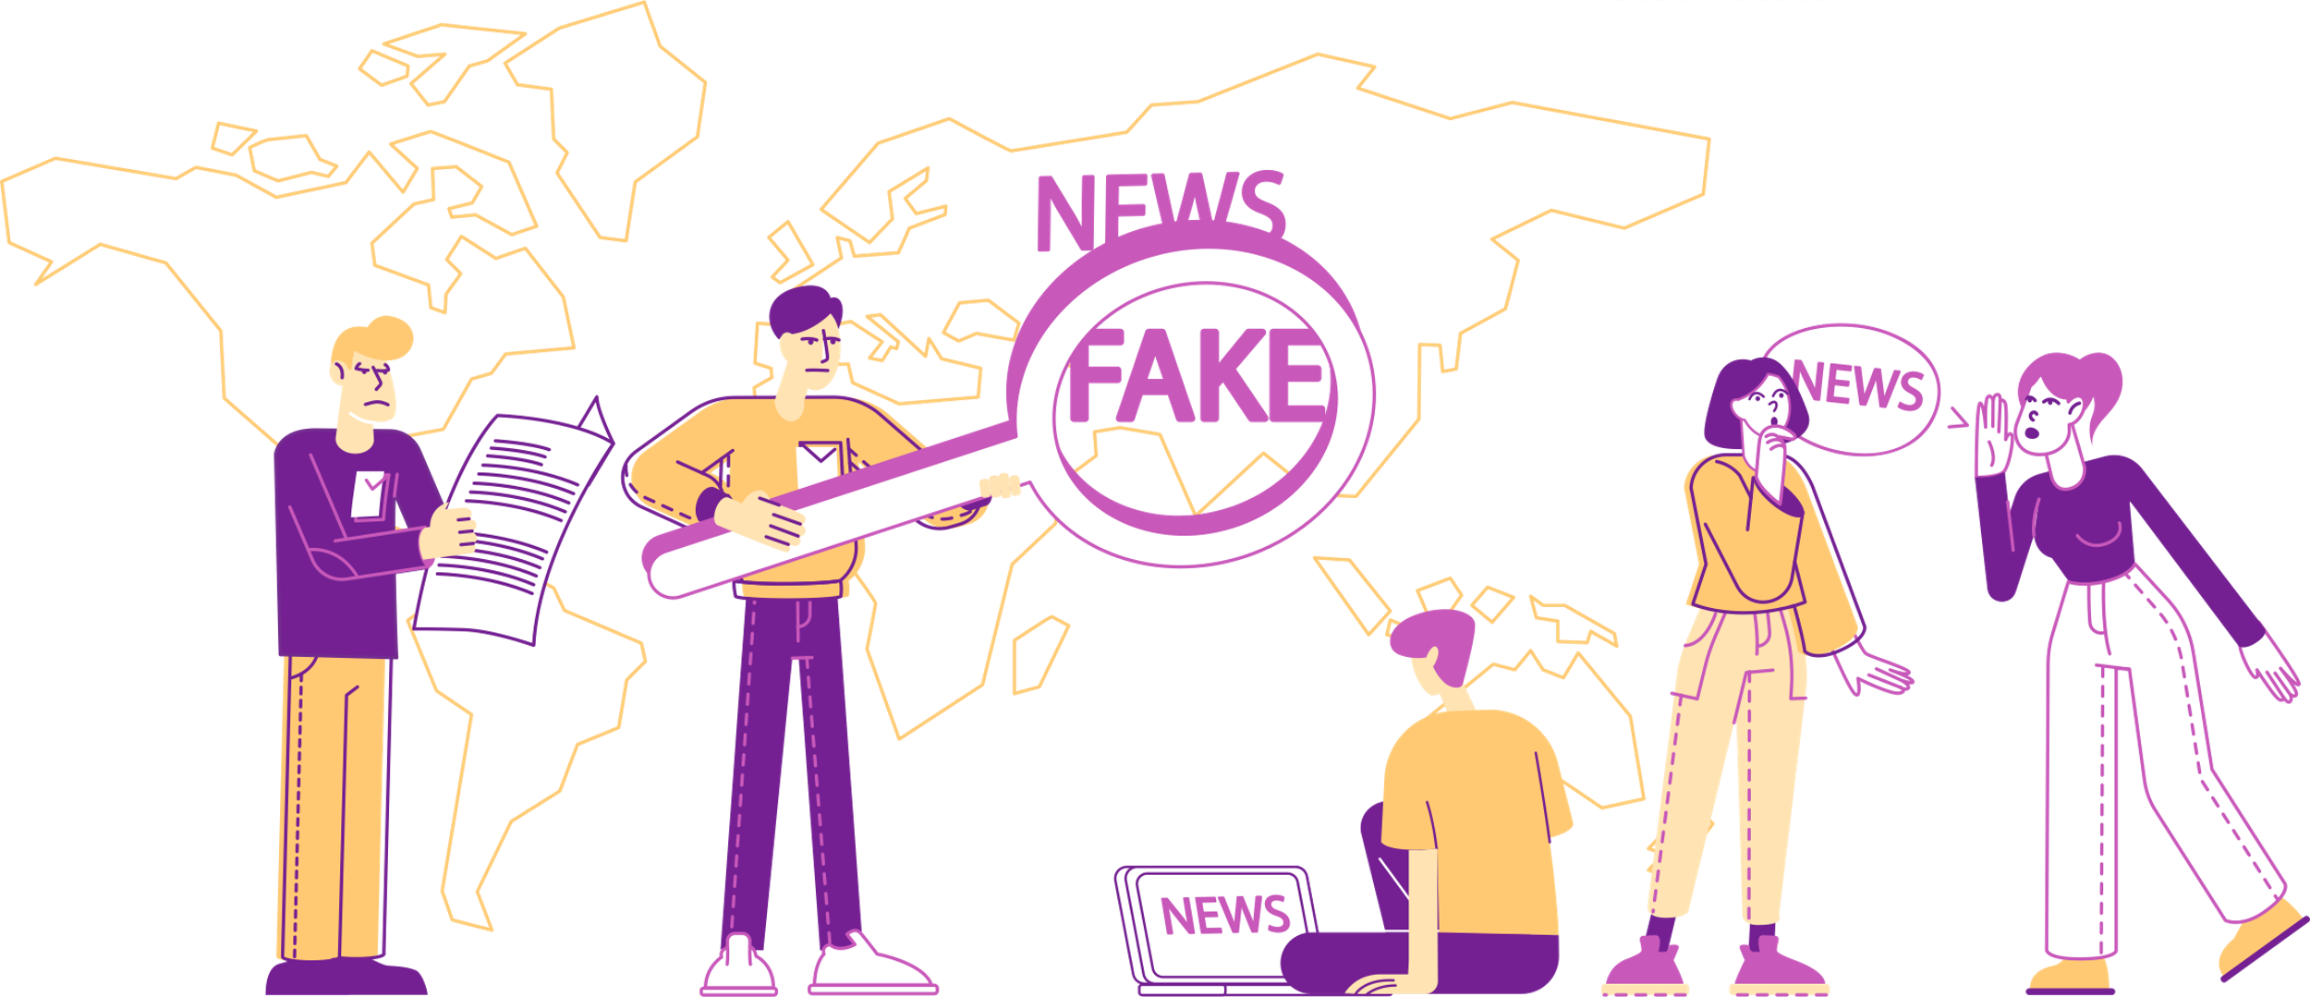
What is misinformation?
Misinformation is sometimes known as fake news. It is false or inaccurate information that is spread to deceive others. It can spread quickly online and cause confusion if believed.

Slide 8


Why do people spread fake news?
People can spread fake news or misinformation either unintentionally or on purpose.
On Purpose
Unintentional
Example: Knowingly spreading a rumour about a classmate when you know it’s not true.
Example: Forwarding a message without checking if the information is true.

Slide 9
What You’ll Need
  Computer or device with internet access
Instructions
In pairs, investigate each news headline to determine if it is fact or fake news. Make sure you jot down the sources you’ve used to make your decision!

Slide 10
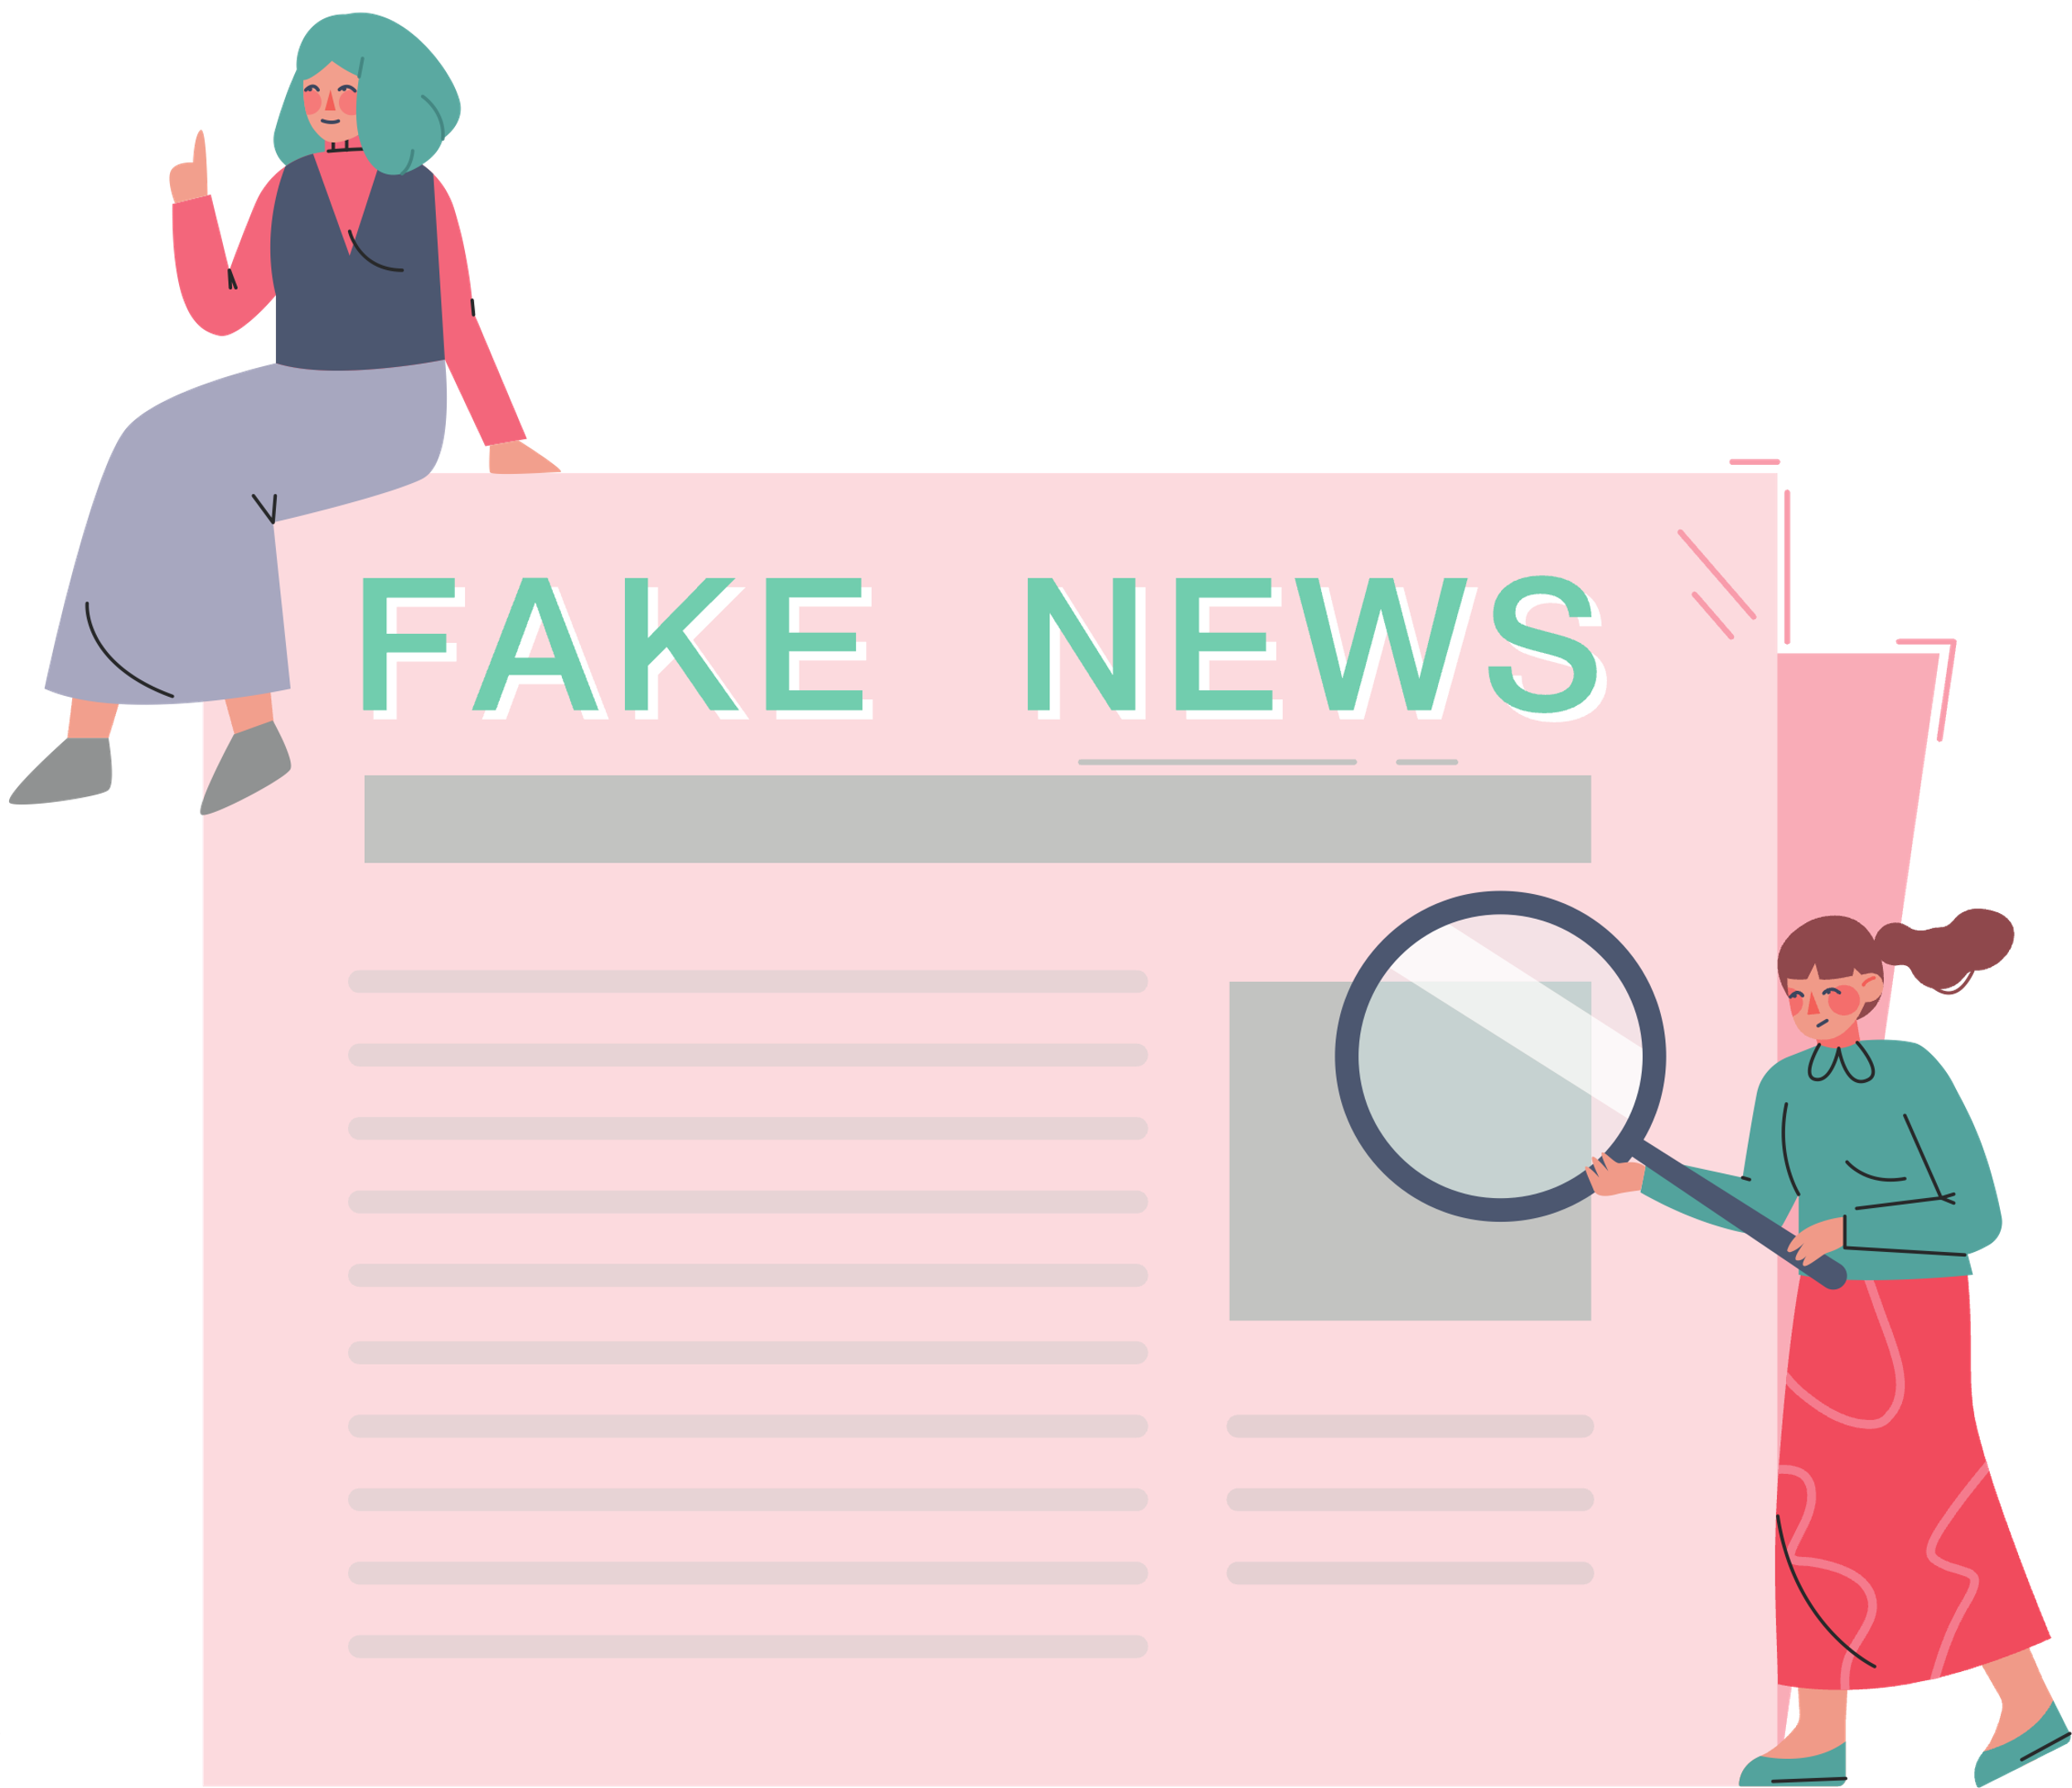
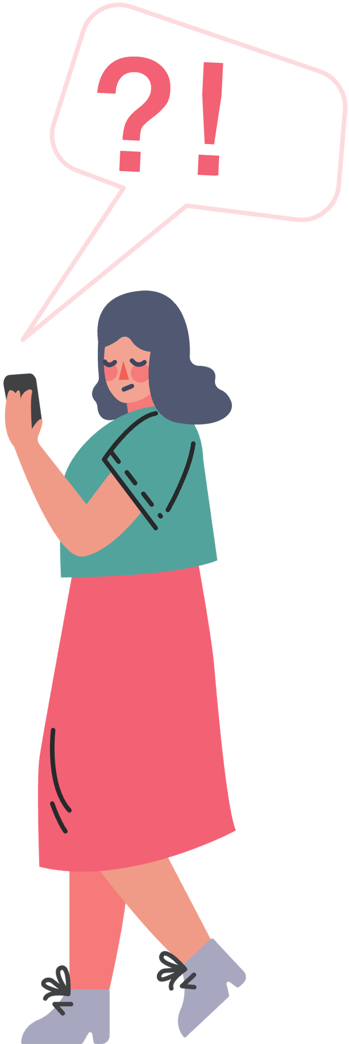

Fact-checking for the Truth
Not everything we see online is true! Fact-checking means verifying if information or news is true by checking reliable sources and evidence.

Slide 11

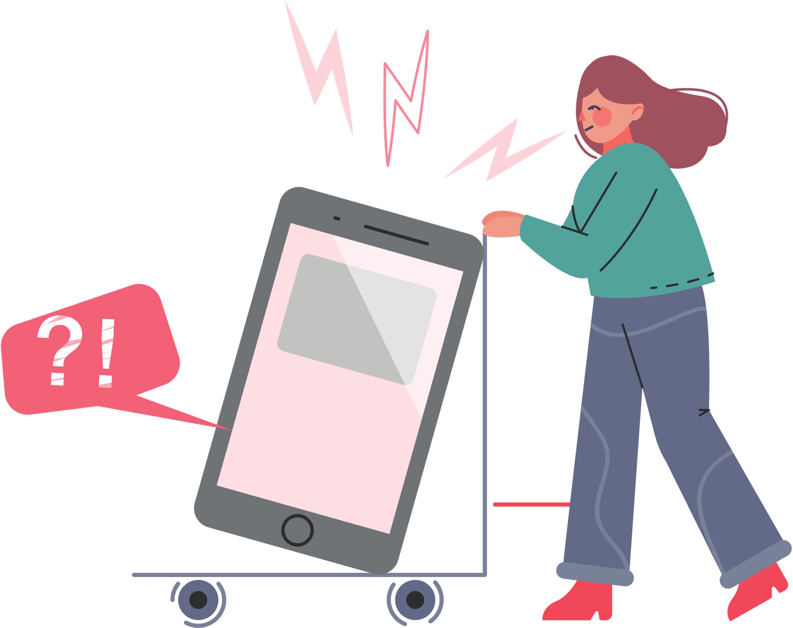

How to Fact-Check
Check the information with multiple trusted sources, like news outlets and educational websites.
Think about who’s saying it. Are they an expert on the subject?
Use fact-checking tools that can help you fact-check information online.
Ask an adult like a parent or teacher if you’re not sure.

Slide 12
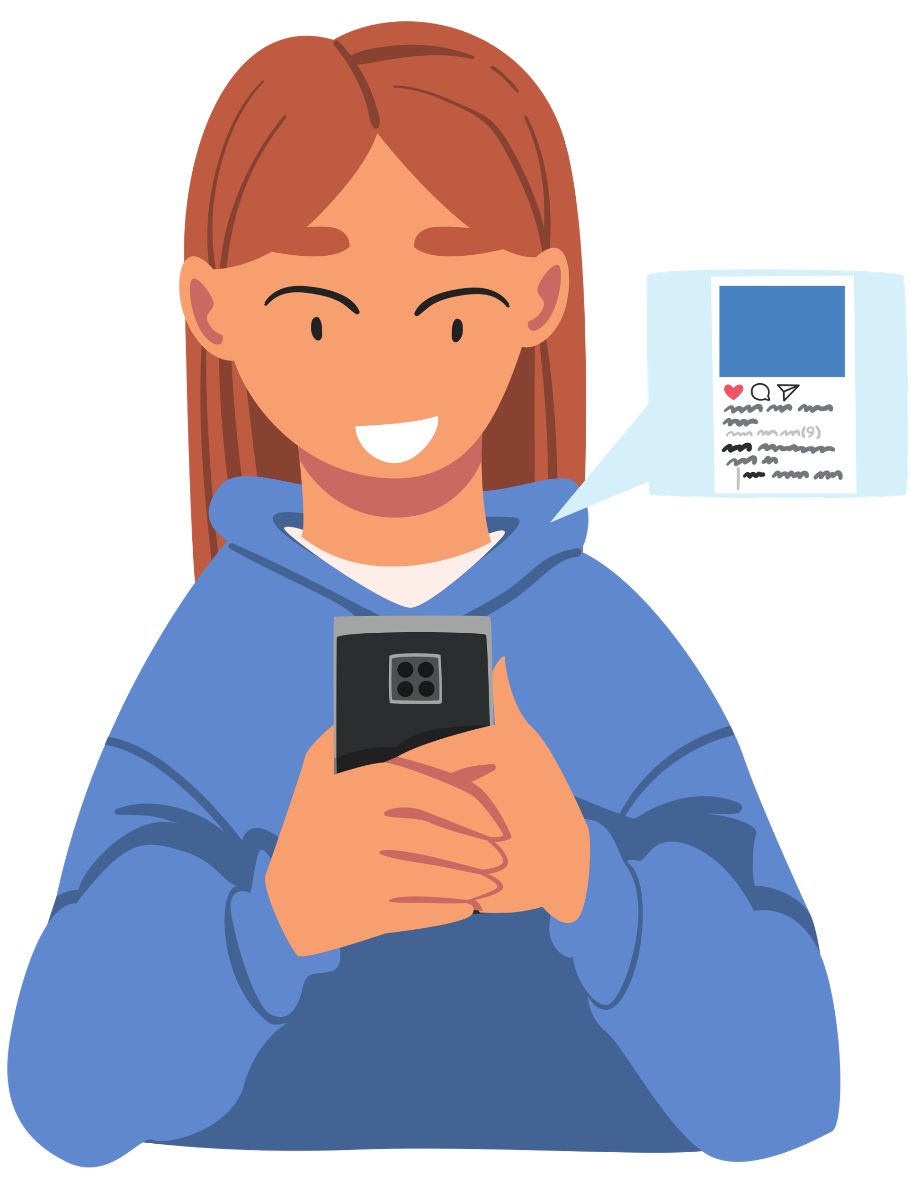
Think Before You Share
Before sharing something on social media or with your friends, ask yourself if it seems believable.
Make sure you think about the information critically and fact-check it first.

Slide 13
ACTIVITY
Fact or Fake News?
Become fact-checking detectives and find out the truth!

Slide 14
EXAMPLE
Let’s investigate this example as a class.
“The Great Wall of China is the only man-made structure visible from space.”

Slide 15
INVESTIGATE THIS!
Now it’s your turn. Decide if these headlines are facts or fake news.
1. Chocolate was once used as money by the ancient Mayans.
2. Pizza Hut sets the world record for the largest pizza ever made.
3. School in Australia cancels school due to emu invasion.
4. Jonathan, the oldest living tortoise, is over 190 years old.
5. Students in South Korea get $100 for every A on their report card.

Slide 16

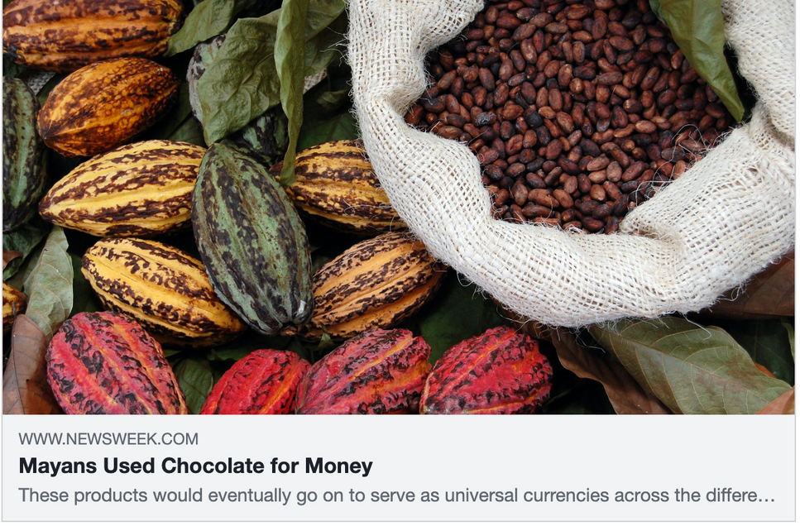
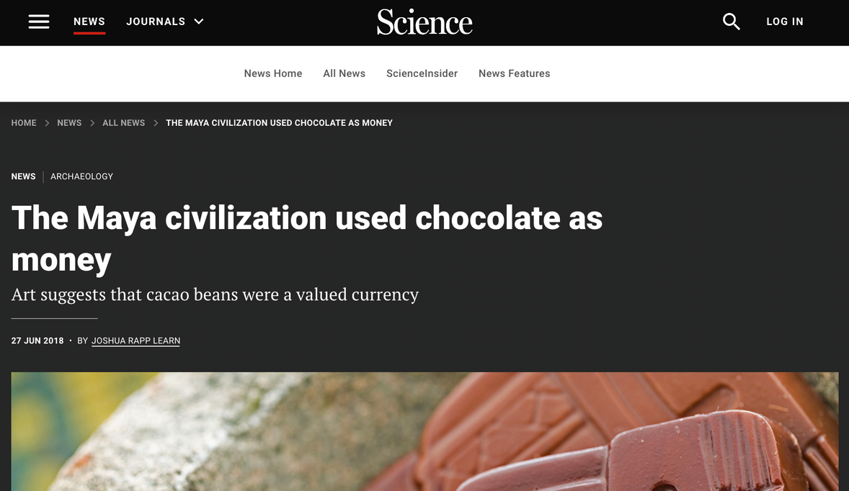
QUESTION ONE
Chocolate was once used as money by the ancient Mayans.
FACT!

Slide 17
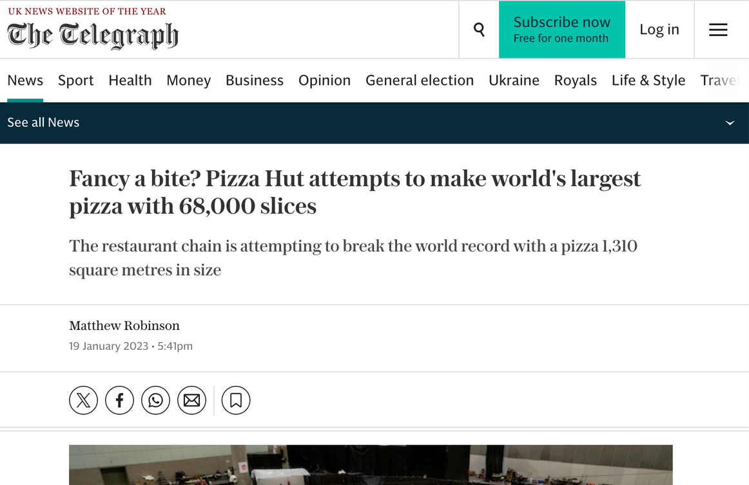
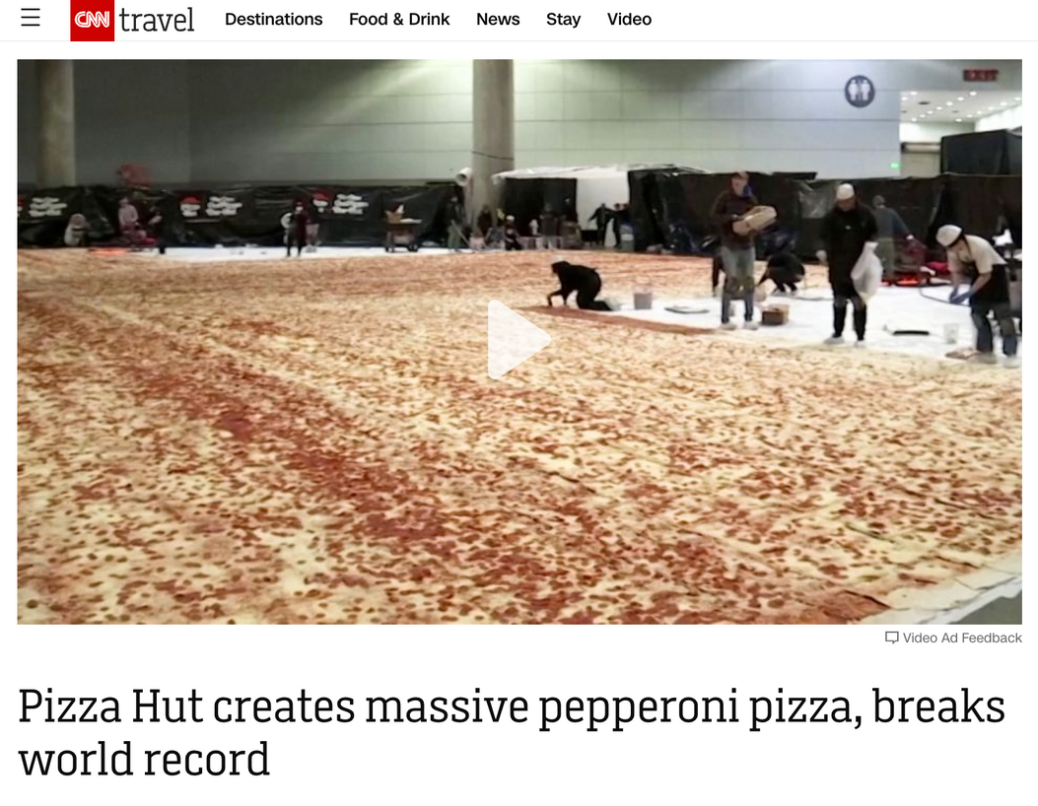
QUESTION TWO
Pizza Hut sets the world record for the largest pizza ever made.
FACT!

Slide 18

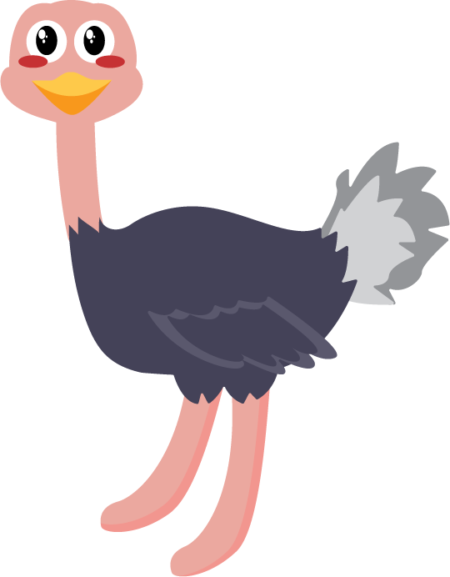
QUESTION THREE
School in Australia cancels school due to emu invasion.
FAKE NEWS!

Slide 19
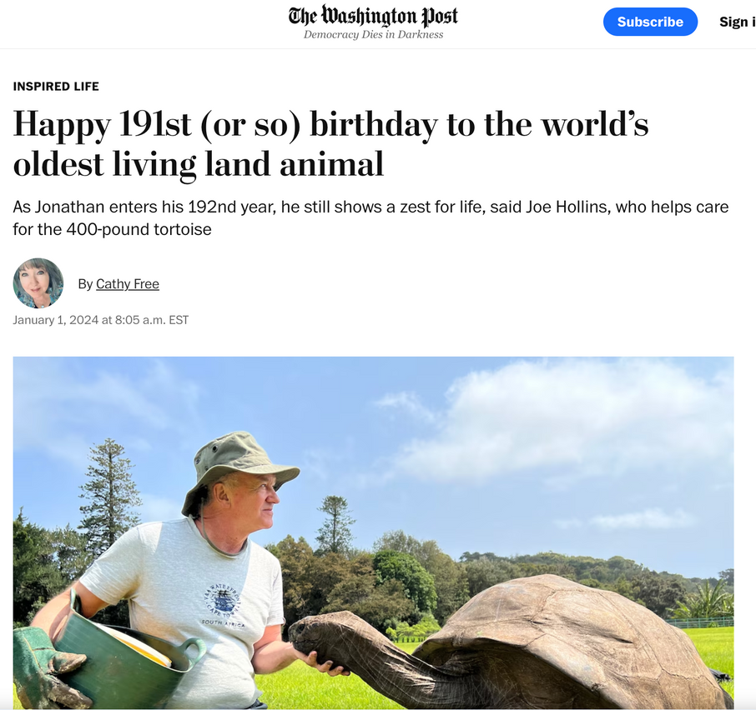
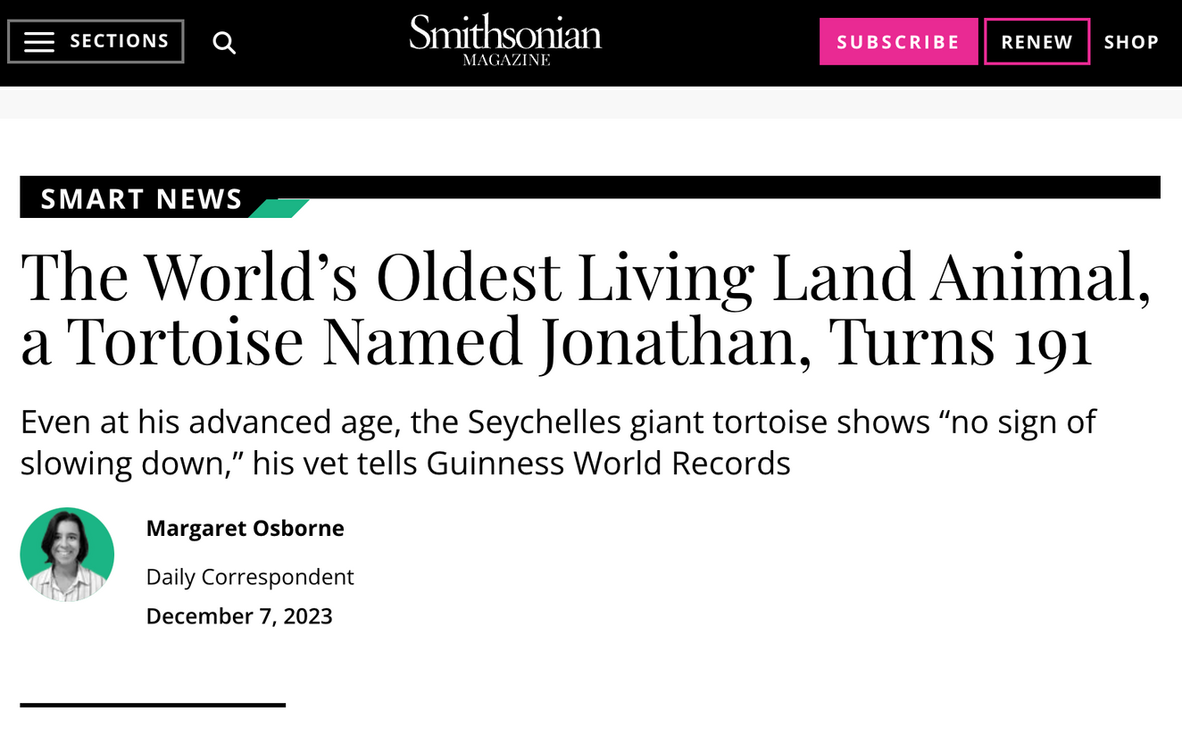
QUESTION FOUR
Jonathan, the oldest living tortoise, is over 190 years old.
FACT!

Slide 20
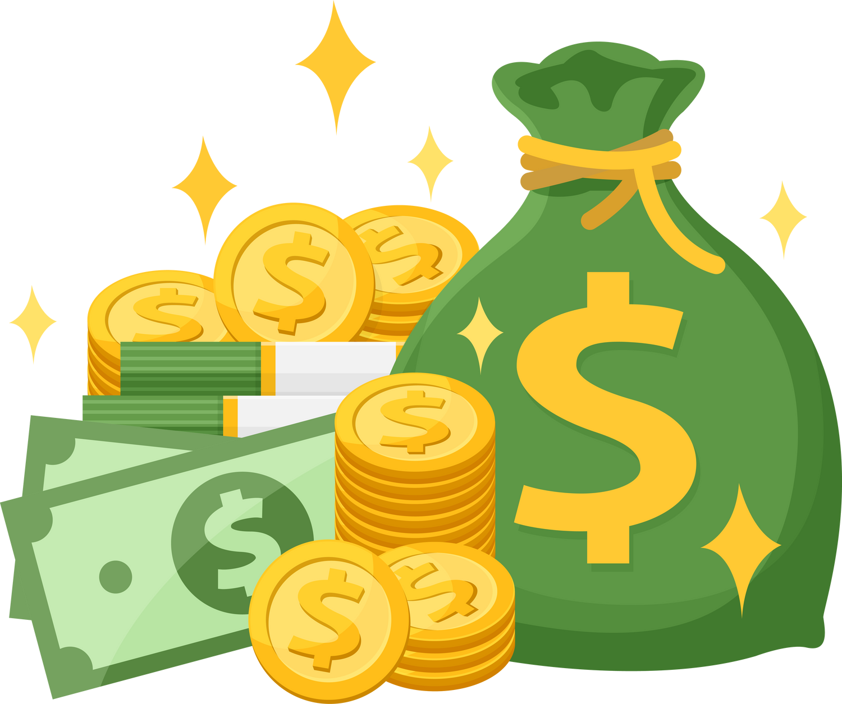
QUESTION FIVE
Students in South Korea get $100 for every A on their report card.
FAKE NEWS!

Slide 21
WRAP UP
What have you learned today?
Let’s reflect on today’s lesson.

Slide 22
Remember This!
  Not everything you see online is true! Always double-check information you find online.
  Fact-checking is like being a detective online. Verify information before believing or sharing it.
  Be cautious of misinformation and always seek the truth!
  Share information responsibly and encourage others to do the same.
  If you're unsure about something you see online or need help fact-checking, talk to a grown-up you trust.

Slide 23
LESSON 2.3
Well Done!

