Slide 1


Lesson 11.01.01
DIGITAL IDENTITY
Think Before You Post
Your responsibilities as a digital citizen
CYBERLITE.ORG
2023-2024 Ⓒ Cyberlite Books Pte. Ltd. All Rights Reserved.

Slide 2
What our online responsibilities are
What are we learning today?
How to maintain our online responsibilities with thoughtful digital interactions
Our online posts have an effect on digital footprints
CYBERLITE.ORG
2023-2024 Ⓒ Cyberlite Books Pte. Ltd. All Rights Reserved.

Slide 3
WARM UP QUESTION
Why do you think we need to think carefully before we post something online?
CYBERLITE.ORG
2023-2024 Ⓒ Cyberlite Books Pte. Ltd. All Rights Reserved.

Slide 4
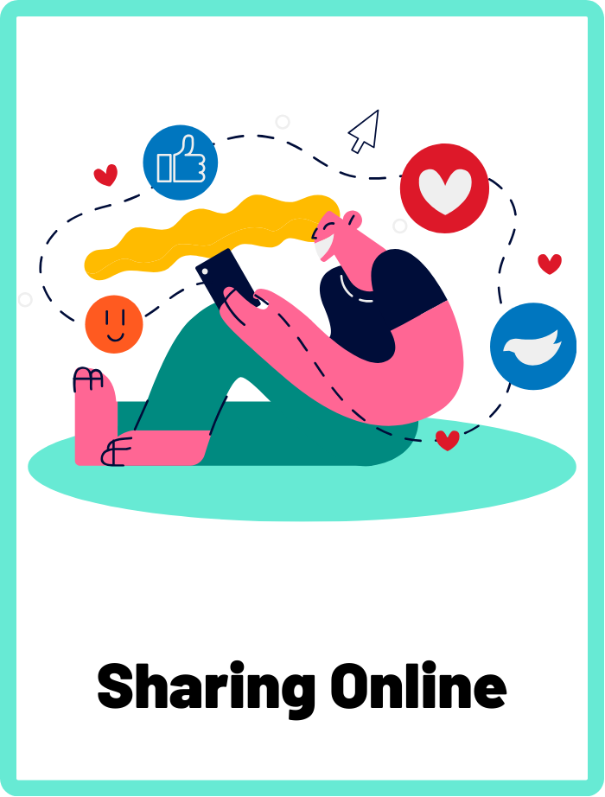
Sharing Online
The act of posting content, information, or personal data on the internet, which can include text, images, videos, and other digital media. It's important to share responsibly and consider the potential consequences.
CYBERLITE.ORG
2023-2024 Ⓒ Cyberlite Books Pte. Ltd. All Rights Reserved.

Slide 5
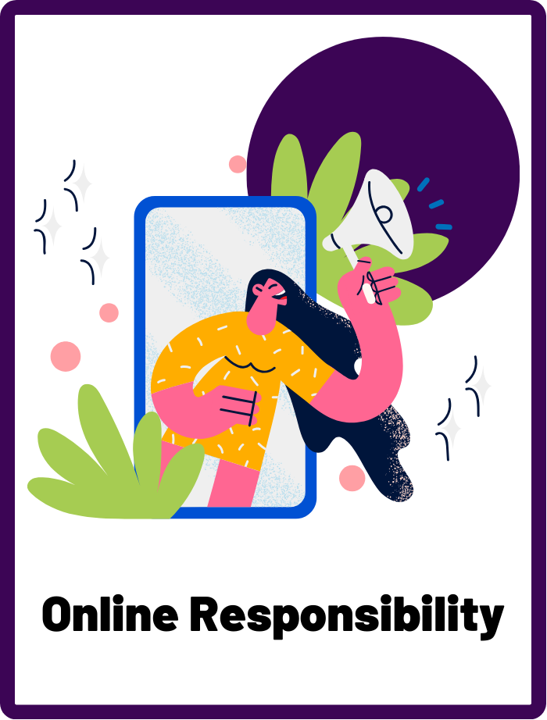
Online Responsibility
The practice of using technology in a way that is respectful, safe, and mindful of one's impact on self and others.
CYBERLITE.ORG
2023-2024 Ⓒ Cyberlite Books Pte. Ltd. All Rights Reserved.

Slide 6


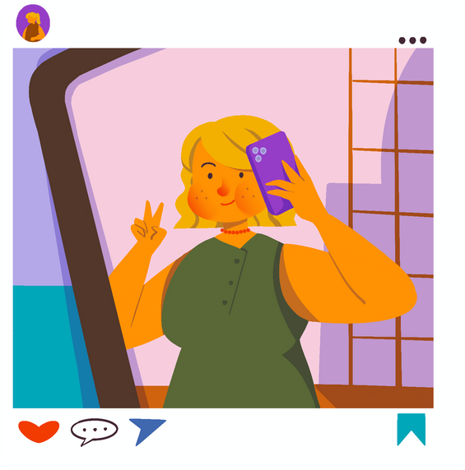
What do people share online?
Photos and Videos
Comments and messages
News and information
What else do people share about themselves online?
CYBERLITE.ORG
2023-2024 Ⓒ Cyberlite Books Pte. Ltd. All Rights Reserved.

Slide 7
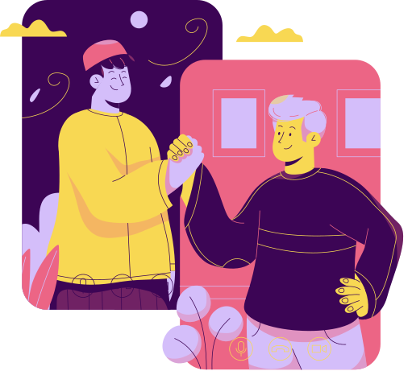
What does being responsible online mean?
It means being a good and careful user of the internet and technology.
It's about making wise choices online and treating others and yourself with respect.
CYBERLITE.ORG
2023-2024 Ⓒ Cyberlite Books Pte. Ltd. All Rights Reserved.

Slide 8
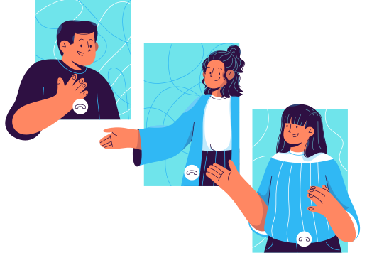
Why is it important to be responsible online?
Being digitally responsible helps create a safer and happier online world for everyone. Your online actions can have real-world consequences, so it's essential to think before you post.
CYBERLITE.ORG
2023-2024 Ⓒ Cyberlite Books Pte. Ltd. All Rights Reserved.

Slide 9
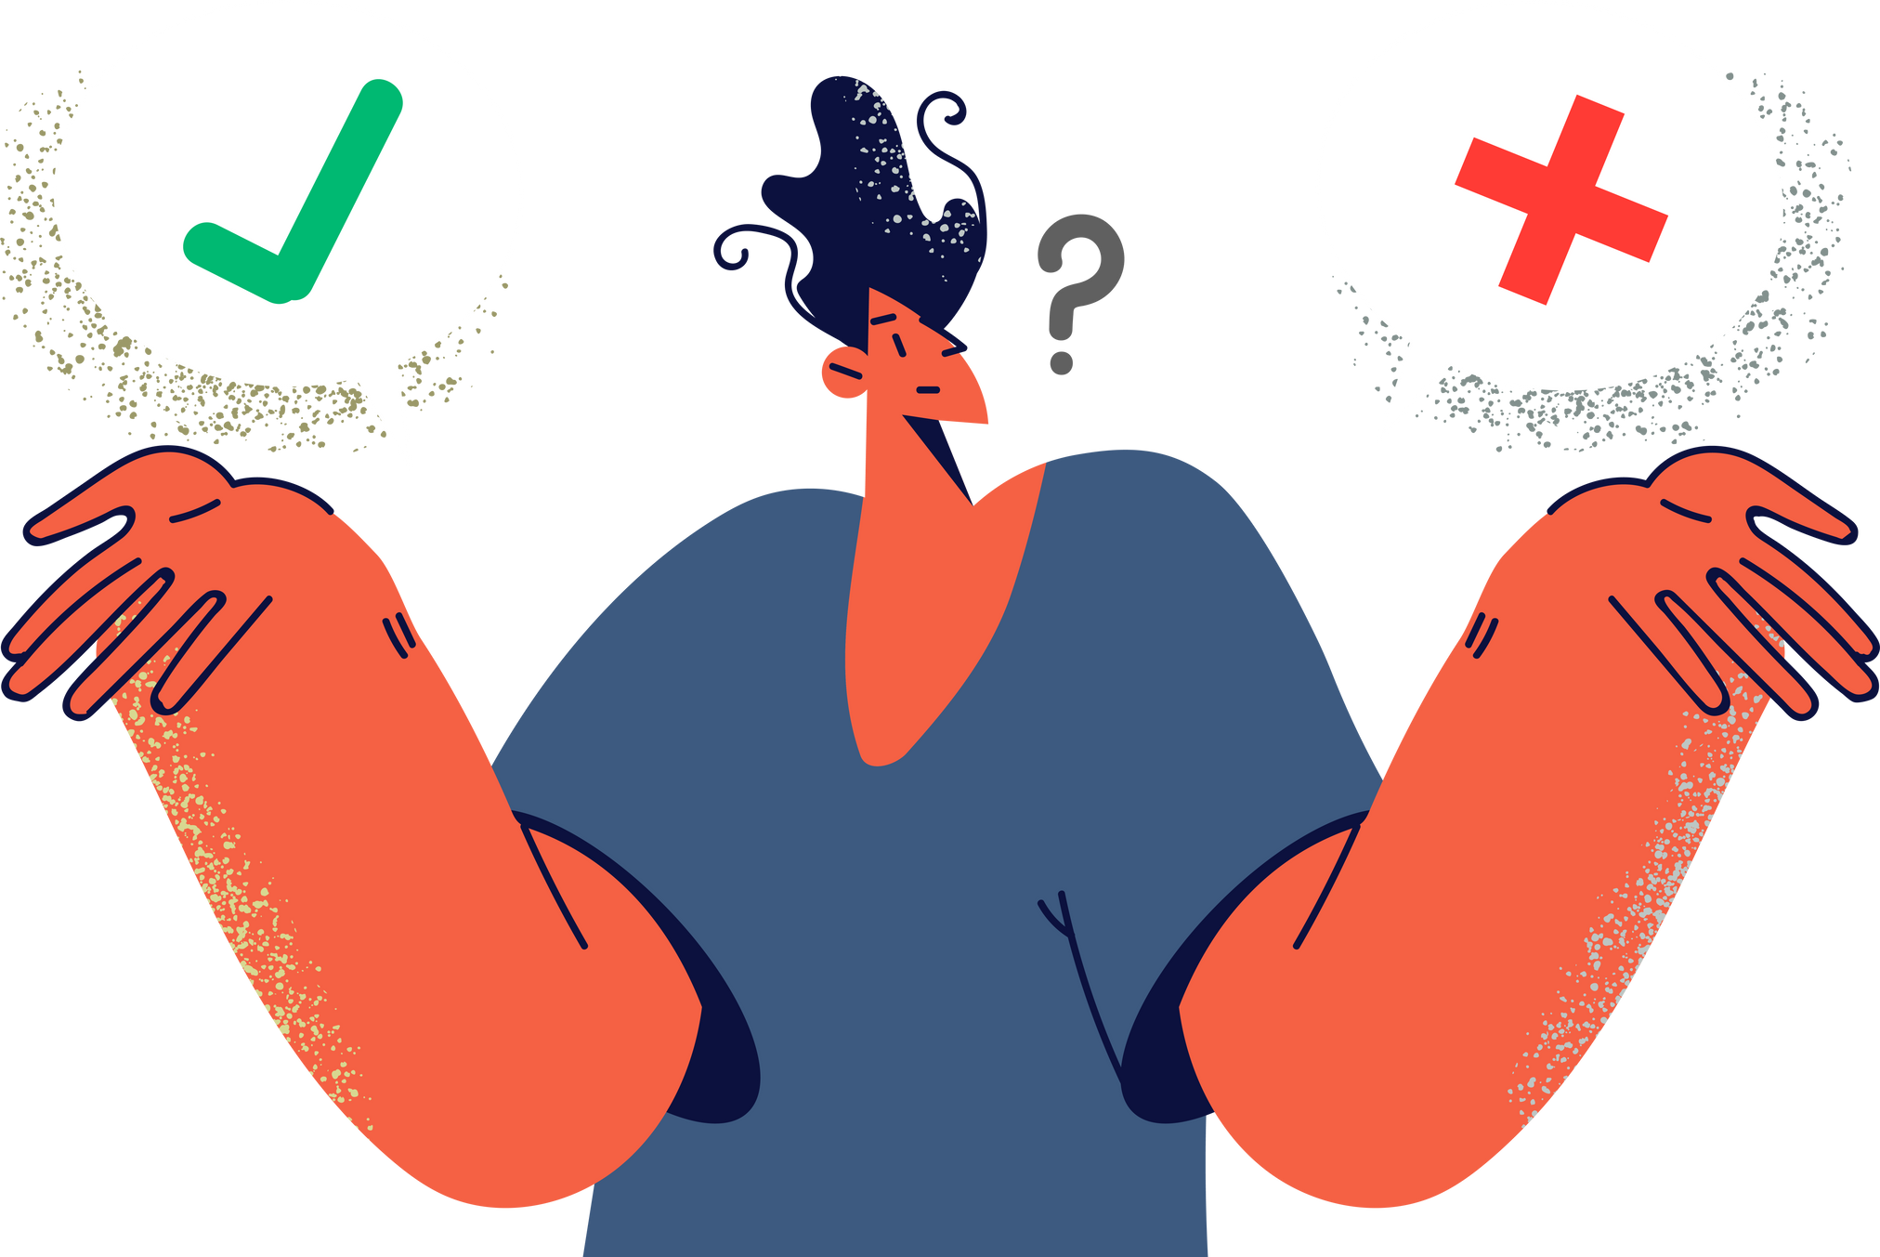
Sharing Online Responsibly
When you share anything online, you must always ask yourself:
“Is this a GOOD post or a BAD post?”
CYBERLITE.ORG
2023-2024 Ⓒ Cyberlite Books Pte. Ltd. All Rights Reserved.

Slide 10

What’s a good post?
A good post is something you may share online that is positive, kind, and nice to others. They are posts that you won’t regret or feel bad about.
  Sharing your hobbies online
  Teaching others something useful
  Posting about your projects
  Leaving nice comments
CYBERLITE.ORG
2023-2024 Ⓒ Cyberlite Books Pte. Ltd. All Rights Reserved.

Slide 11

What’s a bad post?
A bad post is something you may share online that is negative, mean, or unkind to others. They are posts that might get you in trouble or make someone else feel bad.
  Rude or mean comments
  Photos or videos of inappropriate behaviours
  Posting photos or videos of other people without their permission
CYBERLITE.ORG
2023-2024 Ⓒ Cyberlite Books Pte. Ltd. All Rights Reserved.

Slide 12
Our Online Responsibilities
Think before you post! Make sure what you share online is respectful and kind, and that it leaves a positive footprint.
Protect your privacy. Don’t share any personal information of yourself or others online.
Be a responsible friend. Always ask for permission before sharing photos or videos of your friends online. Your activities also contribute to their digital footprints!
CYBERLITE.ORG
2023-2024 Ⓒ Cyberlite Books Pte. Ltd. All Rights Reserved.

Slide 13
ACTIVITY
Good Post, Bad Post?
Determine which posts are good or bad!
CYBERLITE.ORG
2023-2024 Ⓒ Cyberlite Books Pte. Ltd. All Rights Reserved.

Slide 14
Instructions
Can you determine which posts are good or bad to share online? Work together in pairs or as a group to decide your answer!
CYBERLITE.ORG
2023-2024 Ⓒ Cyberlite Books Pte. Ltd. All Rights Reserved.

Slide 15

QUESTION 1
Sharing a funny photo of someone without their permission.
Good Post?
Bad Post?
CYBERLITE.ORG
2023-2024 Ⓒ Cyberlite Books Pte. Ltd. All Rights Reserved.

Slide 16
ANSWER
Sharing a funny photo of someone without their permission.
Good Post?
Bad Post!
You shouldn’t post photos of anyone online or without their permission!
CYBERLITE.ORG
2023-2024 Ⓒ Cyberlite Books Pte. Ltd. All Rights Reserved.

Slide 17
QUESTION 2
Sending this message to a classmate.
Good Post?
Bad Post?
You
You're so ugly, no one likes you. I don't want to be your friend anymore.
CYBERLITE.ORG
2023-2024 Ⓒ Cyberlite Books Pte. Ltd. All Rights Reserved.

Slide 18
ANSWER
Sending this message to a classmate.
Good Post?
Bad Post!
You
You're so ugly, no one likes you. I don't want to be your friend anymore.
This is bad! It’s not kind to send mean messages like this to anyone.
CYBERLITE.ORG
2023-2024 Ⓒ Cyberlite Books Pte. Ltd. All Rights Reserved.

Slide 19
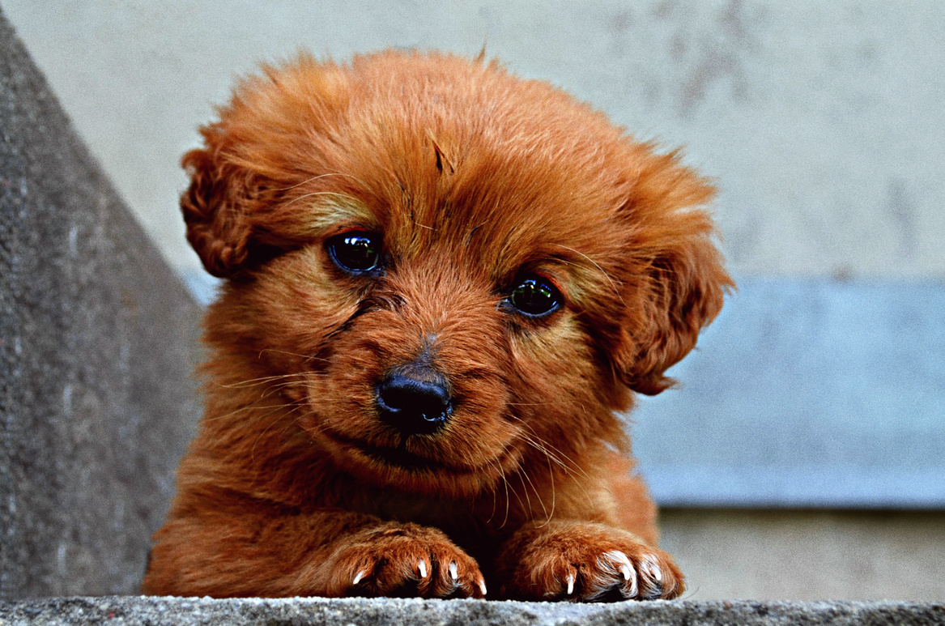
QUESTION 3
Posting a picture of your new puppy.
Good Post?
Bad Post?
CYBERLITE.ORG
2023-2024 Ⓒ Cyberlite Books Pte. Ltd. All Rights Reserved.

Slide 20
ANSWER
Posting a picture of your new puppy.
Good Post!
Bad Post?
This is a good post! It is appropriate to share happy memories with your friends and family online.
CYBERLITE.ORG
2023-2024 Ⓒ Cyberlite Books Pte. Ltd. All Rights Reserved.

Slide 21
QUESTION 4
Sharing a video of you throwing things in class as a joke.
Good Post?
Bad Post?
CYBERLITE.ORG
2023-2024 Ⓒ Cyberlite Books Pte. Ltd. All Rights Reserved.

Slide 22
ANSWER
Sharing a video of you shouting and throwing things in class as a joke.
Good Post?
Bad Post!
It is bad to post videos like this where you are being disruptive or acting inappropriately, even if you think it’s funny at the time. How will this affect your digital footprint?
CYBERLITE.ORG
2023-2024 Ⓒ Cyberlite Books Pte. Ltd. All Rights Reserved.

Slide 23

QUESTION 5
Teaching others about a project you’ve worked on
Good Post?
Bad Post?
CYBERLITE.ORG
2023-2024 Ⓒ Cyberlite Books Pte. Ltd. All Rights Reserved.

Slide 24
ANSWER
Teaching others about a project you’ve worked on
Good Post!
Bad Post?
The internet is a great place to learn and teach others new skills. This is a good post because you’re teaching others about your project.
CYBERLITE.ORG
2023-2024 Ⓒ Cyberlite Books Pte. Ltd. All Rights Reserved.

Slide 25

QUESTION 6
Posting this comment under your friend’s video.
Good Post?
Bad Post?
You
I wish I could sing like you
You're amazing!
CYBERLITE.ORG
2023-2024 Ⓒ Cyberlite Books Pte. Ltd. All Rights Reserved.

Slide 26
ANSWER
Posting this comment under your friend’s video.
Good Post!
Bad Post?
You
I wish I could sing like you
You're amazing!
It’s good to leave kind comments like this that make other people feel good.
CYBERLITE.ORG
2023-2024 Ⓒ Cyberlite Books Pte. Ltd. All Rights Reserved.

Slide 27
WRAP UP
What have you learned today?
Let’s reflect on today’s lesson.
CYBERLITE.ORG
2023-2024 Ⓒ Cyberlite Books Pte. Ltd. All Rights Reserved.

Slide 28
Remember This!
  Being digitally responsible means making choices online that you'd be proud of and treating the internet like a place where kindness and respect matter.
  Think before you post! Remember to be responsible and kind when you share anything online.
CYBERLITE.ORG
2023-2024 Ⓒ Cyberlite Books Pte. Ltd. All Rights Reserved.

Slide 29
Lesson 11.01.01
Well Done!
CYBERLITE.ORG
2023-2024 Ⓒ Cyberlite Books Pte. Ltd. All Rights Reserved.

