Slide 1
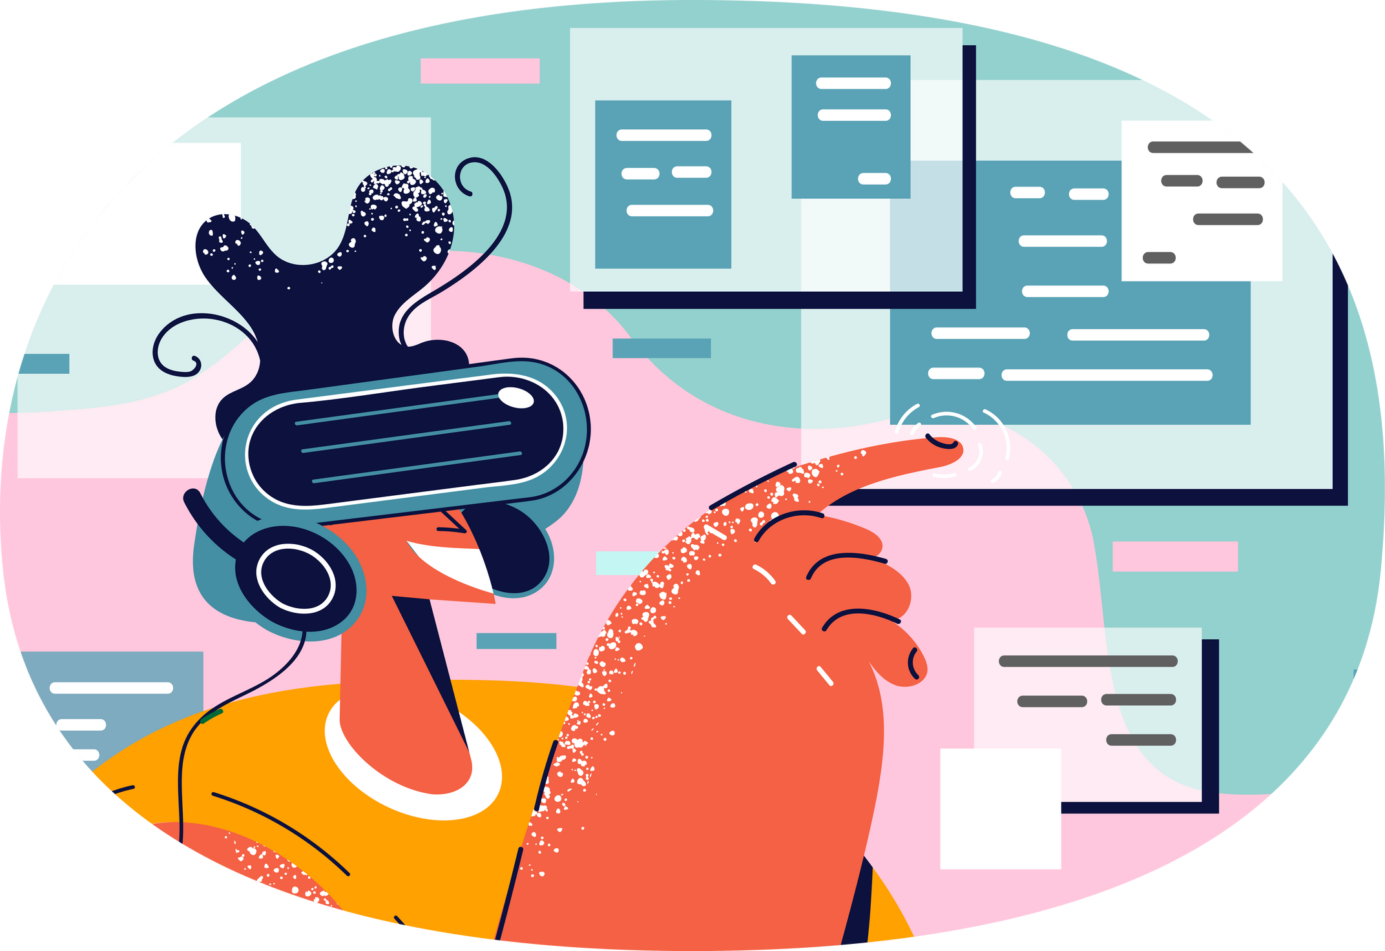

Lesson 07.01.01
DIGITAL IDENTITY
My Cyberspace
Let’s explore our online spaces!
CYBERLITE.ORG
2023-2024 Ⓒ Cyberlite Books Pte. Ltd. All Rights Reserved.

Slide 2
Define what your cyberspace is made up of
What are we learning today?
Explain why cyber safety is important to learn
CYBERLITE.ORG
2023-2024 Ⓒ Cyberlite Books Pte. Ltd. All Rights Reserved.

Slide 3
WARM UP QUESTION
What do you enjoy most about going online?
CYBERLITE.ORG
2023-2024 Ⓒ Cyberlite Books Pte. Ltd. All Rights Reserved.

Slide 4
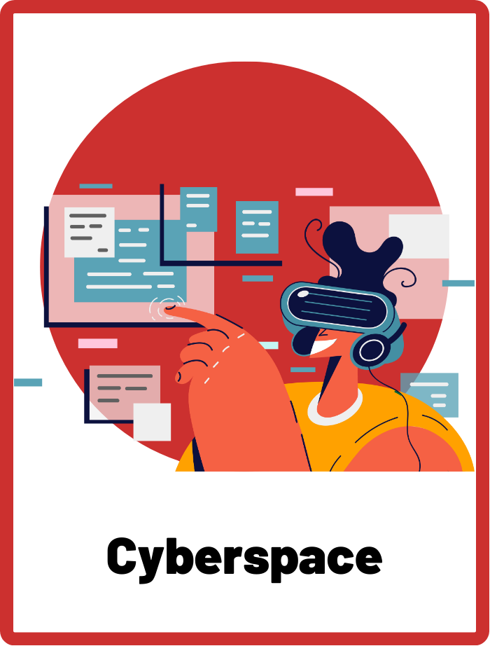
Cyberspace
The online environment where communication, information, and activities take place over the internet, including websites, social media, and online communities.
CYBERLITE.ORG
2023-2024 Ⓒ Cyberlite Books Pte. Ltd. All Rights Reserved.

Slide 5
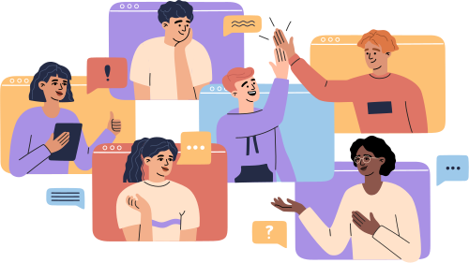
What is cyberspace?
Cyberspace is like a huge digital world on your devices where you can do lots of things, like playing games, watching videos, and talking to friends.
CYBERLITE.ORG
2023-2024 Ⓒ Cyberlite Books Pte. Ltd. All Rights Reserved.

Slide 6



What is cyberspace?
Websites like YouTube, Google, and online games like Minecraft are part of cyberspace!
What other apps, websites, or games do you use?
CYBERLITE.ORG
2023-2024 Ⓒ Cyberlite Books Pte. Ltd. All Rights Reserved.

Slide 7
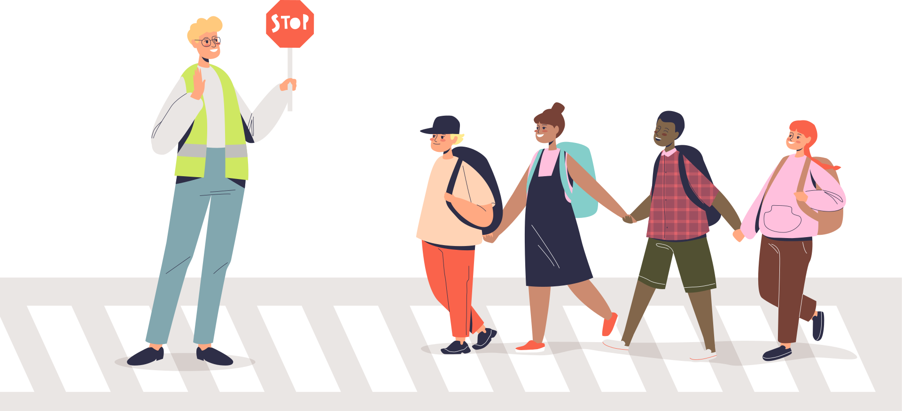
Why do we need to stay safe in cyberspace?
Just like we learn how to cross the street safely, we also need to learn how to use cyberspace safely. It is important because it helps us enjoy all the cool things it offers while making sure we’re protected!
CYBERLITE.ORG
2023-2024 Ⓒ Cyberlite Books Pte. Ltd. All Rights Reserved.

Slide 8
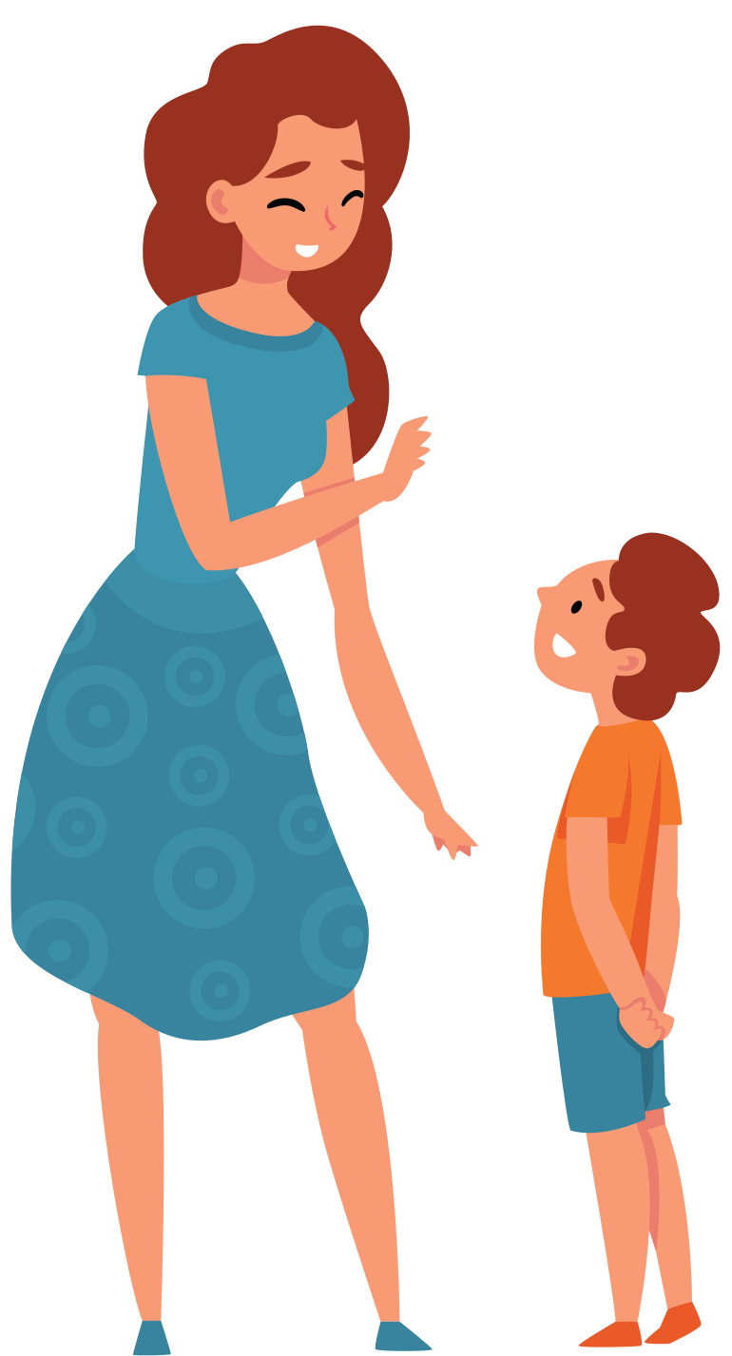
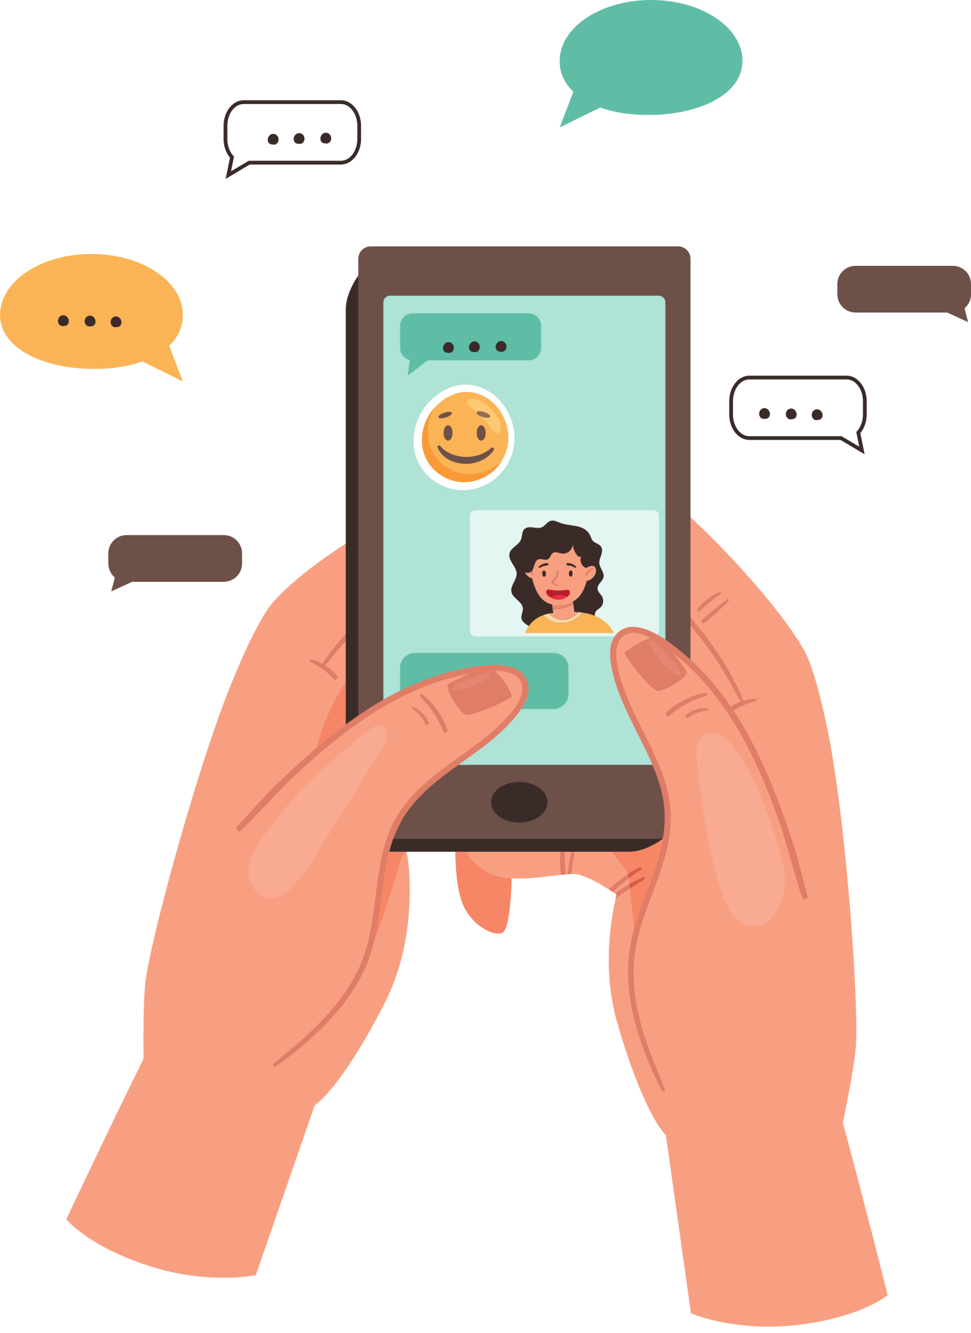



t
How to stay safe in cyberspace
Friend Request?
Always ask a grown-up before going online
Don’t share personal information online
Don’t talk to anyone online that you don’t know in real life!
CYBERLITE.ORG
2023-2024 Ⓒ Cyberlite Books Pte. Ltd. All Rights Reserved.

Slide 9
ACTIVITY
Draw Your Cyberspace
Fill up your cyberspace with your favourite apps!
CYBERLITE.ORG
2023-2024 Ⓒ Cyberlite Books Pte. Ltd. All Rights Reserved.

Slide 10
What You’ll Need
  Paper
  Markers, pens, or pencils
CYBERLITE.ORG
2023-2024 Ⓒ Cyberlite Books Pte. Ltd. All Rights Reserved.

Slide 11
Instructions
1. In the centre of your paper, draw a circle and write your name in it.
Your Name
CYBERLITE.ORG
2023-2024 Ⓒ Cyberlite Books Pte. Ltd. All Rights Reserved.

Slide 12
Instructions
2. Draw around your name:
  2 large circles
  2 medium circles
  2 small circles
Your Name
CYBERLITE.ORG
2023-2024 Ⓒ Cyberlite Books Pte. Ltd. All Rights Reserved.

Slide 13




Instructions
3. Fill in these circles with the apps or websites you love to use!
  Fill in the largest circles with the apps you use the most
Your Name
CYBERLITE.ORG
2023-2024 Ⓒ Cyberlite Books Pte. Ltd. All Rights Reserved.

Slide 14
Group Sharing!
Share your work with the rest of the class.
CYBERLITE.ORG
2023-2024 Ⓒ Cyberlite Books Pte. Ltd. All Rights Reserved.

Slide 15
WRAP UP
What have you learned today?
Let’s reflect on today’s lesson.
CYBERLITE.ORG
2023-2024 Ⓒ Cyberlite Books Pte. Ltd. All Rights Reserved.

Slide 16
Remember This!
  Cyberspace can be a fun place, but just like the real world, we need to be careful and kind when we're there.
  Always ask a grown-up (like your parents or teachers) before going online.
  Don’t share your personal information online
  Don’t talk to anyone online that you don’t know in real life!
CYBERLITE.ORG
2023-2024 Ⓒ Cyberlite Books Pte. Ltd. All Rights Reserved.

Slide 17
Lesson 07.01.01
Well Done!
CYBERLITE.ORG
2023-2024 Ⓒ Cyberlite Books Pte. Ltd. All Rights Reserved.

