Slide 1
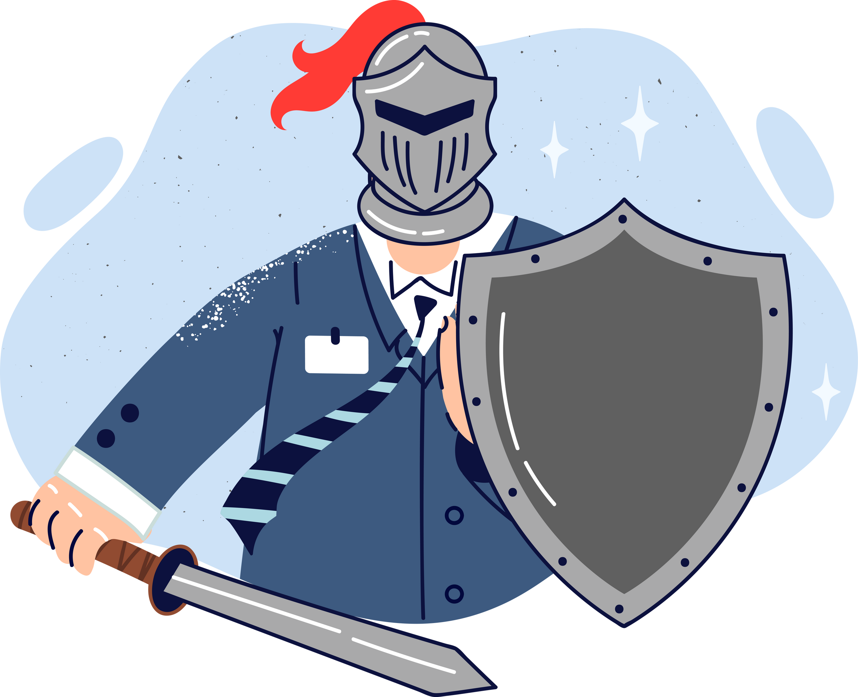
Lesson 11.02.01
PRIVACY & INFORMATION SECURITY
Your Online Shields
Mastering multi-layered protection

Slide 2
How brute force attacks work
What are we learning today?
Importance of multi-factor authentication to protect online accounts

Slide 3
WARM UP QUESTION
What are some ways we can make sure that only we can get into our accounts on computers and phones?

Slide 4
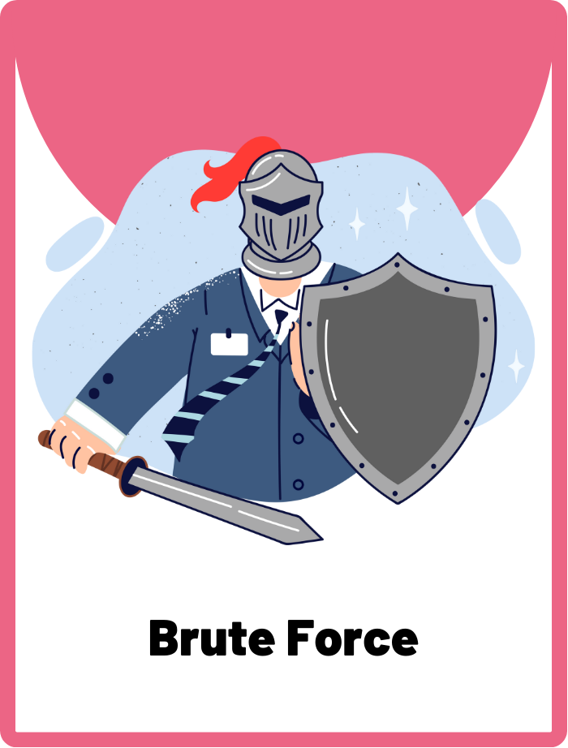
Brute Force
A type of cyber attack method used by hackers using trial-and-error to decode encrypted data such as passwords.

Slide 5
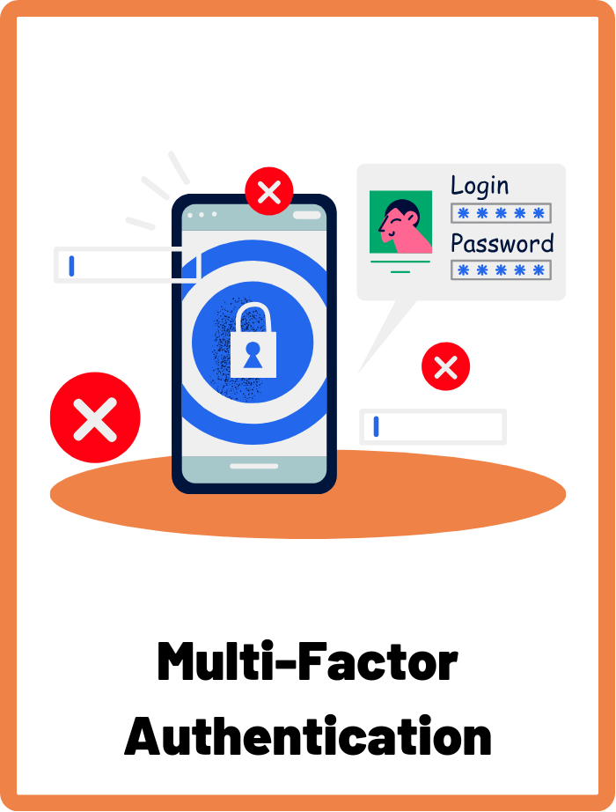
Multi-Factor Authentication
A security method that requires users to provide two or more verification factors to gain access to a resource, such as an online account. This adds an extra layer of protection beyond just a username and password.

Slide 6
Can you list all the websites or apps which you have an online account?
School Email Account
Online Games
(like Roblox and Minecraft)
Studying or Learning Apps
Entertainment
(like YouTube and Netflix)
Messaging Apps
Can you think of any more?

Slide 7
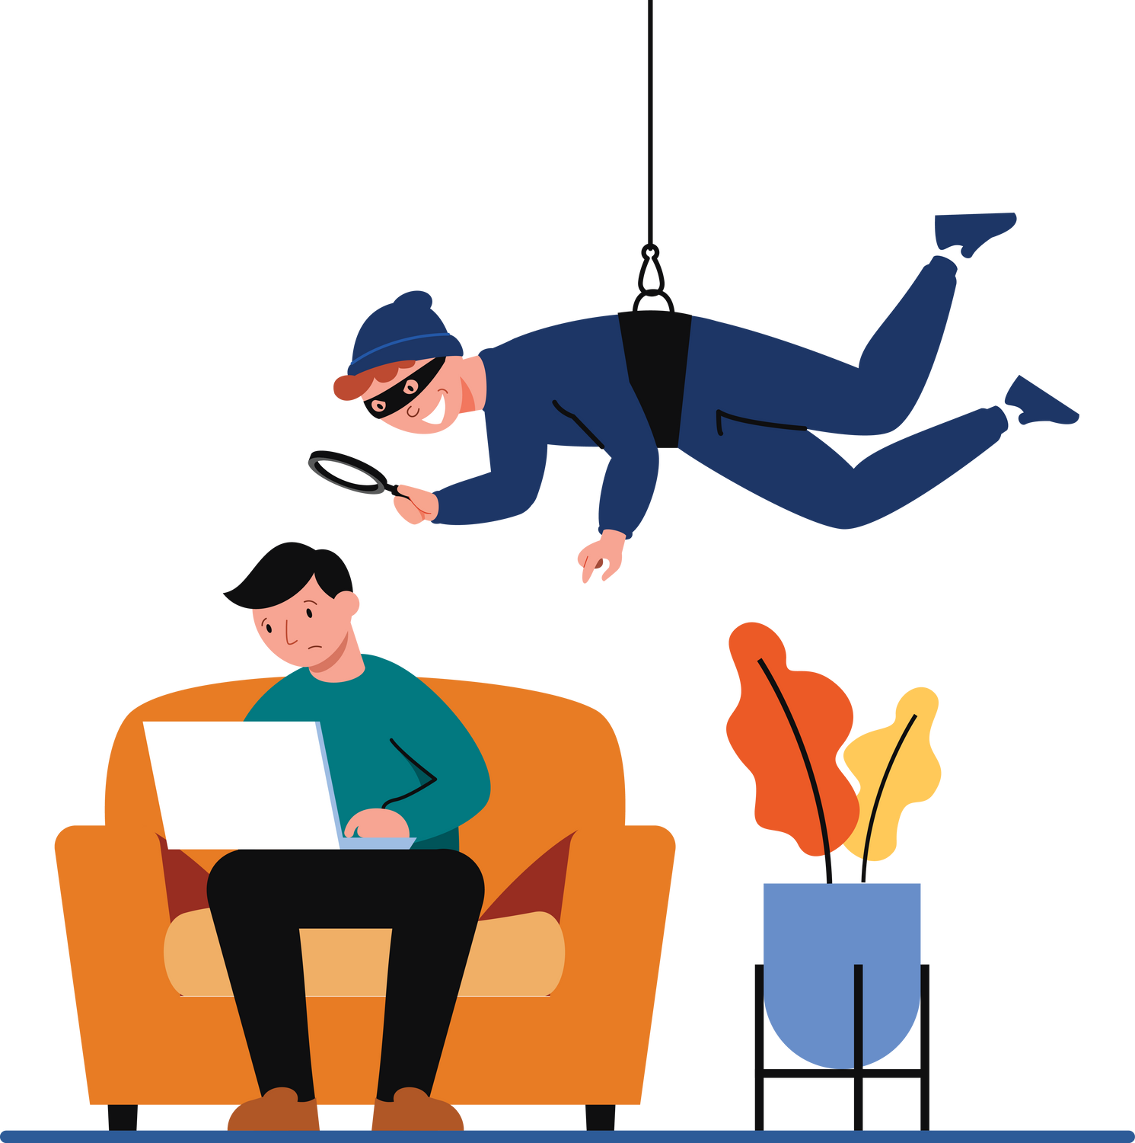
Why is it important to protect your accounts?
Some cyber criminals and black hat hackers want to get into your accounts without your permission to steal your information or cause a lot of trouble.
One way we protect ourselves is by setting up passwords on our accounts.

Slide 8
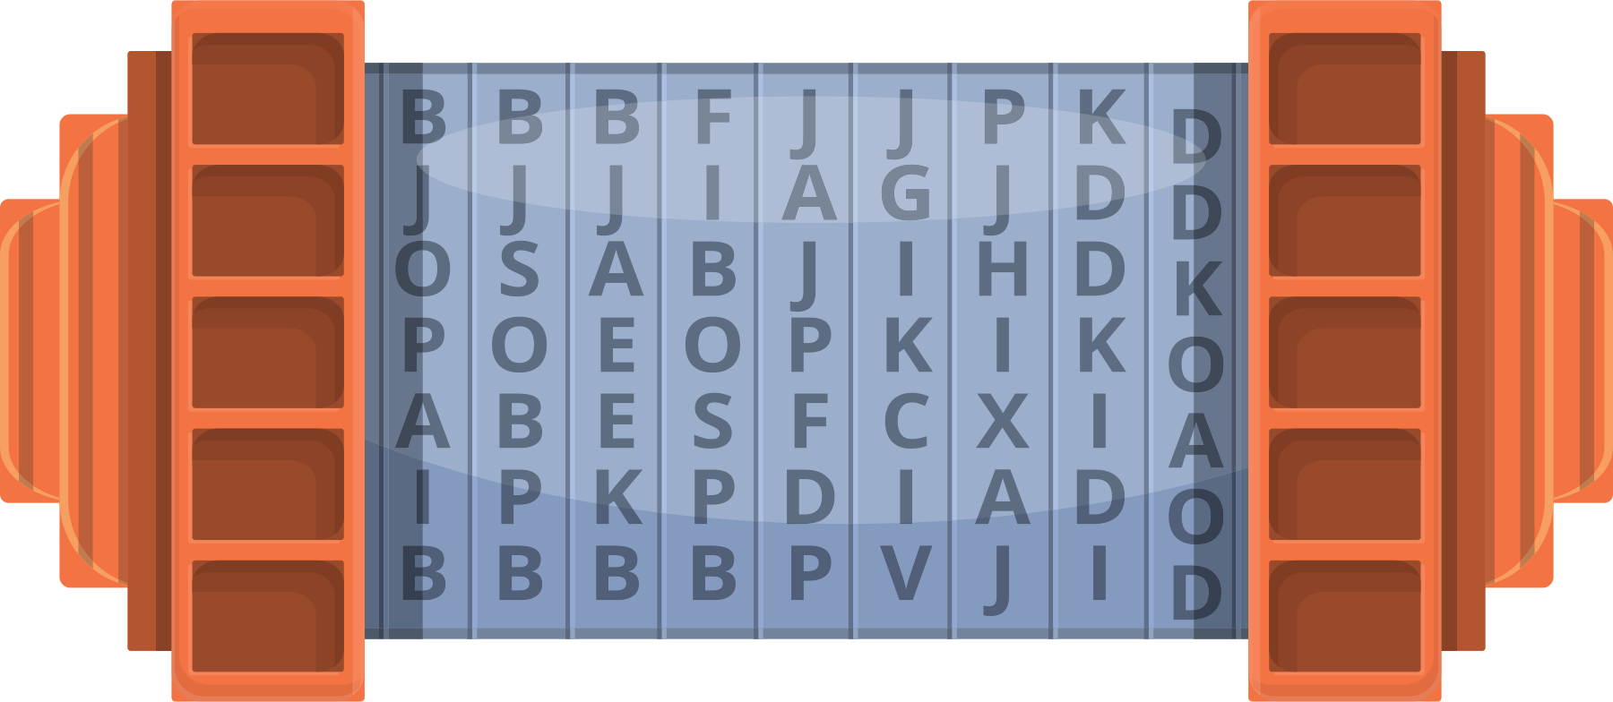
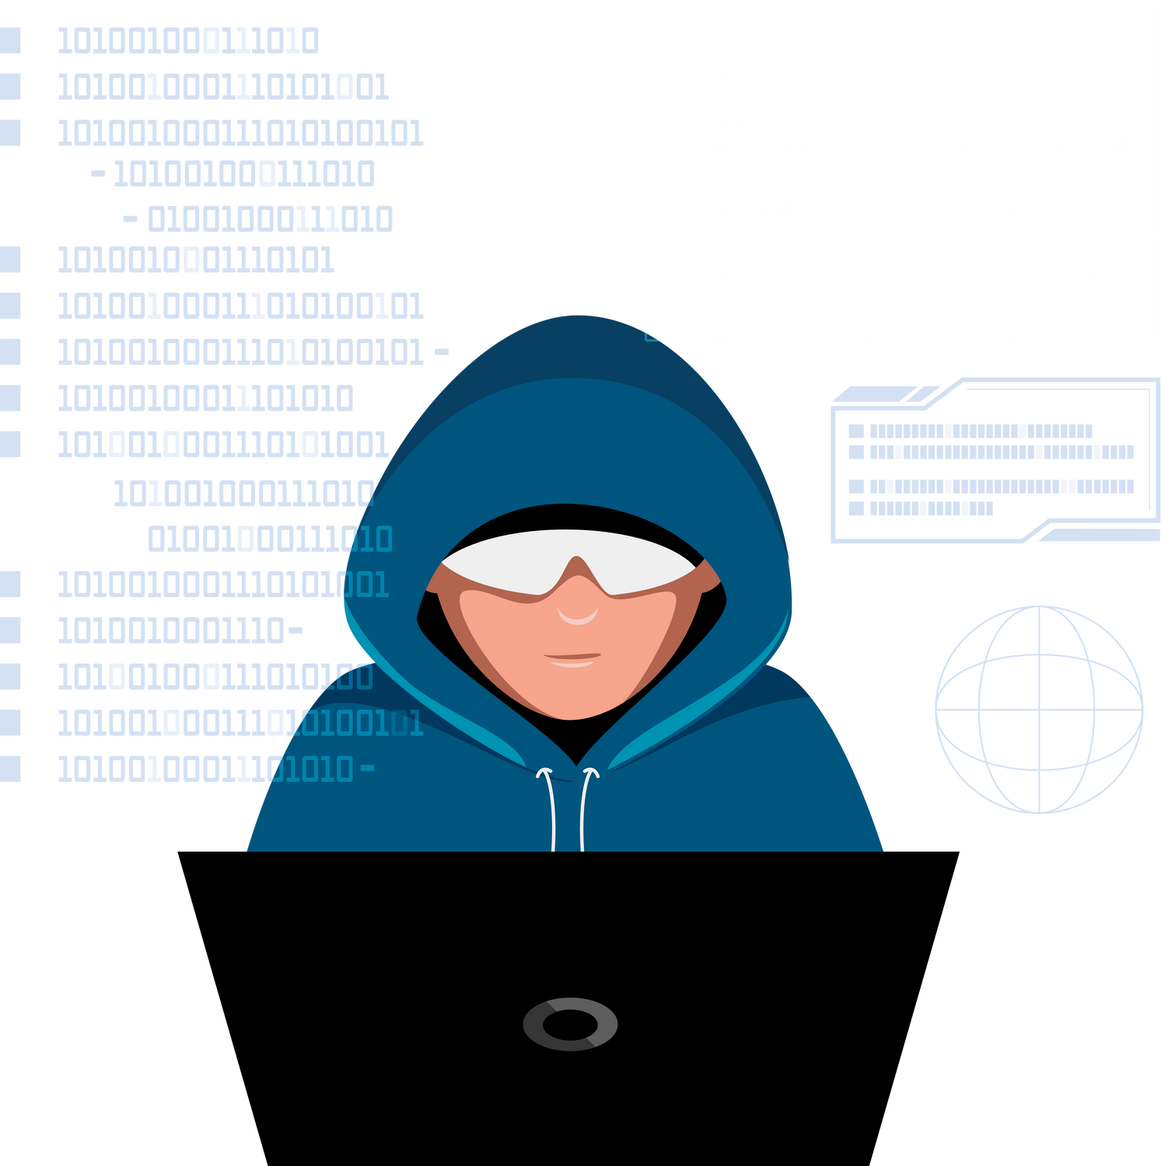
Brute Force Attacks
Hackers sometimes use “brute force” to try and get into your accounts. This is when they try to guess your password by trying lots of different combinations until they get it right. It's like someone trying to guess the combination to a lock by trying every possible number.

Slide 9
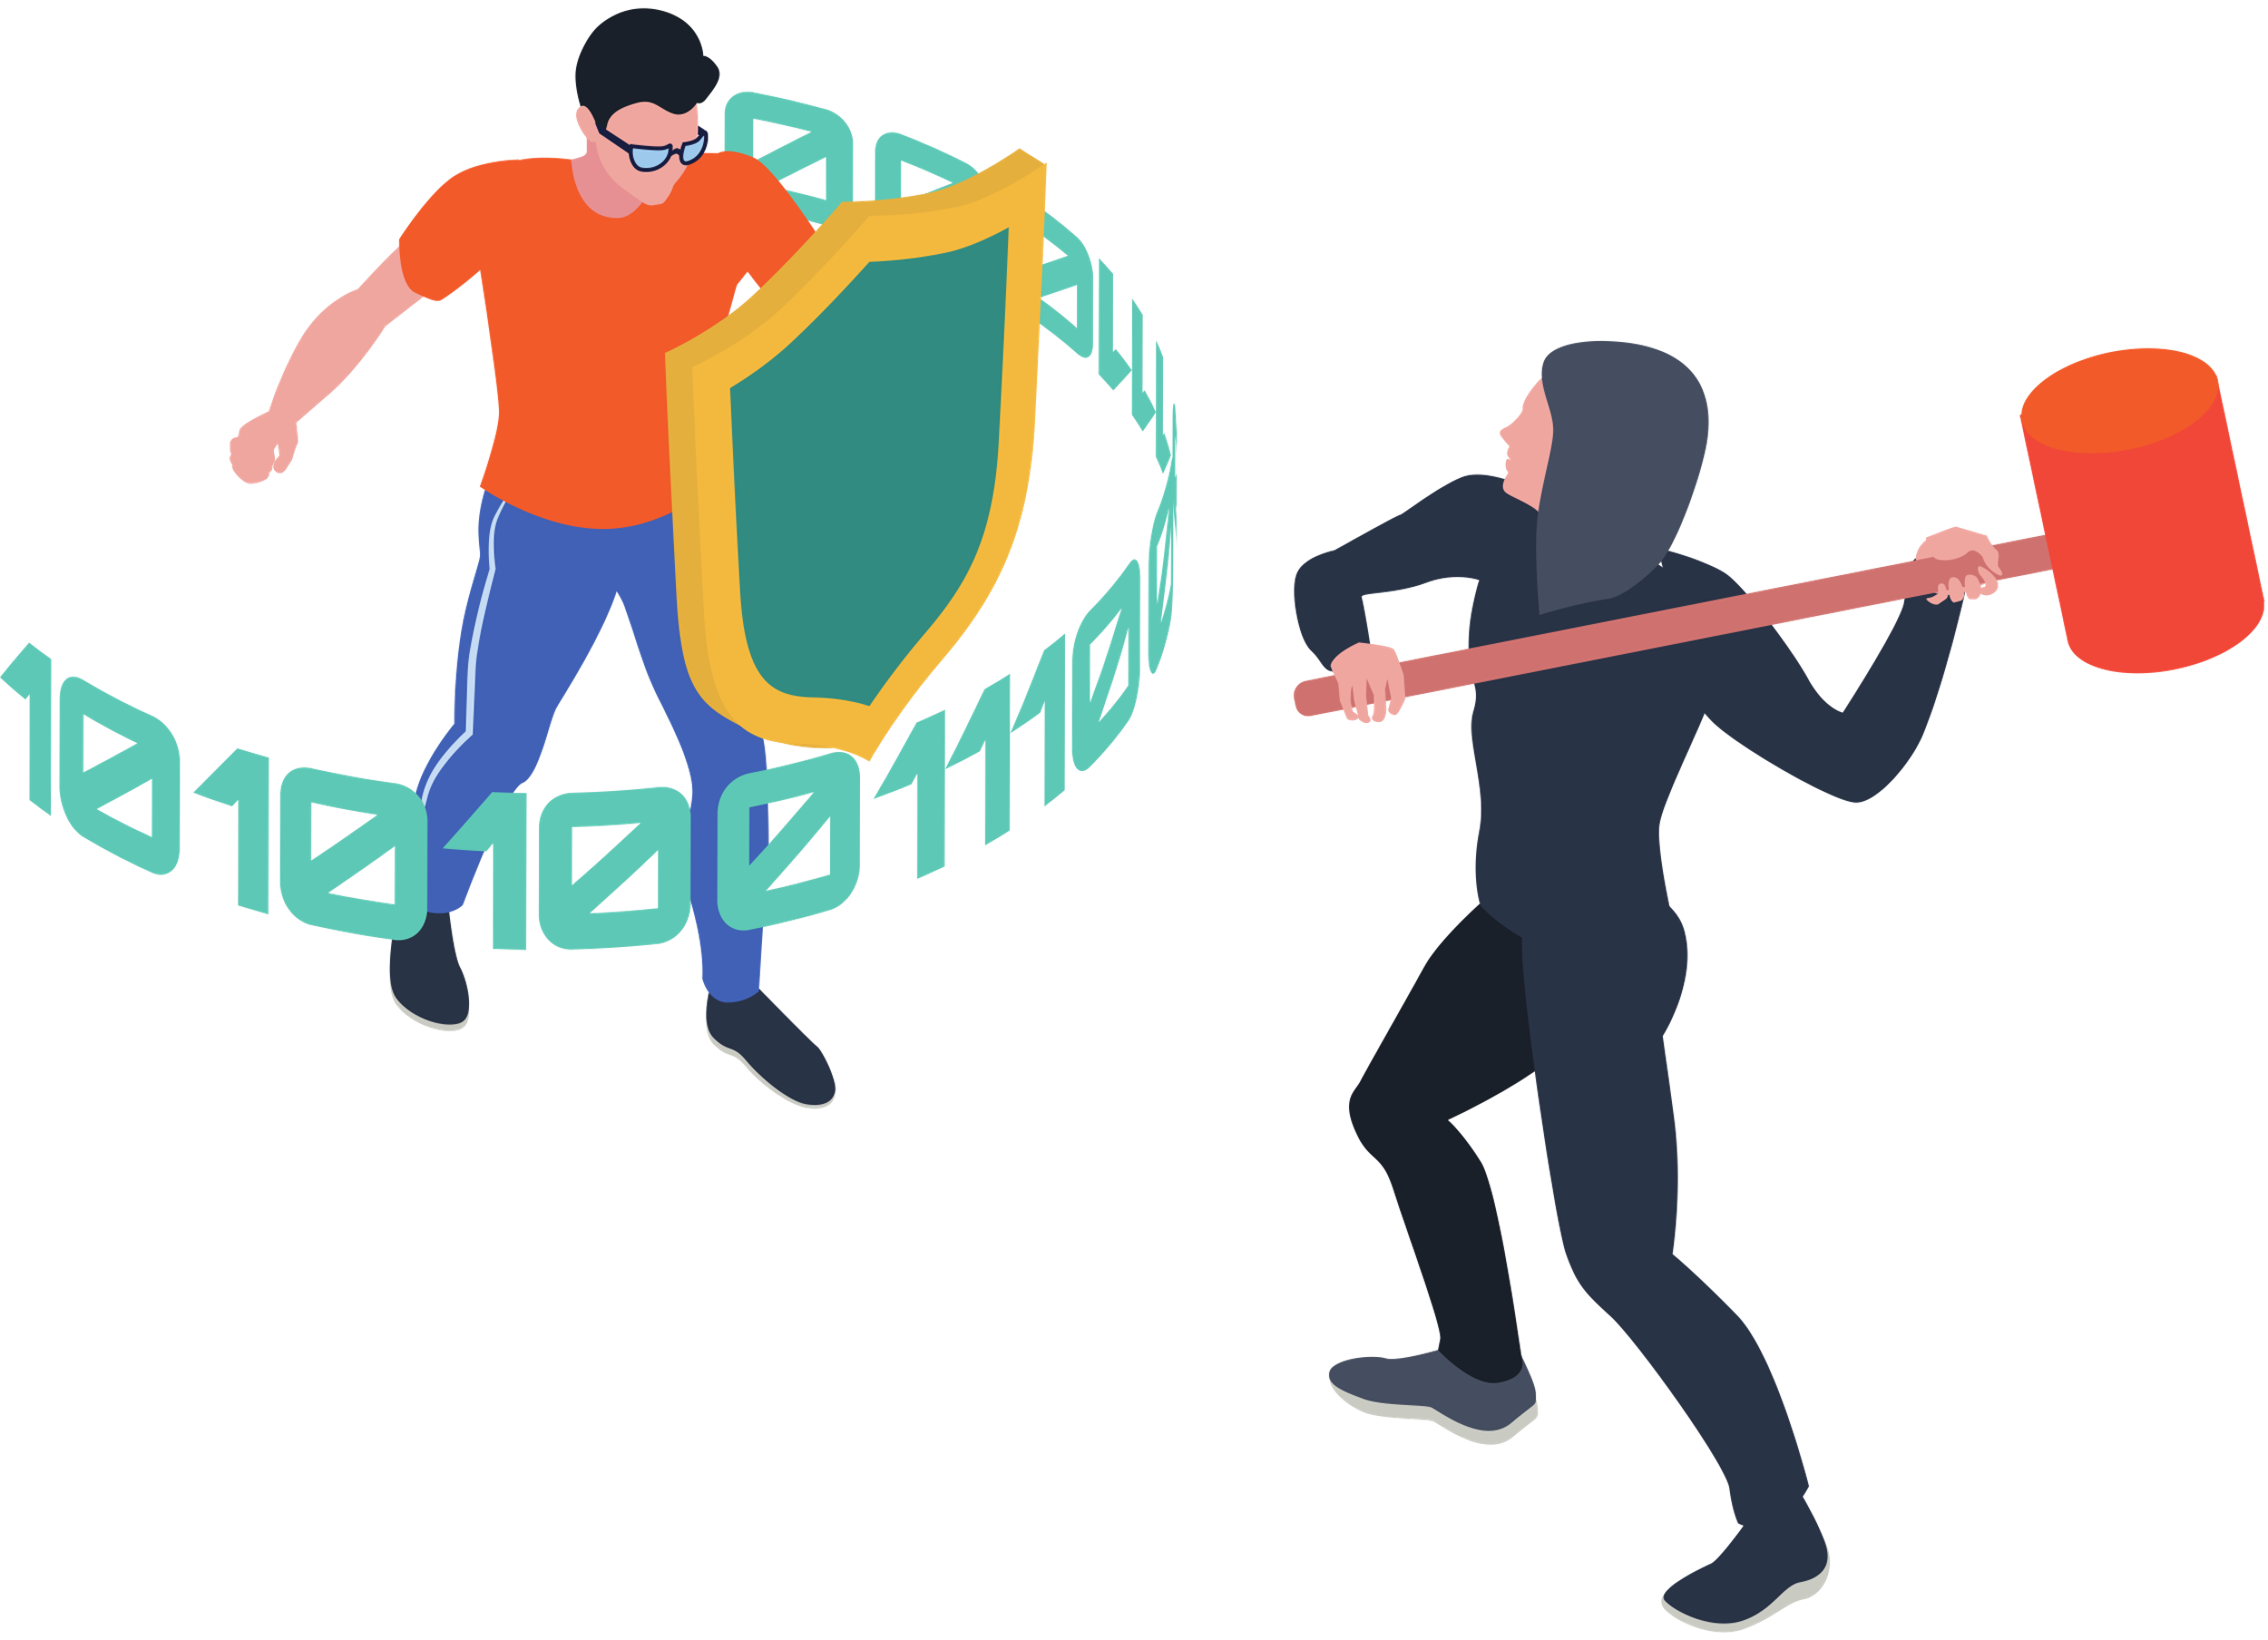
Strong Passwords are Your Shields
Having a strong password is important because it makes it harder for someone to guess it through brute force.
Do you remember what makes up a strong password?

Slide 10
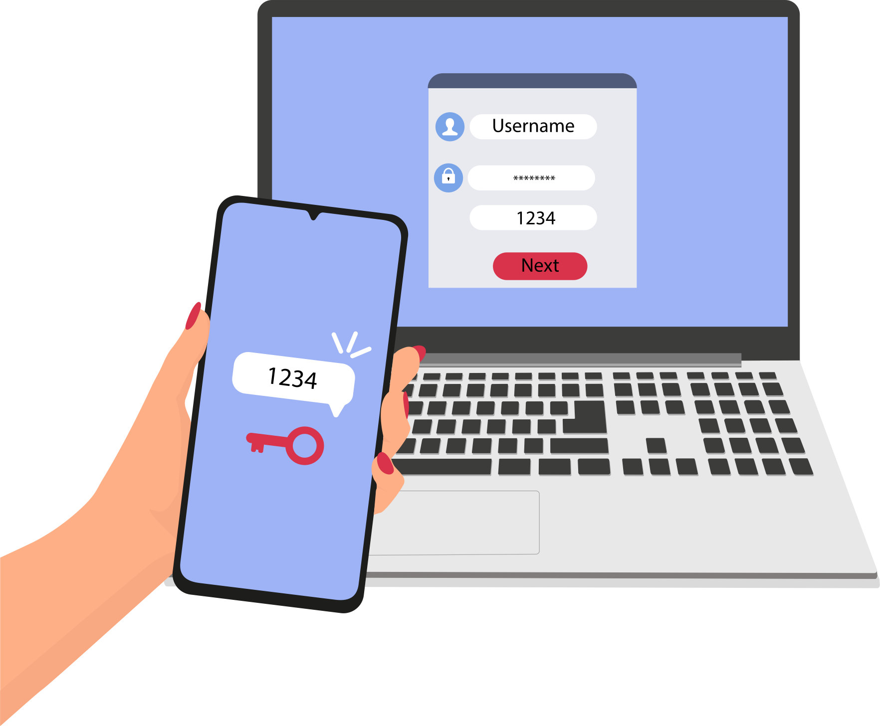
Adding Layers of Protection
Besides strong passwords, we can add add even more protection with Multi-Factor Authentication (MFA).
MFA is a security system that’s like having a second lock in addition to your regular password. It can use:
  Things you know (like a secret code)
  Things you have (like a phone)
  Things you are (like a fingerprint)

Slide 11
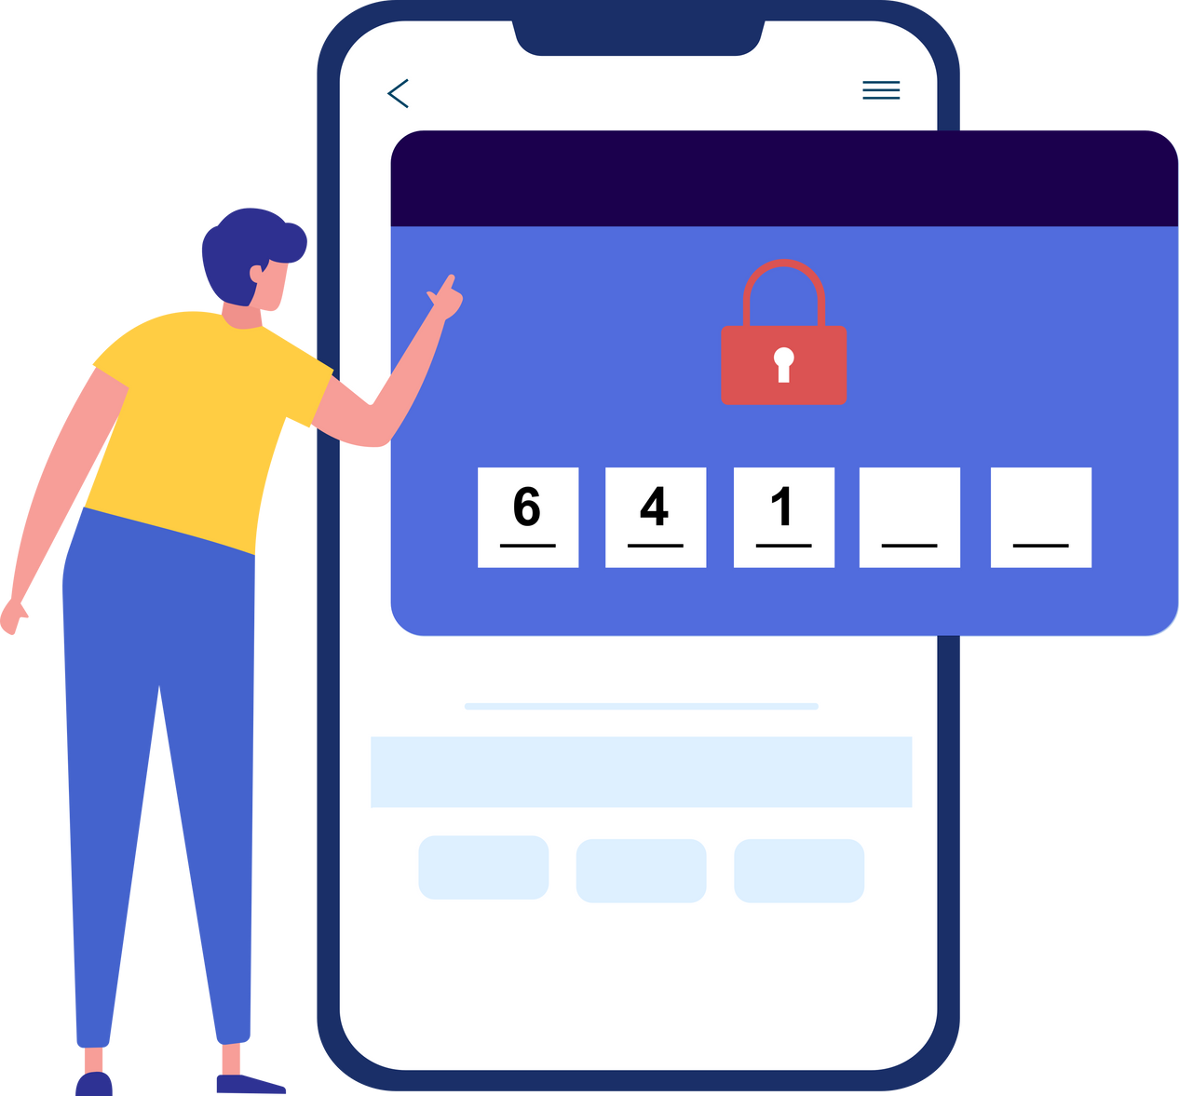
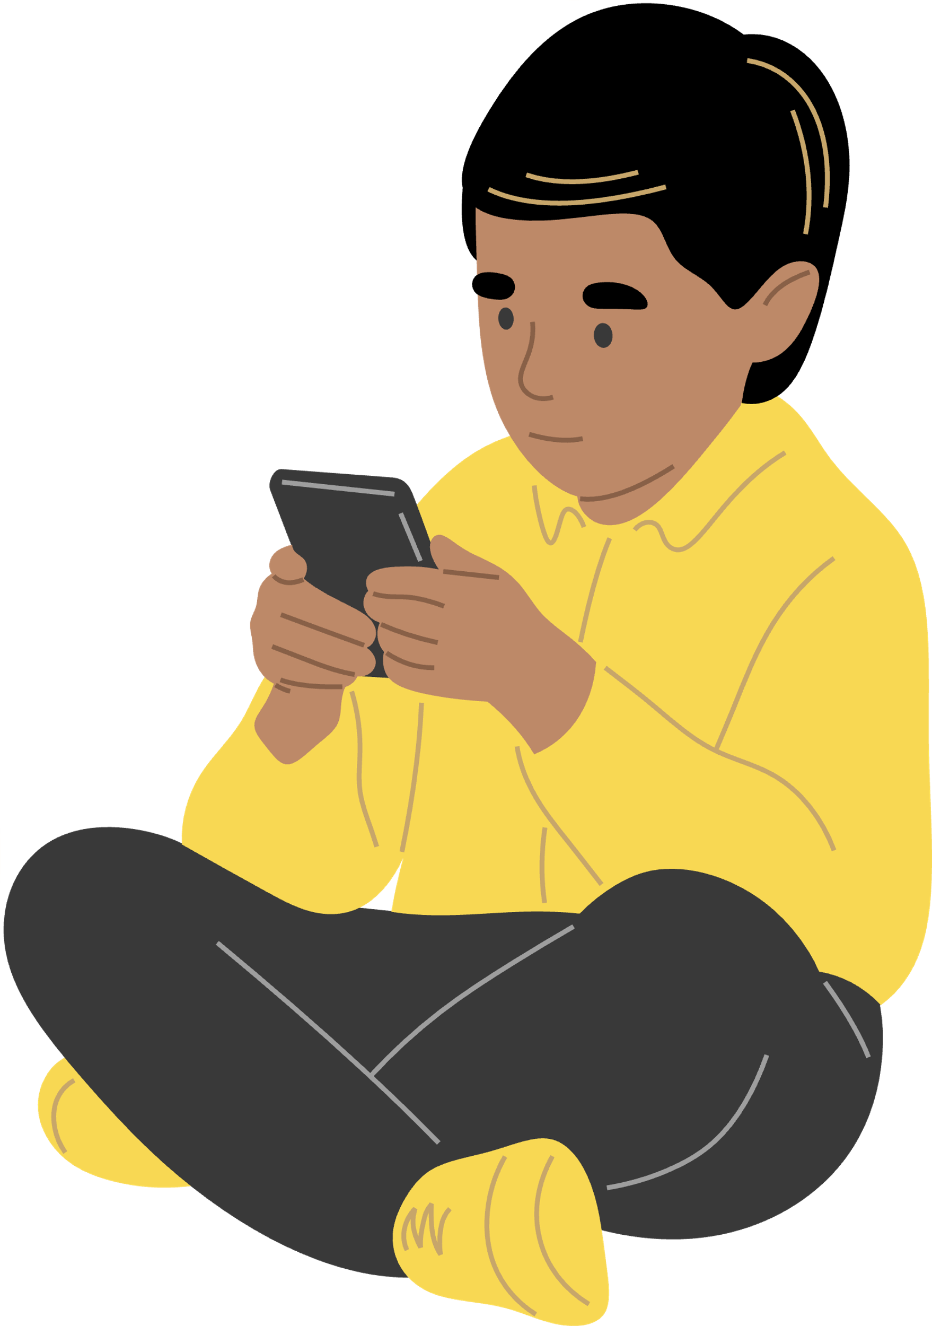
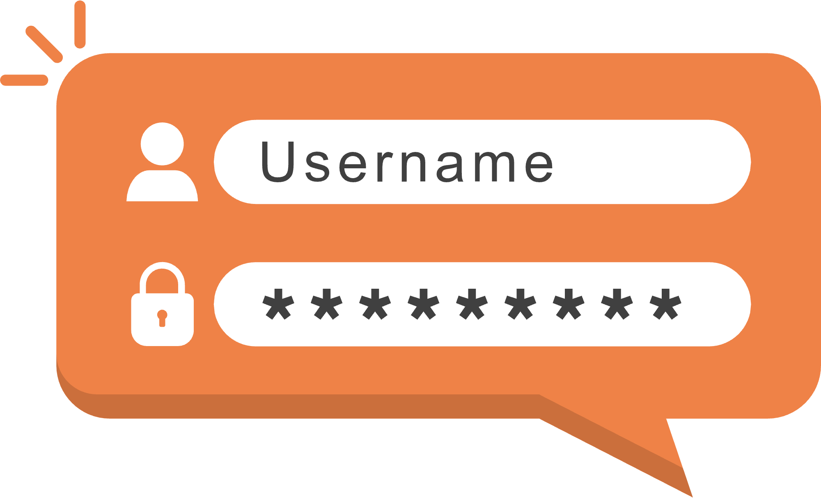

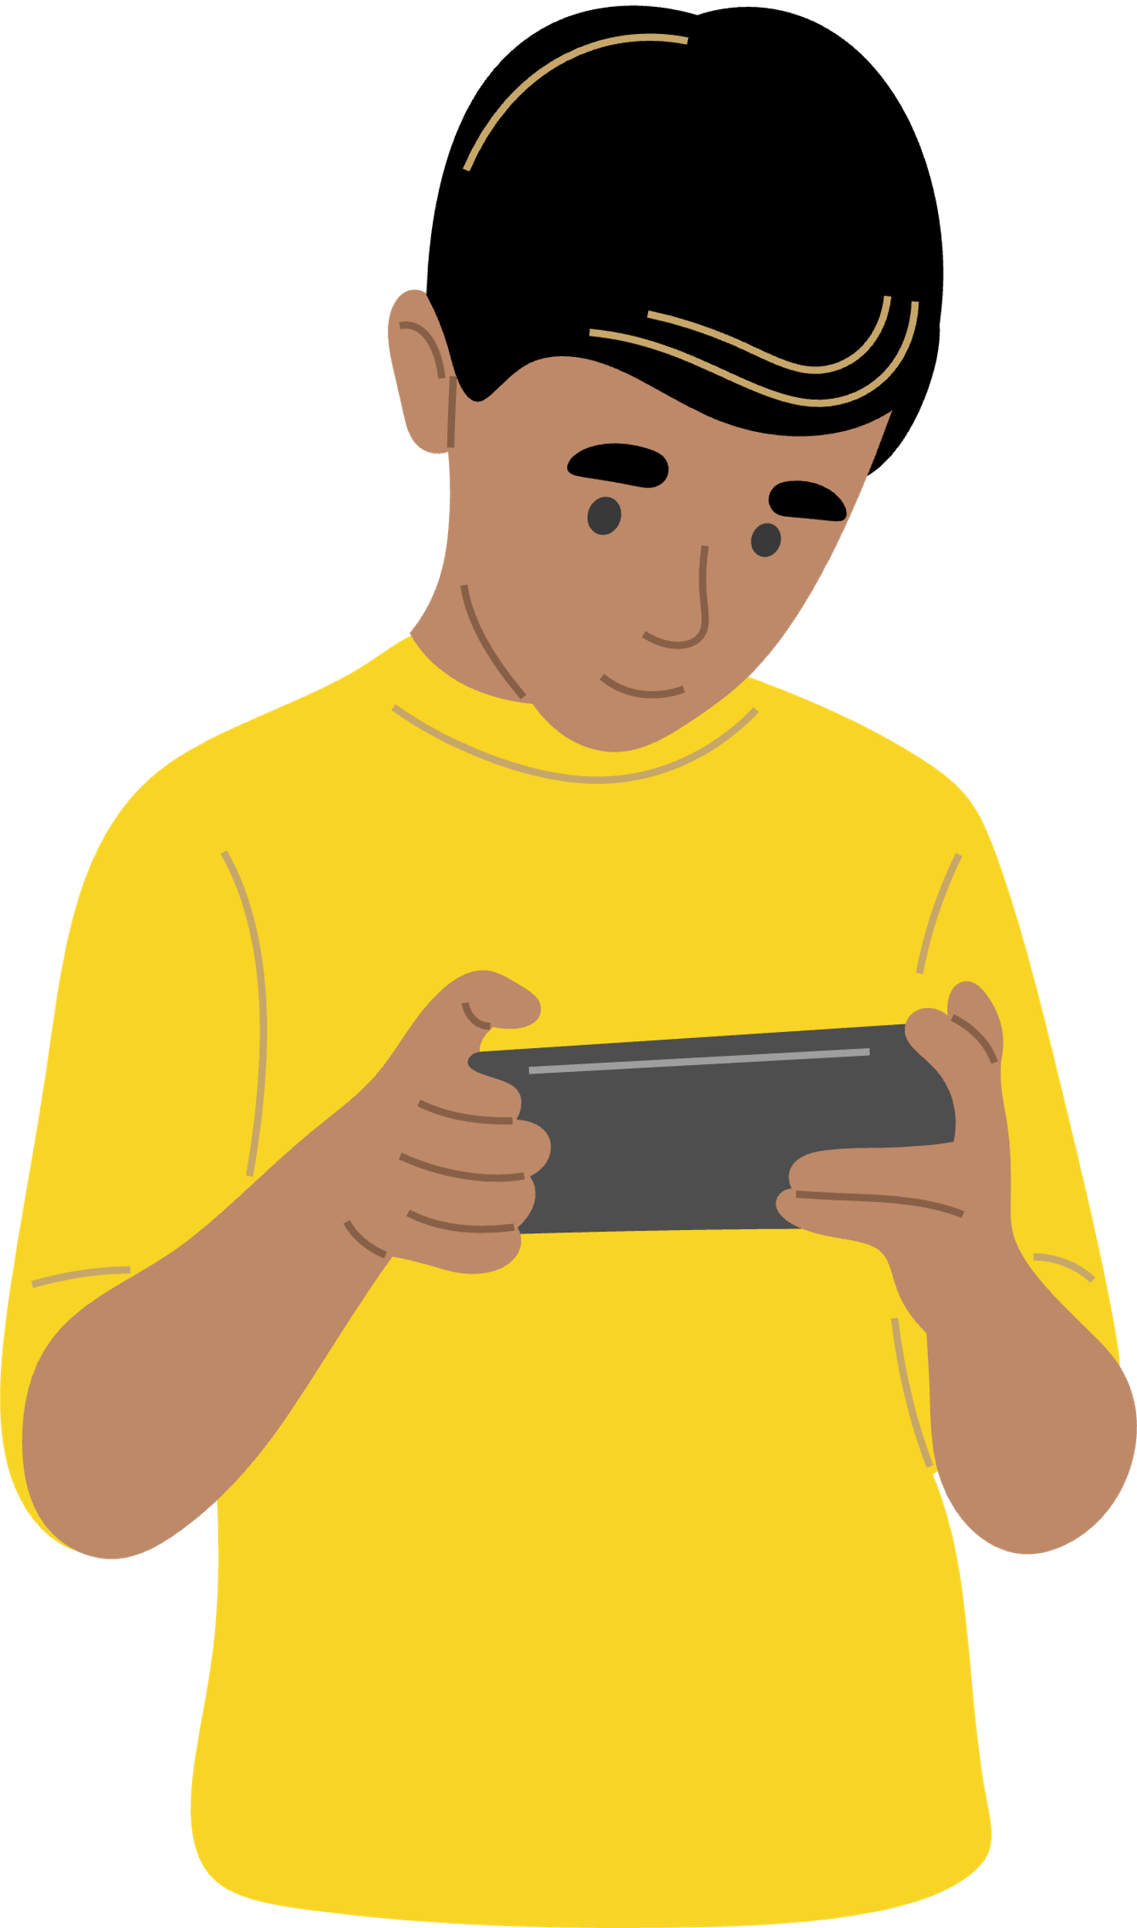


How MFA Works
Let’s see how Ray uses MFA for his gaming account!
4
Is that really you, Ray?
2
Ray can now play his game safely!
1
3
Next time Ray logs in, the game will make sure it’s really him logging in.
Ray sets up MFA by linking his phone, email, and FaceID to his game account.
The game will send a secret code to his phone or email and asks Ray to repeat it. He can also use his face to show it’s really him logging in!

Slide 12
ACTIVITY
The Battle of the Strongest Passwords
See how long it takes a hacker to crack your passwords!

Slide 13
What You’ll Need
  Paper
  Pencils, pens, or writing utensils
Note to teachers:
Please go to https://www.csa.gov.sg/Tips-Resource/Interactive-Tools/Password-Checker for this activity.

Slide 14
Instructions
In this activity, we will demonstrate how a strong password can combat brute force attacks and make it really difficult for cyber criminals to hack into our accounts!
  Split up into small teams or play individually.
  Each round, teams have to come up with a password and write it down on the paper.
  Submit the paper to your teacher. The teacher will use the Password Checker to see how long it would take to crack the password.
  The team with the strongest password wins!

Slide 15
Your Mission
Create strong passwords that will take the longest time to crack!
Ready? Let’s Play!

Slide 16
Round One
Create a password that is 8 characters long.
Write your answer on the paper and hand it to the teacher.
The password that takes the longest to crack wins this round!
Go to the Password Checker ↗

Slide 17
Round Two
Create a password that is 12 characters long and include at least a number and symbol.
Write your answer on the paper and hand it to the teacher.
The password that takes the longest to crack wins this round!
Go to the Password Checker ↗

Slide 18
Round Three
Create a password that will take at least 5,000 years to crack!
Write your answer on the paper and hand it to the teacher.
The password that takes the longest to crack wins this round!
Go to the Password Checker ↗

Slide 19
WRAP UP
What have you learned today?
Let’s reflect on today’s lesson.

Slide 20
Remember This!
  Brute force attacks are when someone tries to guess your password, so having a strong password is important.
  Strong passwords that use a mix of letters, numbers, and symbols will take much longer to crack than simple ones.
  Turn on Multi-Factor Authentication (MFA) as it adds an extra layer of security to your accounts.

Slide 21
Lesson 11.02.01
Well Done!

