Slide 1
Dance Gone Viral
Lesson 14.06.02
CYBERBULLYING & ABUSE
EXERCISE-IN-A-BOX

Slide 2

Have you ever agreed to go along with something you didn’t quite believe in, just because everyone else is doing it?
WARM-UP

Slide 3


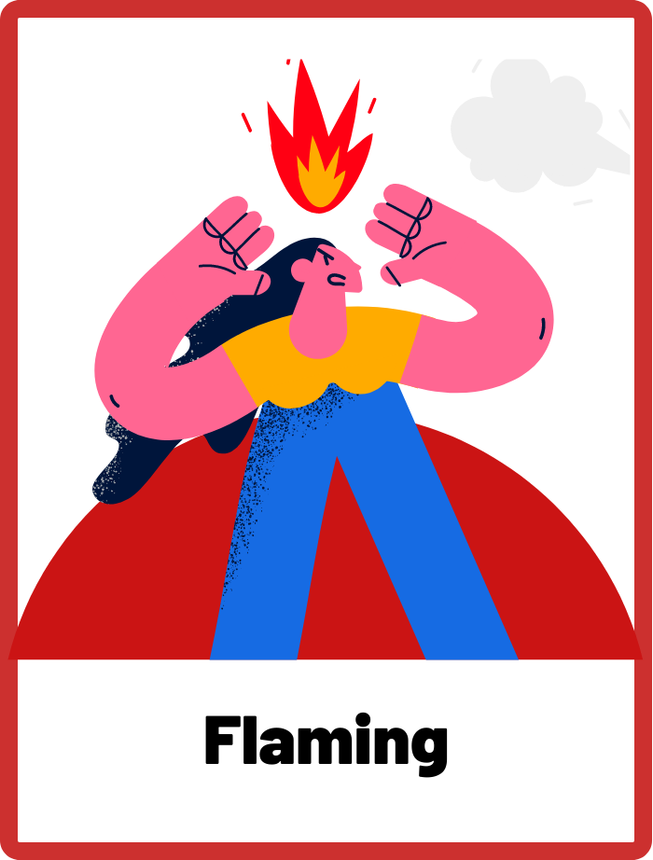
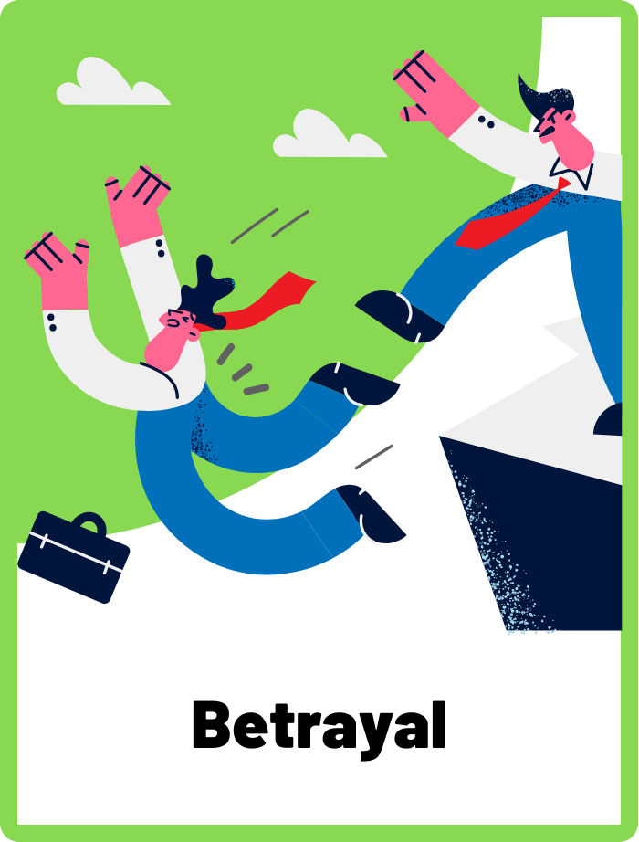
DEFINE THE KEYWORDS
What do you think these terms mean?

Slide 4
DEFINE
Herd Mentality
This refers to the tendency of people to go along with what the group is doing, without thinking for themselves. Herd mentality can make it more likely for people to join in and bully someone just because everyone else is doing it, even if they don't actually believe it's the right thing to do.

Slide 5
DEFINE
Flaming
When someone uses angry, mean, and insulting language to another person online. It can feel like a scary argument because the messages are meant to be hurtful and intimidating.

Slide 6
DEFINE
Betrayal
Betrayal can refer to a friend or trusted peer sharing private or sensitive information, or joining in with others to bully someone. Betrayal can be especially hurtful because it often comes from someone the victim thought was a friend.

Slide 7

INVESTIGATE THE SCENARIO
Read the following evidence carefully to piece together the story. Think critically about the information you are examining and consider the questions.

Slide 8
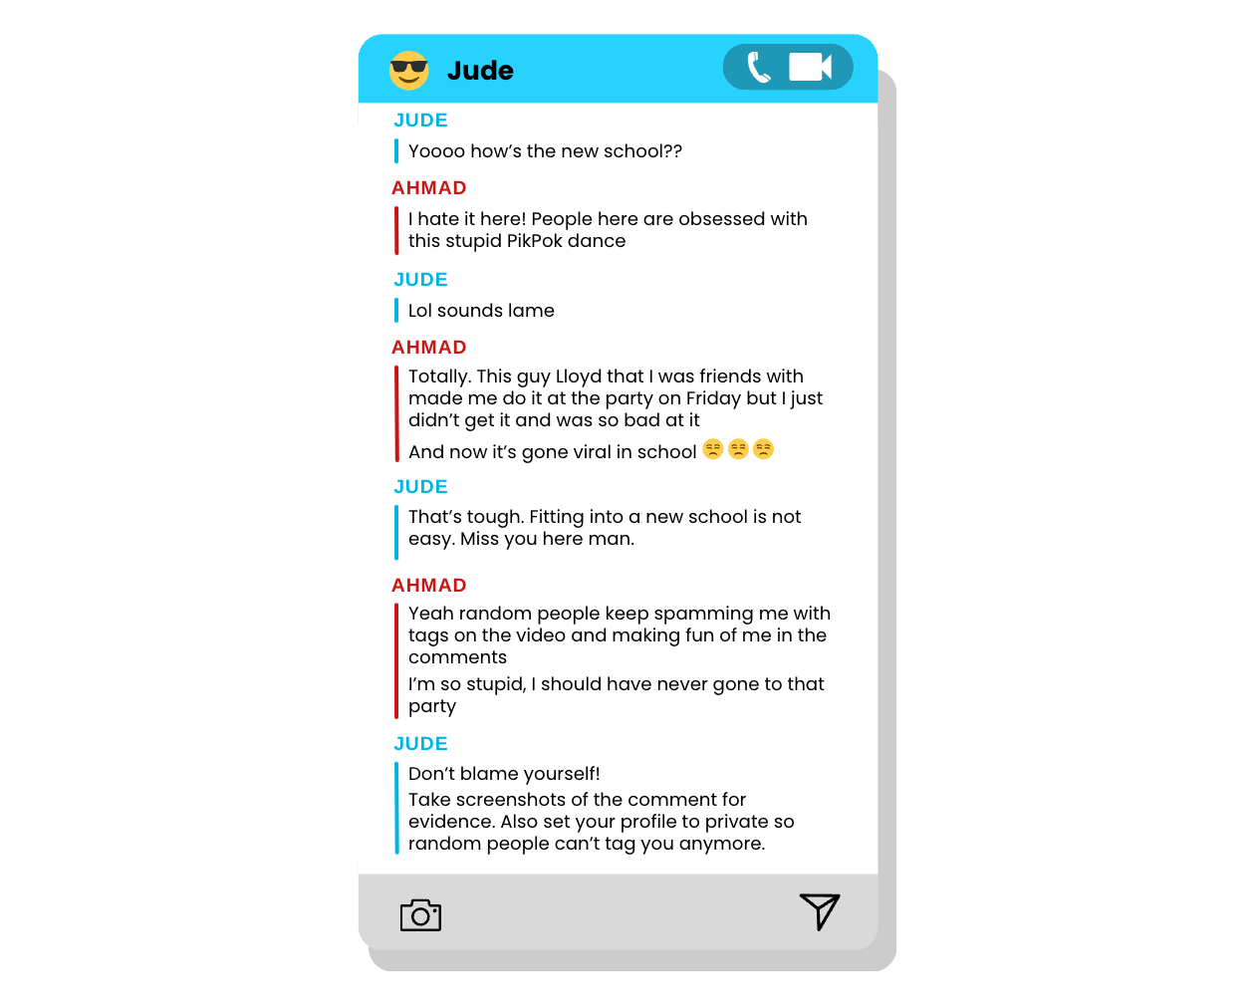
INVESTIGATE
EVIDENCE #1
LET’S DISCUSS
1. Discuss what you think happened at the party on Friday.
2. Why do you think Ahmad decided to do the dance even though he wasn’t very good at it?

Slide 9
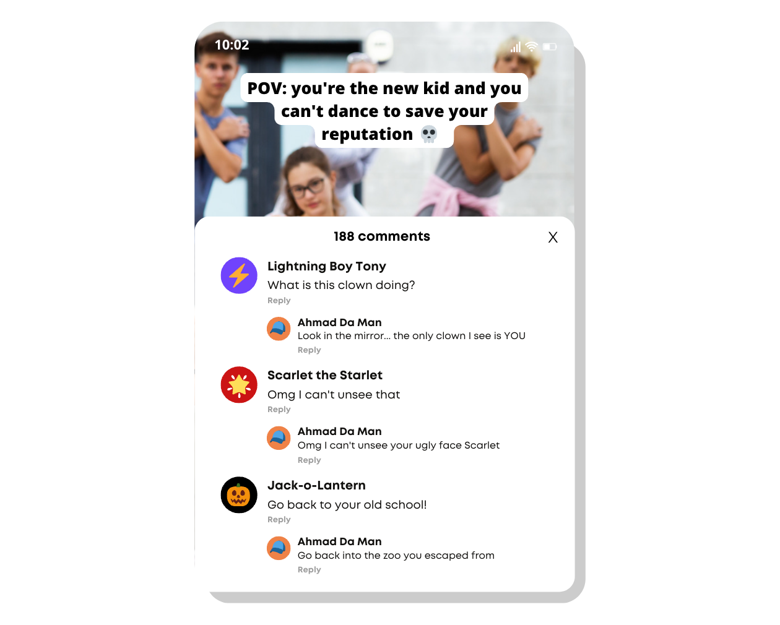
INVESTIGATE
EVIDENCE #2
LET’S DISCUSS
1. Tony, Scarlet, and Jack are leaving negative comments about Ahmad on Lloyd’s video. What are the negative consequences of herd mentality?
2. Which keyword would describe what Ahmad is doing? What are the potential downsides of his actions?
3. What are some alternative positive replies Ahmad could have posted ? Consider language and tone.

Slide 10
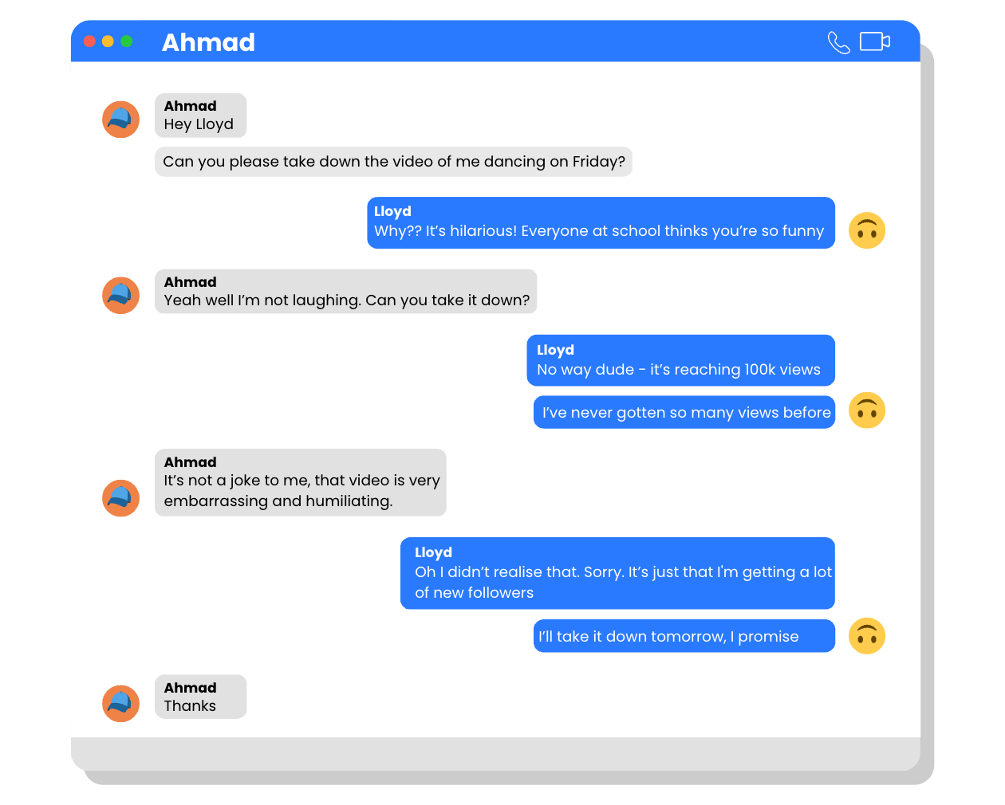
INVESTIGATE
EVIDENCE #3
LET’S DISCUSS
1. Discuss why it is important to get consent from someone before posting a photo or video of them.
2. How did Ahmad stand up for himself in this conversation? Is he right to do so?
3. How do you perceive Lloyd’s intention at this moment? Did he try to humiliate Ahmad on purpose, or did he not realise how it might affect Ahmad?

Slide 11
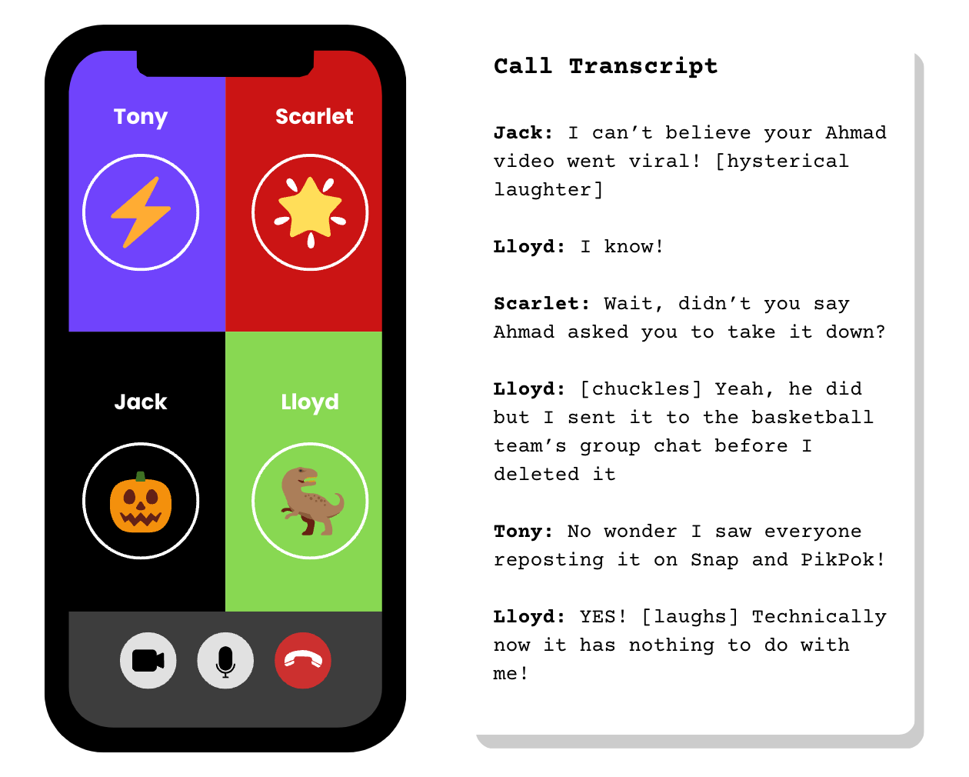
INVESTIGATE
EVIDENCE #4
LET’S DISCUSS
1. Identify which behaviours can be labelled as betrayal.
2. How do you think Jack, Scarlet, and Tony contribute to the herd mentality that has taken place in this situation? Do you think they have critically thought about how their actions and comments might hurt Ahmad’s feelings?

Slide 12
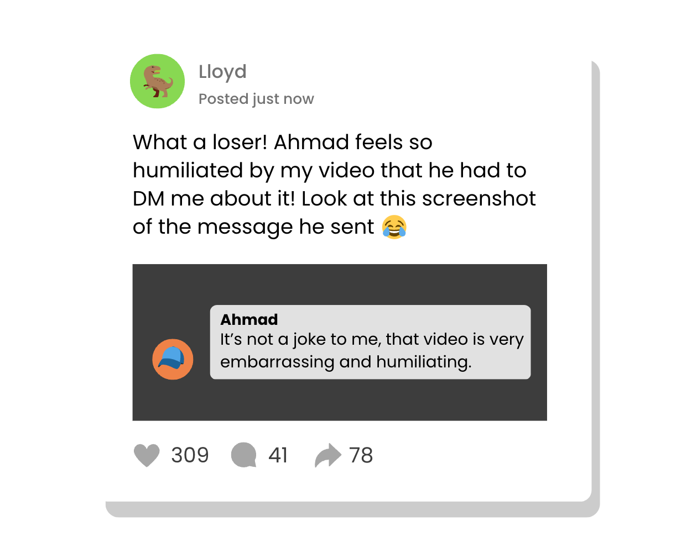
INVESTIGATE
EVIDENCE #5
LET’S DISCUSS
1. Why do you think Lloyd has escalated this situation by posting this screenshot on social media?
2. If you came across a post like this online, what would you do? Discuss what you think your online responsibilities are as a good digital citizen,

Slide 13

PROJECT WORK
Create a short video to demonstrate the devastating effects of herd mentality, flaming, and betrayal.
The video should raise awareness about these types of cyberbullying behaviours and help the audience develop empathy for those who are harmed.

Slide 14
Create a short video to demonstrate the devastating effects of herd mentality, flaming, and betrayal.
What should your project outcome look like?
The video should raise awareness about these types of cyberbullying behaviours and help the audience develop empathy for those who are harmed.
Instructions and Questions to Consider:
Research some examples of herd mentality, flaming, and betrayal.
What are the emotional and psychological effects of these behaviours on the victim?
What message do you want to convey in the video? How can you encourage empathy in your audience and help them understand the negative impact of cyberbullying?
Develop a script for your video that clearly illustrates the negative effects of these behaviours. Think about who you might want to interview in your video.
Be creative with your video! It should be no longer than 3-5 minutes in length.

Slide 15
Share Your Project!
Present your projects to the class.

Slide 16

KEY TAKEAWAYS
Don’t mindlessly follow the crowd. Use critical thinking and good judgement before you fall for herd mentality.
Flaming is never the answer, as fighting fire with fire can result in an escalation of a situation.
Betrayal can be humiliating and embarrassing to someone, and apply empathy by putting yourself in other people’s shoes.
Always ask for permission or consent from others before posting online.

Slide 17
Well Done!
Lesson 14.06.02

